Slide 1

Executive Summary
Implement a semantic search engine using FastAPI and vector embeddings.
STRATEGIC GOALS
SUCCESS METRICS
Reduce documentation search time by 50%
Average search latency under 500ms
Integrate with existing Wiki pages
User adoption rate above 90%
Ensure high security of internal docs
Local AI Search Documentation System
Local AI Search Documentation System
Confidential

Slide 2
Problem Statement
No pain points specified.
Local AI Search Documentation System
Local AI Search Documentation System
Confidential

Slide 3
Proposed Solution
Implement a semantic search engine using FastAPI and vector embeddings.
KEY DIFFERENTIATORS
APPROACH
Semantic RAG capabilities over keyword matches
Establish ingestion pipelines, vectorise docs, and expose API.
Built-in compliance checks for enterprise data
ARCHITECTURE PATTERN
N-Tier RAG Architecture
Local AI Search Documentation System
Local AI Search Documentation System
Confidential

Slide 4
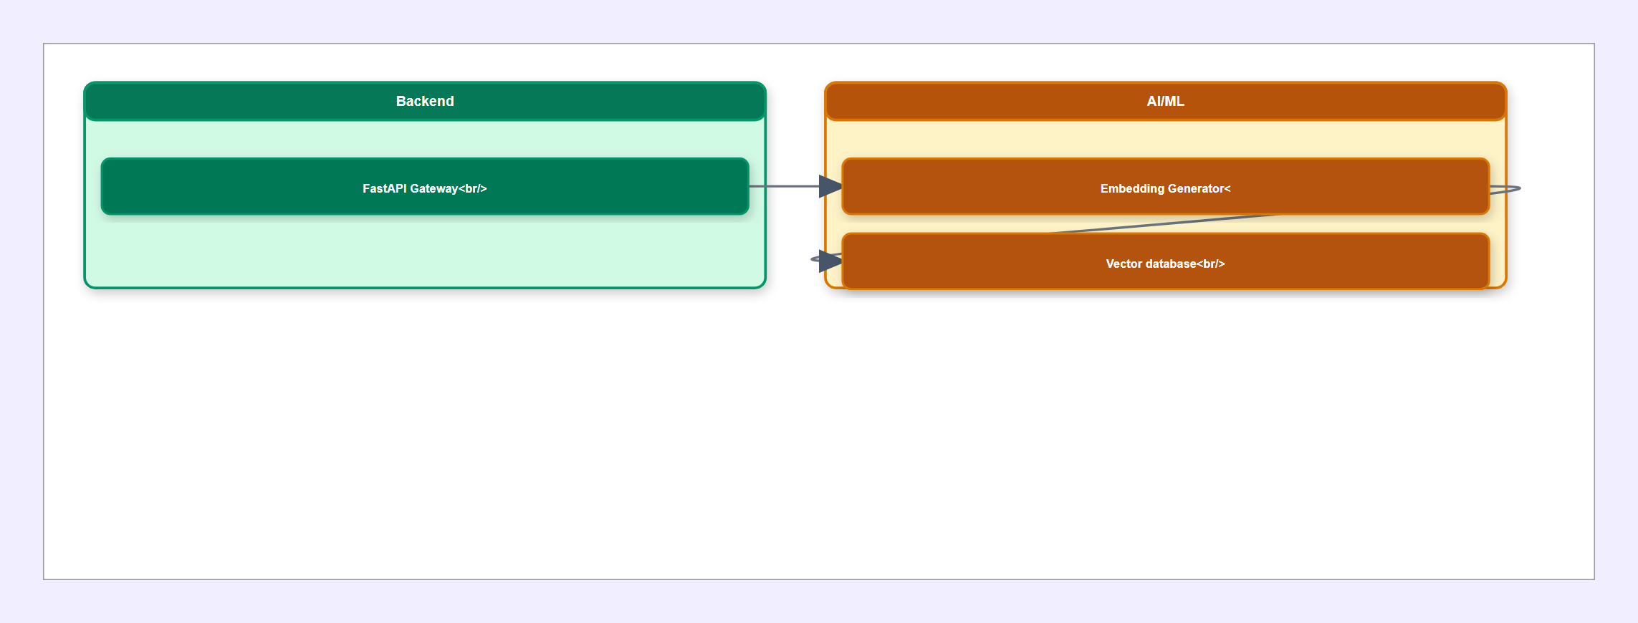
High-Level Architecture Diagram
Local AI Search Documentation System
Local AI Search Documentation System
Confidential

Slide 5
Component Breakdown
FastAPI Gateway
Embedding Generator
FastAPI, JWT
Databricks Embeddings API
Handles request routing and authenticates users.
Converts document paragraphs to high-dimensional vectors.
Vector database
ChromaDB
Stores vectors and retrieves nearest neighbors.
Local AI Search Documentation System
Local AI Search Documentation System
Confidential

Slide 6
Data Flow
No data flow steps defined.
Local AI Search Documentation System
Local AI Search Documentation System
Confidential

Slide 7
Technology Stack
FRONTEND
BACKEND
AI / ML
React
TypeScript
TailwindCSS
FastAPI
Uvicorn
Pydantic
SentenceTransformers
LangChain
DATA
INFRASTRUCTURE
SECURITY
ChromaDB
PostgreSQL
Docker
Kubernetes
Azure
OAuth2
TLS 1.3
Local AI Search Documentation System
Local AI Search Documentation System
Confidential

Slide 8
Key Features & Capabilities
1
Semantic RAG capabilities over keyword matches
2
Built-in compliance checks for enterprise data
3
Reduce documentation search time by 50%
4
Integrate with existing Wiki pages
5
Ensure high security of internal docs
Local AI Search Documentation System
Local AI Search Documentation System
Confidential

Slide 9
Non-Functional Requirements
SCALABILITY
SECURITY
Horizontal pod autoscaling based on CPU usage.
All data encrypted at rest and in transit.
AVAILABILITY
PERFORMANCE
Multi-region deployment for 99.9% uptime.
95th percentile latency under 200ms.
COMPLIANCE
Fully compliant with SOC2 standards.
Local AI Search Documentation System
Local AI Search Documentation System
Confidential

Slide 10
Implementation Roadmap
Phase 1: Ingestion
Phase 2: RAG Backend
4 weeks
3 weeks
File extraction service supporting PDF and DOCX
FastAPI search router endpoints
Databricks integration for embedding generation
ChromaDB retrieval engine and scoring
Local AI Search Documentation System
Local AI Search Documentation System
Confidential

Slide 11
Risks, Assumptions & Open Questions
RISKS & MITIGATION
ASSUMPTIONS
OPEN QUESTIONS
High embedding latency
All internal documentation is accessible via file share.
What is the maximum file size we should support?
Add batching to embedding requests.
Databricks endpoint has sufficient concurrency limits.
Local AI Search Documentation System
Local AI Search Documentation System
Confidential

