Slide 1
Introduction to C5i
Human . AI . Impact
2026

Slide 2
About C5i
Driving business impact with the ideal combination of human expertise and AI
Key Facts
Focus Areas
Awards & Accolades
Our Expertise
Customer & Omnichannel
People Analytics
Gartner
Magic Quadrant for Supply Chain Planning Solutions
Market Guide for Augmented Analytics
Market Guide for Digital Shelf Analytics
Toolkit for AI, Supply Chain, GenAI & Digital Commerce
Niche Player - Magic Quadrant™ for Marketing Mix Modeling Solutions
20+
Years in the Industry
2000+
Global Headcount
Serving 55 of the Fortune 500 Clients
Marketing & Sales
Commercial Analytics
Supply Chain
Enterprise AI
Forrester
Marketing Measurement And Optimization Wave, Q1 2026
Marketing Measurement And Optimization Landscape, Q3 2025
Customer Analytics Service Providers Wave, Q2 2025
Text Mining and Analytics Platforms Landscape, Q1 2024
Marketing Measurement And Optimization Wave, Q3 2023
Key Clients include
Capability Towers
4
of the Top 7
companies in the world by market cap
6
of the Top 10 CPG
Companies in the world
Information Management (Data Modelling, Engg, Pipeline and Governance)
Everest Group PEAK Matrix
Data Science & XOps
Strong Performer Life Sciences AI and Analytics Services for Commercial PEAK Matrix® Assessment 2025
Star Performer & Major Contender Data & AI Services Specialists (North America), 2025
Retail and CPG Data Analytics & AI Services Peak Matrix
AI Solutions & Accelerators
Generative & Agentic AI
IDC
5
of the Top 10 pharmaceutical
companies
in the world
3
of Top 10 Tech Hardware
companies
Data Infrastructure Modernisation
Market Glance: Generative AI Technologies and Service
BI Management, Migration and Support
Analytics India Magazine (AIM)
“Seasoned Vendor” in the 2025 Pharma Commercial Analytics Platforms PeMa Quadrant
“Leader” in the Top Generative AI & Data Science Service Providers 2024
Decision Intelligence Advisory
All trademarks are acknowledged and for representation purposes only

Slide 3

Executive Summary
Implement a semantic search engine using FastAPI and vector embeddings.
STRATEGIC GOALS
SUCCESS METRICS
Reduce documentation search time by 50%
Average search latency under 500ms
Integrate with existing Wiki pages
User adoption rate above 90%
Ensure high security of internal docs
Local AI Search Documentation System
Local AI Search Documentation System
Confidential

Slide 4
Problem Statement
No pain points specified.
Local AI Search Documentation System
Local AI Search Documentation System
Confidential

Slide 5
Proposed Solution
Implement a semantic search engine using FastAPI and vector embeddings.
KEY DIFFERENTIATORS
APPROACH
Semantic RAG capabilities over keyword matches
Establish ingestion pipelines, vectorise docs, and expose API.
Built-in compliance checks for enterprise data
ARCHITECTURE PATTERN
N-Tier RAG Architecture
Local AI Search Documentation System
Local AI Search Documentation System
Confidential

Slide 6
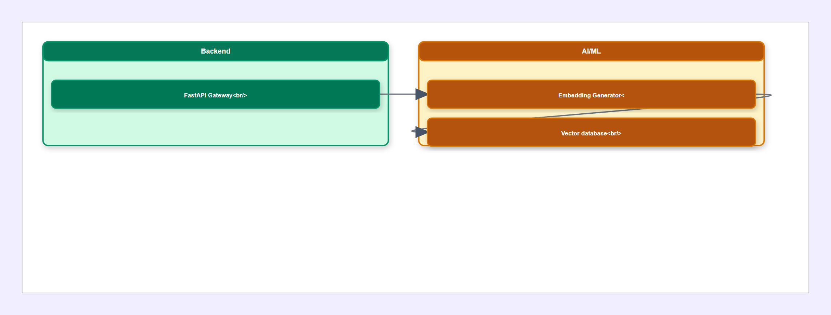
High-Level Architecture Diagram
Local AI Search Documentation System
Local AI Search Documentation System
Confidential

Slide 7
Component Breakdown
FastAPI Gateway
Embedding Generator
FastAPI, JWT
Databricks Embeddings API
Handles request routing and authenticates users.
Converts document paragraphs to high-dimensional vectors.
Vector database
ChromaDB
Stores vectors and retrieves nearest neighbors.
Local AI Search Documentation System
Local AI Search Documentation System
Confidential

Slide 8
Data Flow
No data flow steps defined.
Local AI Search Documentation System
Local AI Search Documentation System
Confidential

Slide 9
Technology Stack
FRONTEND
BACKEND
AI / ML
React
TypeScript
TailwindCSS
FastAPI
Uvicorn
Pydantic
SentenceTransformers
LangChain
DATA
INFRASTRUCTURE
SECURITY
ChromaDB
PostgreSQL
Docker
Kubernetes
Azure
OAuth2
TLS 1.3
Local AI Search Documentation System
Local AI Search Documentation System
Confidential

Slide 10
Key Features & Capabilities
1
Semantic RAG capabilities over keyword matches
2
Built-in compliance checks for enterprise data
3
Reduce documentation search time by 50%
4
Integrate with existing Wiki pages
5
Ensure high security of internal docs
Local AI Search Documentation System
Local AI Search Documentation System
Confidential

Slide 11
Non-Functional Requirements
SCALABILITY
SECURITY
Horizontal pod autoscaling based on CPU usage.
All data encrypted at rest and in transit.
AVAILABILITY
PERFORMANCE
Multi-region deployment for 99.9% uptime.
95th percentile latency under 200ms.
COMPLIANCE
Fully compliant with SOC2 standards.
Local AI Search Documentation System
Local AI Search Documentation System
Confidential

Slide 12
Implementation Roadmap
Phase 1: Ingestion
Phase 2: RAG Backend
4 weeks
3 weeks
File extraction service supporting PDF and DOCX
FastAPI search router endpoints
Databricks integration for embedding generation
ChromaDB retrieval engine and scoring
Local AI Search Documentation System
Local AI Search Documentation System
Confidential

Slide 13
Risks, Assumptions & Open Questions
RISKS & MITIGATION
ASSUMPTIONS
OPEN QUESTIONS
High embedding latency
All internal documentation is accessible via file share.
What is the maximum file size we should support?
Add batching to embedding requests.
Databricks endpoint has sufficient concurrency limits.
Local AI Search Documentation System
Local AI Search Documentation System
Confidential

Slide 14
My Custom Slide
Test bullet one with specific details
Test bullet two with specific details
Test bullet three with specific details
Local AI Search Documentation System
Local AI Search Documentation System
Confidential

Slide 15
Thank you
Danke . Gracias . Arigato . شكرًا لك
Needs & Expectations of Analytical Insights are changing rapidly
We can partner together for greater decision-making speed,
And help you make the changes
United States . United Kingdom . India . United Arab Emirates
www.c5i.ai

