Slide 1
Fundamental of Coding
Week 3

Slide 2
Content for today:
Python
Structure of Python code
Examples
Exercise

Slide 3
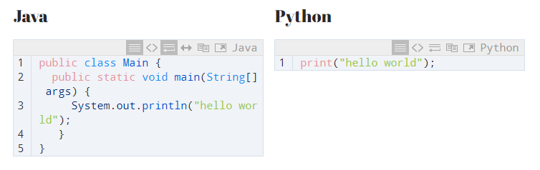
Why start with Python 1. Ease to understand the concept

Slide 4
2. Code Development Speed
Easy to Remember core syntax
No Compilation required (5 times faster than C++)
Rich Library Support (Ready piece of code) – numpy()
Open-source library
Use in Data Science, Machine Learning and Scientific Computing
Used widely in Software Development Industry

Slide 5
Basic Structure of a Python Code
Comments – For explanation of the code
Variables – Containers to store values
Key-words – Words with specific meaning https://www.w3schools.com/python/python_ref_keywords.asp
Build in Data types – Types of pre-defined variables
Conditionals – if… else…
Loops – for, while,
Functions – Block of code which runs when called

Slide 6
Variables: Containers of storing data values
Create Variables
No need to declare the type of variable, can be changed later
Casting: Specify or change the type of variable
Get the type of declared variable
“Variable names are case-sensitive”

Slide 7
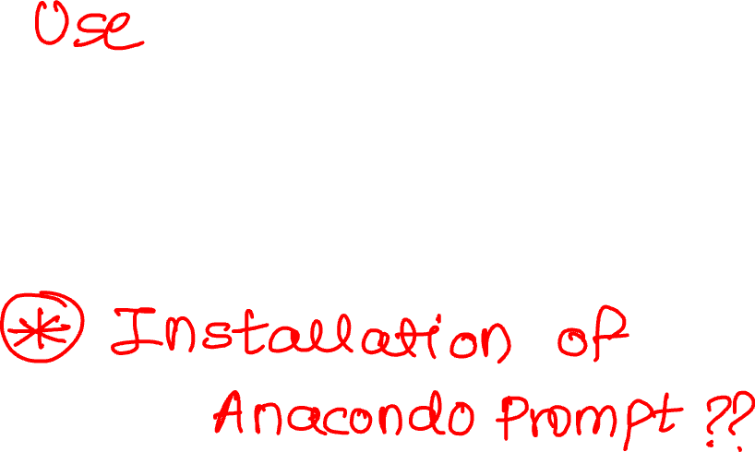

Try all the cases mentioned for variables Open Anaconda: Jupyter Notebook

Slide 8
Built in Data Types:
Different type of variables, and different types can do different things
https://www.w3schools.com/python/python_datatypes.asp

Slide 9
Exercise:
Write a code to add, subtract, multiple and divide two numbers
Functionize the code
Write a code for a basic calculator

Slide 10
GitHub:
Version control software
Platform used to collaborate
Maintain Documentation
Track changes in the code
https://github.com/AtharvaGokhale95/JnanaPrabodhini_FundamentalsofProgramming

Slide 11
Installations:
Python 3.7
PIP
Basic Python Libraries (As per your choice)
https://www.youtube.com/watch?v=6lBPM-MiGNI&list=PLeo1K3hjS3uv5U-Lmlnucd7gqF-3ehIh0&index=2
https://www.youtube.com/watch?v=Vig1IeU2RYk&list=PLeo1K3hjS3uv5U-Lmlnucd7gqF-3ehIh0&index=7
https://www.youtube.com/watch?v=7snh_1Hf_TI&list=PLeo1K3hjS3uv5U-Lmlnucd7gqF-3ehIh0&index=13

