Slide 1
Fundamentals of Programming

Slide 2
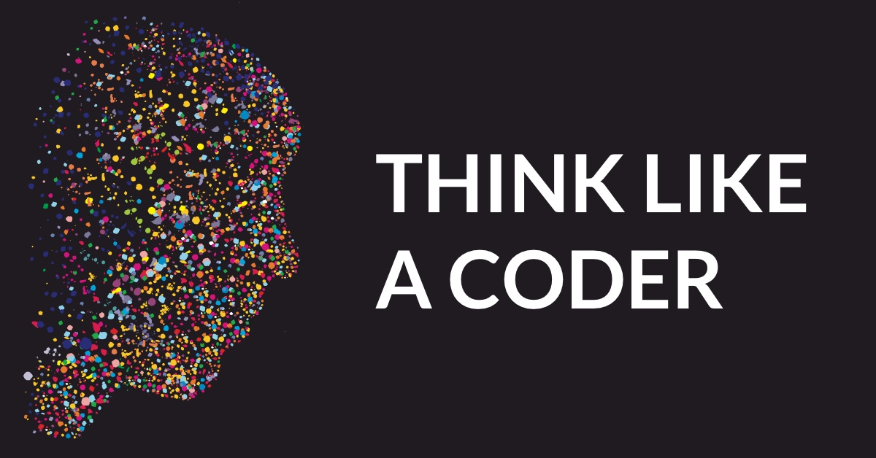
Why to be a programmer
What is programming
Advantages of thinking like a programmer
Use of programming in different career paths
Notes:
What is programming
Automation
Doing dumb thing repeatedly
Thinking out of box
Considering all possibilities that may occur
Thinking like a programmer
Logical thinking
Approach based on achieving the target
Binary options
Time and space complexity
Advantages:
Programming is art: Creativity
Confident
Smart thinking
Approach
Accomplishment of something working in front of you
Use computers
Career options: Everything is data – Only Job is to predict
Computer Science
Biology
Commerce
Arts
Engineering

Slide 3
What you need to be a coder?
Sharp mind
Good at Math
Long Study Sessions
Being Sincere
Think Differently
Logical Mind Set
Creative
Passion for Technology

Slide 4
What we will learn in this activity:
Mathematics:
Set Theory
Logic
Linear Algebra
Discrete Mathematics
Coding:
Architecture
Data Types
Data structures
OOP’s concepts
Language:
Python (Initial few weeks)
Introduce to C++ (once comfortable)

Slide 5
Outcome of this activity:
General Outcomes:
Understand the basics of programming
Figure do I love it…. But after becoming a master of it.
Specific outcomes:
Built basic applications
Introduction to Data Science and Machine Learning
Built Web Applications and logic behind it
Do what ever you desire to…. Using Computers (Personal assistant, Automations…)

Slide 6
Things that you need:
Interest in Technology
A Computer
White Board

Slide 7
Questions????

