Slide 1
Week 2
Fundamentals of Programming

Slide 2
Basic components on computer
I/O devices
CPU
Display
Memory

Slide 3
What exactly happens when we write a code:
Give input commands using I/O devices
Use of human understandable language (english)
Computer executes the code
Involvement of memory to store the instructions
Receive the O/P using the I/O devices
A = 2
B = 2
Sol = a + b
Print(sold)

Slide 4
How exactly Compiler works ?
Instructions are converted into the language that computer understands
The instructions are stored in the memory (optimized way)
Some intelligent system takes the steps mentioned in the code
The final output is again stored in the memory
*** The intelligent system is also coded to behave so…

Slide 5
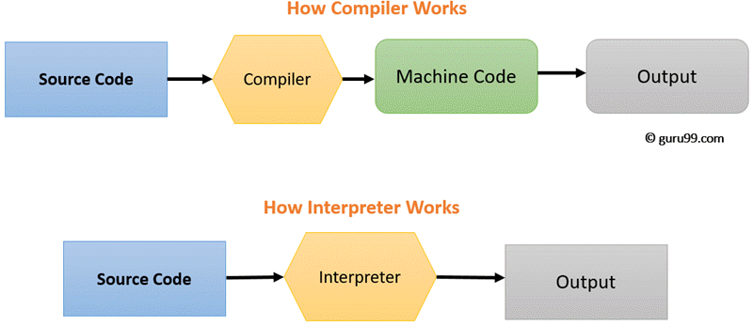
Compiler????

Slide 6
Installation of Software: Anaconda
https://docs.anaconda.com/anaconda/install/index.html

