Slide 1



Slide 2
CONTENTS
PROJECT OVERVIEW
TECHNOLOGY STACK
ADMIN DASHBOARD
USER AUTHENTICATION AND BOOKING
PAYMENT INTEGRATION
MAP FEATURE
CHART FEATURE
FUTURE ENHANCEMENTS
SCREENSHOTS

Slide 3
PROJECT OVERVIEW
Administrator Empowerment
Streamlined car management for administrators.
User-Centric Design
Prioritizing user experience for seamless interactions.
Payment Integration
Secure and reliable payment processing.
Dynamic Map Feature
Effortless addition of new cars with pricing details.
Maintenance of an up-to-date and dynamic inventory.
Secure authentication process for user accounts.
Intuitive booking processes for user convenience.
Enhancing user experience with a dynamic map for location tracking.
Visual exploration and selection of cars based on geographical preferences.
Seamless integration of Stripe for transparent and efficient transactions.
Used Stripe for payment Integration

Slide 4





TECHNOLOGY STACK
REACT
REDUX
EXPRESS
MONGOOSE
NODE
SASS
Dynamic and responsive UI using React.
Components-based architecture for modularity.
Centralized state management with Redux.
Predictable and scalable state handling.
Seamless communication between React components through a global state.
Robust and scalable backend with Express.js.
Middleware for enhanced HTTP request handling.
RESTful API architecture for efficient frontend-backend communication.
Integration of Mongoose as an ODM for MongoDB.
Design and management of consistent database schemas.
Utilizing MongoDB's flexibility and scalability for efficient data storage.
Node.js as the server-side runtime for high performance.
Non-blocking, event-driven architecture.
Consistent JavaScript usage promoting code reusability.
Efficient and maintainable styling using Sass.
Utilization of variables, mixins, and nesting for enhanced CSS authoring.
Improved code readability and organization through Sass's modular approach.

Slide 5
ADMIN DASH BOARD
Effortless Car Management:
Add new cars seamlessly.
Set and update prices effortlessly.
Intuitive Interface:
User-friendly design for easy navigation.
Clear visuals for an intuitive experience.
Comprehensive Inventory Control:
Manage the entire car inventory centrally.
Quick updates for real-time information.
Data Security Measures:
Secure access controls.
Authentication protocols for data protection.
Analytics and Reporting:
Insightful analytics for trends.
Customizable reports for analysis.

Slide 6
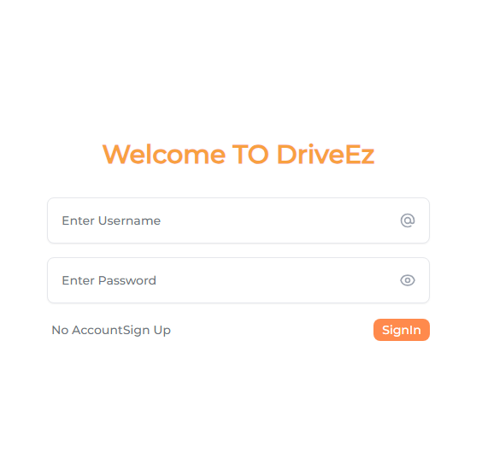
USER AUTHENTICATION AND BOOKING
User Registration:
Seamless sign-up process for new users.
Capture essential information for personalized experiences.
User Login:
Secure login procedure for authenticated access.
Protection of user data through robust authentication protocols.
Intuitive Booking:
User-friendly interface for browsing available cars.
Effortless selection and confirmation of car bookings.
Booking History:
Accessible overview of past transactions.
Convenient tracking of upcoming reservations for users.

Slide 7
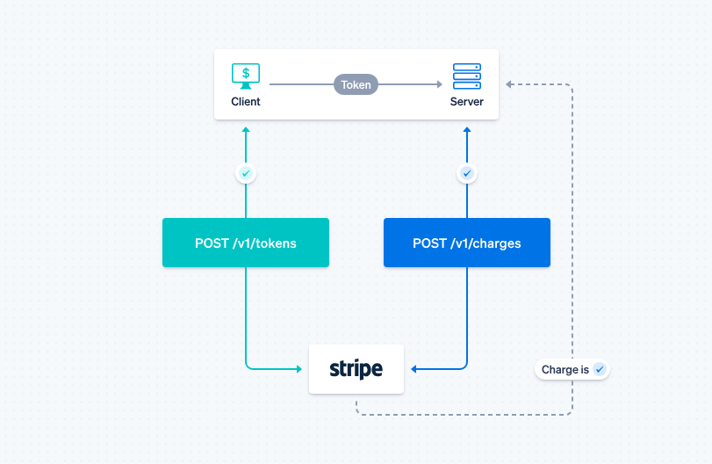
PAYMENT INTEGRRATION WITH STRIPE
Stripe Integration:
Secure and reliable payment gateway.
Facilitates various payment methods.
Payment Flow Overview:
Smooth checkout process for users.
Real-time payment verification for transparency.

Slide 8
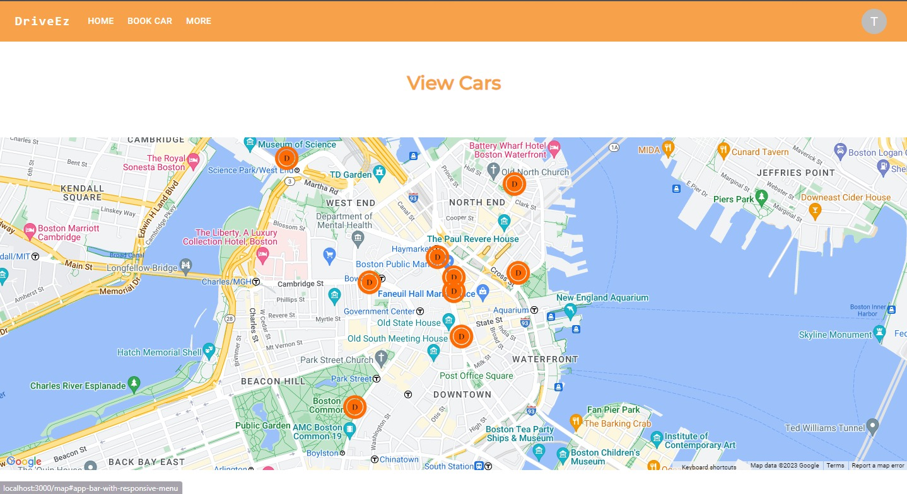
MAP FEATURE
Geolocation for Cars:
Real-time tracking of available cars.
Enhanced visibility for users.
User-Friendly Map Interface:
Intuitive map interface for effortless exploration.
Simplified selection and tracking of desired locations.

Slide 9
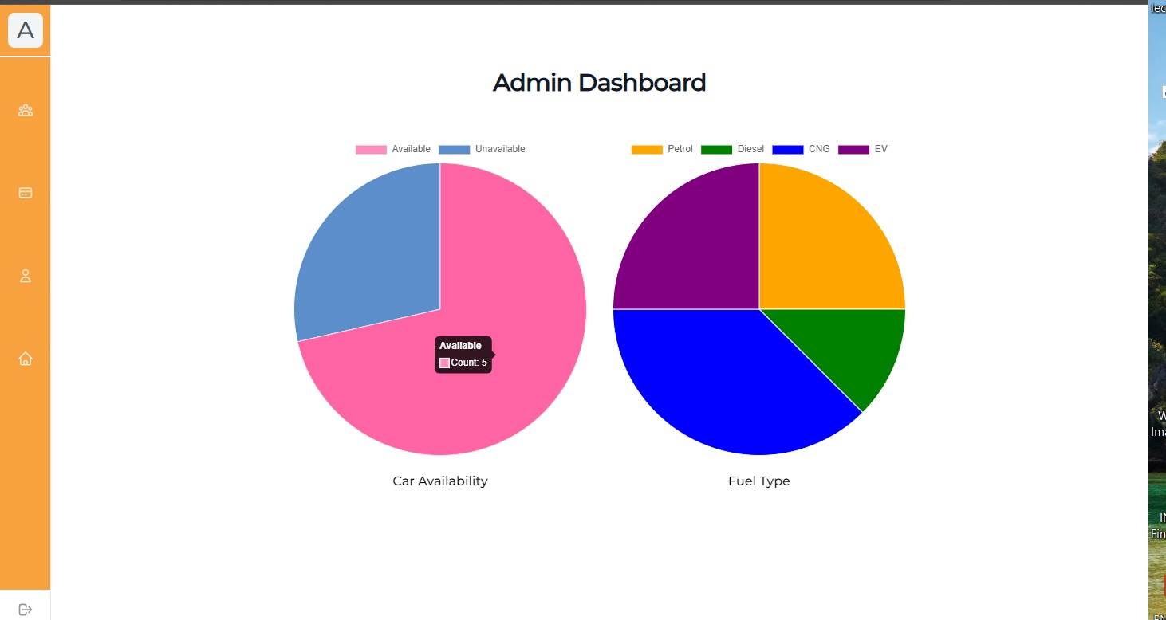
CHART FEATURE
JavaScript library for creating dynamic, interactive charts. Seamless integration with the MERN stack (MongoDB, Express, React, Node.js).
Chart 1: Availability of Cars
Visual representation of the distribution of available cars.
Helps in strategic planning for fleet management.
Chart 2: Types of Fuel Used
Understanding the types of fuel used by rented cars.
Categories include Petrol, Diesel, Electric (EV), Compressed Natural Gas (CNG).
Key information on the distribution of fuel types.
Aids in sustainability analysis and catering to diverse customer preferences.

Slide 10
FUTURE ENHANCEMENTS
Additional Features:
Explore integration of user reviews and ratings.
Implement advanced analytics for user behavior.
Continuous Improvements:
Enhance user interface for a more intuitive experience.
Regular updates for security and performance optimizations.
Scalability Planning:
Prepare for increased user base and transaction volume.
Evaluate technologies for seamless scalability.
Feedback Integration:
Welcome user feedback for ongoing improvements.
Establish channels for user suggestions and concerns.
Collaboration Opportunities:
Open to collaborative efforts with other platforms.
Seek partnerships for expanding service offerings.

Slide 11
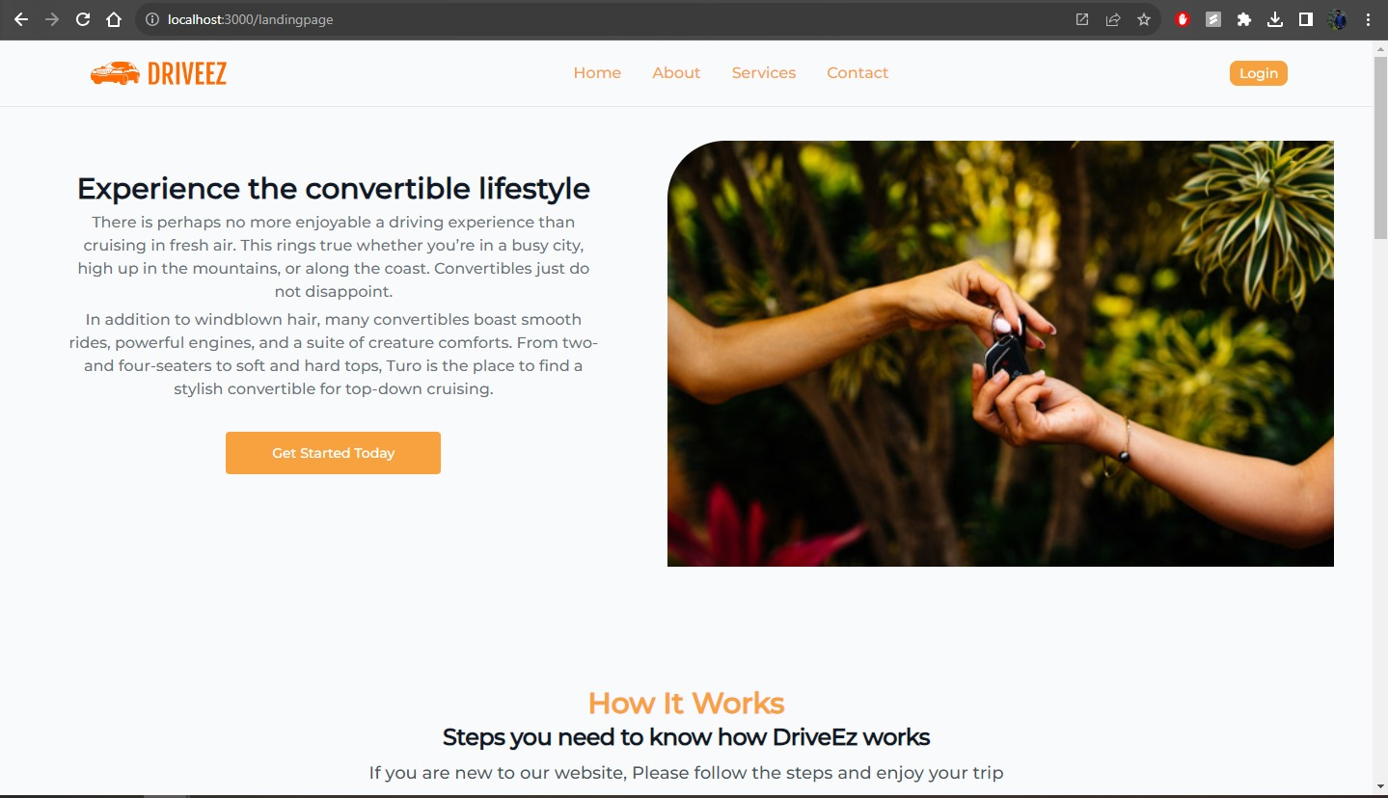
SCREENSHOT :Landing Page

Slide 12
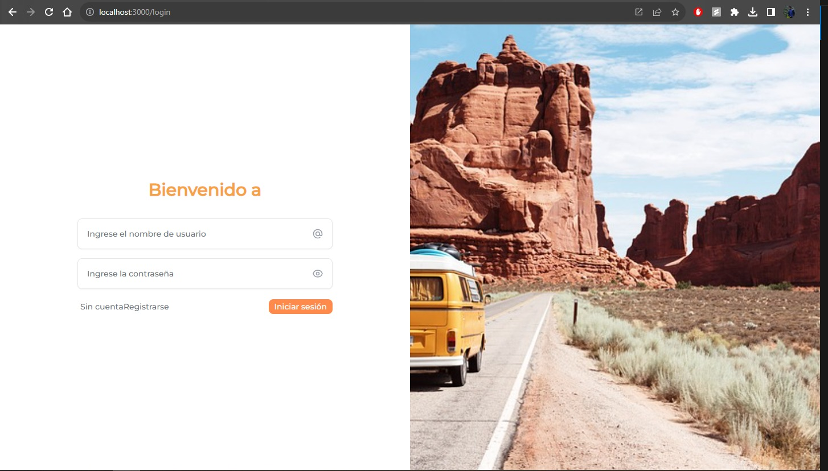
SCREENSHOT Language Change to Spanish

Slide 13
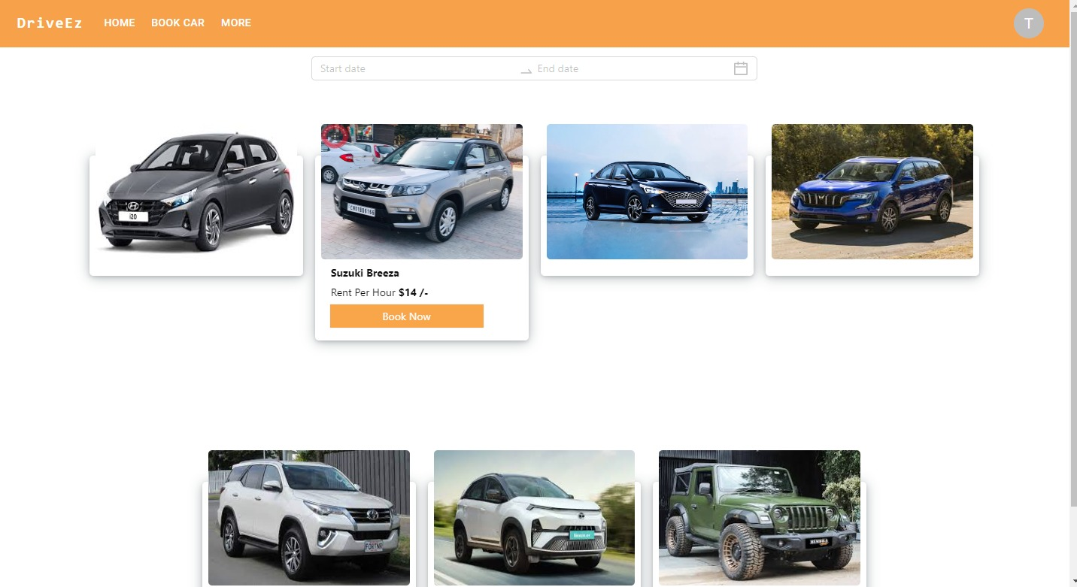
SCREENSHOT: User Car Fleet And Admin Dashboard

Slide 14
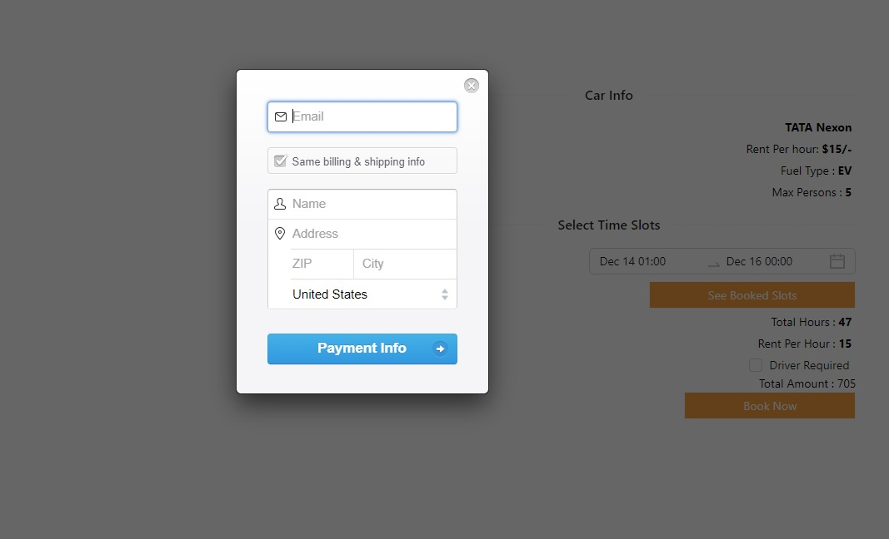
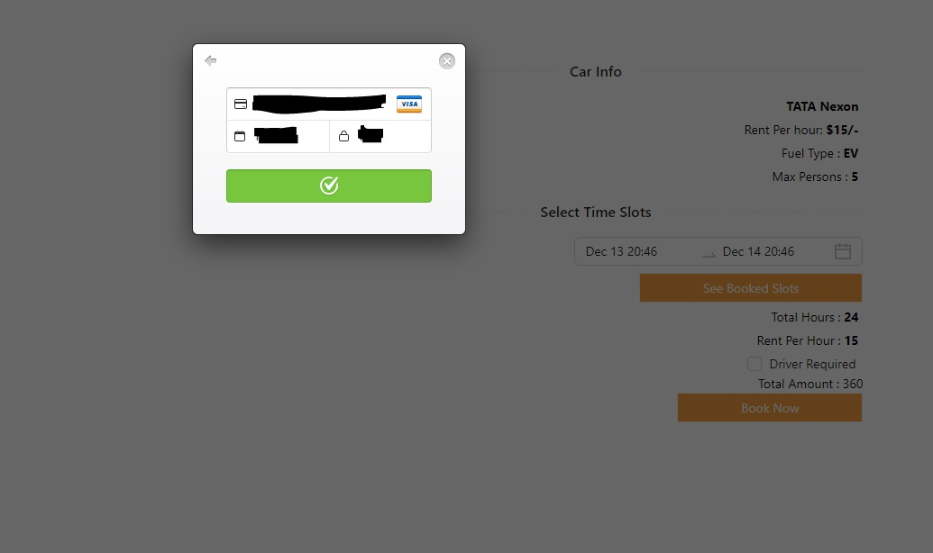
SCREENSHOT:User Payment Gateway

