Slide 1
HAndwritten Text recoganization tool
Session 2019-20
Submitted By: Submitted To:
Adhikesh Jadhav (4) Prof. Gaurav Mandloi
Aishwarya Chouhan (7)
Amisha Bhawsar (10)
Atharva Keshre (24)

Slide 2
Outline
Abstract
Introduction
Problem Statement
Project Objectives
Solution Proposed
The Implementation

Slide 3
Abstract
This project seeks to classify individual handwritten words so that handwritten text can be translated to a digital form.
The aim of this project is to develop such a tool which takes an Image as input and extract characters (alphabets, digits, symbols) from it. The Image can be of handwritten document or Printed document.

Slide 4
Introduction
Despite the abundance of technological writing tools, many people still choose to take their notes traditionally: with pen and paper. However, there are drawbacks to handwriting text. It’s difficult to store and access physical documents in an efficient manner, search through them efficiently and to share them with others.

Slide 5
Introduction
The aim of this project is to develop such a tool which takes an Image as input and extract characters (alphabets, digits, symbols) from it. The Image can be of handwritten document or Printed document.

Slide 6
The Problem Statement
The need for converting hand written text to digital form was recognized.
Since many hand written documents, notes etc are manually converted into digitalize form for further processing.

Slide 7
Objectives
To develop a tool using machine learning in python which can convert an image of hand written text into digital form .
To convert handwritten text as well as printed documents into digital format.

Slide 8
Solution Proposed
Handwritten character recognition is a field of research in artificial intelligence. A computer performing handwriting recognition is said to be able to acquire and detect characters in paper documents, pictures, touch-screen devices and other sources and convert them into machine-encoded form.
The Implementation of such a tool depends on two factors – Feature extraction and classification algorithm.

Slide 9
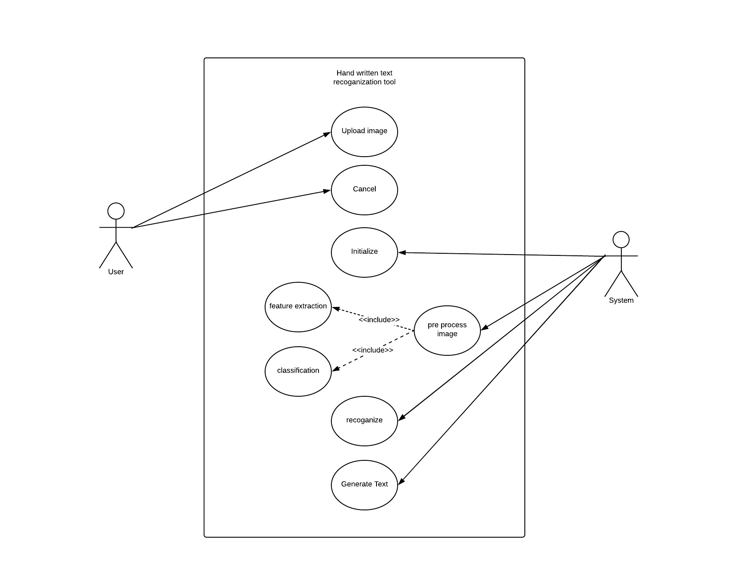
Use case Diagram

Slide 10
Feature Extraction -
Feature extraction is a process of dimensionality reduction by which an initial set of raw data is reduced to more manageable groups for processing. A characteristic of these large data sets is a large number of variables that require a lot of computing resources to process. Feature extraction is the name for methods that select and /or combine variables into features, effectively reducing the amount of data that must be processed, while still accurately and completely describing the original data set.

Slide 11
Classification -
In machine learning, classification is a supervised learning approach in which the computer program learns from the data input given to it and then uses this learning to classify new observation. This data set may simply be bi-class (like identifying whether the person is male or female or that the mail is spam or non-spam) or it may be multi-class too. Some examples of classification problems are: speech recognition, handwriting recognition, bio metric identification, document classification etc..

Slide 12
Machine Learning
Machine Learning is a sub-set of artificial intelligence where computer algorithms are used to autonomously learn from data and information.
Machine learning is a type of artificial intelligence (AI) that provides computers with the ability to learn without being explicitly programmed. Machine learning focuses on the development of Computer Programs that can change when exposed to new data.

Slide 13
Python
Python is a widely used general-purpose, high level programming language.
Python allows programming in Object Oriented and Procedural paradigms.
Python programs generally are smaller than other programming languages like Java. Programmers have to type relatively less and identation requirement of the language, makes them readable all the time.

Slide 14
The biggest strength of the Python is large libraries which can be used for the following
Machine Learning
GUI Applications
Web frameworks like Flask
Multimedia
Image processing
Test frameworks
Web scraping

Slide 15
Thank you !!

