Slide 1

Home Workout App - FITZY

Slide 2

Introduction
FITZY is more than just a tool—it’s a companion for everyday individuals striving to lead healthier lives amidst their busy schedules. With its personalized approach, motivational features, and community support, it has the potential to transform how people perceive and pursue fitness.

Slide 3

01
FITZY is a home workout App
No gym nearby, just FITZY

Slide 4

We make Workouts you actually want to do!

Slide 5
Technical applications
Frontend
Styling
Auth/Backend
React + TypeScript for modular architecture.
Tailwind CSS for clean UI design.
Firebase for real-time authentication and data storage.
Build-Tool
Deployment
Vite for fast performance.
Netlify with CI/CD workflows for seamless updates.

Slide 6
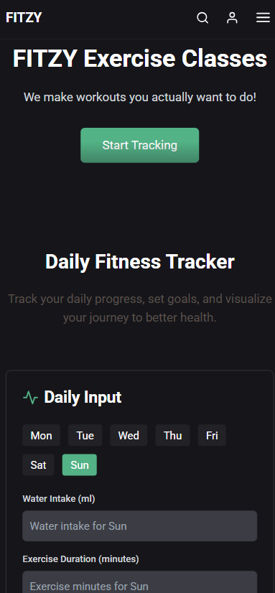
Product demo
FITZY
Login and authentication screens.
Workout calendar in action.
Daily fitness tracker

Slide 7
Thank You
Team 4bits – Atharva Vishal Rahul Neeraj

