Slide 1

Laksh AI: Empowering Career Journey
Laksh AI is a career guidance platform designed to equip individuals with the tools and resources needed to navigate the ever-evolving job market and achieve their professional aspirations. By leveraging cutting-edge technology, Laksh AI provides personalized career recommendations, tailored learning roadmaps, interview preparation and virtual internship experiences to help users discover their ideal path.
Team Members:-
Harshal Nelge
Urmi Sawant
Yash Raikar
Atharva Kolekar
Munir Siddiqui

Slide 2
The Problem: Career Crossroads
Lack of Guidance
Understanding Options
Limited access to quality career guidance leaves many feeling lost and uncertain about their future.
It's difficult to navigate the vast landscape of careers and understand the various paths available.
Lack of Experience
Not Prepared for Placement
Many students struggle to gain relevant hands-on experience that employers seek, leading to challenges in job readiness.
Insufficient preparation for placement tests, aptitude assessments, and interviews often results in missed job opportunities.

Slide 3



Laksh AI: The Solution
Personalized Recommendations
1
Laksh AI analyzes individual skills, interests, and aspirations to provide tailored career suggestions.
AI-Powered Roadmaps and Interview Prep
2
Customized learning plans guide users in acquiring essential skills for their target careers, paired with focused interview preparation.
Mentor Guidance and Virtual Internships
3
Personalized mentor support and virtual internships bridge academic learning and job readiness, providing essential skills and experience.

Slide 4





Laksh AI: Key Features
Goal Setting
Users set specific career goals and track their progress toward achieving them.
Career Insights
Access to the latest industry trends and insights to inform career decisions.
Mentorship
Connect with industry professionals for personalized guidance and advice.
AI Chatbot
Get instant answers to career-related questions and support throughout the journey.

Slide 5
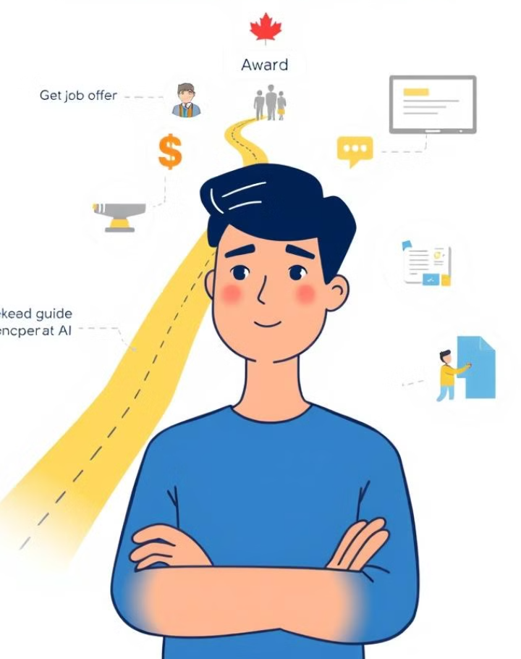
Laksh AI: Empowering Career Journey
1
Laksh AI helps users identify their strengths and passions to guide them toward their ideal careers.
2
The platform provides personalized learning resources and virtual internship experiences to build relevant skills.
3
With its intuitive interface and AI-powered features, Laksh AI empowers users to take control of their career development.

Slide 6

Laksh AI: Technology Stack
Django and LangChain
Llama model and Vertex AI
Django powers the backend of Laksh AI, providing a robust framework for seamless integration, while LangChain enables advanced AI-driven interactions and interview simulations
The Llama model powers the AI chatbot for roadmap generation and personalized interview simulations, while Vertex AI enhances scalability and efficient deployment.
Firebase
Next JS, Tailwind CSS
Used for real-time database management and authentication, ensuring secure user data handling and seamless interaction
Next.js for building the frontend and Tailwind CSS for creating responsive, customizable designs.

Slide 7

Laksh AI: Impact and Future
100K+
Users
Our goal is to reach a vast audience of individuals seeking career guidance and support.
50K+
Virtual Internships
We aim to provide hands-on experience to a large number of users through our virtual internship program.

Slide 8




Laksh AI: Next Steps
Expand Features
Continue to enhance Laksh AI's functionalities, such as adding new career paths and learning resources.
Community Building
Foster a supportive community of users through online forums and mentorship programs.
Partnerships
Collaborate with educational institutions and industry partners to offer even more valuable resources.

