Slide 1

Title : ReUseX
Atharva Late (24107059)
Asad Khan (24107048)
Charukesh Addugula (24107139)
Project Guide
Dr. Avinash Shrivas

Slide 2
Contents
Introduction
Objectives
Scope
Features / Functionality
Project Outcomes
Technology Stack
Block Diagram

Slide 3
1. Introduction
ReUseX is a digital platform for reselling, and recycling used electronic components. It ensures quality through inspection-based verification, promotes responsible e-waste recycling, and rewards users for supporting a sustainable circular economy.
Problem Identified :
    No trusted platform for verified resale and reuse of electronic components.
    Increasing e-waste due to lack of organized reuse and recycling systems.
Solution Proposed :
    ReUseX provides inspection-based resale and recycling of electronics.
    A reward system encourages users to reuse devices and reduce e-waste.

Slide 4
2. Objectives
To build a user-friendly mobile application that enables users to easily list, browse, buy, sell, and recycle electronic products, along with features such as order history tracking and structured product discovery for a seamless and intuitive user experience.
To design and implement a role-based admin dashboard that facilitates category and product management, listing approval workflows, and recycling request handling, along with advanced system monitoring features such as order status tracking (completed, pending, canceled), sales analytics, e-waste management reports, and interactive visualizations including charts and graphs.
To develop a high-performance system with seamless image upload, coupon codes and real-time data synchronization, ensuring fast updates, efficient data consistency, and smooth application performance across all user interactions.
To design and integrate a scalable cloud-based backend using Firebase Authentication and Firestore for secure user management and real-time data handling, along with Cloudinary for efficient image storage and delivery.

Slide 5
3. Scope
The proposed system can be applied in the electronics resale and recycling domain, enabling individuals and small sellers to resell, buy and recycle used electronic components through a single digital platform.
The system can be used by students, hobbyists and technical professionals who require affordable and verified electronic parts such as RAM, CPUs, cameras and accessories.
The platform can be adopted by institutions and small repair centers to manage electronic reuse, repair and reduce electronic waste through structured recycling requests.
The project promotes environmental sustainability, and can be useful for colleges, training institutes and community initiatives working towards awareness and reduction of e-waste.

Slide 6
4. Feature /Functionality
Feature 1 : Inspection and Grading System
Each listed electronic product is inspected and assigned a grade from A,B,C & F based on its condition. This helps buyers clearly understand the quality and reliability of the product before purchasing.
Feature 2 : Resale of Electronic Components and Accessories
The platform supports buying and selling of small & individual electronic parts such as RAM, CPUs, lenses and accessories. Users can easily list products with images, description and condition details.

Slide 7
4. Feature /Functionality
Feature 3 : Category-wise and Condition-based Product Search
Products can be filtered using categories and condition levels. This helps users quickly find suitable products based on their requirements.
Feature 4 : Recycling with Reward Points
Users can submit unusable electronic items for recycling and receive reward points. These points can be redeemed within the application to encourage eco-friendly usage.

Slide 8
5. Outcome of Project
User can register and log in and manage profile for important activities within the application.
User can buy, sell and recycle electronic products by providing required details, uploading product images, entering delivery address and using the Cash-on-Delivery option, along with viewing order history.
Admin can manage categories, products and inspections, assign grades, maintain inspection history and ensure transparent listing of electronic items.
Admin can manage orders and monitor sales through the dashboard, including handling placed and cancelled orders and viewing graphical sales reports.

Slide 9
6. Technology Stack
Front-End (GUI): Develop the user interface mobile application using Flutter for login, buy, sell, recycle, orders and profile management. Admin dashboard using Flutter for category management, inspection, order handling and sales monitoring.
Back-End & Database: Implement backend services and data storage using Firebase Authentication & Firestore for application logic and secure storage of users, products and orders, along with Cloudinary for efficient image storage and delivery.

Slide 10
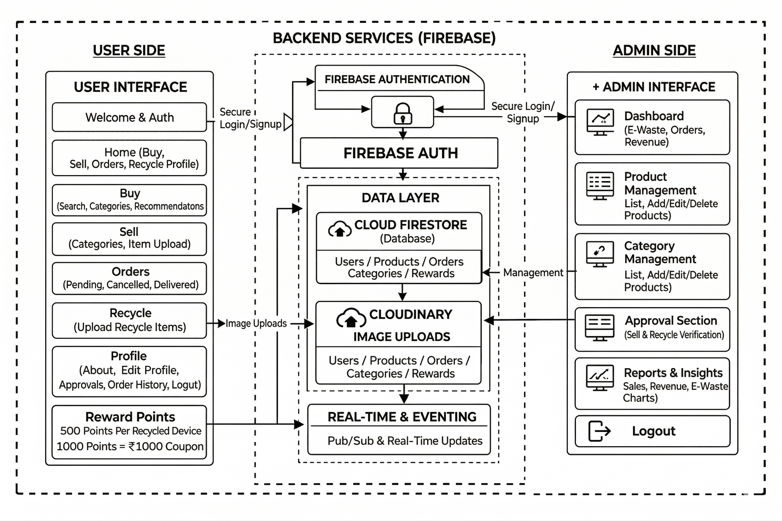
7. Block Diagram

Slide 11
8. SDGs
SDG 12: Responsible Consumption and Production (Primary)
The project primarily aligns with SDG 12 by enabling the reuse, resale, and recycling of electronic components, reducing e-waste and promoting a sustainable circular economy where resources are efficiently utilized instead of being discarded.
SDG 13: Climate Action (Secondary)
The project contributes to SDG 13 by minimizing environmental pollution and reducing carbon emissions through decreased electronic waste and reduced demand for new device manufacturing.
SDG 11: Sustainable Cities and Communities (Secondary)
The project supports SDG 11 by providing a structured system for managing electronic waste, helping create cleaner, more sustainable, and resource-efficient urban communities.

Slide 12
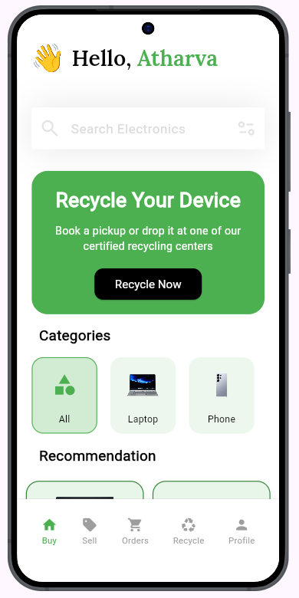
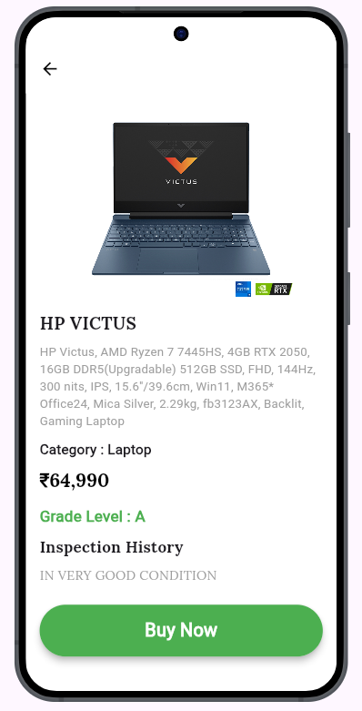
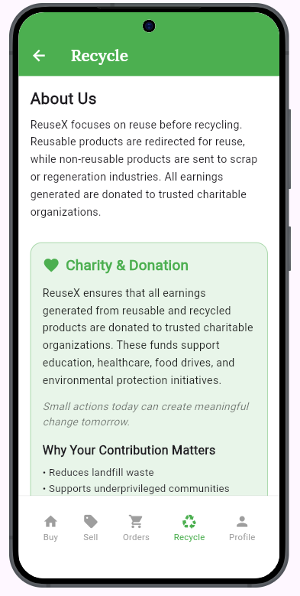
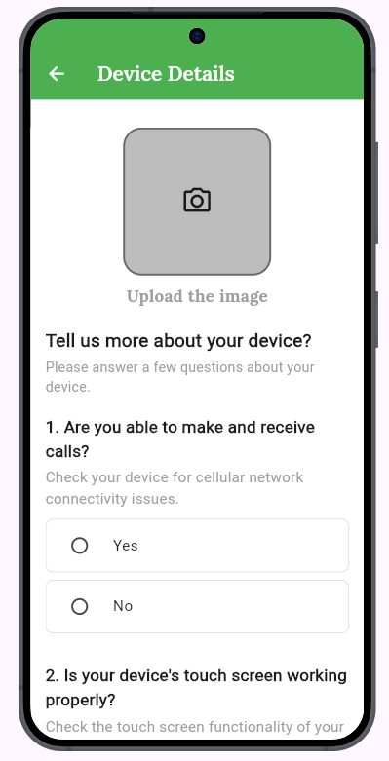
User Interface UI

Slide 13
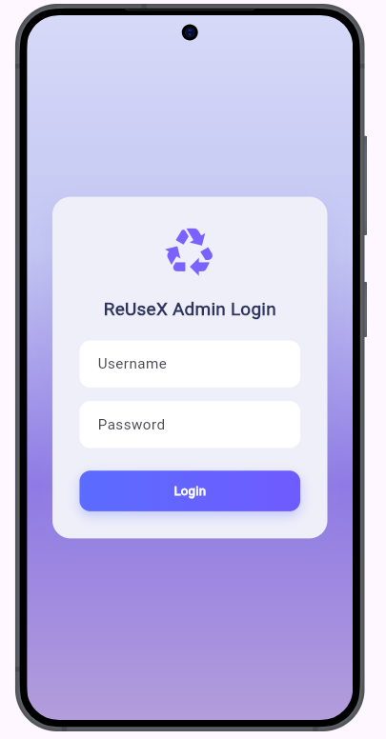
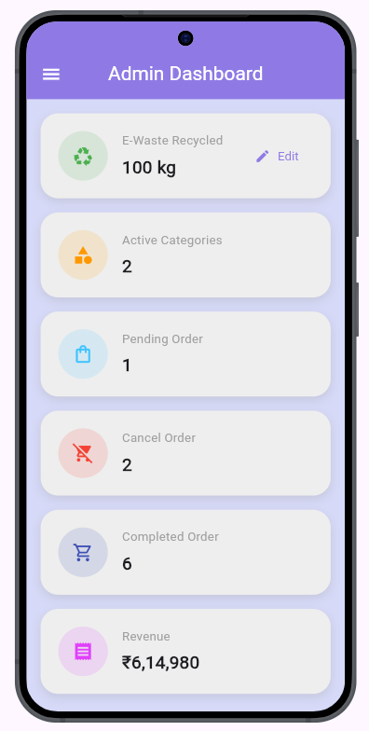
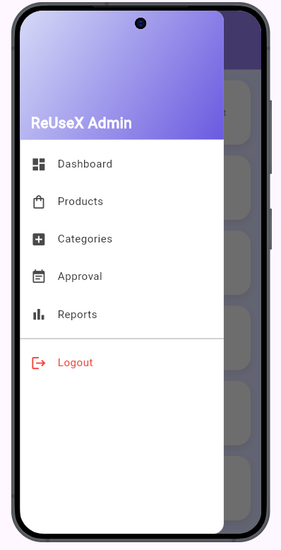
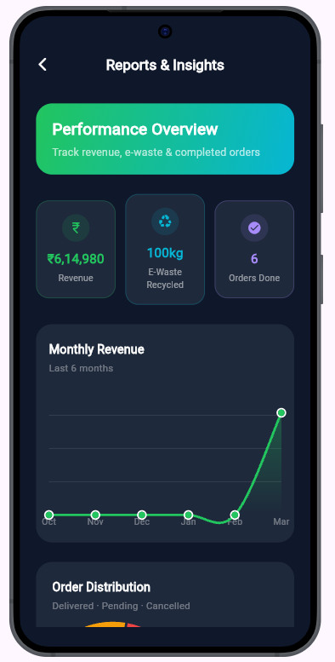
Admin Interface UI

Slide 14
Thank You...!!

