Slide 1


BTI
Mid Review
A.Y. 2025-2026
Project Title: Performance Evaluation of Campus Networks
Presented by: Atharva Lingayat C002, Aarya Nadiger C004, Naman Sheth C016
Under the guidance of : Prof. Khushbu Chauhan
Computer Engineering Dept. MPSTME, Mumbai Campus
1

Slide 2

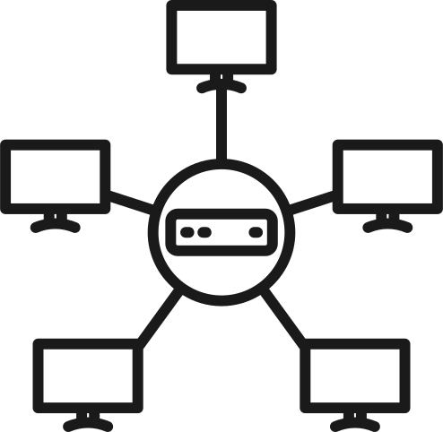
Aim & Objectives
01
To perform quantitative performance evaluation of campus network topologies
02
To compare network behavior under different traffic conditions
03
To perform quantitative performance evaluation of campus network topologies
04
To apply data analysis and visualization for objective conclusions

Slide 3

Literature Review Summary
Recent studies (2023–2026) establish Cisco Packet Tracer (CPT) as an effective tool for simulating campus network architectures, routing protocols, VLAN segmentation, and IoT-enabled systems. The literature also highlights the integration of Python-based tools to extend simulation analysis. Specifically, SimPy supports event-driven performance simulation, NetworkX enables graph-based topology modeling, and Matplotlib facilitates visualization of network metrics. Together, these tools form a hybrid framework for simulation, analysis, and optimization of campus computer networks.

Slide 4

Research Gap
Existing studies primarily use Cisco Packet Tracer for network topology and protocol simulation or Python tools for analytical modeling, but rarely integrate both approaches in a single framework. Most papers focus on individual aspects such as routing performance, IoT devices, or security mechanisms, with limited quantitative analysis of simulation-generated network data.
Additionally, dynamic traffic modeling and topology-based performance evaluation in campus networks remain underexplored. This project addresses these gaps by integrating Cisco Packet Tracer with Python tools (SimPy, NetworkX, and Matplotlib) to enable data-driven simulation, topology analysis, and performance visualization of campus computer networks.

Slide 5
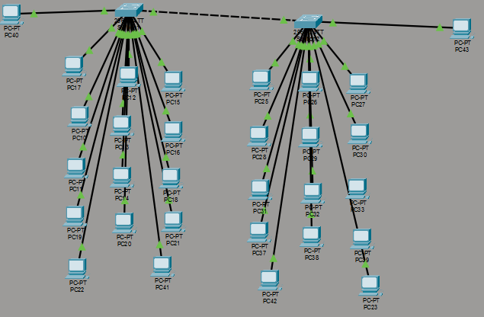
Initial Project Architecture
01
Hierarchical Switched Network:
The diagram shows two parallel tree-structured networks, each with switches at multiple layers connecting to end-user PCs at the bottom. This represents a classic hierarchical network design with core switches at the top distributing traffic downward.
02
Redundant Core Connectivity:
The green dotted lines at the top indicate redundant links between the core switches of both network trees, providing backup paths and fault tolerance if one connection fails.
03
Multi-Layer Distribution:
Each tree has multiple tiers of switches (core, distribution, and access layers) that aggregate connections from numerous PCs (labeled PC17-PC42), efficiently managing traffic flow from many endpoints through progressively fewer uplink connections.

Slide 6
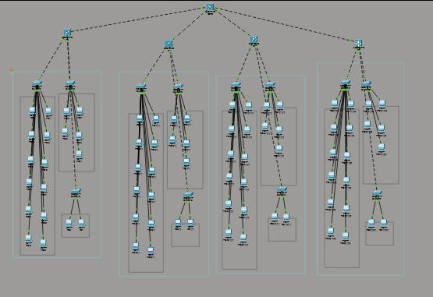
Hierarchical Campus Network Design
01
Multi-Floor Hierarchical Design:
The network spans multiple floors of a building, with each floor (shown by the rectangular zones) having its own set of access switches connecting end devices. Each floor follows a consistent hierarchical structure for uniformity.
02
Meshed Core Backbone:
The dotted lines at the top represent a fully meshed core layer that interconnects all floors, providing redundant vertical connectivity throughout the building. This ensures any floor can communicate with any other floor through multiple paths.
03
Vertical Distribution Model:
Each floor has distribution switches that aggregate connections from access-layer switches and PCs, then connect upward to the building's core switches. This vertical stacking approach efficiently manages inter-floor traffic and provides fault isolation per floor.

Slide 7
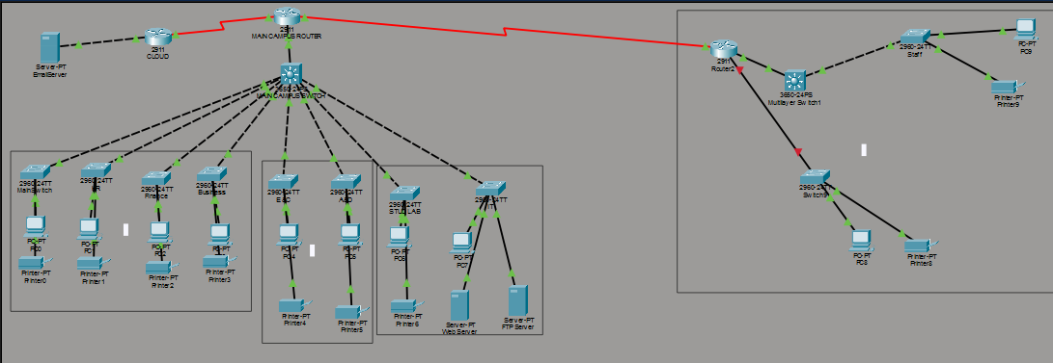
01
Centralized Hub with WAN Connectivity:
02
Segmented Internal Campus:
The main campus router serves as the central hub connecting to external sites via WAN links (red lines) - including remote branch offices, cloud services, and internet - creating a unified enterprise network across multiple physical locations.
The green dotted lines show the internal campus LAN divided into multiple zones/buildings, each with distribution switches connecting end devices (printers, PCs, servers), providing logical separation while maintaining centralized routing control.

Slide 8

Tech Stack
Simpy
NetworkX
Matplotlib
Cisco Packet Tracer

Slide 9

Code Walkthrough
01
Network Topology Creation:
A three-layer Campus Network architecture (Core → Distribution → Access) is created using NetworkX. The Core switch connects to departmental routers (IT, CS, EXTC), and each router connects to multiple host devices.
02
RIP-Based Packet Routing:
Packets travel using the shortest path computed by NetworkX, simulating the behavior of Routing Information Protocol where hop count acts as the routing metric. Packets exceeding the 15-hop RIP limit are dropped.

Slide 10
Code Walkthrough
03
Traffic and Error Simulation:
Using SimPy, hosts generate random traffic. The simulation introduces random packet loss (5%), processing delays per hop, and jitter to mimic real network conditions.
04
Performance Visualization:
Results are visualized using Matplotlib to display network topology, packet delivery vs loss, hop count distribution, and end-to-end delay, enabling analysis of network performance.

Slide 11
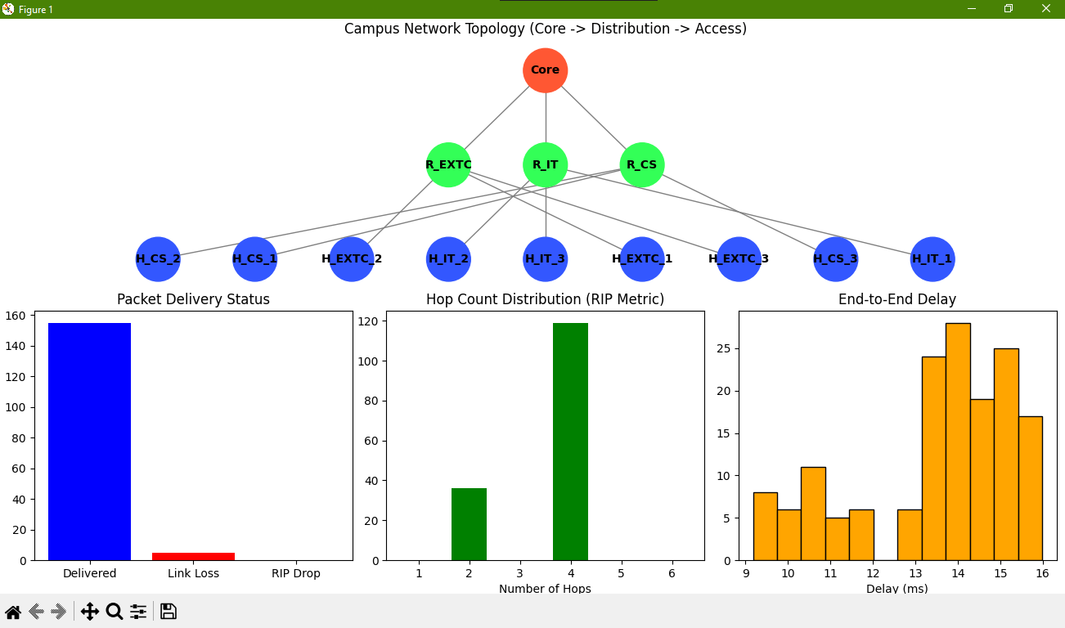

Slide 12
What We Learnt:
Basic topologies in CPT (Cisco Packet Tracer)
Star, mesh, bus, ring, and hierarchical network designs
Understanding how devices interconnect in different configurations
Visual representation and simulation of network layouts
End/Host devices
PCs, laptops, servers, printers, IP phones
Devices that generate or consume network traffic
Configuration of IP addresses, gateways, and DNS settings
Switch Trunk
Trunk links carry traffic for multiple VLANs between switches
802.1Q tagging protocol
Allows VLAN extension across multiple switches in a network
DHCP pooling
Dynamic Host Configuration Protocol automatically assigns IP addresses
Configuring IP address ranges (pools) for automatic distribution
Setting default gateways, DNS servers, and lease times
RIP V2 routing
Routing Information Protocol version 2 - a distance-vector routing protocol
Automatic route advertisement between routers
Uses hop count as metric (max 15 hops)

Slide 13


BASIC CISCO PACKET TRACER
Completed
VLAN CONFIGURATIONS
IMPLEMENTATION STATUS
Completed
LITERATURE REVIEW
We are methodically bringing the project in execution.
Completed
DESIGN & FINAL IMPLEMENTATION
In progress

Slide 14
Thank
you!

