Slide 1
PYBOT
A Virtual Assistant
Developed By:
Siddhesh Dharmadhikari-18if018
Athrava Navathe-18if045
Guided by: Yashwardhan Ramchawre-18if048
Prof. R.R.Bhoge Vedant Shah-18IF052
Shreyash Nakod-18if043

Slide 2
Approach
The approach is to make this Pybot as useful and easy as possible to end-users, especially for a non-technical person.
So that, they don’t waste their time on redundant tasks.
We made it user-friendly so that it is easy to use and users would like to use it in their day-to-day life.

Slide 3

Python Bot
A Python bot is an software designed to interact with humans in their natural language.
In the past few years, Python bots have become wildly popular in the tech and business sectors.
These bots are so adept at imitating natural human languages and conversing with humans, that companies across various industrial sectors are adopting them.
This python bot will be able to search and open files with their exact location which many other bots cannot able to do.

Slide 4
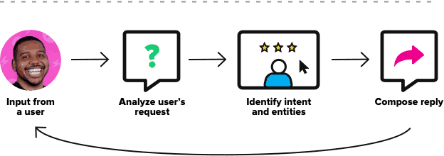
Working
User: Asks Question/Gives Commands
*Recognizes and analyse the query.
Bot: Answers the question/Performs the task.

Slide 5
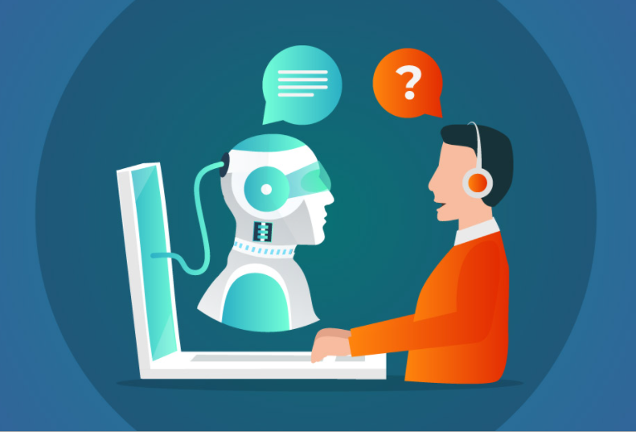
Pybot software executes pre-determined actions based on functions we set up in the code of project. Much like a virtual assistant, by recognizing a particular keyword or group of keywords associated with a particular task to executed after recognizing the input given by user.
The listening and recognizing process
keeps on-going since it is in an
infinite loop. User can terminate the
program by saying ‘Stop Listening’ or can
keep the bot in Stand-By mode.

Slide 6
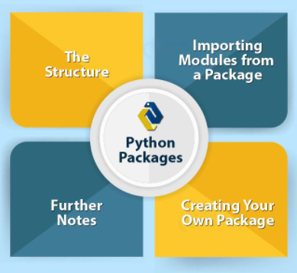
Packages
PYTTSX3: It is an open-source text-to-speech conversion library in Python
Speech_recognition- It is a module which actually recognizes the commands given by the user.
Pyautogui: It is Used to programmatically control the mouse & keyboard
Bs4 (BeautifulSoup): Used for pulling data out of HTML and XML files
Os: provides functions for operating system
Pywhatkit: In our project it is used to automate the browsing and surfing through internet

Slide 7
Features
PYBOT have variety of functions, they are as follows:
It can launch Notepad which is built-in in every computer
It has a Dictation mode in which user can dictate bot to write on notepad
It can launch variety of applications installed on the computer system
It can open the Command Prompt
It can Close Any running Application by just giving command
It can Search and Open any file you mentioned stored on the system
It can tell the IP Address of the system
It can tell the Current Temperature of any city user mentions
It can fetch any Information from Wikipedia which users want
It can search anything on the Google Search Engine

Slide 8
It can open any Website by just giving voice commands
It can Play Any Video user desires from official You-tube website
It can tell Top 10 News Headlines from the Technology World
It can tell a Joke
It can manipulate the Volume Controls of the system
It can tell the Current Date & Day to the user
It can Switch Applications by just commanding
It can Close Current Tabs by commanding
It can Set Reminder for minutes and can be worked as a stopwatch
It can be in Stand-by mode until the user revokes the bot
It can Shutdown, Restart, Sleep the system by just commanding

Slide 9
Advantages of Pybot
Easy to work with.
Dictation Mode.
Automation of Tasks.
Time Saving.
Variety of Features.
Information from Wikipedia.
Accurate Search-Results.
Online Surfing.

Slide 10
Limitations of Pybot
Internet Connection.
Single-tasking while Dictation mode.
Wikipedia Results.
Speech Recognition.
Slower in some cases.

Slide 11
Future Scope
This technology leads to other developing technologies such as Cloud Computing, Artificial Intelligence and so on to improve and implement advanced and new things which eventually gives us the devices and softwares like Alexa and Google Home.
This project can be developed aiming a particular organization, for educational purposes, home automations and so on.
More and more features can be added in this according to user’s requirements.

Slide 12
Conclusion
In this project we discussed about the development, implementation and execution of our Pybot. We researched and used the available open source modules and libraries because of which the near future updates will get easily available without any cost to pay. The implementation of this code file can be done anywhere according to user’s requirements.
This type of technology started developing many years ago, each time new and advanced features gets added, sometimes they are free to use and sometimes not. The interactivity, ease of use, automation of daily basis tasks increases the popularity of such technology. The addition of features is unending but they can be implemented according to the user’s requirements.

Slide 13
References
AI based Voice Assistant Using Python by Ria Umahiya, Deepak Shende.
Desktop Voice Assistant for visually Impaired by Ankush Yadav, Aman Singh.
Libraries and modules research on official Pypi website. [https://pypi.org/project]
Virtual Assistant on Wikipedia [https://en.wikipedia.org/wiki/Virtual_assistant ]

