Slide 1


A Project Presentation on
“Implementation of efficient Quantum Computing Algorithm for searching”
Presented by Group ID:B01 Mr. Malwade Rohit Suresh Exam No: B400100389 Mr. Nirhali Atharva Ajay Exam No: B400100400 Mr. Panchal Soham Satish Exam No: B400100401 Mr. Patil Akshay Anna Exam No: B400100406
Under the Guidance of
Prof. R. L. Paikrao
Department of Computer Engineering
Amrutvahini College of Engineering, Sangamner

Slide 2
Contents
1.Abstract
2.Introduction
3.Literature Review
4.Architecture
5.Algorithm/methodology used
6.Implementation
7.Testing
8.Results
9.Conclusion
10.References
11. Participation Details

Slide 3
1.Abstract
The K-SAT problem poses significant computational challenges due to its exponential time complexity in classical algorithms..
This research introduces a quantum approach using Grover’s algorithm to achieve a quadratic speedup in finding satisfiable solutions.
A custom quantum oracle is designed to encode K-SAT clauses and is integrated into Grover’s iterative search using Qiskit.
Simulation results demonstrate improved efficiency, showcasing the potential of quantum computing in solving complex combinatorial problems.

Slide 4
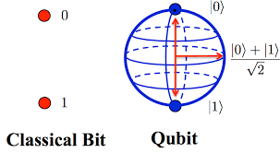
2.Introduction
K-SAT is a hard NP-complete problem with applications in AI, optimization, and circuit design.
Classical methods become inefficient as problem size grows, leading to interest in quantum solutions..
Grover’s algorithm offers a quadratic speedup using quantum superposition and interference.
This work builds and simulates optimized quantum circuits for K-SAT, showing improved speed and accuracy.

Slide 5
3.Literature Review
Author(s) | Year | Title | Key Focus | Findings
Ominato | 2024 | Improved Grover Adaptive Search | Optimization of Grover’s algorithm | Reduced the number of quantum queries, enhancing overall search efficiency.
Shafique | 2024 | Overview of Quantum Computing Concepts | Quantum circuits and foundational algorithms | Provided foundational understanding useful for Grover’s algorithm.
Mandviwalla | 2018 | Implementation of Grover’s Algorithm | Real-world implementation on IBM hardware | Demonstrated Grover’s algorithm is feasible on actual quantum machines.
Ambainis | 2013 | Error Analysis in Grover’s Algorithm | Error impact in quantum computation | Highlighted the need for error mitigation in Grover’s algorithm.

Slide 6
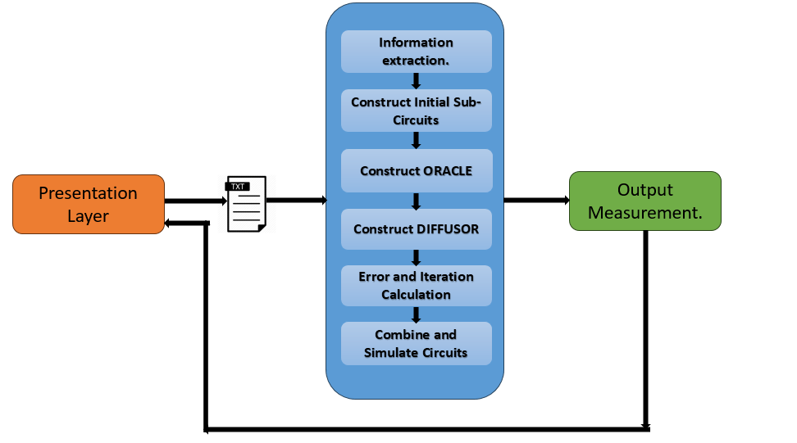
4.Architecture

Slide 7
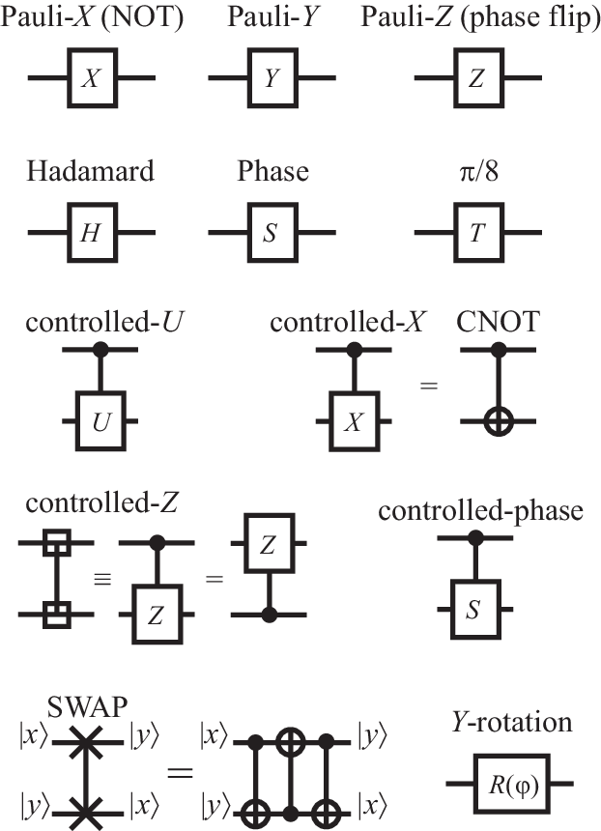
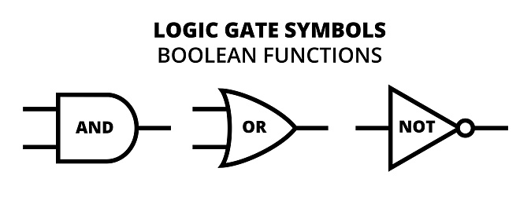
BASICS
Bits v/s Qubits:
Gates:
0 1
Superposition:
|0>
H
|0>
H
0.25
00 01 10 11

Slide 8
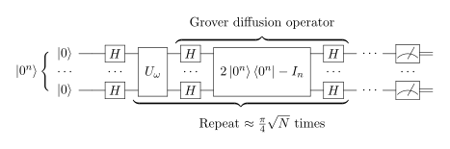
5.Algorithm/methodology

Slide 9
6.Implementation
Circuits for each CLAUSE and then for combined clauses.
Building ORACLE by appending Circuits build so far.
Build a DIFFUSOR Circuit.
Calculate Error Rate and Iteration Count
Construct Grovers.

Slide 10
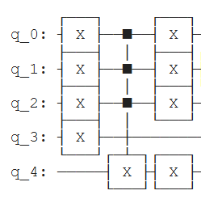
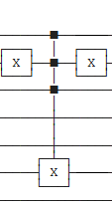
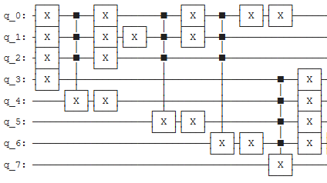
Implementation
Circuits for each CLAUSE and then for combined clauses.
Ex:
3 3
1 2 3
-1 2 -3
1 -2 -3
i. For Clause = 1 2 3:
ii. For Clause = -1 2 -3
ii. For all Clauses:
q_0:
q_1:
q_2:
q_3:
q_4:
q_5:
q_6:

Slide 11
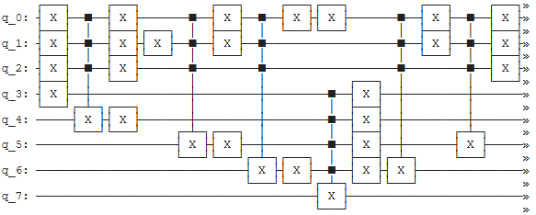
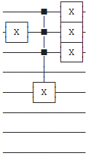
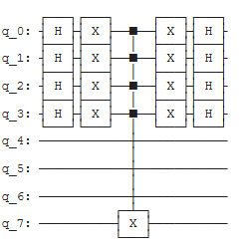
Implementation
2. Building ORACLE by appending Circuits build so far.
3. Build a DIFFUSOR Circuit

Slide 12
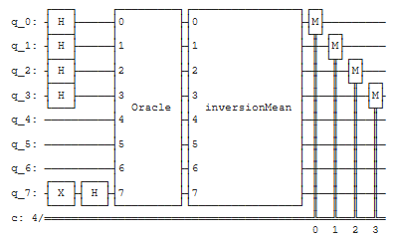

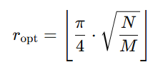
4. Calculate Error Rate and Iteration Count
5. Construct Grovers Circuit:
a. Error Calculation:
a. Iteration Calculation:

Slide 13
7.Testing
Objective: Ensure Grover’s Algorithm works accurately for solving the 3-SAT problem on a 6-qubit quantum circuit using Qiskit.
Testing types:
Unit Testing – Oracle, diffuser, Hadamard gates.
Integration Testing – Full quantum circuit.
Acceptance Testing – Verified search accuracy.
System Testing – End-to-end execution.
⚙ Tools Used:
Qiskit Aer Simulator (for testing & validation)
Python + plot_histogram() (for result analysis)

Slide 14
Test ID | Focus | Result
QC01 | Oracle phase inversion | ✅ Passed
QC03 | Grover’s algorithm execution | ✅ Passed
QC06 | Final measurement accuracy | ✅ Passed
QC09 | Classical vs Quantum output | ✅ Matched
QC11 | 6-qubit scalability test | ✅ Success
Key Test Cases & Results

Slide 15
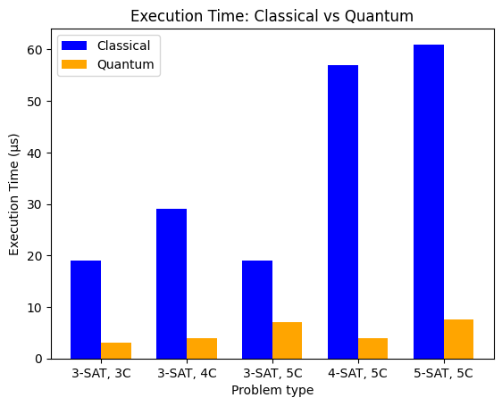
8.Results

Slide 16
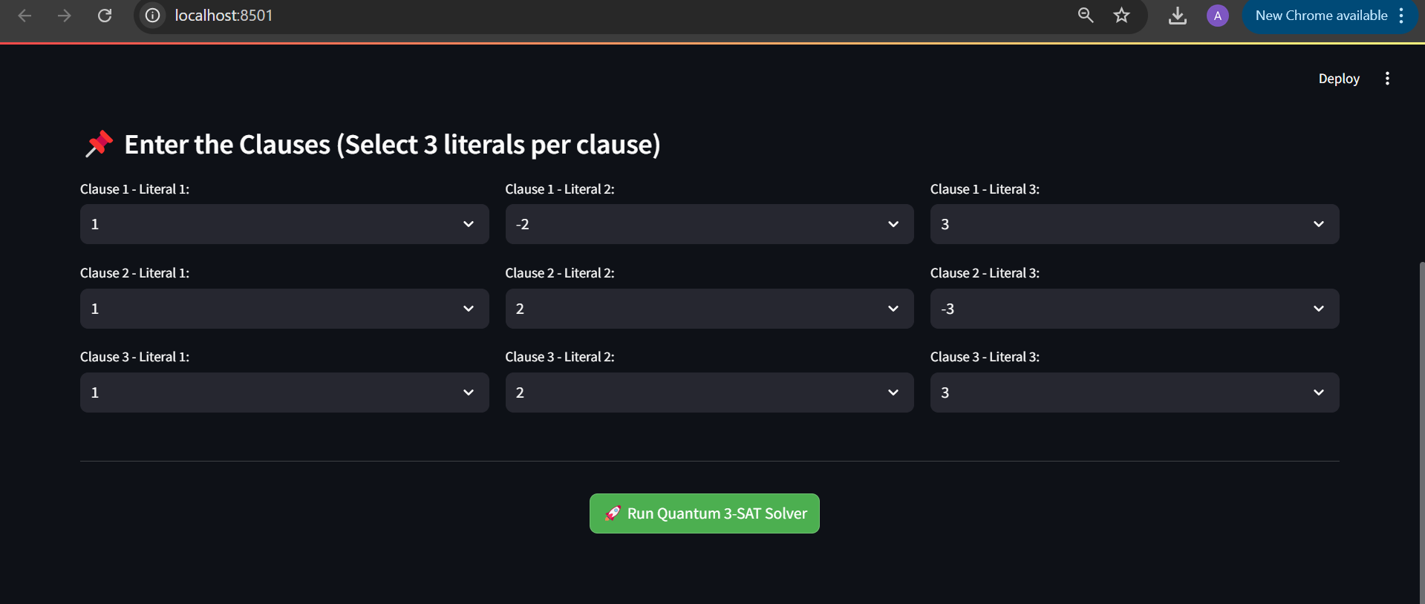
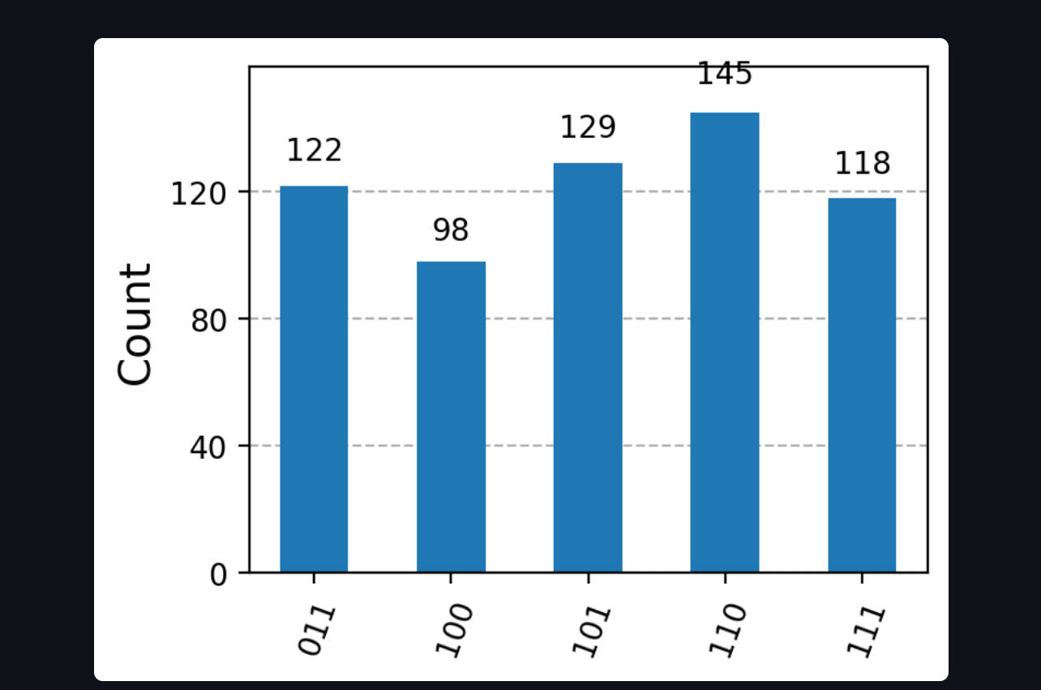

Slide 17
9.Conclusion
The project proves that Grover’s algorithm can efficiently solve small-scale K-SAT problems with up to 95% accuracy and significant time reduction.
Despite current limitations due to noise and scalability, the approach shows strong potential, paving the way for future hybrid quantum-classical solutions in complex problem-solving.

Slide 18
10.References
[1].Hiroaki Ominato, Takahiro Ohyama, and Koichiro Yamaguchi. Grover adaptive search with fewer queries. IEEE Access, 12:74619–74632, 2024.
[2].Muhammad Ali Shafique, Arslan Munir, and Imran Latif. Quantum computing: Circuits, algorithms, and applications. IEEE Access, 12:22296–22314, 2024.
[3].Aamir Mandviwalla, Keita Ohshiro, and Bo Ji. Implementing grover’s algorithm on the ibm quantum computers. In 2018 IEEE International Conference on Big Data (Big Data), pages 2531–2537, 2018.
[4].Andris Ambainis, Artrs Bakurs, Nikolajs Nahimovs, and Alexander Rivosh. Grover’s algorithm with errors. In Mathematical and Engineering Methods in Computer Science, pages 180–189, 2013.
[5].Bansal, P. K., Rupasinghe, A. S., & Jain, A. S. (1996). An empirical correction for sizing capillary tubes. International Journal of Refrigeration, 19(8), 497–505.

Slide 19
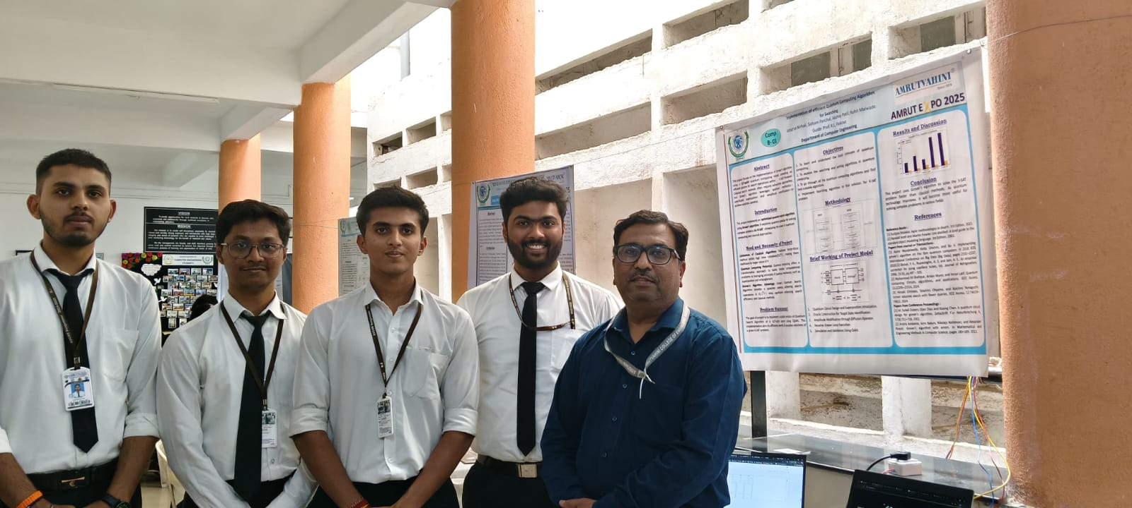
11. Participation Details
Participated in Amrut Expo 2025 – a Project Exhibition & Competition held on 4th & 5th April 2025 at Amrutvahini College of Engineering.
Received a Certificate of Excellence for active participation and project demonstration.

Slide 20
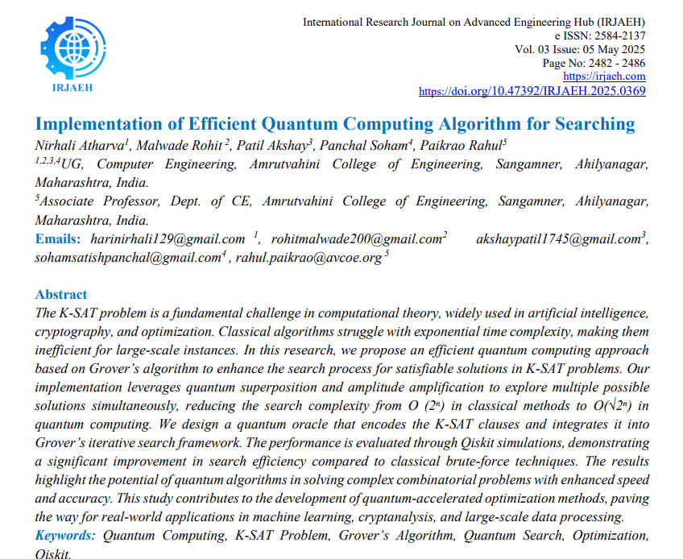

Slide 21
THANK YOU!!

