Slide 1
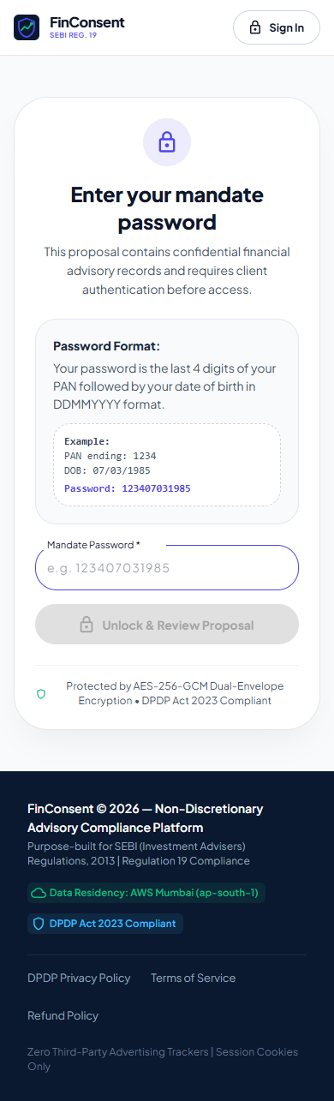
FINCONSENT
Enterprise Statutory Trade Authorization & Tax Infrastructure for Indian RIAs
Engineered specifically to operationalize SEBI (Investment Advisers) Regulations, 2013 Regulation 19 compliance, eliminate pre-trade capital gains tax surprises under Finance Act 2024, and establish immutable Section 63 Bharatiya Sakshya Adhiniyam, 2023 (BSA) electronic evidence.
• SEBI Regulation 19 Compliant | • Finance Act 2024 Tax Engine | • BSA §63 Cryptographic Receipts
Rohan Mehta's Mobile Verification Screen
FinConsent | Statutory RIA Infrastructure • Slide 1 of 29
Notes:
Welcome. FinConsent is purpose-built statutory software for Registered Investment Advisers managing non-discretionary portfolios in India. It bridges investment formulation and client authorization.

Slide 2
EXECUTIVE AGENDA & INDUSTRY CONTEXT
The Operational Crisis Facing Indian Investment Advisers
Why legacy approval methods fail both regulatory audits and investor trust.
1. Informal WhatsApp & Email Approvals (Regulatory Rejection)
Advisers routinely gather approvals over text messages or calls. SEBI inspection teams reject informal communications under Regulation 19 record-keeping rules, leaving RIAs vulnerable to claims of unauthorized trading. Such communications fail Section 63 BSA electronic admissibility standards.
2. Post-Trade Capital Gains Tax Shocks (Investor Friction)
Finance Act 2024 increased STCG to 20% and LTCG to 12.5% (+ 4% cess). When rebalancing occurs without pre-trade tax visibility, investors are blindsided by unexpected tax liabilities and penalty interest under Section 208 and 234C where liability reaches ₹10,000.
3. Fragmented Audit Trails (Inadmissible in Disputes)
Advice, rationale, client responses, and execution logs live in disconnected silos. Compiling annual compliance records takes weeks. Raw screenshots lack cryptographic hash continuity and device provenance, rendering them contestable before regulatory authorities.
FinConsent | Statutory RIA Infrastructure • Slide 2 of 29
Notes:
Today, SEBI registered advisers manage crores under non-discretionary agreements, yet 80% still collect approvals over WhatsApp or email. This slide highlights the three systemic failure modes.

Slide 3
USER PERSONAS & OPERATIONAL CONTEXT
Grounding Compliance in Human Realities: Suresh & Rohan
A fee-only RIA managing family wealth and an executive demanding frictionless transparency.
SURESH NARAYANAN [SN]
Principal Officer & Founder, Prudent Wealth Advisory (SEBI Reg: INA000088921)
Key Metrics: ₹180 Crores AUM | 75 Affluent Families | Fee-Only Model
• Role: Non-discretionary investment formulation, asset allocation, and rebalancing.
• Pain Point: Surging equity markets triggered 15%+ allocation drift. Needs immediate consent without administrative phone chasing or legal exposure.
• Statutory Need: Mandated 5-year audit trail for rationale under SEBI Regulation 19.
“I cannot risk my SEBI licence on unrecorded phone calls or casual text messages. When markets drift, I need a verifiable, locked consent record in under an hour.”
ROHAN MEHTA [RM]
Managing Director, Auto-Tech Firm, Pune (Masked PAN: XXXXX1234F)
Key Metrics: ₹4.2 Crore Portfolio | 2-Minute Review Limit | Mobile-First
• Role: Busy corporate executive reviewing financial proposals on smartphone.
• Pain Point: Refuses to read lengthy PDF attachments or guess year-end capital gains taxes while travelling between meetings.
• Expectation: 2-minute mobile authorization flow with exact rupee tax impact before agreeing.
“Tell me exactly what we are buying and selling, why we are doing it, and what my tax bill is. If it takes more than 2 minutes on my phone, I will postpone it.”
FinConsent | Statutory RIA Infrastructure • Slide 3 of 29
Notes:
Meet our two personas: Suresh, the compliant adviser managing family wealth, and Rohan, the busy client who requires crisp mobile transparency.

Slide 4
FRICTION & RISK ANALYSIS
Four Critical Vulnerabilities of Legacy Approval Channels
Analyzing the legal, financial, and operational penalties of informal processes.
SEBI Regulation 19 Compliance Exposure
Failing to maintain contemporaneous records of investment advice, rationale, and documented client agreement for 5 years leaves advisers vulnerable during mandatory inspections and enforcement actions.
Advance Tax Penal Interest (Sec 208, 234B & 234C)
Selling equities without advance tax warnings triggers 1% monthly penal interest if net tax liability reaches ₹10,000; requires planning under Section 234C capital gains installment relief proviso.
Electronic Evidence Inadmissibility (BSA Sec 63 / Sec 65B)
Under Section 63 of Bharatiya Sakshya Adhiniyam, 2023, raw text screenshots lack server hash continuity and device provenance required for judicial and regulatory admissibility.
Operational Delay & Market Slippage
Chasing clients across phone calls and emails causes days of delay, during which market prices drift and optimal rebalancing windows evaporate.
FinConsent | Statutory RIA Infrastructure • Slide 4 of 29
Notes:
Notice that each risk maps directly to Indian statutory codes: SEBI Regulation 19, Income Tax Act Section 234C, and BSA Section 63.

Slide 5
PLATFORM ARCHITECTURE
FinConsent Solution Overview: The Four Core Pillars
An integrated statutory infrastructure bridging advisory formulation and client mobile consent.
1. Pre-Trade Tax Transparency
Dynamic Finance Act 2024 tax engine. Real-time STCG (20%) and LTCG (12.5% + 4% cess) computation with quarterly advance tax alerts under Section 208 / 234C.
2. Dual-Envelope Encryption
AES-256-GCM encryption with dual key wrapping and isolated Server Master Key. Financial data remains encrypted at rest until client unlocks via PAN last 4 + DOB.
3. Secure Mobile Consent Rail
Direct password-protected 256-bit magic links. Responsive smartphone layout, mandate clarification chat, and secure email/in-app 6-digit OTP verification.
4. Section 63 BSA Audit Ledger
Append-only forward SHA-256 hash chaining. Emits digitally fingerprinted Regulation 19 compliance dossiers with IP, User-Agent, and IST timestamps.
FinConsent | Statutory RIA Infrastructure • Slide 5 of 29
Notes:
Here are the four foundational pillars: Pre-trade Tax, Dual-envelope Encryption, Mobile Consent Rail, and BSA Section 63 Audit Ledger.

Slide 6
NARRATIVE FLOW
End-to-End User Journey: Advisor, Platform & Client Lanes
Chronological sequence mapping advisory formulation to statutory compliance archive.
ADVISOR LANE (RIA: Suresh Narayanan)
1. Detects 15% equity drift in Rohan's portfolio ➜ 2. Drafts sell and buy baskets with statutory rationale ➜ 3. Dispatches encrypted mandate with 48h market window ➜ 6. Clarifies questions in chat rail.
FINCONSENT ENGINE (Platform Core)
Calculates ₹11,440 capital gains tax estimate ➜ Derives dual-envelope AES-256-GCM keys ➜ Delivers magic link ➜ Issues 6-digit OTP (5m TTL) ➜ Chains SHA-256 audit ledger.
CLIENT LANE (HNI: Rohan Mehta)
4. Receives link on smartphone ➜ 5. Unlocks proposal via PAN last 4 + DOB ➜ Reviews drift & tax ➜ 7. Asks question in chat ➜ 8. Accepts declarations & enters 6-digit OTP ➜ Receives signed receipt.
FinConsent | Statutory RIA Infrastructure • Slide 6 of 29
Notes:
Notice how the three actor lanes interact: Suresh initiates, FinConsent secures and computes, and Rohan authorizes on his mobile device.

Slide 7
PROCESS ARCHITECTURE
Statutory State Progression: Happy Path & Exception Boundaries
Deterministic finite-state machine governing advisory recommendations and legal evidence.
MAIN STATUTORY JOURNEY (Deterministic Progression to Legal Lock)
[DRAFT] Advisor formulates trade baskets & rationale
➜ [SENT] Encrypted magic link dispatched with 48-hour cutoff window
➜ [VIEWED / IN REVIEW] Client unlocks via PAN+DOB; full tax & drift displayed
➜ [CONSENTED] 3 statutory declarations accepted & 6-digit OTP verified
➜ [EVIDENCE LOCKED] SHA-256 chained receipt emitted; trade executed via broker.
TERMINAL EXCEPTION BOUNDARIES (Strict Safety Limits)
• EXPIRED STATE: If 48-hour cutoff window elapses prior to OTP entry, proposal becomes permanently inaccessible (HTTP 410 Gone) to prevent stale market execution.
• REVOKED STATE: Advisor can click 'Revoke Link' at any moment if market volatility alters optimal rebalance strategy, immediately terminating client access.
• LOCKED OUT STATE: 3 consecutive failed OTP attempts immediately locks authorization and burns the token (HTTP 429), defending against brute force.
FinConsent | Statutory RIA Infrastructure • Slide 7 of 29
Notes:
State transitions in FinConsent are strictly unidirectional. Once Consented or Expired, a mandate cannot be edited or revived.

Slide 8
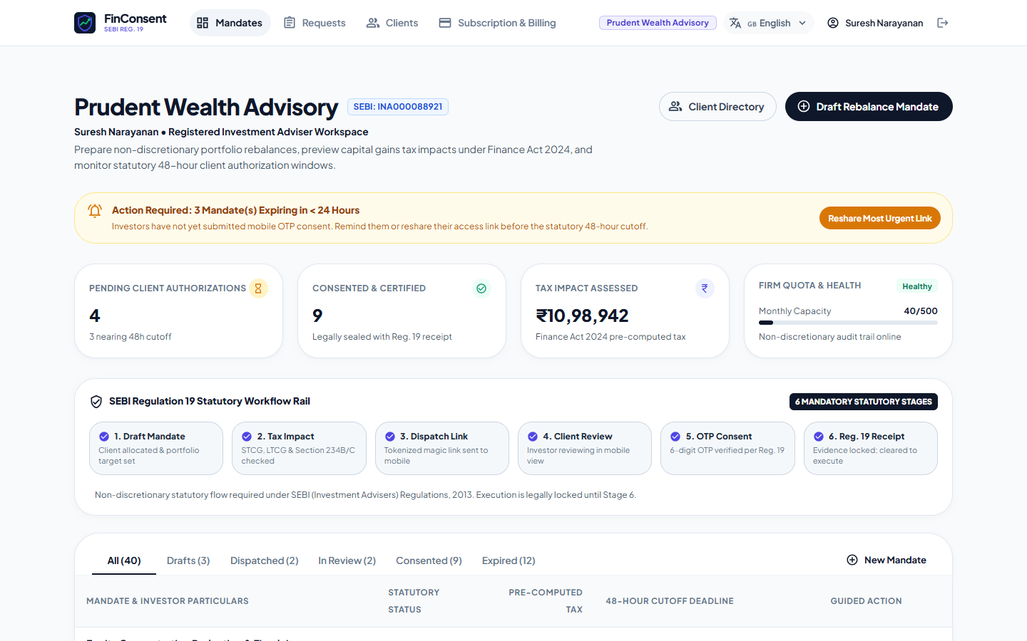
RIA WORKSPACE
The Advisor (RIA) Experience: Formulation & Real-Time Control
Prudent Wealth Advisory center showing active practice mandates and countdown timers.
Advisor Capabilities & Controls
[1] Practice Workspace: Scoped view displaying active mandates (Draft, Sent, Viewed, Consented, Expired, Revoked) with live 48-hour countdown badges.
[2] Client Registry: Client management enforcing valid PAN syntax ([A-Z]{5}[0-9]{4}[A-Z]), masked presentation (XXXXX1234F), and mobile formatting.
[3] Rebalance Formulation: Simultaneous formulation of current vs target allocations, sell baskets, buy baskets, and investment rationale.
[4] Emergency Revocation: One-click 'Revoke Link' feature allows advisers to immediately cancel dispatched proposals if market conditions shift.
Figure 8.1: Authenticated RIA Dashboard showing portfolio overview and practice mandates.
FinConsent | Statutory RIA Infrastructure • Slide 8 of 29
Notes:
Figure 8.1 shows the RIA dashboard. Note the 48-hour countdown badges. Advisers retain full control, including instant revocation.

Slide 9
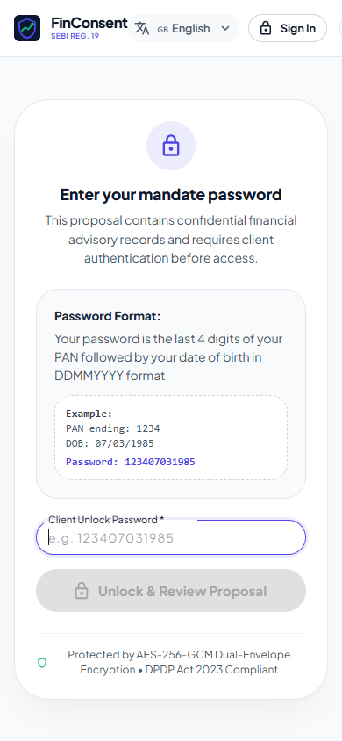
CLIENT INTERFACE
The Client Experience: Mobile-First Transparency
Rohan Mehta's smartphone review interface designed for executive clarity on the go.
Key Client-Facing Elements
[1] Direct Magic Link Convenience: Clients tap the link received via email without remembering portal passwords or downloading an app.
[2] Allocation Drift Visualization: High-contrast visual bars illustrate how portfolio risk is being restored (Equity scaling from 65% down to 50%).
[3] Transparent Trade Baskets: Exact share quantities, current market value, ISIN numbers, and rationale displayed clearly (Tata Motors, HDFC Bank -> Bharat Bond, Gold ETF).
[4] Pre-Computed Tax Liability: Displays estimated rupee liability (₹11,440) so the client understands net financial impact before consenting.
Figure 9.1: Rohan Mehta's Mobile Proposal Screen
FinConsent | Statutory RIA Infrastructure • Slide 9 of 29
Notes:
Here is Rohan's actual smartphone review screen. Note how the allocation drift and pre-computed ₹11,440 tax bill are visible before consent.

Slide 10
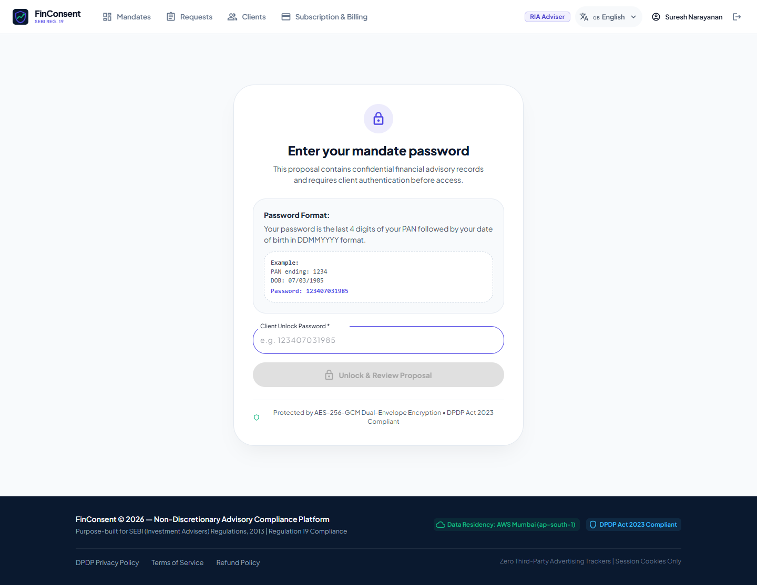
DATA PRIVACY GATE
Mandate Security: Password-Protected Access Gate
Zero sensitive financial disclosure prior to client identity verification.
PAN + DOB Password Mechanism & PBKDF2 Sequence
Sequence: Magic Link ➜ Password Entry (PAN Last 4 + DOB) ➜ PBKDF2 Key Derivation ➜ DEK Unwrap ➜ AES-256-GCM Decrypt
• Zero PII Exposure Prior to Unlock: If a link is leaked or forwarded, the recipient sees only the adviser firm name. Zero holdings or tax figures are emitted.
• Deterministic Verification PIN: Password formatted as Last 4 PAN digits + Date of Birth (DDMMYYYY). Example: Rohan's PAN XXXXX1234F + 14/08/1978 = 123414081978.
• PBKDF2 Key Derivation: Derives 256-bit cryptographic key using 100,000 SHA-256 iterations to unwrap the Data Encryption Key (DEK).
• Strict Online Rate Limiting: Defended online by sliding-window rate limiters (5 failed attempts -> 15 min lockout) and offline by salted PBKDF2.
Figure 10.1: Client Password Gate on Mobile
FinConsent | Statutory RIA Infrastructure • Slide 10 of 29
Notes:
Figure 10.1 shows our password gate. The magic link alone reveals nothing. The client must enter their PAN last 4 and DOB to derive the key.

Slide 11
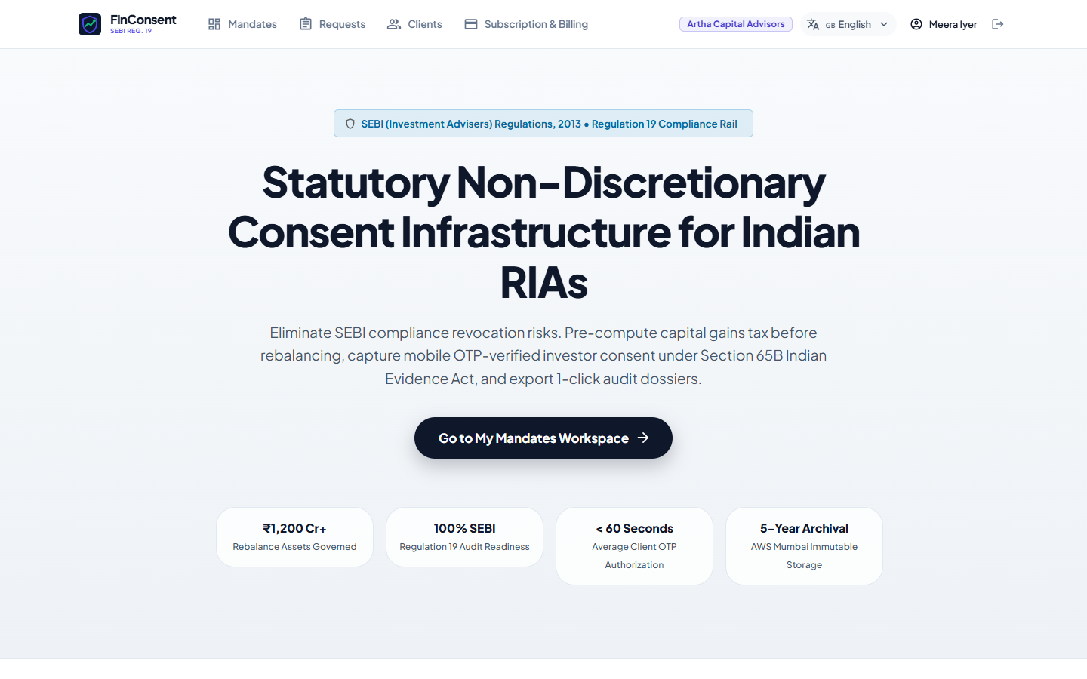
MULTI-TENANCY & RBAC
Authentication, Authorization & Tenant Isolation
Architectural barriers guaranteeing strict multi-tenant privacy across advisory practices.
Tenancy Invariants & Controls
• Firm Tenancy Scoping: Every database query for clients, mandates, and audit logs is strictly partitioned by authenticated firm ID (req.user.firmName).
• Zero Cross-RIA Data Leakage: RIA 1 attempting to query Client or Mandate of RIA 2 receives an immediate HTTP 403 Forbidden with zero data disclosure.
• Role-Based Access Control (RBAC): Strict segregation across sebi-ria, hni-client, compliance_officer, admin, and guest personas.
• Privilege Escalation Defense: Client users navigating to advisor creation or billing routes are intercepted by React ProtectedRoute and Express middleware.
Figure 11.1: Security Evidence — Cross-tenant access rejected with HTTP 403 Forbidden.
FinConsent | Statutory RIA Infrastructure • Slide 11 of 29
Notes:
Figure 11.1 demonstrates our tenant isolation test. When an advisor from Firm A attempts to access Firm B's mandate, the API rejects with 403.

Slide 12
CRYPTOGRAPHIC CORE
Data Security Architecture & Dual-Envelope Encryption
Institutional cryptographic defense protecting financial mandates at rest and in transit.
Payload Encryption
• Algorithm: AES-256-GCM
• Unique Key: 256-bit random Data Encryption Key (DEK) per mandate
• IV: 12-byte random initialization vector
• Auth Tag: 16-byte authentication tag ensuring anti-tampering.
Dual Key Wrapping
• Server Wrapping: DEK encrypted with isolated Server Master Key (SERVER_MASTER_KEY) for RIA dashboard access.
• Client Wrapping: DEK encrypted with PBKDF2(PAN_last_4 + DOB, 100k rounds).
• Zero Plaintext: Neither plaintext DEK nor password stored in database.
Transit & Storage
• Magic Token Hashing: 256-bit token stored strictly as SHA-256 digest in database.
• In-Transit Security: Forced TLS 1.3 with Helmet HSTS (1-year max-age: 31,536,000s).
• Sanitized Logs: Credentials, OTPs, and tokens scrubbed from all logs.
FinConsent | Statutory RIA Infrastructure • Slide 12 of 29
Notes:
Dual-envelope encryption ensures that even if database records are compromised, financial payloads cannot be decrypted without the Server Master Key or client password.

Slide 13
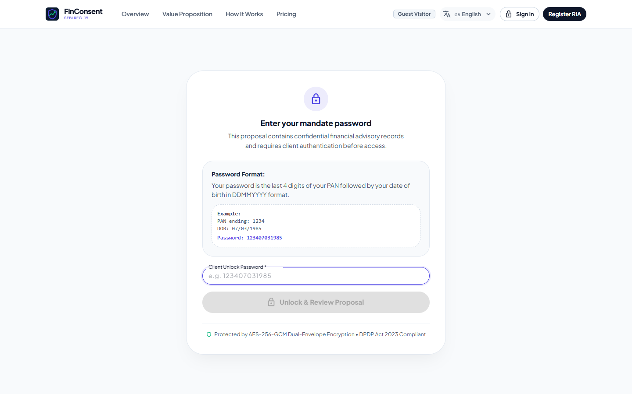
CONSENT VERIFICATION
OTP & Consent Integrity: Anti-Tamper Authorization
Statutory verification guaranteeing explicit non-discretionary client approval.
Statutory Authorization Safeguards
• Mandatory Declarations: Clients must actively check 3 statutory declarations (Regulation 19 Informed Consent, Capital Gains Acceptance, Section 63 BSA Evidence).
• Dynamic 6-Digit OTP: Generated via CSPRNG with 5-minute Time-To-Live (TTL); delivered via registered email and in-app display (SMS disabled by policy).
• 3-Attempt Brute-Force Lockout: Maximum 3 attempts allowed. A 3rd failed attempt immediately locks verification and burns the token (HTTP 429).
• Single-Use Atomic Revocation: The instant consent succeeds, the magic token is burned. Re-accessing returns HTTP 410 Gone, preventing replay attacks.
Figure 13.1: 6-Digit Mobile OTP Modal with 5-minute statutory timer.
FinConsent | Statutory RIA Infrastructure • Slide 13 of 29
Notes:
Figure 13.1 displays the client OTP modal. Notice the 3 statutory checkboxes that must be acknowledged before the 6-digit OTP can be verified.

Slide 14
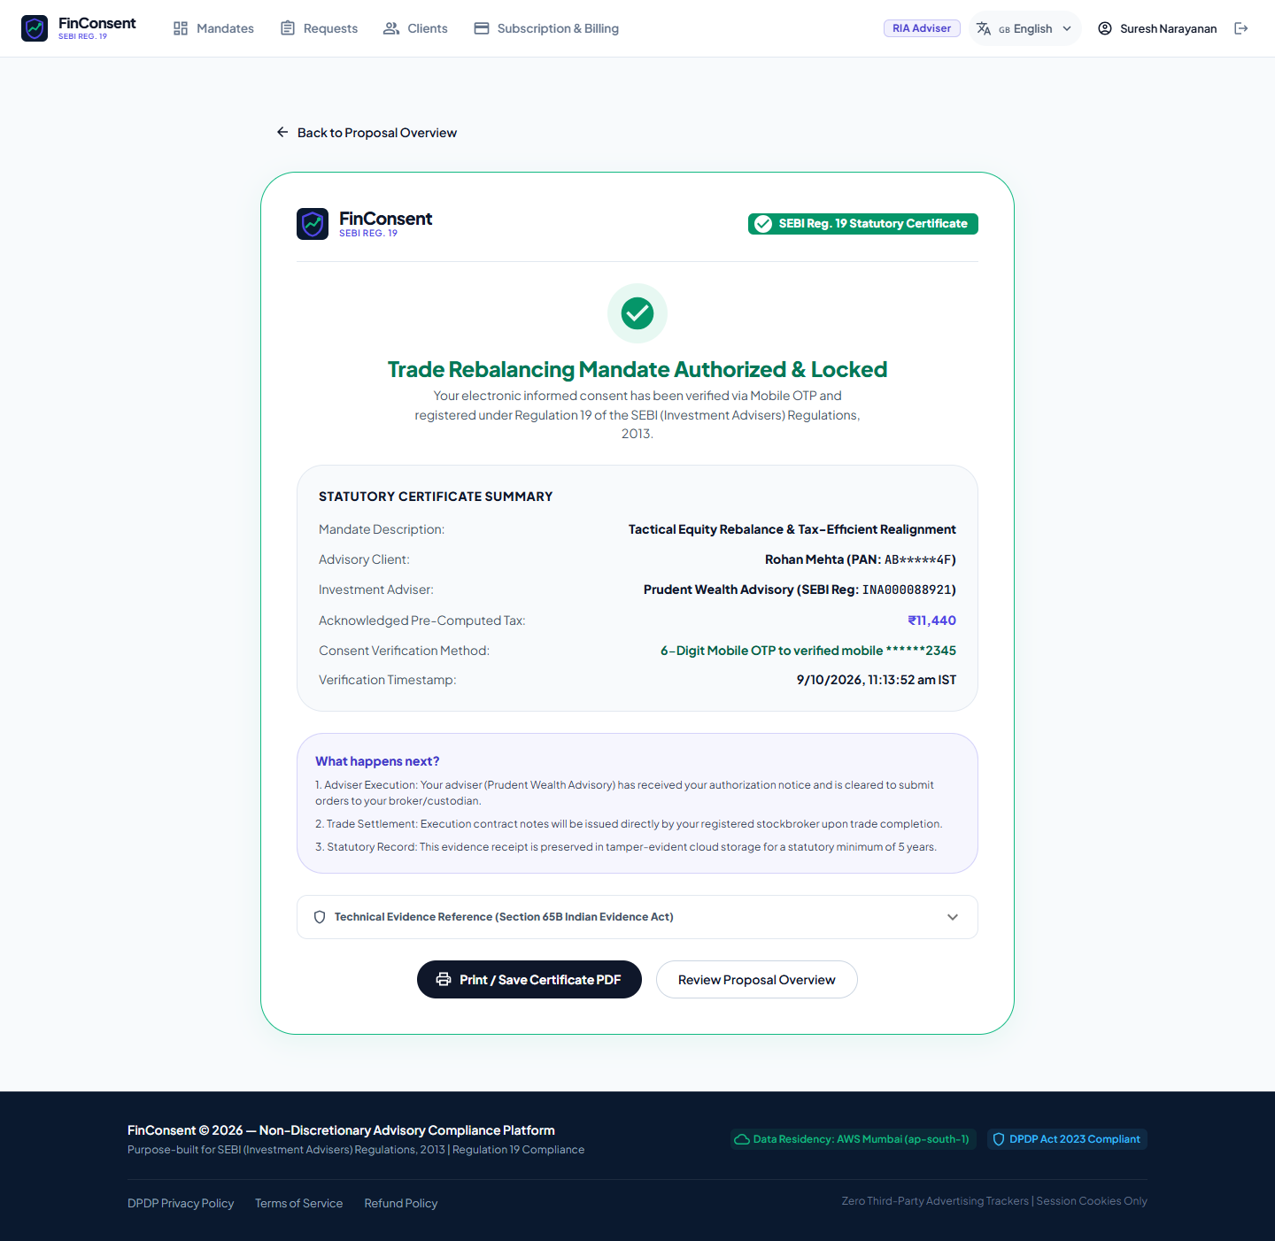
AUDIT INFRASTRUCTURE
Audit Trail & Compliance Evidence: Cryptographic Proof
Chained SHA-256 audit ledger meeting Section 63 BSA and SEBI Regulation 19 standards.
Legal Admissibility & Hash Chaining
• Forward Hash Chaining: Each log entry hashes the previous record: payloadHash = SHA256(prevHash + timestamp + event + payload). Any retroactive tampering breaks the entire chain.
• Section 63 BSA Certificate: Captures client device IP (RFC 5737 203.0.113.12), browser User-Agent, exact IST timestamp, and masked PAN (XXXXX1234F).
• 5-Year Regulatory Preservation: Designed to satisfy SEBI Regulation 19 mandatory 5-year retention requirements for investment advice and rationale.
• Verified Disaster Recovery: Non-destructive drill restored 1,460 audit logs with zero broken cryptographic hash links.
Figure 14.1: Section 63 BSA / Section 65B Compliance Receipt.
FinConsent | Statutory RIA Infrastructure • Slide 14 of 29
Notes:
Figure 14.1 shows the Section 63 BSA compliance receipt generated at the exact millisecond consent is locked.

Slide 15
STATE MACHINE
Mandate Lifecycle & State Model: Server-Enforced Transitions
Finite-state machine guaranteeing deterministic transitions with zero client-side bypass.
┌────────────────────────────────────────────────────────┐
│ │
▼ │
┌─────────┐ RIA Dispatches Link ┌──────────┐ │
│ DRAFT │ ───────────────────────────────────> │ SENT │ │
└─────────┘ └──────────┘ │
│ │ │
│ │ Client Inputs
│ │ PAN + DOB Password
│ ▼ │
│ ┌──────────┐ │
│ │ VIEWED │ │ (In Review)
│ └──────────┘ │
│ │ │
│ │ 1. Accept Declarations
│ 48-Hour Cutoff │ 2. Verify 6-Digit OTP
│ Elapsed ▼ │
│ ┌───────────┐│
├─────────────────────────────────────────> │ CONSENTED ││ (Immutable Lock)
│ └───────────┘│
│ │
│ Advisory Revocation / Market Drift │
▼ │
┌─────────┐ │
│ REVOKED │ <─────────────────────────────────────────────────┘ (Manual RIA Revoke)
└─────────┘
▲
│ Cutoff Elapsed Prior to Consent
┌─────────┐
│ EXPIRED │ (48h Window Elapsed)
└─────────┘
FinConsent | Statutory RIA Infrastructure • Slide 15 of 29
Notes:
This diagram represents the immutable lifecycle state machine. State transitions can only occur through server-validated cryptographic events.

Slide 16
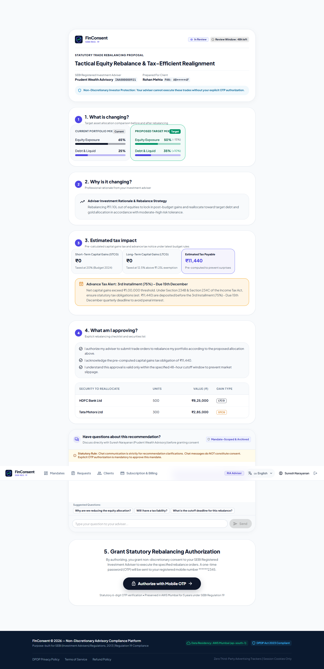
DISCUSSION RAIL
Mandate-Specific Chat: Advisory Clarification vs. Consent
Why in-app discussion is vital for client trust, but legally distinct from trade consent.
Separation of Communication & Consent
• Real-Time Contextual Discussion: Allows clients to ask specific allocation or yield questions directly within the mandate context, eliminating scattered WhatsApp threads.
• Complete Audit Archiving: Every message posted by client or advisor is committed to the immutable audit log under CHAT_MESSAGE_SENT.
• ⚠️ CHAT DOES NOT CONSTITUTE CONSENT: Under SEBI Regulation 19, informal dialogue ('Yes go ahead', 'Proceed') CANNOT authorize transactions.
• Uncompromising Consent Rail: Trade authorization strictly requires formal statutory declaration checkboxes followed by 6-digit OTP verification.
Figure 16.1: Rohan posts an inquiry regarding Tata Motors in the password-protected chat.
FinConsent | Statutory RIA Infrastructure • Slide 16 of 29
Notes:
In Figure 16.1, Rohan asks: 'Why sell Tata Motors now?'. Suresh clarifies directly inside the secure mandate. Crucially, chat dialogue never substitutes for OTP consent.

Slide 17
TAX ENGINE
Tax-Impact Transparency: Finance Act 2024 Engine
Pre-trade capital gains tax visibility eliminating investor surprise liabilities.
Component | Statutory Rate | Taxable Base | Estimated Tax
STCG (Tata Motors) | 20.0% (Sec 111A) | ₹55,000 | ₹11,000
LTCG (HDFC Bank) | 12.5% (Sec 112A) | ₹1,25,000 (Exempt) | ₹0
Health & Educ. Cess | 4.0% on Base Tax | On ₹11,000 | ₹440
Total Estimated Tax | Finance Act 2024 | Pre-Trade Calc | ₹11,440
Quarterly Advance Tax Schedule (Sec 208 & 234C)
• 1st Installment (15%): On or before 15th June
• 2nd Installment (45%): On or before 15th September
• 3rd Installment (75%): On or before 15th December
• 4th Installment (100%): On or before 15th March
• Proviso to Section 234C: Relieves penal interest for installments prior to the capital gains realization date if remaining tax is paid in subsequent installments.
• Tax Note: Excludes individual surcharges (up to 15% on equity capital gains) and prior carried-forward losses. Annual LTCG exemption of ₹1,25,000 applied under Section 112A.
FinConsent | Statutory RIA Infrastructure • Slide 17 of 29
Notes:
This native table shows the verified tax model: ₹11,000 STCG + ₹0 LTCG (exempt under ₹1.25L) + ₹440 cess = ₹11,440. On the right is the advance tax installment calendar.

Slide 18
ACCESSIBILITY & I18N
Multilingual Localization Capability: 8 Languages
Delivering advisory transparency in regional and international languages.
8 Fully Supported Languages Across Client & Advisor Portals
[ English (en) ] [ हिंदी (hi) ] [ தமிழ் (ta) ] [ বাংলা (bn) ]
[ ગુજરાતી (gu) ] [ Deutsch (de) ] [ 日本語 (ja) ] [ 한국어 (ko) ]
Financial Invariant: Standardized ASCII Numerals Across All Locales
• Western Arabic Digits (0-9): Under regulatory standards, all rupee amounts (₹), trade quantities, percentages, and ISIN codes remain strictly in ASCII English numerals across all locales, eliminating ambiguity during legal disputes.
• Universal Accessibility: HNIs review proposals, disclosures, and receipts in their preferred language while financial terms remain standardized.
• Seamless Profile Toggling: Advisers and clients switch languages seamlessly via navigation bar or profile settings.
FinConsent | Statutory RIA Infrastructure • Slide 18 of 29
Notes:
FinConsent supports 8 languages while strictly enforcing ASCII numerals for all financial figures to avoid dispute ambiguities.

Slide 19
SYSTEM TOPOLOGY
Technical Architecture: Security & Service Boundaries
High-level system topology illustrating frontend, API, security engine, and storage tiers.
┌────────────────────────────────────────────────────────────────────────────────────────┐
│ CLIENT & ADVISOR CLIENTS │
│ • Desktop Advisory Hub (React 18 / MUI / Vite) • Mobile Client Review (360px) │
└───────────────────────────────────────────▲────────────────────────────────────────────┘
│ HTTPS / TLS 1.3 (Helmet HSTS)
┌───────────────────────────────────────────▼────────────────────────────────────────────┐
│ API GATEWAY & SECURITY MIDDLEWARE │
│ • Express REST API (Node.js ESM) • CORS Strict Whitelist │
│ • JWT Auth & TOTP Staff MFA • Distributed Sliding Rate Limit│
│ • Tenancy Scoping Middleware (Firm Isolation) • Input Sanitization & Masking │
└───────────────────────────────────────────▲────────────────────────────────────────────┘
│
┌───────────────────────────────────────────▼────────────────────────────────────────────┐
│ FINCONSENT CORE BUSINESS ENGINES │
│ • Mandate State Machine Engine • Finance Act 2024 Tax Engine │
│ • Dual-Envelope AES-256-GCM Crypto Engine • PBKDF2 Client Key Derivation │
│ • In-App Mandate Clarification Chat Rail • OTP Verification & Lockout │
└───────────────────────────────────────────▲────────────────────────────────────────────┘
│
┌───────────────────────────────────────────▼────────────────────────────────────────────┐
│ PERSISTENT DATA & AUDIT TIERS │
│ • MongoDB Atlas (AWS Mumbai ap-south-1) • Dedicated SERVER_MASTER_KEY │
│ • Append-Only SHA-256 Chained Audit Ledger • Point-in-Time Recovery (PITR) │
└────────────────────────────────────────────────────────────────────────────────────────┘
FinConsent | Statutory RIA Infrastructure • Slide 19 of 29
Notes:
This architectural topology illustrates the tier separation between frontend, API gateway, core engines, and persistent data tiers in AWS Mumbai.

Slide 20

THREAT MODELING
Security Threat Scenarios & Evidenced Protections
Proven runtime boundary enforcement against malicious and accidental vectors.
Threat Modeling & Architectural Defenses
• Credential Stuffing & OTP Brute-Force: Sliding-window rate limiters block rapid bursts; 3 failed OTPs permanently lock the token (HTTP 429).
• Cross-Tenant IDOR & Privilege Escalation: Tampering with mandate or client UUIDs across RIA practices rejected with HTTP 403 Forbidden.
• Expired / Replay Attacks: Opening links past the 48-hour cutoff or after successful consent returns HTTP 410 Gone / Revoked.
• Token Sniffing & Database Breaches: Plaintext magic tokens are never persisted in the database (stored strictly as SHA-256 hashes).
Figure 20.1: Security Evidence — OTP lockout engaged after 3 failed verification attempts.
FinConsent | Statutory RIA Infrastructure • Slide 20 of 29
Notes:
Figure 20.1 shows our automated security test verifying that after 3 failed OTP attempts, verification is permanently locked.

Slide 21
EVIDENCE BASE
Operational & Testing Validation: Grounded in Real Runs
Concrete evidence demonstrating zero regressions across automated and browser tests.
230 / 230
Automated Tests Passing
17 test suites running across tax calculation, security, RBAC, i18n, and API regressions (100% pass rate).
81
Screenshots Captured
42 baseline, 25 security, and 14 mandate-security screenshots verifying desktop and mobile viewports.
1,460
Records Disaster Drill
Synthetic non-destructive restore drill verified 1,460 audit logs with zero broken cryptographic hash links.
0
Broken Hash Chains
Full mathematical continuity verified across all state changes, guaranteeing tamper-evident audit records.
FinConsent | Statutory RIA Infrastructure • Slide 21 of 29
Notes:
All 230 Vitest tests pass with 0 regressions. 81 screenshots verify UI across roles, and 1,460 audit records verified in disaster recovery.

Slide 22
INFRASTRUCTURE
Deployment Architecture: Indian Data Sovereignty
Compliance with SEBI Cybersecurity Framework (CSCRF) and DPDP directives.
Territorial Data Residency (ap-south-1)
All primary databases, cryptographic keys, and audit ledgers reside exclusively in AWS Asia Pacific (Mumbai) region (ap-south-1) to comply with SEBI CSCRF and DPDP Act directives.
Multi-Stage Production Containers
Hardened Docker multi-stage build packaging optimized Vite static assets and hardened Express Node.js ESM runtime with zero external runtime package installations.
Orchestration & Health Probes
Production container environment with automated /api/health and /api/ready probes reporting database connectivity, readiness, and active tenancy health.
Cryptographic Key Isolation
Server Master Key (SERVER_MASTER_KEY) isolated from application authentication secrets (JWT_SECRET); zero third-party advertising tracking or analytics beacons.
FinConsent | Statutory RIA Infrastructure • Slide 22 of 29
Notes:
Data sovereignty is absolute: all data resides in AWS Mumbai (ap-south-1). No data leaves Indian territory.

Slide 23
BUSINESS IMPACT
Business Value & Practice Impact for Advisory Firms
Quantifiable efficiency, compliance security, and investor satisfaction gains.
100% Inspection-Ready
Instantly downloadable Section 63 BSA / Section 65B compliance dossiers provide contemporaneous regulatory evidence.
• Replaces weeks of manual audit trail compilation with instantaneous verification.
• Safeguards RIA practice and principal officers against claims of unauthorized or discretionary trading.
Zero Tax Shocks
Complete pre-trade capital gains tax visibility eliminates investor surprise liabilities.
• Proactively alerts clients to quarterly advance tax obligations under Section 208 and 234C.
• Elevates advisory relationship from administrative chasing to high-trust strategic wealth planning.
< 2h Turnaround
Accelerates client review and consent turnaround to under 2 hours on mobile.
• Minimizes market slippage during high-volatility rebalancing windows.
• Secure password-protected magic link delivery without requiring client app installation.
FinConsent | Statutory RIA Infrastructure • Slide 23 of 29
Notes:
The impact is threefold: 100% inspection-ready compliance, zero client tax shocks, and consent turnaround in under two hours.

Slide 24
THE TRANSFORMATION
The Transformation: What Changes for Advisor and Client
Comparing legacy advisory friction with FinConsent's institutional digital rail.
Advisory Dimension | Legacy Process (Informal / Dispersed) | FinConsent Institutional Rail
Trade Authorization | ✗ Fragmented WhatsApp texts or email replies; rejected during SEBI inspection. | ✓ Explicit statutory declarations + 6-digit OTP verification with 48h market window.
Capital Gains Tax | ✗ Post-trade surprise tax bill; penal interest under Sections 208 & 234B/C. | ✓ Pre-trade Finance Act 2024 calculation with quarterly advance tax alert.
Client Security | ✗ Confidential trade details sent over plain WhatsApp or email attachments. | ✓ Dual-envelope AES-256-GCM encryption with PAN+DOB client password gate.
Audit & Legal Trail | ✗ Scattered screenshots and PDFs; inadmissible under Section 63 BSA. | ✓ Append-only forward SHA-256 ledger emitting certified Section 63 BSA compliance dossier.
FinConsent | Statutory RIA Infrastructure • Slide 24 of 29
Notes:
This comparison highlights the operational leap across authorization, tax visibility, data security, and evidentiary admissibility.

Slide 25
APPENDIX A
Technical Deep-Dive: Cryptographic Invariants & Key Derivation
Formal mathematical specifications for envelope encryption and PBKDF2 KDF.
Cryptographic Implementation Specifications
• Symmetric Cipher: AES-256-GCM (Galois/Counter Mode) with 12-byte random IV and 16-byte authentication tag ensuring anti-tampering.
• Key Derivation Function: PBKDF2 with SHA-256 digest, 100,000 rounds in production (1,000 in test mode), and 16-byte random salt.
• Key Derivation Input: Normalized string concatenation of PAN last 4 digits + DOB in DDMMYYYY format (e.g. '123414081978').
• Dual Wrapping Invariant: Server DEK wrapped with isolated SERVER_MASTER_KEY; Client DEK wrapped with Client Derived Key.
• Zero Secret Storage: The database never persists client plaintext passwords, unencrypted DEKs, or plaintext magic tokens.
FinConsent | Statutory RIA Infrastructure • Slide 25 of 29
Notes:
Appendix A outlines the formal cryptographic specifications: AES-256-GCM, 100,000 rounds of PBKDF2, and zero plaintext secret storage.

Slide 26
APPENDIX B
Technical Deep-Dive: Role-Based Authorization Matrix
Detailed API permission matrix with monospaced endpoints and coloured permission chips.
API Route / Resource | RIA (sebi-ria) | Client (hni-client) | Compliance Officer
/api/mandates (POST / Create) | ALLOWED (Scoped to firm) | FORBIDDEN (HTTP 403) | FORBIDDEN (Read-only)
/api/mandates/:id/dispatch | ALLOWED (Own mandates only) | FORBIDDEN (HTTP 403) | FORBIDDEN (Read-only)
/api/public/mandates/:t/unlock | N/A (Uses dashboard) | ALLOWED (Valid password) | N/A (Uses compliance hub)
/api/public/mandates/:t/verify-otp | FORBIDDEN (HTTP 403) | ALLOWED (Valid 6-digit OTP) | FORBIDDEN (HTTP 403)
/api/requests (Scrutiny Hub) | ALLOWED (Submit requests) | ALLOWED (View own requests) | ALLOWED (Full Adjudication)
FinConsent | Statutory RIA Infrastructure • Slide 26 of 29
Notes:
Appendix B provides the role-based access matrix. Every API endpoint enforces strict authorization rules.

Slide 27
APPENDIX C
Technical Deep-Dive: Audit Schema & Section 63 BSA Admissibility
Evidentiary record structures required by Indian legal standards.
Section 63 BSA Mandatory Evidentiary Attributions
1. Origin Identification: Client IP Address (RFC 5737 203.0.113.12) and browser User-Agent recorded at execution time.
2. Synchronized Timestamp: Server-side NTP timestamping localized to Indian Standard Time (IST).
3. Hash Integrity Seal: SHA-256 payloadHash computed over the immutable consent certificate.
4. Device Custody Proof: Evidence that the computer system was operating properly during record generation.
5. Regulation 19 Admissibility: Cryptographically chained forward hashes guarantee zero retroactive modifications.
FinConsent | Statutory RIA Infrastructure • Slide 27 of 29
Notes:
Appendix C details the exact criteria required under Section 63 of Bharatiya Sakshya Adhiniyam, 2023 for electronic records to be admitted in court.

Slide 28
APPENDIX D
Operational Considerations: Implemented State vs. Roadmap
Clear demarcation between current production capabilities and future roadmap milestones.
Implemented Capabilities (Now)
✓ Full non-discretionary mandate formulation & tax engine
✓ AES-256-GCM dual-envelope encryption & PBKDF2 password gate
✓ 256-bit magic links with SHA-256 database hashing & 48h cutoff
✓ In-app mandate chat with explicit non-consent separation
✓ Section 63 BSA compliance receipts with SHA-256 hash chaining
✓ Multi-tenant isolation, RBAC, staff TOTP MFA, and rate limiting
✓ 8 supported languages with English ASCII numerals.
Documented Scope & Future Roadmap (Next)
• Production TRAI DLT SMS Gateway: Current setup delivers OTP via email/in-app; commercial SMS requires TRAI DLT aggregator.
• WhatsApp Channel Delivery: Secure email magic links active; WhatsApp Business API delivery on product roadmap.
• CloudHSM Key Management: Envelope Server Master Key isolated in env config; AWS CloudHSM/KMS recommended for banking tiers.
• Direct Broker Execution: FinConsent intentionally halts at locked consent; API execution via brokers on future roadmap.
FinConsent | Statutory RIA Infrastructure • Slide 28 of 29
Notes:
Appendix D provides transparency on implemented features versus roadmap enhancements like WhatsApp delivery and direct broker execution.

Slide 29
PILOT PROPOSAL & NEXT STEPS
Institutional Pilot Proposal & Implementation Roadmap
Structured 4-week pilot deployment for fee-only advisory practices with verified commercial terms.
4-Week Phased Implementation Roadmap
• Week 1: Governance & Setup: Configure SEBI INA registration number (e.g. INA000088921), firm compliance officer contacts, and staff TOTP MFA.
• Week 2: Client Roster Ingestion: Import client profiles with validated PAN syntax (XXXXX1234F), DOB attributes, and rebalance templates.
• Week 3: Controlled Pilot Rebalance: Execute live mandates with 10–25 client families; demonstrate pre-trade tax visibility and mobile OTP consent.
• Week 4: Compliance Review & Scale: Audit Section 63 BSA receipts with firm Compliance Officer; transition practice to automated FinConsent workflows.
Verified Commercial Terms & Inquiries
₹2,499 / Month (+ 18% GST)
• Pro Practice Plan: Includes up to 100 active mandates/month, unlimited client roster, complete tax engine, and 5-year audit ledger retention.
• Zero Execution Surcharges: FinConsent charges zero basis points (bps) or AUM percentages. Pure software utility model.
• Demonstration Workspace: Prudent Wealth Advisory (SEBI Reg: INA000088921) with synthetic demonstration data.
• Official Inquiries & Onboarding: compliance@finconsent.in
FinConsent | Statutory RIA Infrastructure • Slide 29 of 29
Notes:
To begin, we propose a 4-week pilot starting with 10-25 families. The Pro Practice plan is ₹2,499/month with zero AUM surcharges. Inquiries: compliance@finconsent.in.

