Slide 1

Project Title:
Medbuddy : Optimal Real-Time
Medication Management for the Elderly
Presented By-
Manvi Singh (1032211990) PF-43
Atharva Thorat (1032212077) PF-45
Khilee Singhal (1032212172) PF-50
Guided By- Prof. Laxmi Bhagwat
SOCSE-DCET

Slide 2
Is the project inhouse/industry sponsored : Inhouse
Number of Time Students met the Project Guide : 6 times
Are the slides approved by Project Guide : YES

Slide 3
Index
S.no. | Table of Contents | Page No.
1. | Problem Statement | 09
2. | Literature Survey | 05
3. | Requirements Gathering | 11
4. | Project Timeline | 44
5. | System Design [Team] | 15
6. | System Design [Individually] | 30
7. | Future Aspects | 47
8. | References | 49

Slide 4
Introduction
MedBuddy is a smart healthcare companion app designed to assist elderly patients with poor vision in managing their daily medications. The app addresses common challenges faced by senior citizens, such as missing doses, confusion between pills, and accidental overdosing, by offering an intuitive and accessible solution.
Leveraging technologies like Optical Character Recognition (OCR), Text-to-Speech (TTS), and QR code scanning, MedBuddy allows users to:
Scan medicine labels for automatic identification
Hear their prescription details read out loud
Store and access medical information with ease

Slide 5
Literature Survey
Sr. No. | Publication Title with authors | Publication Year | Positive points of the Publication | Gaps in publication
1. | A Comprehensive Review of Pill Image Recognition [Journal] | 2025 | Surveys advanced computer vision and deep learning models for pill detection & classification Emphasizes image-based medication identification to prevent dosage errors Traces evolution from handcrafted features to CNN-based architectures | Lacks focus on accessibility for elderly users (e.g., voice guidance, simple UI) Does not cover integration with medication workflows (alerts, adherence tracking)
2. | Medication Adherence in the Elderly: A Comprehensive Review [Journal] | 2024 | Analyzes key barriers to elderly medication adherence: cognitive decline, isolation, forgetfulness Provides a framework to understand patient behavior Supports development of targeted solutions like reminder systems | Misses discussion on digital tools like mobile apps and wearable reminders Lacks insight into real-time feedback and personalized scheduling systems

Slide 6
Literature Survey
Sr. No. | Publication Title with authors | Publication Year | Positive points of the Publication | Gaps in publication
3. | Smart Medication Management: Enhancing Medication Adherence with an IoT-Based Pill Dispenser and Smart Cup Authors: Vinay Peddisetti , Joel [Conference] | 2024 | Introduced an IoT-based pill dispenser integrated with a smart cup to enhance medication adherence. | Implementation challenges in diverse healthcare settings not addressed.
4. | Developing an Artificial Intelligence-Driven Nudge Intervention to Improve Medication Adherence Authors:Sumner J. [Conference] | 2023 | Co-developed a digital AI-driven nudge intervention with stakeholders to improve medication adherence. | Focused on initial development stages; lacks long-term efficacy data.

Slide 7
Literature Survey
Sr. No. | Publication Title with authors | Publication Year | Positive points of the Publication | Gaps in publication
5. | Older Adults' Intention to Use Voice Assistants [Journal] | 2023 | Investigates cognitive and psychological factors influencing elderly adoption of voice technologies—relevant for TTS in healthcare. | Doesn't examine integration with real-time reminders or emergency assistance for medication tracking.
6. | Design and Implementation of a Smart Pill Reminder System for Elderly Patients Authors: A. Kumar, S. Patel [Conference] | 2021 | This study presents a smart pill reminder system integrating IoT and mobile technologies to assist elderly patients in medication adherence. The system features real-time alerts and user-friendly interfaces tailored for seniors. | The study lacks integration with voice-assisted technologies, which could further enhance accessibility for visually impaired users.

Slide 8
Research Gap Summary
Elderly Accessibility Overlooked: Limited focus on voice-guided interaction, large-text UI, and cognitive ease in existing systems.
Fragmented Functionality: Most solutions address only one aspect—pill ID, reminders, or TTS—without a unified approach or data inaccuracies during substitutions.
Lack of Real-Time Voice Feedback: Few applications offer real-time TTS confirmation to prevent dosage errors.
Dependence on Internet Connectivity: Minimal research on offline-capable medication management using local databases like SQLite.
Limited Personalization of Reminders: Existing systems rarely adapt schedules based on user behavior or health changes.

Slide 9
Problem Statement
“Elderly patients—especially those with visual or cognitive impairments—struggle with consistent medication adherence due to limited accessibility, fragmented solutions, and dependence on internet-based systems. Existing tools often lack real-time feedback, offline functionality, and personalized scheduling. MedBuddy addresses these challenges through an integrated mobile solution combining OCR for pill detection, text-to-speech for voice feedback, SQLite for offline storage empowering elderly users to manage their medications safely and independently.”

Slide 10
Project Objectives
1. Multi-Modal Medicine Identification {Achieved}
Integrated OCR and QR code scanning for accurate detection of medicine labels and packaging.
Aids elderly users with visual impairments.
2. Text-to-Speech Enabled Interaction {Achieved}
Implemented TTS to read out medicine names, doses, and times.
Ensures clarity and accessibility for visually impaired users.
3. Offline-First Alert System {Achieved}
Built on SQLite, enabling reliable alerts without internet.
Ensures consistent medication adherence.
4. Elderly-Friendly User Interface {Achieved}
Simple UI with large fonts, minimal navigation, and high contrast.
Designed for users with cognitive or visual challenges.
5. Integrated Medicine Tracking {Achieved}
Allows users to log intake history and monitor adherence.
Helpful for self-tracking and caregiver support.

Slide 11
Requirements Gathering
Data Ingestion:
Capture medicine details via OCR from labels or QR codes on packaging.
Extract name, dosage, and schedule information accurately.
Medicine Database and Tracking:
Maintain medicine logs using SQLite for offline access.
Store intake history, dosage times, and missed alerts.
Text-to-Speech (TTS) Module:
Convert medication info into spoken instructions.
Assist users with visual impairments or literacy barriers.
User Interface:
Design an elderly-friendly UI with large buttons, minimal steps, and high-contrast colors.
Enable easy interaction without external help.

Slide 12
System Design [Team]

Slide 13
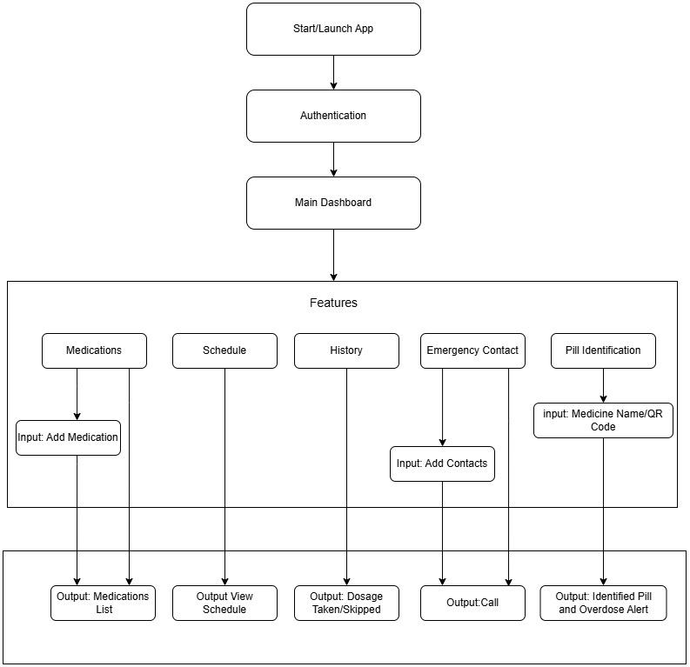
High Level Diagram

Slide 14
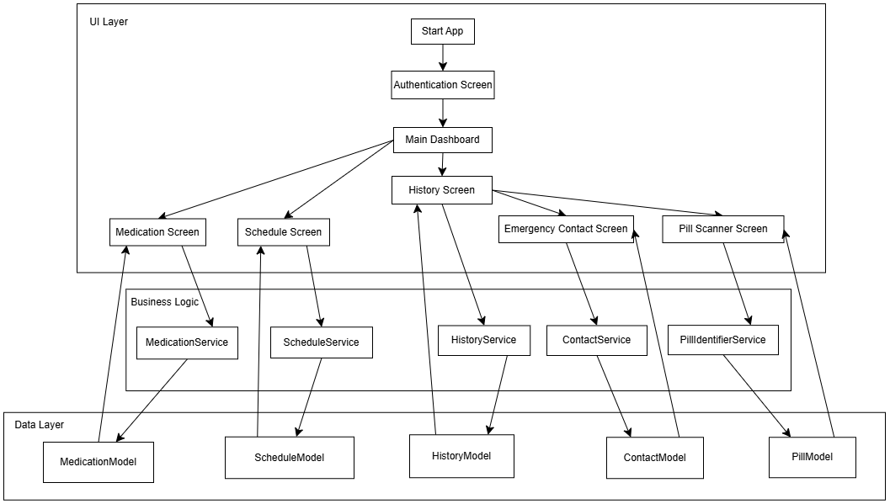
Low Level Diagram

Slide 15
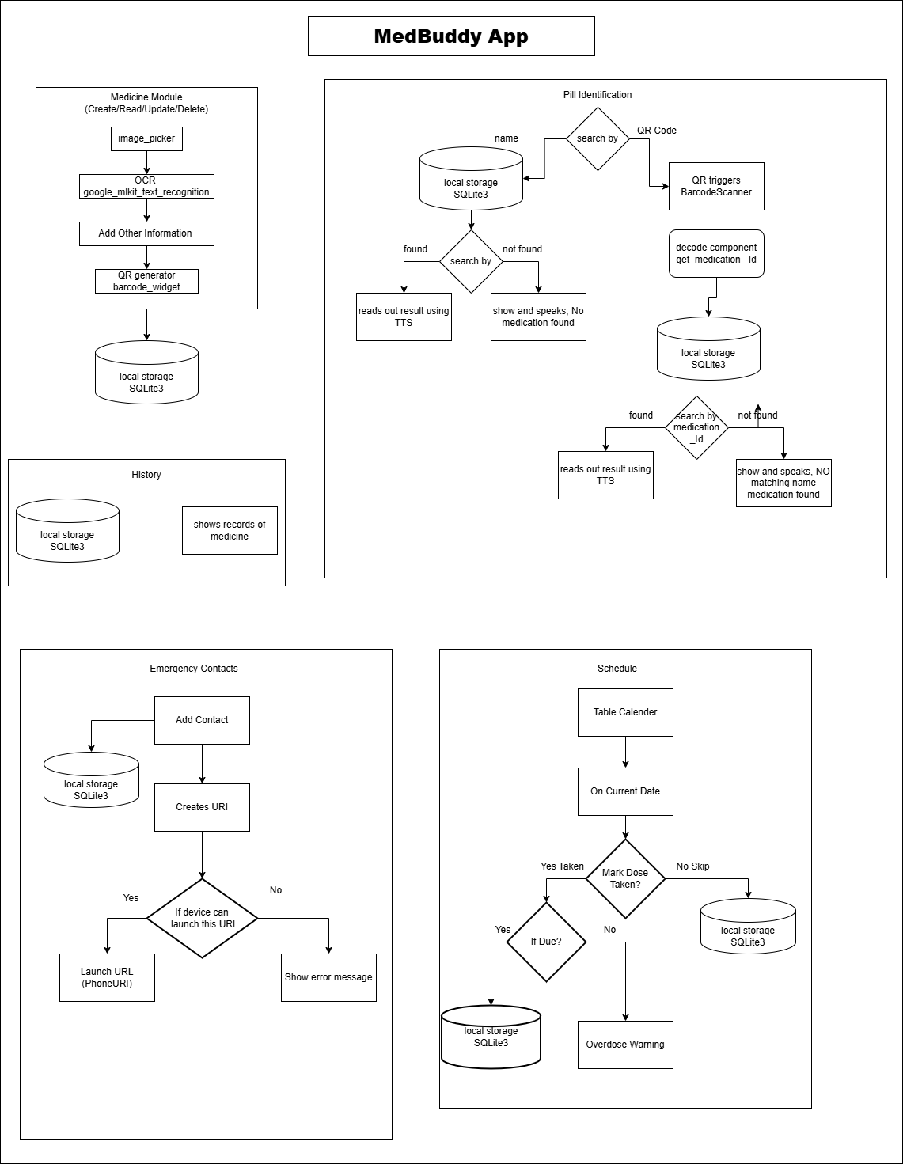
System Architecture Diagram

Slide 16
Implementation of Project [Algorithms, Techniques, and Technologies Used]

Slide 17
Implementation of Project [Algorithms, Techniques, and Technologies Used]
Frontend (Flutter + Dart):-
Flutter SDK (Dart): Cross-platform UI development.
State Management: provider, flutter_bloc – for reactive data flow.
TTS Integration: flutter_tts – speech feedback for accessibility.
UI Features:
table_calendar – schedule view.
image_picker, cached_network_image – image input & caching.
barcode_widget – QR code generation.
Backend (Local Logic & Data Handling):-
Local Storage:
sqlite – medication & schedule database.
shared_preferences, flutter_secure_storage – app config & sensitive data.
OCR & Vision:
google_mlkit_text_recognition – medicine info extraction from images (based on Convolutional Neural Networks.)
QR Code Handling: barcode_scan2 – scan medicine QR for fast identification.
File System Access: path, path_provider – handles local file paths.

Slide 18
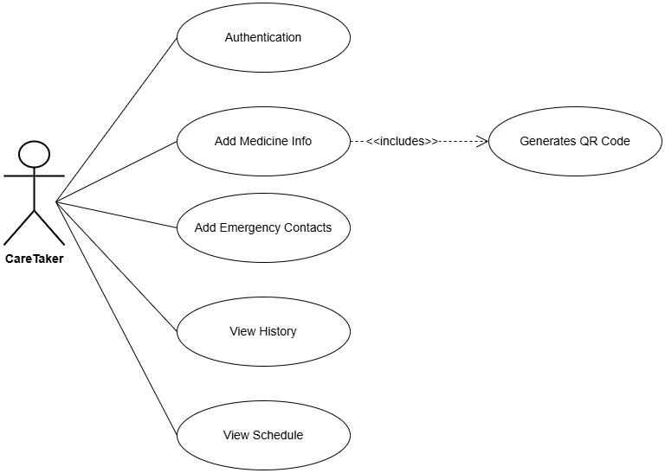
1. UML Diagrams
Caretaker Use Case Diagram

Slide 19
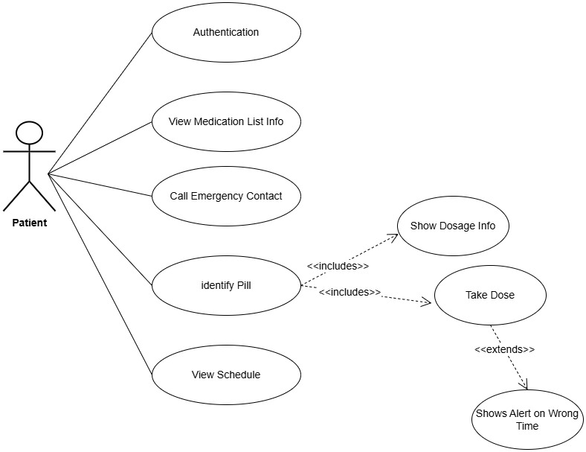
1. UML Diagrams
User Use Case Diagram

Slide 20
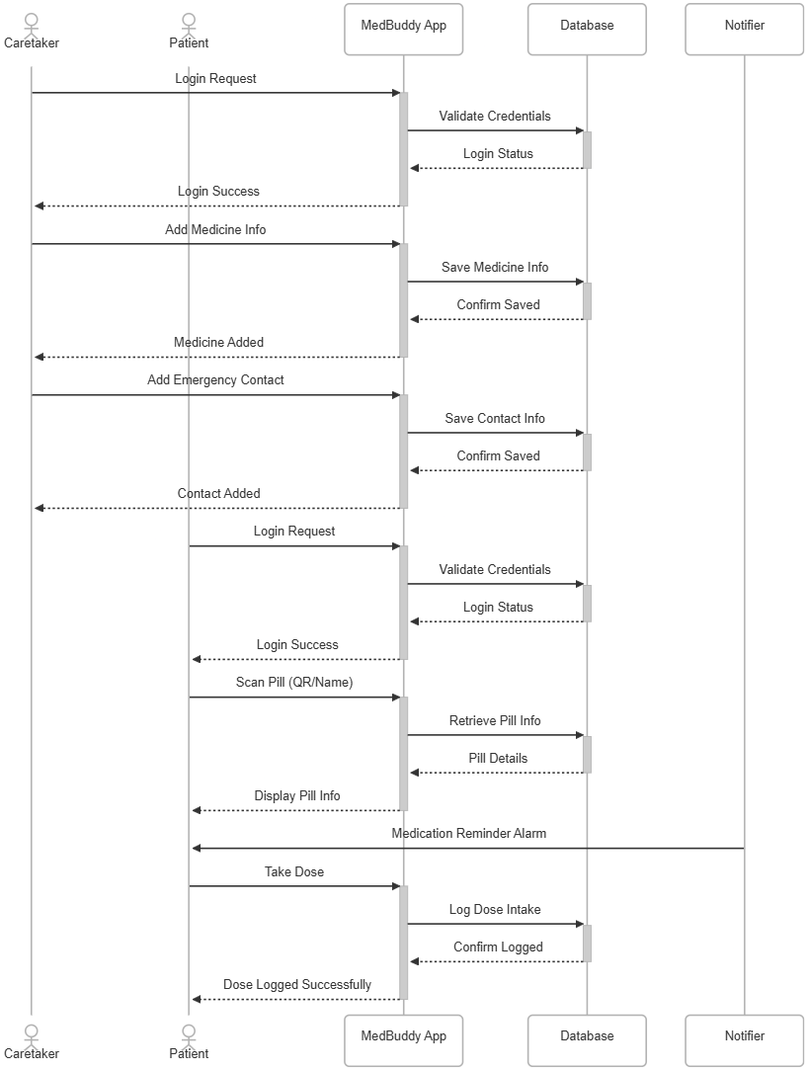
2. Sequence Diagram

Slide 21
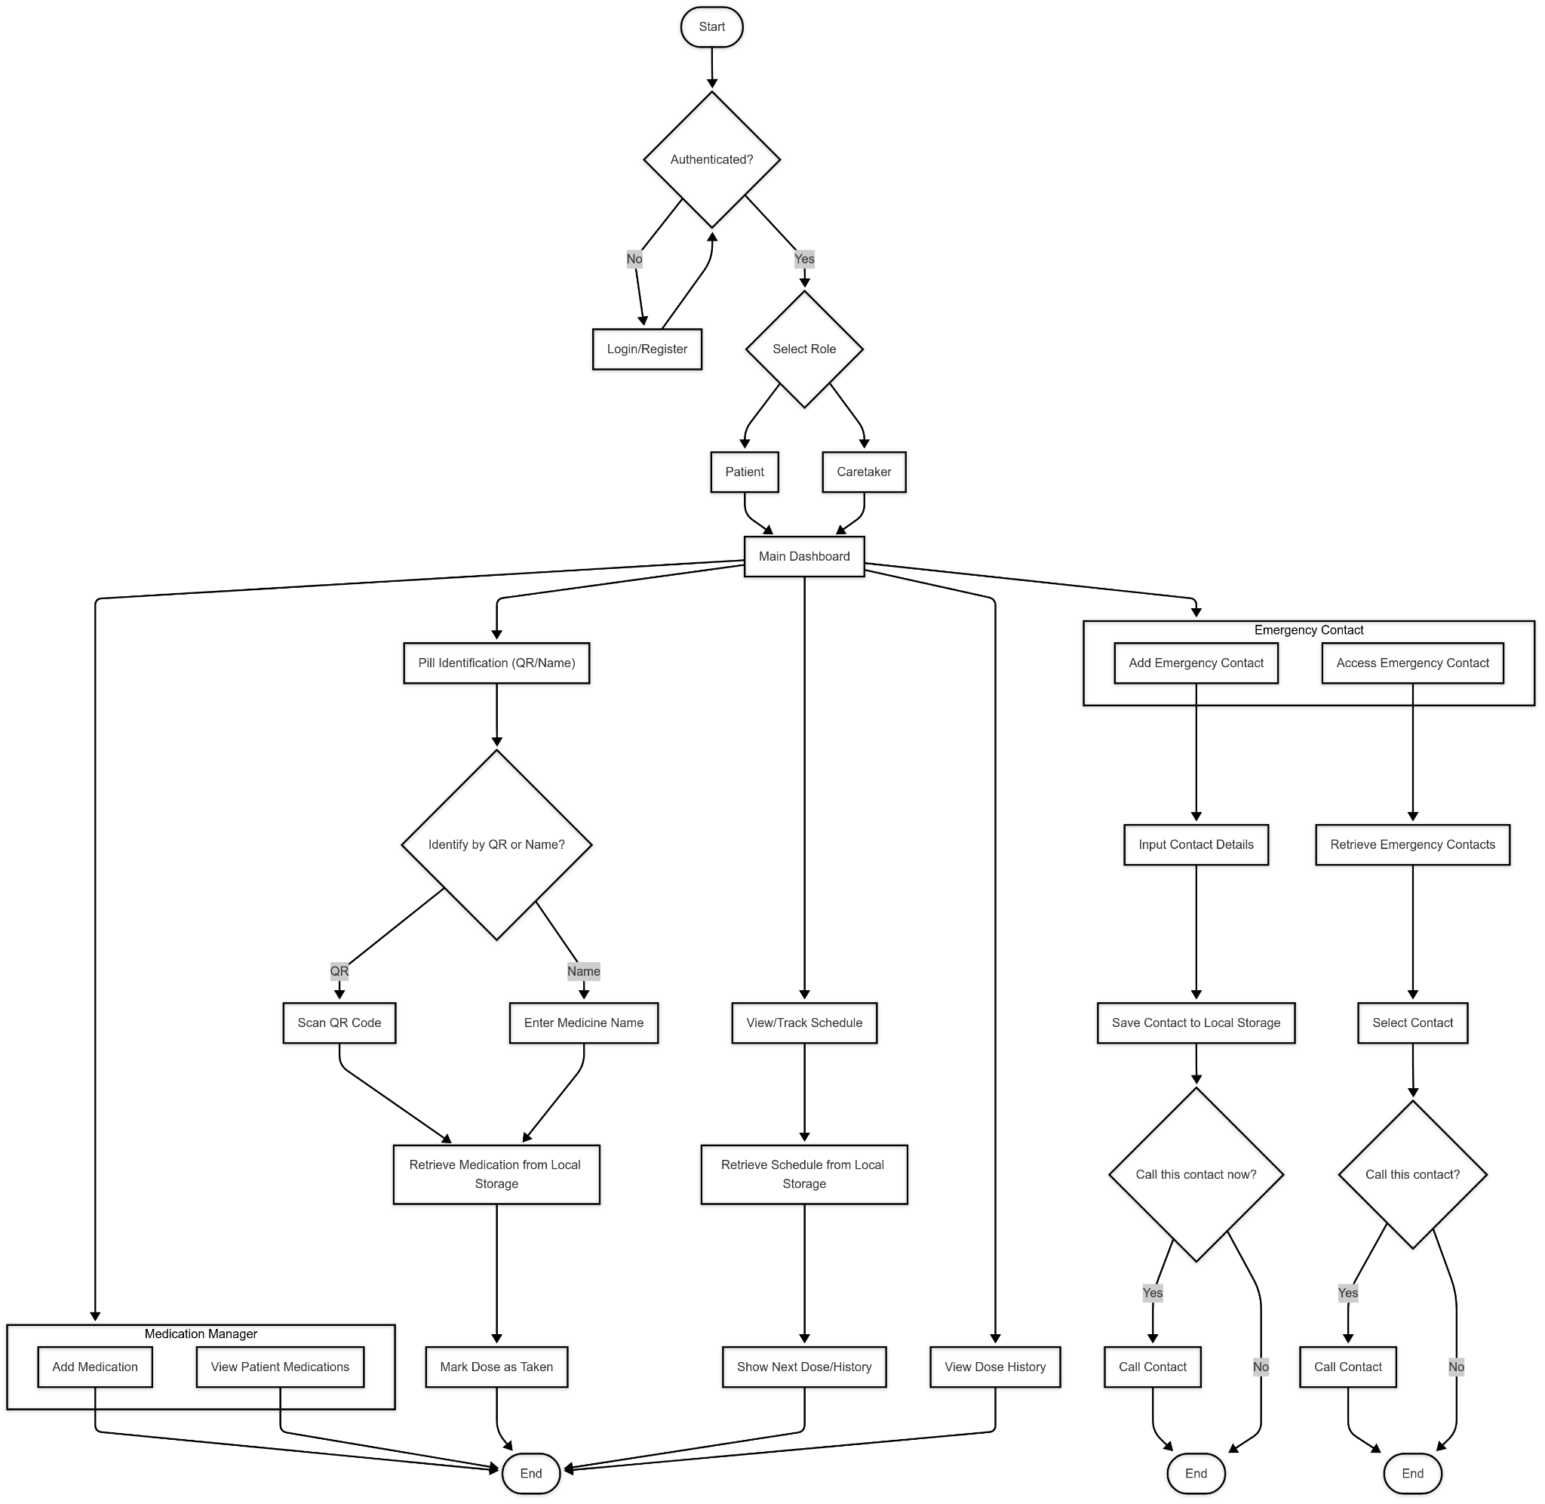
3. Activity Diagram

Slide 22
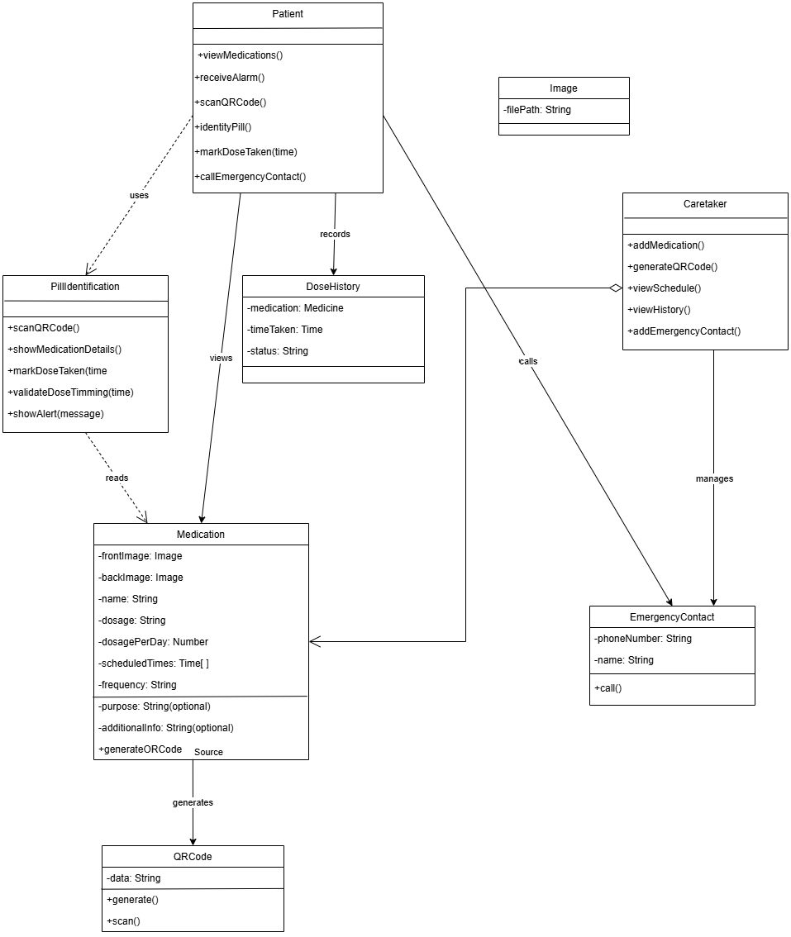
4. Class Diagram

Slide 23
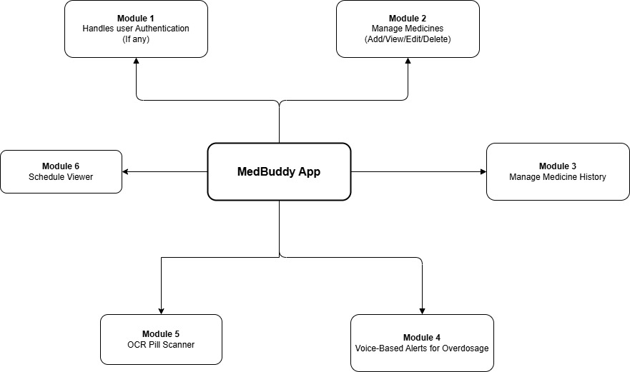
6. Module Diagram

Slide 24
Implementation and Testing
Implementation: The app integrates native device features and third-party packages for medication management. It uses SQLite for offline data storage, image_picker and camera for capturing medication images, and barcode_widget with barcode_scan2 for QR code generation and scanning. flutter_tts adds text-to-speech for accessibility. Custom Dart classes handle CRUD operations, dose tracking, scheduling, and emergency contacts, ensuring modularity and maintainability.
Testing: MedBuddy is tested through unit and integration tests for medication CRUD, dose logging, schedule tracking, and emergency contact features. Real-world scenarios simulate user actions like adding meds, logging doses, and triggering emergency calls. Key validations include preventing duplicates, handling overdose logic, and ensuring data persists across restarts.
Security Aspects: All user data is stored locally using SQLite, with no external sharing. The app requests only essential permissions and confirms sensitive actions like emergency calls and deletions. Future improvements include local database encryption and biometric login. User privacy and data control are core priorities.

Slide 25
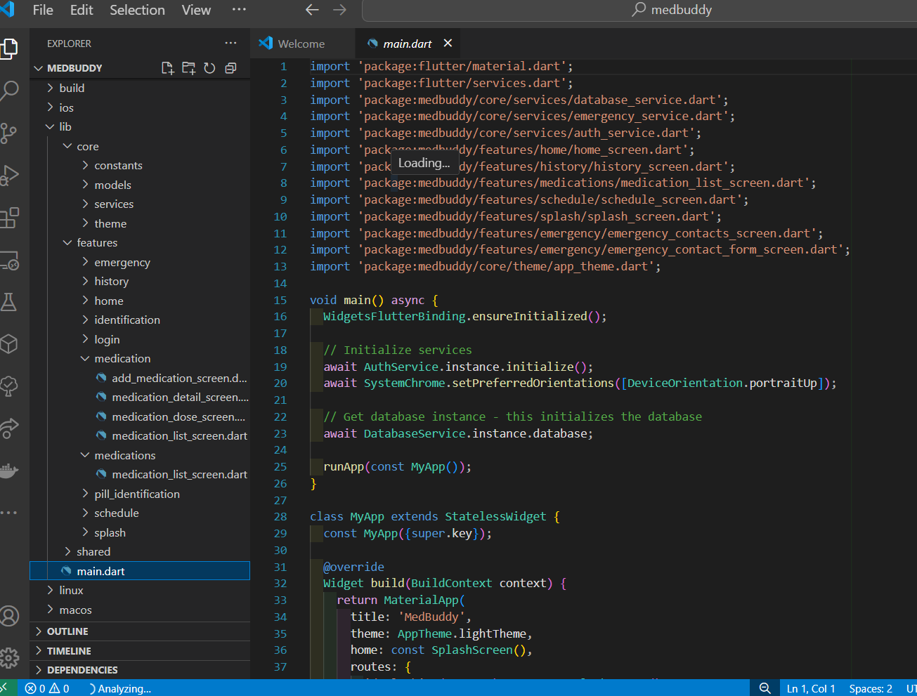
Source Code
Programming Style: The MedBuddy codebase follows a modular and organized programming style. Each feature—such as medication management, pill identification, dose tracking, and emergency contact handling—is encapsulated in its own Dart file or class, promoting separation of concerns and maintainability. Functions and methods are dedicated to specific tasks (e.g., adding, updating, deleting medications; marking doses; handling emergency calls), which improves readability and makes the codebase easier to test and extend. Descriptive variable and method names are used throughout, and the code is organized into logical sections (models, services, features, and widgets), enhancing clarity and facilitating collaboration among developers.

Slide 26
Source Code
Strategies:
User-centered design with intuitive forms and offline data storage (SQLite)
Modular architecture for easy feature expansion and maintainability
Uses camera for pill images, QR scanning, and phone dialer for emergencies
Accessibility via large fonts, simple navigation, and text-to-speech
Continuous improvement based on user feedback
Ethics:
All data stored locally; never shared without user consent
Only essential permissions requested with clear explanations
Accessibility features support inclusive usage
Follows ethical practices: transparency, user autonomy, and data privacy

Slide 27
Deployment Strategies
A straightforward deployment approach for MedBuddy as a mobile app involves distributing the application through the Google Play Store (Android) and Apple App Store (iOS). The app is designed to work entirely offline, utilizing the phone’s local database (such as SQLite) to securely store all user data, including medication schedules, history, and pill identification features.
Scalability: Since all data is stored locally on each user’s device, the app can efficiently serve any number of users without requiring a central server or cloud infrastructure. Updates to the app can be delivered through the app stores, ensuring all users receive new features and bug fixes automatically.
Security: User data never leaves the device, ensuring privacy and security. The app should use secure storage practices for sensitive information and follow platform guidelines for data protection. No internet connection is required for core features, and there is no risk of data exposure through external servers.

Slide 28
Individual Details

Slide 29
Atharva Thorat
Aim : Design and develop intuitive, elderly-friendly interfaces with robust backend integration for medication management.
Objectives:
Frontend Development: Built key screens ( Dashboard, Schedule) in Flutter ensuring intuitive navigation.
Accessibility Implementation: Added text-to-speech, high-contrast UI, and large fonts with dynamic scaling.
Navigation Flow: Designed and tested user journeys for patients/caretakers, ensuring minimal steps.
OCR Integration: Developed frontend camera handling for pill identification fallback.
Testing: Validated UI responsiveness with real-world scenarios (e.g., low vision, emergency calls).

Slide 30
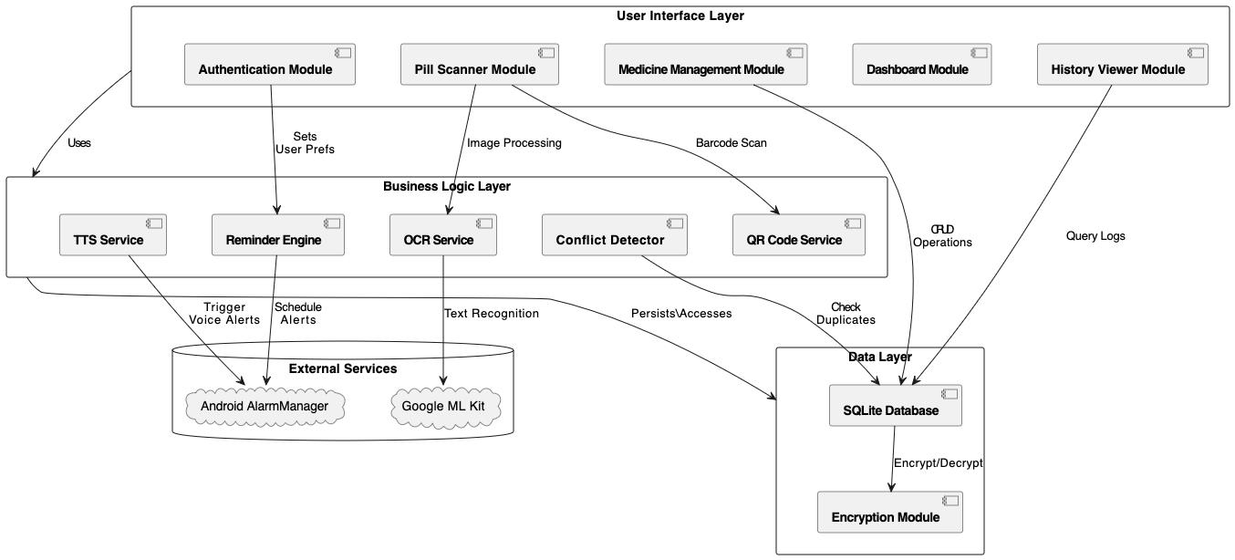
Atharva Thorat
Module Diagram

Slide 31
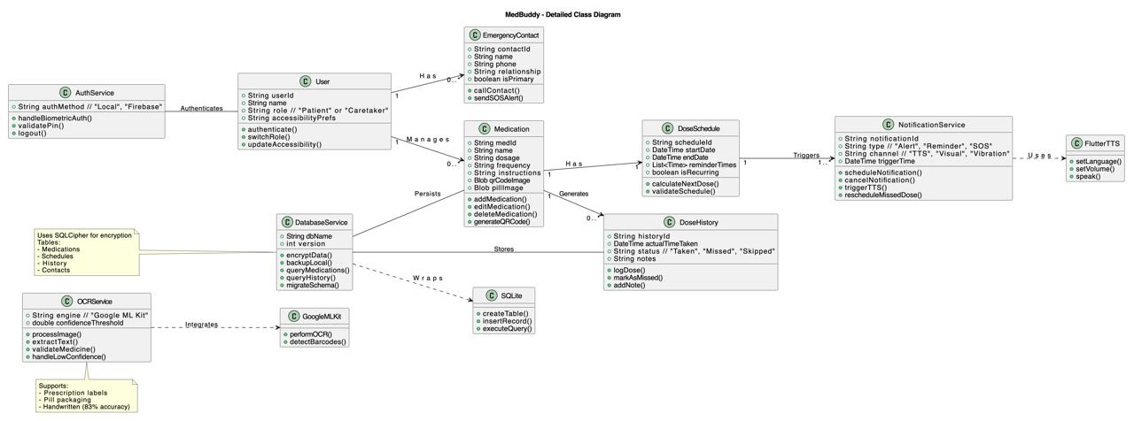
Atharva Thorat
Class Diagram

Slide 32
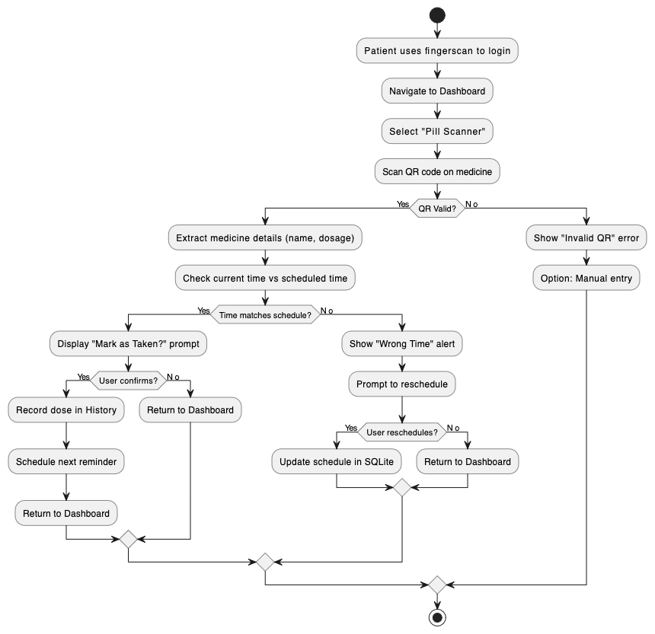
Atharva Thorat
Activity Diagram

Slide 33
Khilee Singhal
Aim : Designed and implemented the core functionality of the app—including medication management, QR code generation, and pill identification—using Flutter’s cross-platform framework and Dart programming language.
Objectives:
App Development: Designed and built all core screens using Flutter framework written in Dart (Medications, QR Code Generation, Pill Identification).
QR Code Integration: Implemented dynamic QR generation and scanning for medication tracking.
Pill Identification Logic: Developed functionality to verify timing and dosage of medicine based on patient input.
Local Storage: Used SQLite to store medicines, schedules, and history offline.
Emergency Contact Logic: Integrated emergency call functionality.
Dose History Management: Logged doses with timestamp and validation.
Tested Data Handling: Built classes like Medication, DoseHistory, and QRCode logic.

Slide 34
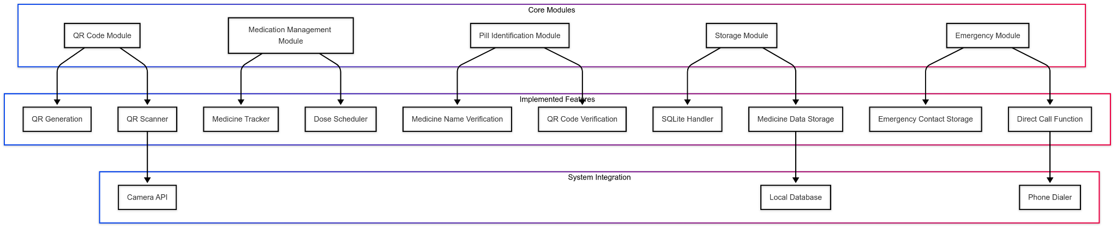
Khilee Singhal
Module Diagram

Slide 35
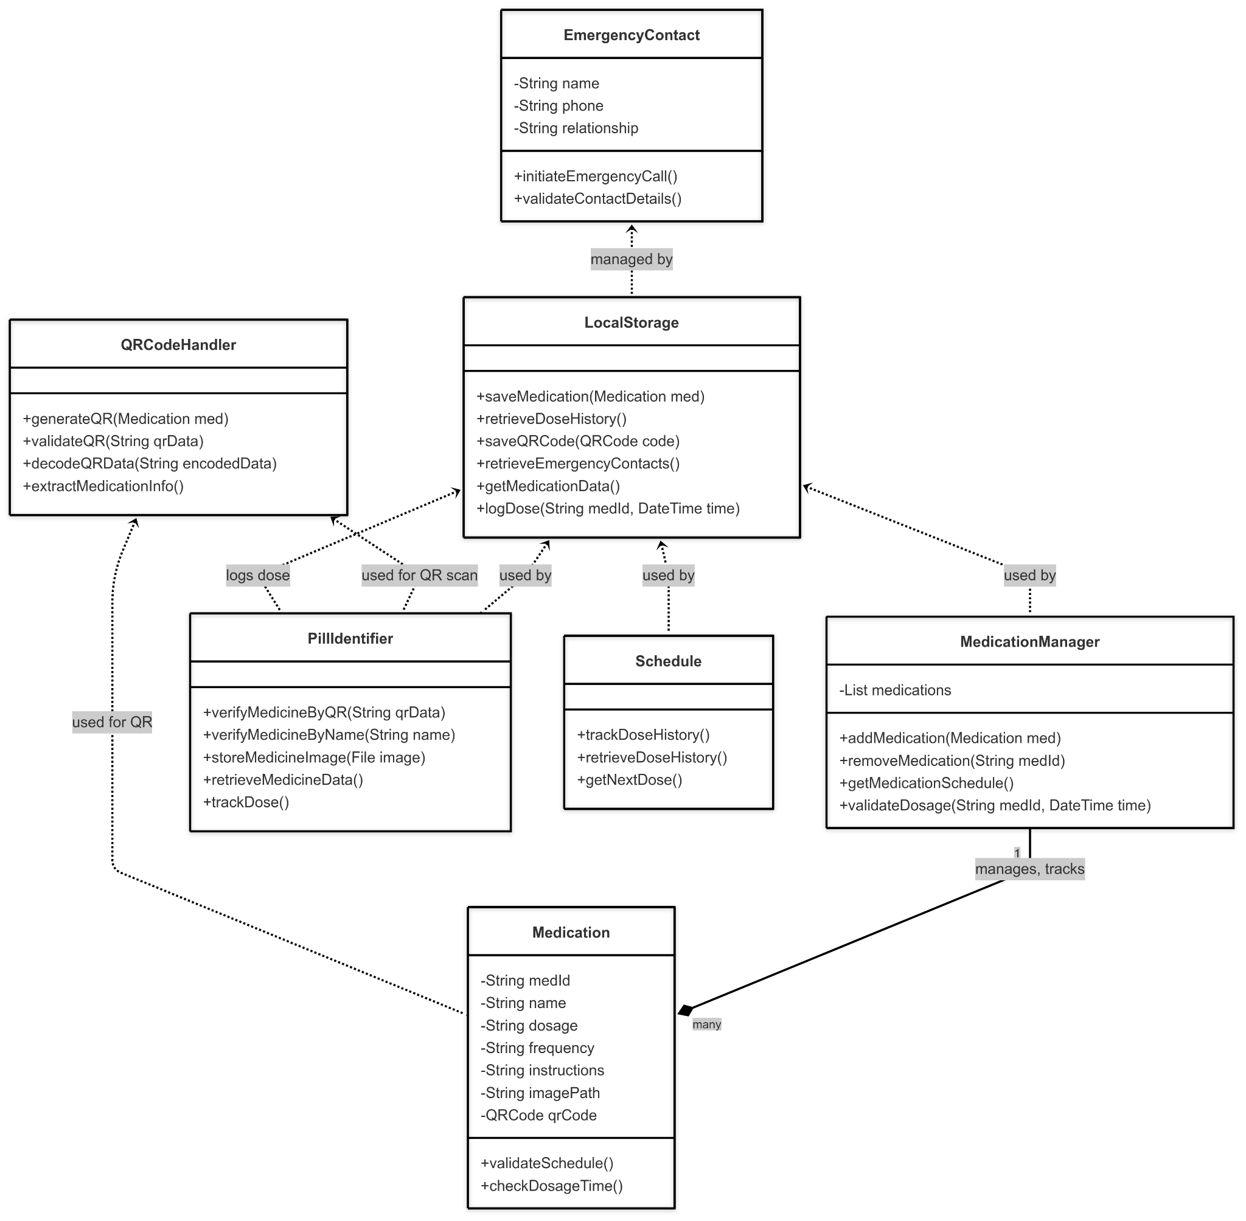
Khilee Singhal
Class Diagram

Slide 36
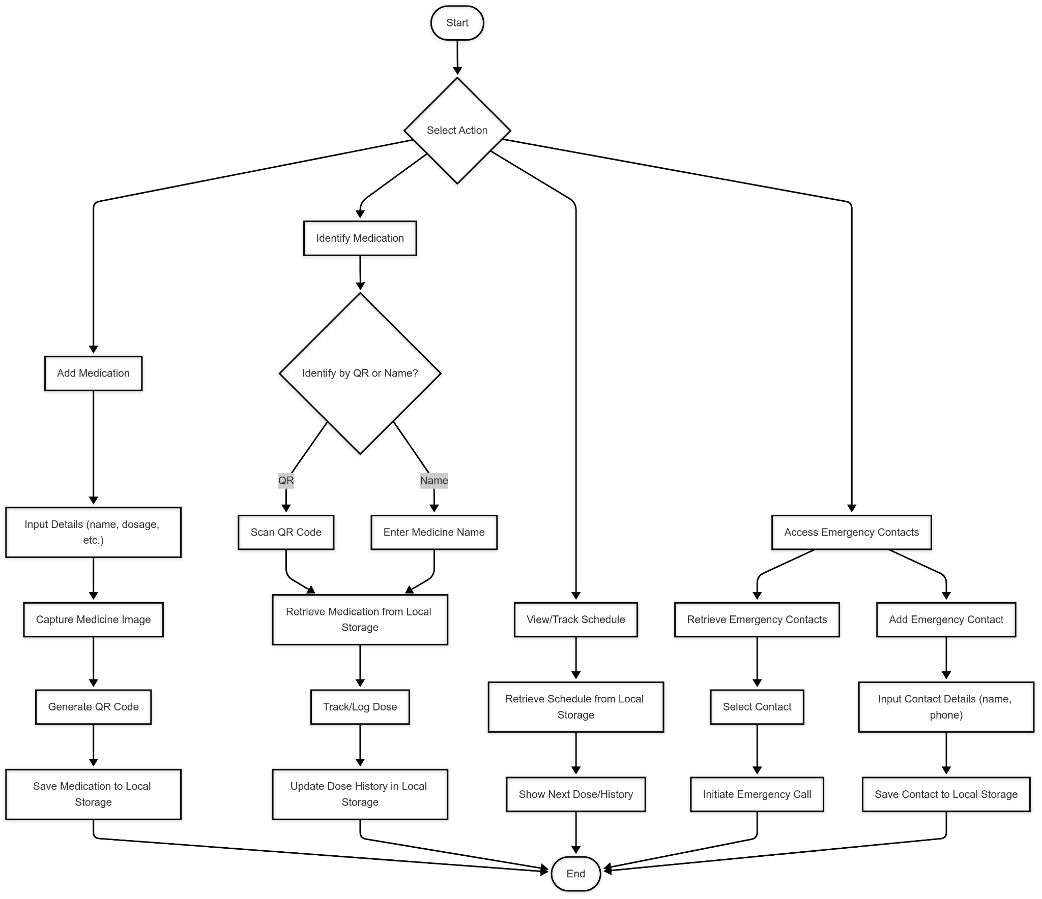
Khilee Singhal
Activity Diagram

Slide 37
Manvi Singh
Aim : Validate user role behaviors (caretaker vs patient), simulate medication scheduling scenarios, and ensure the app meets accessibility and functional standards for elderly users.
Objectives:
Schedule Logic & UI Support: Validated flow of dose timing and daily reminders from a user’s viewpoint.
Pill Identification Testing: Checked OCR fallback, QR-based scans, and their behavior across time.
Emergency Contact Functionality: Ensured triggering calls works reliably offline.
User Roles (Patient & Caretaker): Provided practical insights into how both interact with the app in daily life, including what features are most intuitive or require training.
Dose Timing Alerts: Verified that alerts are raised on wrong dosage times or excess usage.
Test Cases: Helped test the class logic and UI across various usage states.

Slide 38
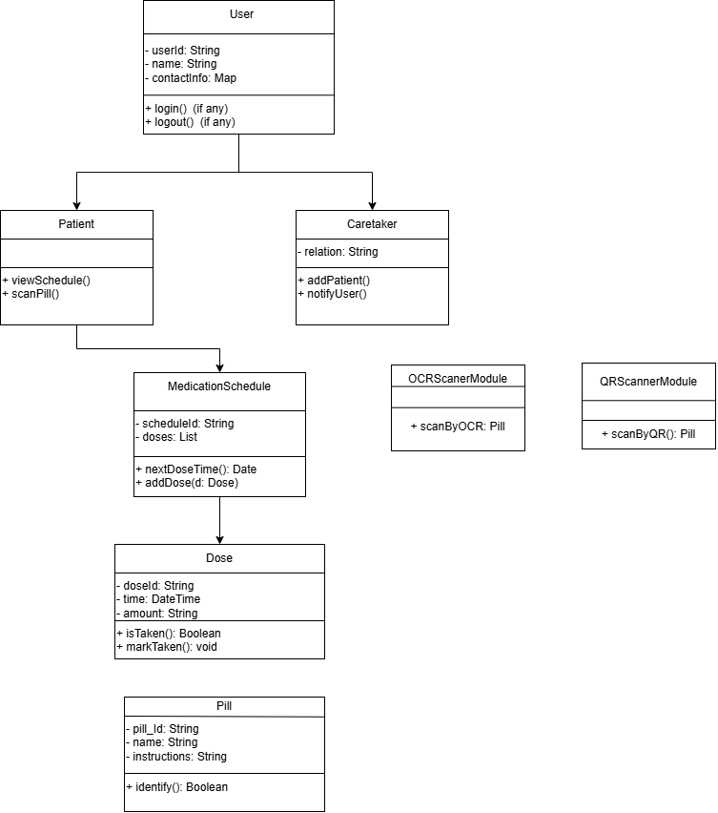
Manvi Singh
Class Diagram

Slide 39
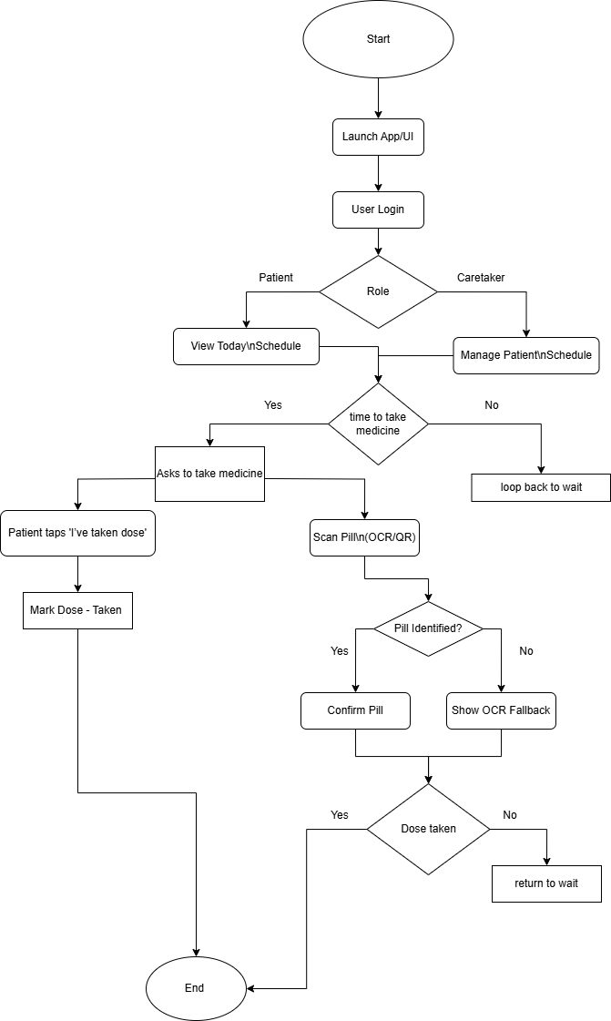
Manvi Singh
Activity Diagram

Slide 40
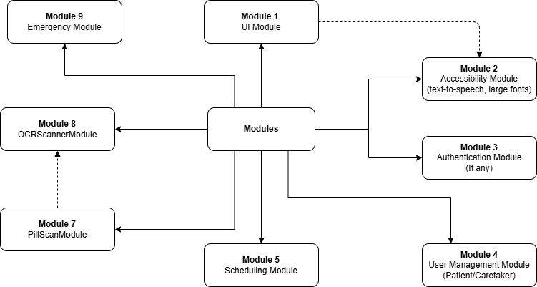
Manvi Singh
Module Diagram

Slide 41
Methodologies
Data Collection
User Input:- Collect medication details,schedules and emergency contacts directly from users via intuitive app forms.
Image Capture:- Enabled users to capture and upload images of medications for identification and record-keeping.
QR Code Integration:- Generated and scanned QR codes for efficient medication tracking and retrieval.
Data Storage and Management
Local Database:- Utilized SQLite for secure, offline storage of medication records, dose history, schedules, and emergency contacts.
Data Validation:- Implemented input validation to ensure accuracy and consistency of stored information
Medication & Dose Management
CRUD Operations:- Developed robust create, read, update, and delete functionalities for medication and contact management.
Dose Tracking:- Logged each dose taken, including timestamp and validation against the prescribed schedule.

Slide 42
Methodologies
Pill Identification
QR & Name-Based Identification: Enabled pill identification via QR code scanning or manual name entry.
Image Storage: Stored medication images for future reference and verification.
Emergency Contact Handling
Contact Management: Allowed users to add, edit, and delete emergency contacts.
Direct Calling: Integrated with the device’s phone dialer to enable one-tap emergency calls from within the app.
Accessibility & User Experience
UI/UX Design: Designed elderly-friendly interfaces with large fonts, clear navigation, and minimal steps.
Text-to-Speech: Integrated TTS for improved accessibility, reading out medication names and instructions.
Testing & Validation
Unit & Integration Testing: Tested core functionalities such as medication management, dose logging, and emergency workflows.
Real-World Scenarios: Simulated user interactions to validate scheduling, pill identification, and emergency features.
Visualization & Feedback
Dose History Visualization: Provided users with clear visual histories of taken and missed doses.
Alerts & Notifications: Delivered timely reminders and warnings for scheduled doses and emergencies.

Slide 43
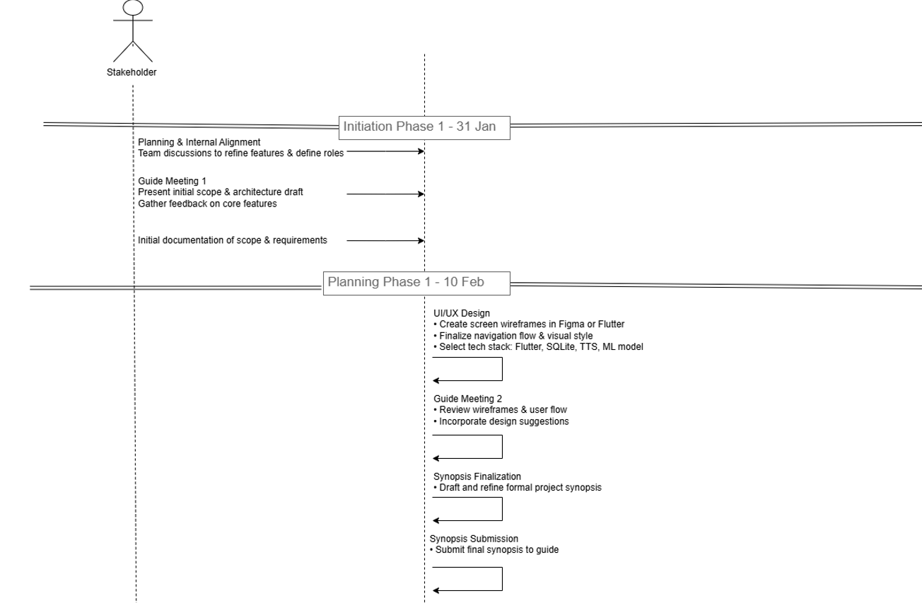
Project Timeline

Slide 44
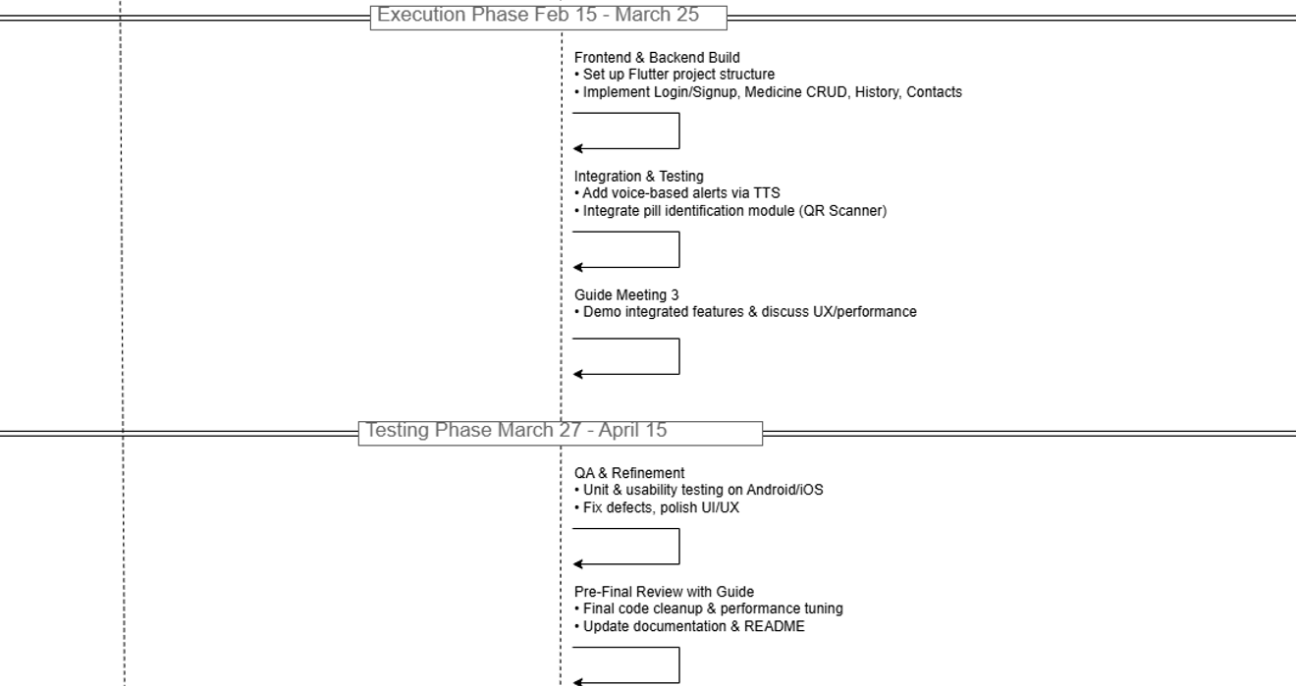
Project Timeline

Slide 45
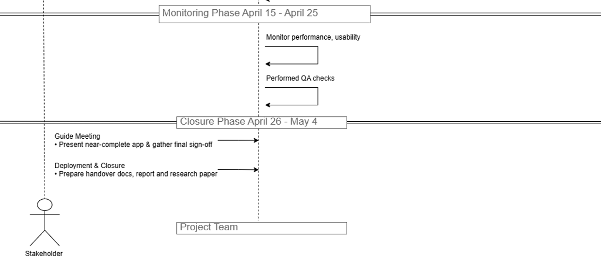
Project Timeline

Slide 46
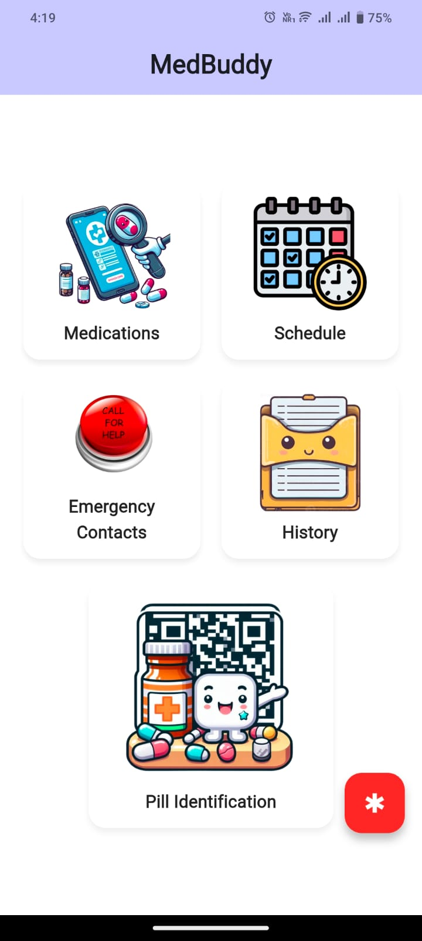
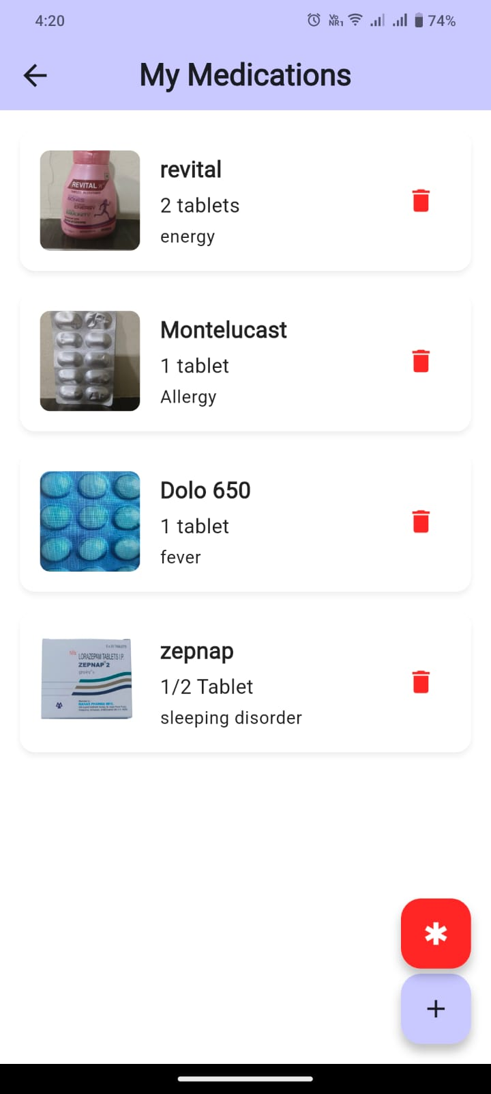
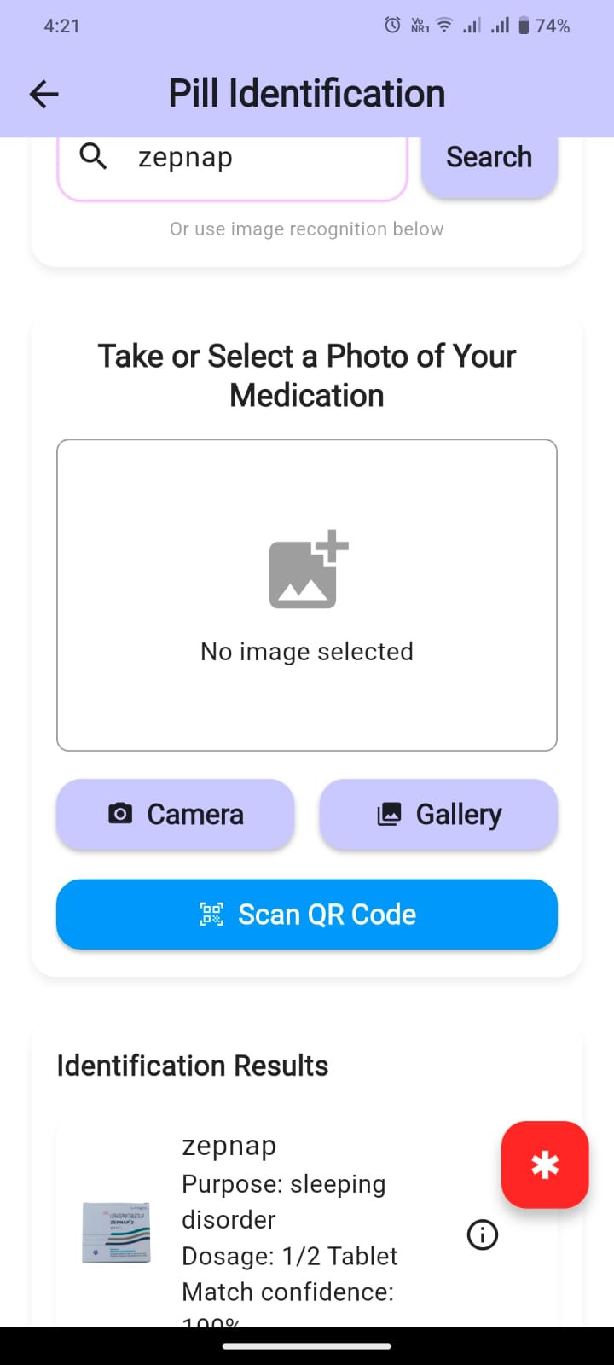
Results

Slide 47
Future Scope for Medbuddy
1. Advanced Image-Based Medicine Identification:
Implement intelligent image recognition to accurately identify medicines from scanned strip images.
Enhance the reliability of pill recognition using the device camera.
2. Voice-Enabled Medicine Search and Information Retrieval:
Enable patients to search for medicines through voice commands for improved accessibility and ease of use.
3. Medicine Information on Demand:
Display dosage, usage instructions, and potential side effects when a medicine is not found in the local database.
4. Personalized Medication Reminders and Tracking:
Provide personalized alerts, track medication doses, and send timely refill notifications to ensure adherence.
5. Integration with Pharmacies and Healthcare Providers:
Establish connectivity with online pharmacies for convenient reordering and collaboration with healthcare professionals.

Slide 48
Publication Details
Details on Literature Review paper
Paper has been completed and submitted for Publication in the Conference.
Details of Future Planning for Implementation Paper
For future planning, we aim to enhance MedBuddy with advanced features such as voice-enabled medicine search, intelligent image recognition, and seamless integration with pharmacies and healthcare providers for improved user convenience and care continuity.

Slide 49
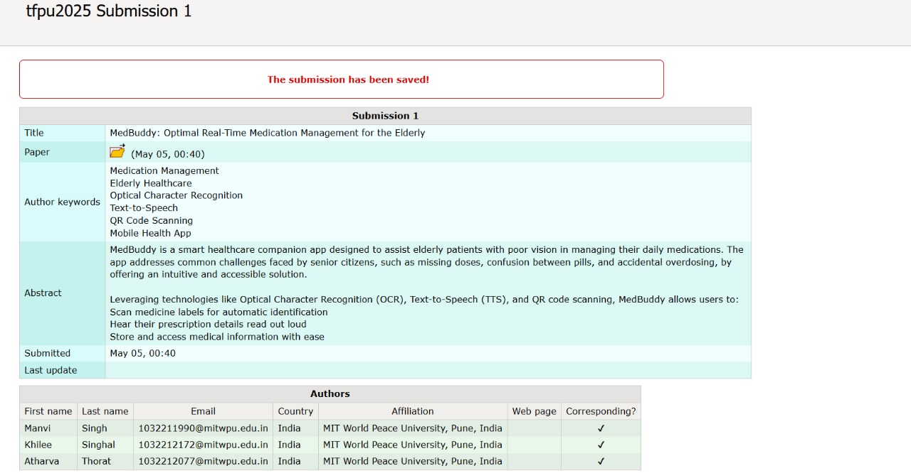
Publication Details

Slide 50
References
[1]. A. A. Kumar, V. Sharma and R. Khanna, "Smart Pillbox: IoT-based Medication Management System," 2023 International Conference on Computing, Communication, and Intelligent Systems (ICCCIS), Greater Noida, India, 2023, pp. 105–110, doi: 10.1109/ICCCIS58092.2023.10505973.
[2]. T. Singh and N. Saini, "AI Enabled Medication Management System," 2022 9th International Conference on Computing for Sustainable Global Development (INDIACom), New Delhi, India, 2022, pp. 1181–1185, doi: 10.1109/INDIACom54597.2022.9991234.
[3]. L. N. T. My, V.-T. Le, T. Vo and V. T. Hoang, "A Comprehensive Review of Pill Image Recognition," Computers, Materials & Continua, vol. 82, no. 3, pp. 3693–3715, 2025, doi: 10.32604/cmc.2025.060793.
[4]. D. S. Rammal, M. Alomar and S. Palaian, "AI-Driven Pharmacy Practice: Unleashing the Revolutionary Potential in Medication Management, Pharmacy Workflow, and Patient Care," Pharmacy Practice, vol. 22, no. 2, 2024, Art. no. 2958, doi: 10.18549/PharmPract.2024.2.2958.
Notes:
‹#›

Slide 51
References
[5]. J. E. McGilton et al., "Medication Safety for People with Dementia in Care Homes: An Interdisciplinary Approach," J. Gerontol. Nurs., vol. 48, no. 11, pp. 6–13, Nov. 2022, doi: 10.3928/00989134-20221107-02. [6]. B. T. Nowak and D. F. Smith, "Personalized Medication Management: Applications in Cardiovascular Risk Reduction," Curr. Cardiovasc. Risk Rep., vol. 15, 2021, Art. no. 16, doi: 10.1007/S12170-021-00673-9. [7]. S. N. Alwashmi et al., "Perceptions of Usefulness and Ease of Use of a Mobile App for Medication Adherence in Older Adults: Qualitative Study," JMIR Mhealth Uhealth, vol. 9, no. 4, p. e24646, Apr. 2021, doi: 10.2196/24646. [8]. A. R. Fakoor et al., "A survey of intelligent medication management systems," Neurocomputing, vol. 368, pp. 1–12, Dec. 2019, doi: 10.1016/j.neucom.2019.08.046.
Notes:
‹#›

Slide 52
References
[9]. M. Delcker, "Ethical Challenges of AI in Medication Management," AI & Society, 2024, doi: 10.1007/s00146-024-01865-8.
[10]. J. M. Torres-Ruiz et al., "Designing a Voice-Based Digital Assistant to Support Medication Management for Older Adults," JMIR Form Res., vol. 5, no. 9, p. e26361, Sep. 2021, doi: 10.2196/26361.
[11]. L. Cooper et al., "Assistive technologies and strategies to support the medication management of individuals with hearing and/or visual impairment: A scoping review," Disabil Health J., vol. 16, 2023, Art. no. 101500, doi: 10.1016/j.dhjo.2023.101500.
[12]. X. Yin, J. Qian, L. Huangfu, and D. Wei, "Intelligent Medication Management System with Voice Reminder," Proc. 2018 Int. Conf. Big Data Artif. Intell. (ICBDAI), pp. 113–116, doi: 10.25236/icbdai.2018.018
Notes:
‹#›

Slide 53
Thank You

