Slide 1
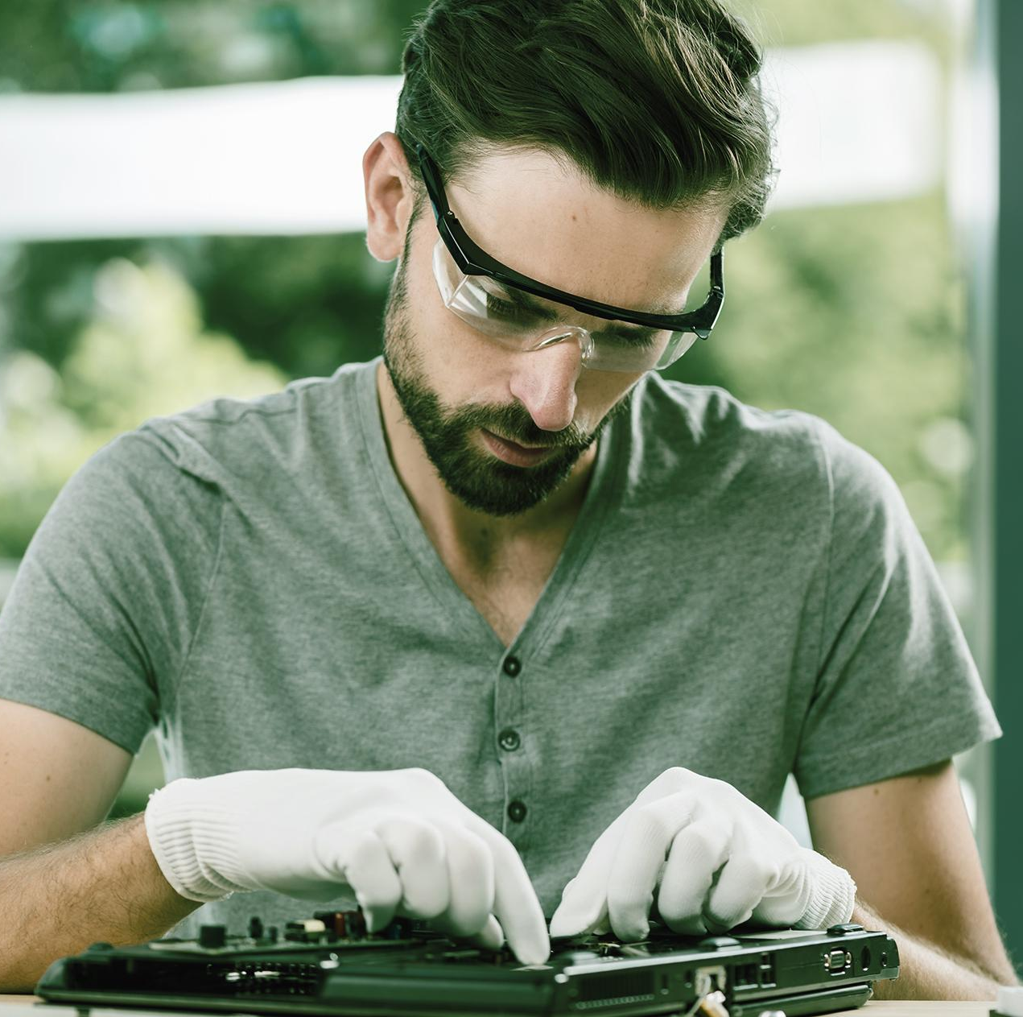
Designing IoT Face Recognition AI Robot
Group Members
Shreenivas Telkar (51)(11810432)
Onkar Thombare (54)
Sanket Veer (59)
Atharva Vidye (61)(11810320)
Parikshit Wagh (62)(11810569)

Slide 2
Objective
1
3
2
The aim is to design a smart AI robot that can recognize a person’s face based on OpenCV Library and Python.
Also to recognize the person’s voice.
Receive various commands for welcoming guests or for security purposes.

Slide 3
Problem Statement
In office, there is need of registration of person, who is going in and going out so to the aim is build a robot which will recognize the person through face recognition and greet the user and save the data on cloud.

Slide 4
Literature Review
Face Recognition Techniques
Feature-based approach
Face recognition based on video sequences
Face recognition from sensory
Neural Network approach

Slide 5
Literature Review
Feature-based approach
Feature-based methodology will process the input picture to distinguish and remove facial highlights, for example, eyes, mouth, nose, and so forth and after that, it figures out the geometric relationship among those facial focuses. This methodology is sub partitioned into:
Geometric feature-based matching
Elastic bunch graph

Slide 6
Literature Review
Face recognition based on video sequences
It deals with real-time recognition of faces by order of images being recorded in a video camera. The most significant use of face resolution is mainly for supervising the security requirement. This part comprises detecting, recording, and diagnosing of faces
Advantages:
• The ample amount of information enables the system to choose the frame.

Slide 7
Literature Review
Face recognition from sensory
This method will aid in accomplishing the characteristics which are depended on the shape of face and outline cheeks without disturbing the changes occurred due to lighting, orientation, and background clusters that will influence the 2D system. Examples of 3D include scanning systems, stereo vision systems, structured light systems, reverse rendering/shape from shading, etc.

Slide 8
Literature Review
Neural Network approach
There are different methods to perform feature extraction using neural networks. For example, Intrator et al. proposed a hybrid or semi-supervised method. They consolidated unsupervised techniques for feature extraction and, directed techniques for discovering features ready to decrease classification blunder. For classification, feed forwarding neural networks (FFNN) can be used.

Slide 9
Technology
Domain
Tools
Internet of Things (IoT), Artificial Intelligence (AI).
Python, Arduino IDE, Visual Studio.

Slide 10
References
W.S. Mada Sanjaya,”The Design of Face Recognition and Tracking for Human-Robot Interaction”.
A. Karisma,”SMART OFFICE SURVEILLANCE ROBOT USING FACE RECOGNITION”.
Pravin Kumar Singh,”IoT and AI Based Emotion Detection and Face Recognition System”.
https://www.roboticsbusinessreview.com/ai/ai-advances-facial-recognition-robots/
https://www.diva-portal.org/smash/get/diva2:1457000/FULLTEXT01.pdf

Slide 11
Learning Outcomes
To examine the significances of IoT in the field of emotions and face recognition.
Utilizing IoT and AI for face and feeling acknowledgment.
Getting familiar with the Raspberry pi and camera and other hardware components.

Slide 12
THANK YOU

