Slide 1
YouTube Insights: Exploring the Leading 1000 Channels
CAPSTONE PROJECT
Presented By:
Atharva Rahul Wankar
College Name : PCET NMIET
Department : Computer Engineering

Slide 2
OUTLINE
Problem Statement
Proposed System/Solution
System Development Approach
Algorithm & Deployment
Result
Conclusion
Future Scope
References

Slide 3
Problem Statement
In today's ever-evolving digital realm, YouTube stands as a pivotal force, molding trends, shaping consumer choices, and serving as a hub for boundless creativity, entertainment, and global communication.
This initiative addresses a pressing necessity: the establishment of a meticulous analytical framework to decipher the landscape of YouTube's top channels. This framework proves indispensable for marketers, content creators, and platform developers alike. By discerning the driving forces behind channel expansion, content preferences, and audience engagement tactics, it furnishes actionable intelligence vital for maintaining competitiveness and seizing untapped prospects in YouTube content curation and dissemination.
The revelations of this endeavor promise substantial benefits for marketers, content creators, and platform developers, furnishing them with invaluable insights to fine-tune strategies and harness nascent opportunities within this dynamic sphere.

Slide 4
Proposed Solution
Description: Our solution aims to offer extensive insights into YouTube's top subscribed channels using advanced data analysis and visualization. With a dataset comprising the top 1,000 channels, we aim to uncover patterns and metrics, aiding stakeholders in better understanding the YouTube landscape.
Approach:
Data Collection: Leveraging a dataset sourced from Kaggle, our analysis focuses on the top 1,000 subscribed YouTube channels. This dataset provides invaluable information for uncovering trends and insights crucial for understanding the YouTube landscape comprehensively.
Data Cleaning & Wrangling: We'll tackle data quality issues by addressing missing values, correcting data types, and resolving inconsistencies, ensuring the dataset's integrity for robust analysis.
Data Analysis & Visualization: Perform exploratory data analysis to unveil insights and depict key metrics through visual representations such as charts and graphs, enhancing understanding and facilitating informed decision-making.
Relationship Analysis: Delve into the interrelationships among variables like subscribers, video views, and video counts to glean deeper insights and understand underlying patterns, facilitating comprehensive analysis.
Classification Analysis: Categorize channels by factors like genre, channel age, and other pertinent criteria to discern trends and patterns, enabling nuanced analysis and strategic insights.
Expected Outcome: A detailed analysis report highlighting the findings, trends, and actionable insights derived from the top subscribed channels dataset.

Slide 5
System Approach
Software Requirements:
Python: Programming language for data analysis and visualization.
Jupyter Notebook: Interactive development environment for Python.
Pandas: Python library for data manipulation and analysis.
Matplotlib & Seaborn: Python libraries for data visualization.
NumPy: Python library for numerical computing.
Scikit-learn: Python library for machine learning algorithms (if applicable).
Hardware Requirements:
Operating System: Windows, macOS, or Linux.
Processor: Intel Core i5 or equivalent.
RAM: Minimum 8 GB.
Storage: Sufficient disk space for dataset storage and analysis.

Slide 6
Algorithm & Deployment
Algorithm & Deployment: Since EDA is centered on data exploration and analysis, devoid of predictive modeling, it eschews specific algorithms or deployment procedures. Instead, emphasis lies on leveraging descriptive statistics, visual aids, and exploratory techniques to glean insights from the dataset.
Loading Necessary Libraries and Dataset: Prepare the environment and data for analysis.
Steps:
Imported essential libraries: NumPy, Pandas, Matplotlib, Seaborn.
Loaded the dataset containing information about the top 1,000 subscribed YouTube channels.
Checked basic dataset information, such as column names, data types, and missing values.
Data Cleaning & Wrangling
Data Problems Identification: Identify and address data quality issues.
Issues Identified:
Zero values in video views and video count.
Missing values in the category column.
Incorrect data types.
Erroneous year values.
Cleaning & Format Data: Resolve identified issues to ensure data quality.
Steps:
Dropped observations with zero values and missing data.
Corrected erroneous year values.
Addressed duplicated data.

Slide 7
Algorithm & Deployment
Wrangling the Data: Generate additional metrics and insights from the cleaned data.
Steps:
Calculated channel age.
Computed average subscribers, video views, and video count per year.
Determined average subscribers and views per video.
Insights from Wrangling:
Channel Age: Median age is 10 years, suggesting channels need time to establish.
Subscribers Growth Rate: Median growth rate is 1,687,500 subscribers/year.
Views Growth Rate: Median growth rate is 644,577,700 views/year.
Efficiency Metrics: Average subscribers per video is 18,674.
Exploratory Data Analysis:
Gain deeper insights into the dataset through visualization and statistical analysis. Addressed relationships between variables and category-wise statistics.
Variable Relationships: Explored relationships between views, subscribers, video counts, and channel age.
Category Analysis: Analyzed category-wise statistics, including subscriber counts, video views, and video counts.
Categories (2013 to 2018) : We analyze how the distribution of categories has evolved over time by focusing on channels started between 2013 and 2018.
Linear Correlation: Determined correlations between variables to understand their impact on each other.

Slide 8
Algorithm & Deployment
Insights:
Views and subscribers exhibit a strong positive correlation.
Video counts show no significant correlation with subscribers.
Age of channels has a low positive correlation with subscribers.
Classification Analysis
Objective: Classify channels based on their category and rank. Investigate the top categories, newcomer categories, and channel maturity.
Classification Insights:
Identified top categories among the top 100 channels.
Explored categories of the last 100 ranked channels.
Analysed statistics based on channel age.
Findings:
Music, Entertainment, and People & Blogs are dominant categories among the top 100 channels.
Gaming emerges as a popular category among the last 100 ranked channels.
Channel maturity suggests a positive correlation with subscriber count.

Slide 9
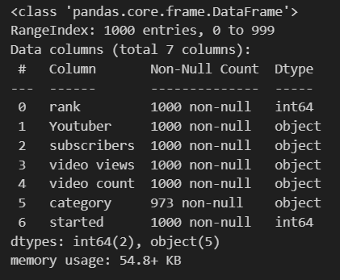
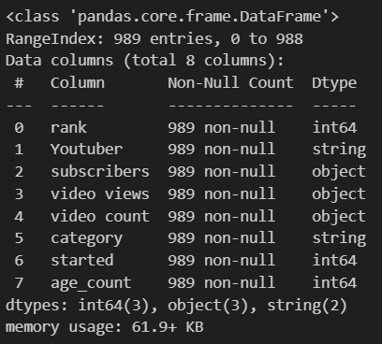
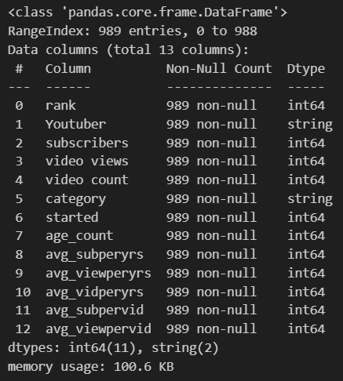
Result
After data cleaning
After data transformation and wrangling

Slide 10
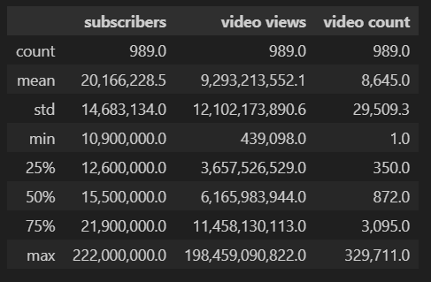
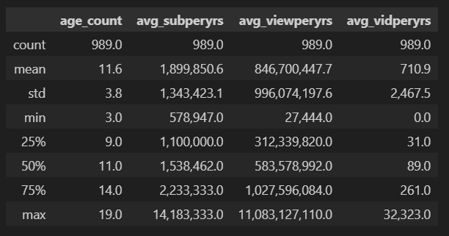
Result
Statistical analysis
Statistical analysis of 1000 YouTube channels involves summarizing key metrics like subscribers and views, exploring correlations between variables, visualizing distributions, and comparing performance across different categories. This analysis provides quantitative insights into channel characteristics and audience engagement, aiding strategic decision-making for content creators and marketers in the digital landscape.

Slide 11
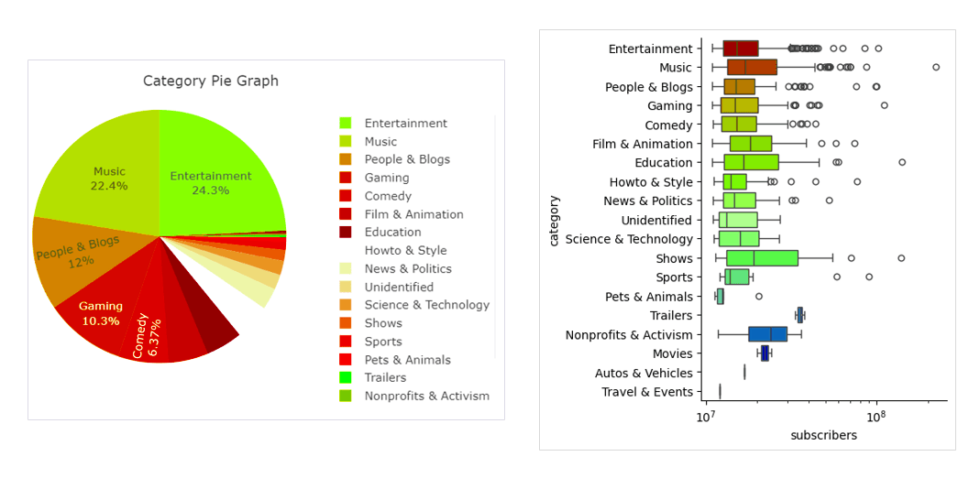
Result

Slide 12
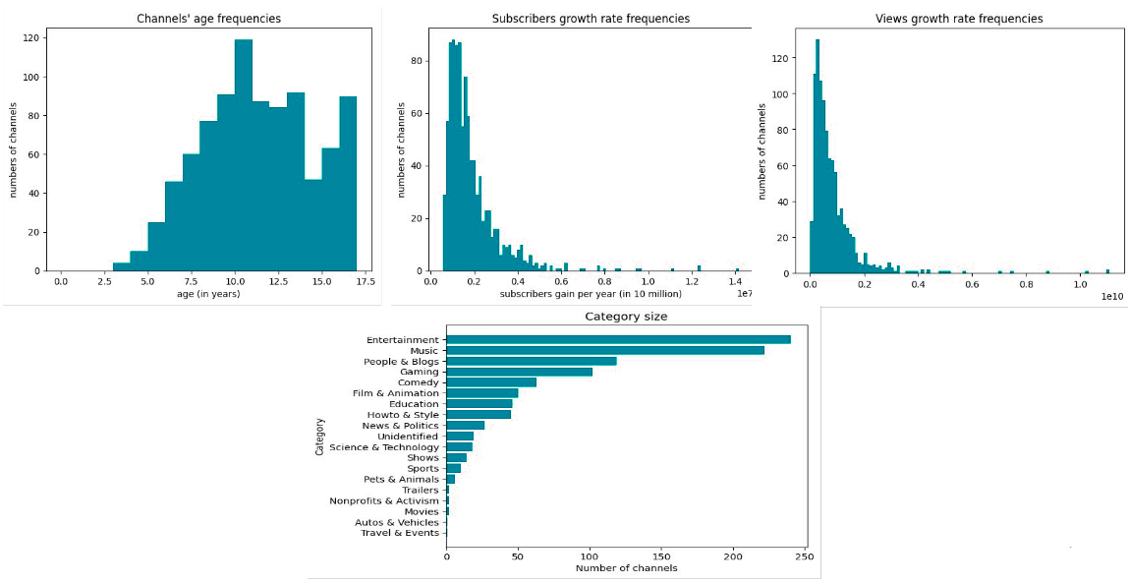
Result

Slide 13
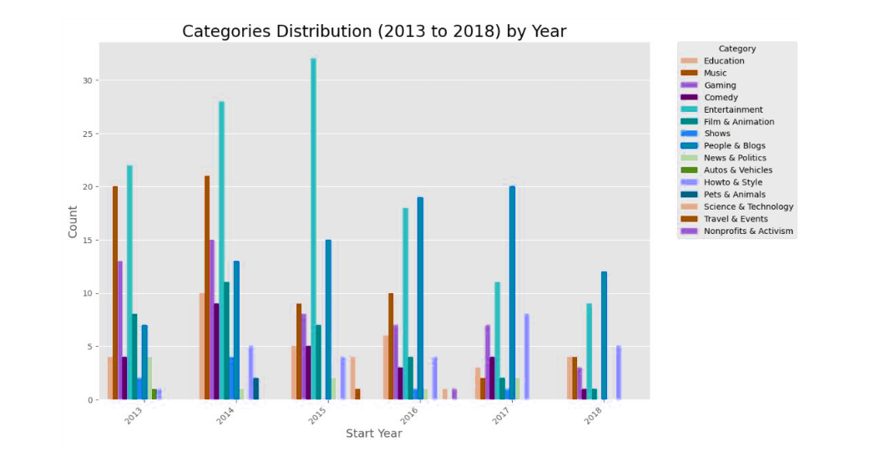
Result

Slide 14
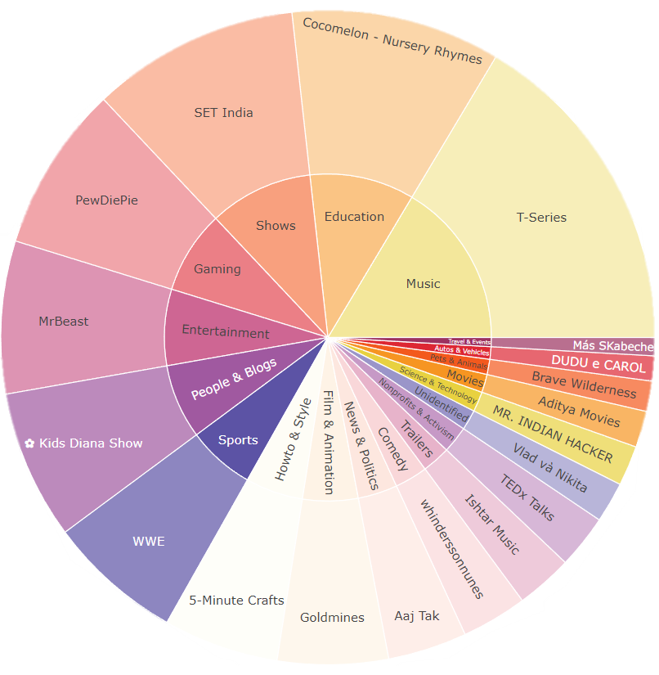
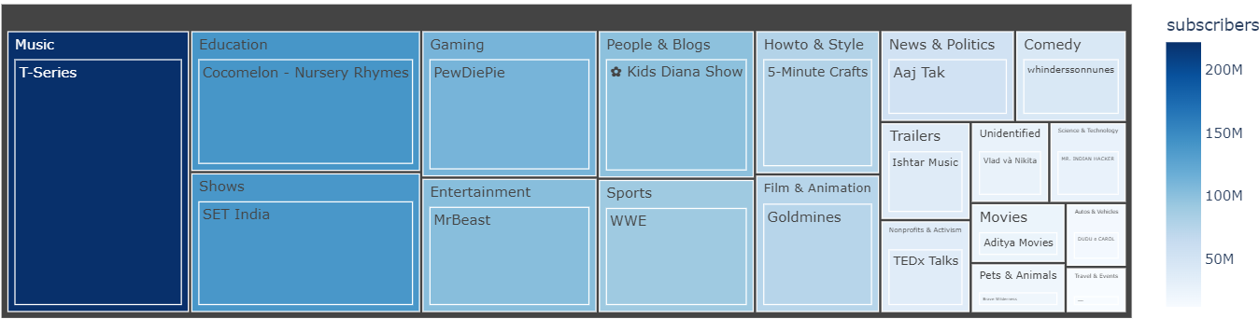
Youtuber with Most Subscribers in Each Category
Represented by
Sunburst and Treemap
Sunburst :
TREEMAP :

Slide 15
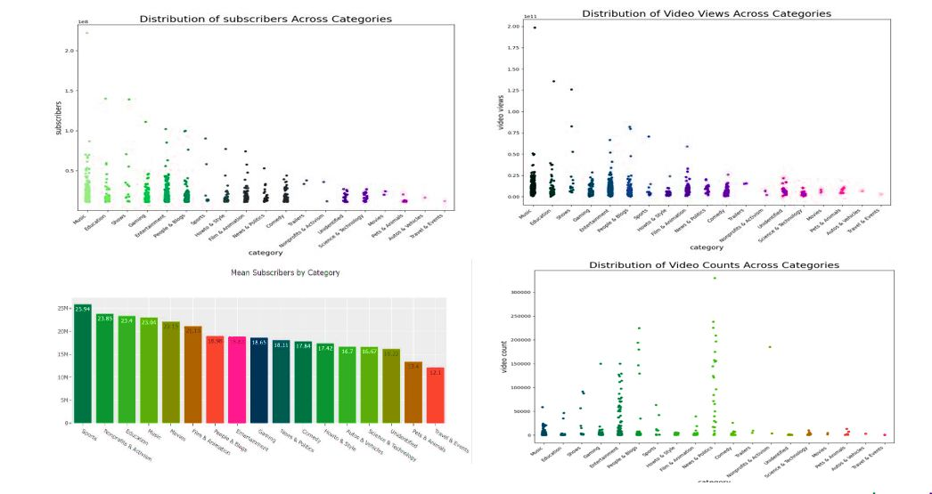
Result

Slide 16
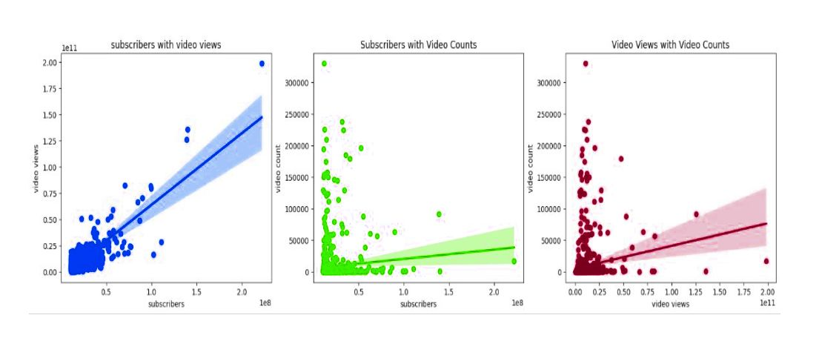
Result
Regression plot on columns 'Subscribers', 'Video Views' and 'Video Counts'

Slide 17
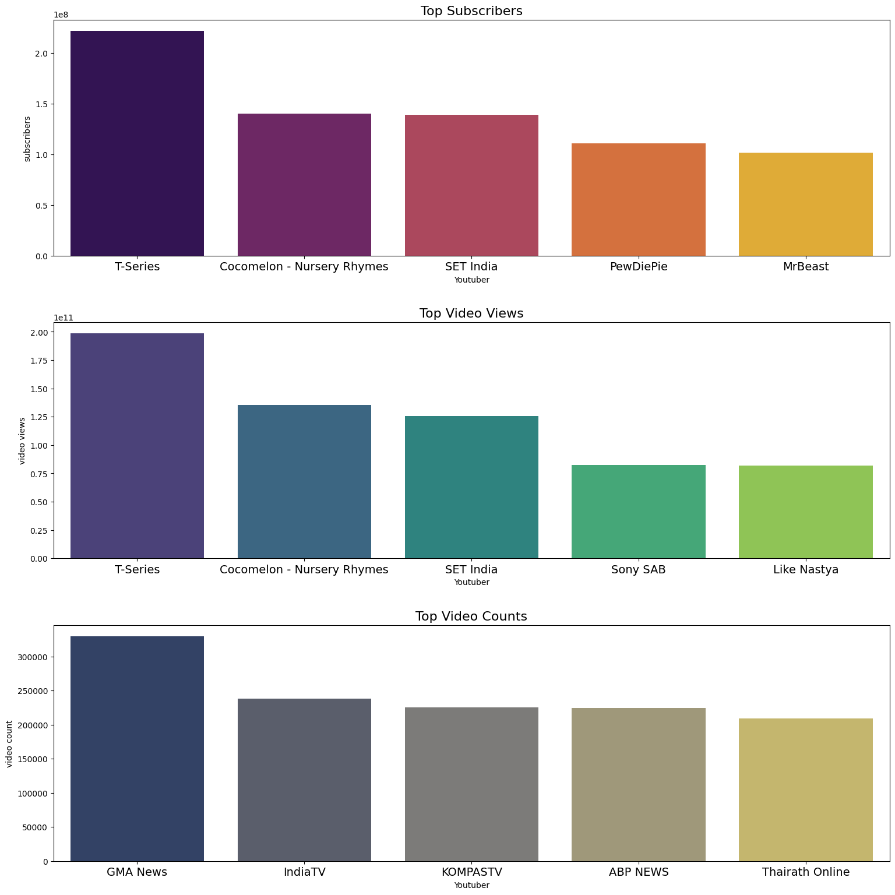
Result
Top 5 YouTubers Analysis:
Based on Subscribers
Rank | Youtuber | subscribers
0 | T-Series | 222000000
1 | YouTube Movies | 154000000
2 | Cocomelon - Nursery Rhymes | 140000000
3 | SET India | 139000000
4 | Music | 116000000
Based on Video Views
Rank | Youtuber | video views
0 | T-Series | 19845909082
2 | Cocomelon - Nursery Rhymes | 135481339848
3 | SET India | 125764252686
17 | Sony SAB | 82473581441
8 | Like Nastya | 81963845811
Based on Video Counts
Rank | Youtuber | video counts
815 | GMA News | 329711
112 | IndiaTV | 237971
777 | KOMPASTV | 225232
100 | ABP NEWS | 224455
576 | Thairath Online | 209097

Slide 18
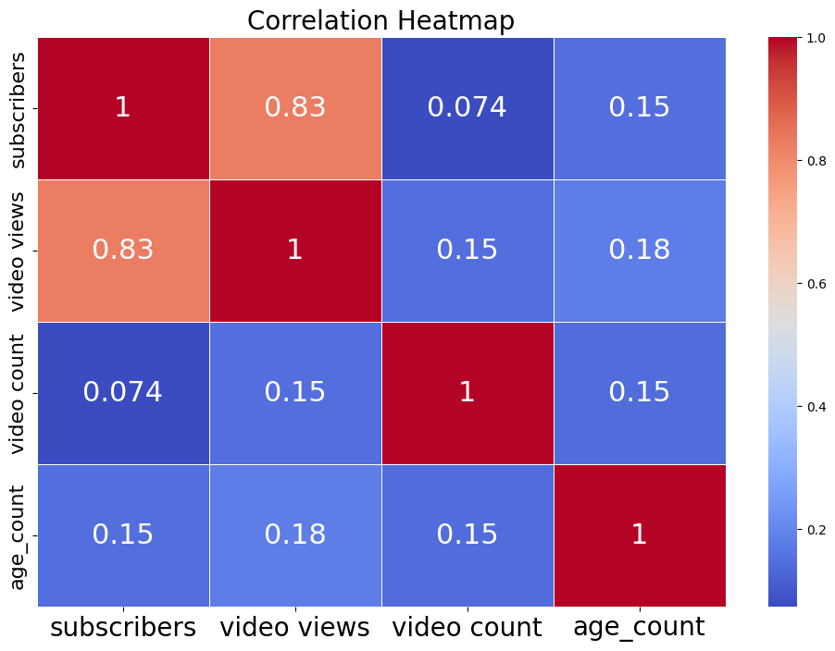
Result

Slide 19
Conclusion
In summary, this analysis has provided invaluable insights into the ecosystem of top subscribed YouTube channels. Through meticulous data exploration, cleansing, and analysis, we have garnered a deeper comprehension of channel dynamics, category trends, and subscriber behaviors. Key inquiries regarding the correlation between views and subscribers, the influence of video counts on channel success, and the significance of channel maturity have been effectively addressed. Moreover, classification revelations have highlighted dominant categories among top channels, discerned trends among emerging channels, and scrutinized growth trajectories based on channel age.
Overall, this project serves as a comprehensive roadmap for navigating the YouTube content landscape, furnishing essential information for brands, content creators, and aspiring YouTubers to refine their strategies and decision-making endeavors.
Notable Findings from EDA:
Skewed Distribution: Subscribers, views, and video counts exhibit skewed distributions.
Category Dominance: Music, Entertainment, People & Blogs, and Gaming are dominant categories.
Subscriber-View Relationship: Strong positive correlation between subscribers and views.
Channel Maturity Impact: Established channels dominate top ranks; newcomer channels face challenges.
Content Diversity: Wide range of content categories indicate a diverse content landscape.
Variable Relationships: Views and subscribers positively correlated; video counts show no significant correlation.
Platform Evolution: Shifts in category trends and channel maturity over time.
Content Popularity: Top channels command substantial viewership and subscriber base.

Slide 20
Future scope
Future enhancements may include:
Perform sentiment analysis on comments and engagement metrics to gauge audience sentiment towards content and feedback effectively.
Utilize machine learning models for predictive analytics, like forecasting subscriber growth or predicting video virality, to enhance strategic planning and decision-making.
Conduct comparative analysis with competitor channels to discern strengths, weaknesses, and areas for improvement, enabling a more informed competitive strategy.
Undertake market trend analysis to identify emerging content categories and market trends, facilitating strategic content creation and audience engagement.
Engage in social network analysis to unravel subscriber interactions and influencer networks, gaining insights into audience dynamics and maximizing reach and engagement.

Slide 21
References
https://pandas.pydata.org/docs/
https://matplotlib.org/stable/users/explain/quick_start.html
https://seaborn.pydata.org/tutorial/introduction.html
https://www.kaggle.com/datasets/surajjha101/top-youtube-channels-data

Slide 22

course certificate 1

Slide 23

course certificate 2

Slide 24
THANK YOU !

