Slide 1
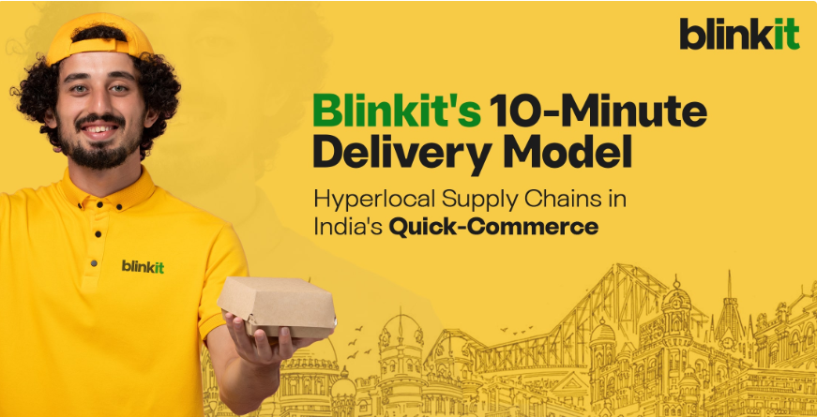

Slide 2
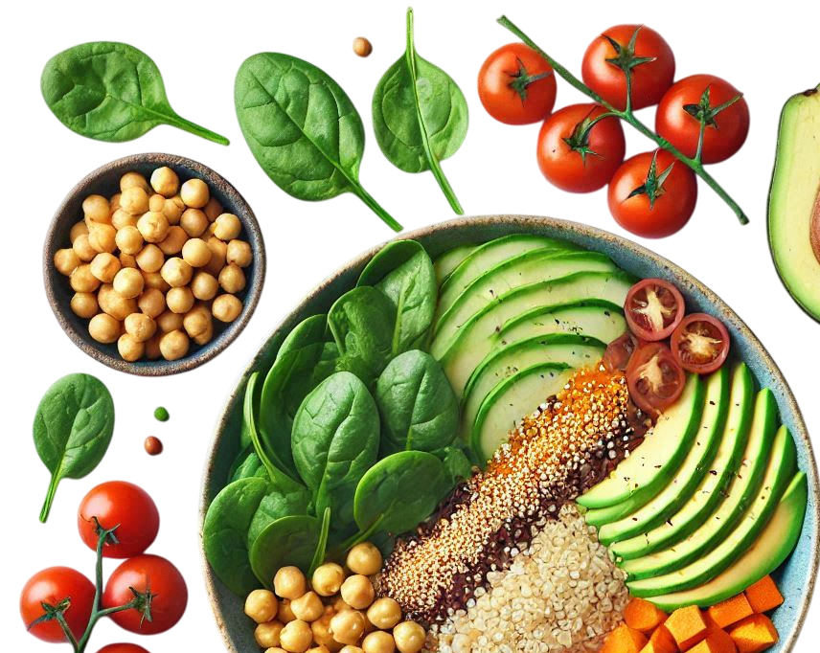


Blinkit
Case Study
India's Last Minute App
-by Atharva Raju Jagnade (Data Analyst)

Slide 3
Introduction
Blinkit, formerly known as Gofers, is a leading online grocery delivery service in India. Founded in 2013, it has revolutionized the way people shop for groceries by offering a wide range of products delivered to their doorstep within minutes. With a user-friendly app and website, Blinkit ensures a seamless shopping experience, catering to the needs of busy urban consumers. The company's focus on speed, convenience, and quality has made it a popular choice among customers seeking hassle-free grocery shopping.

Slide 4
History of Blinkit
2013
2015-2021
2021-2023
Founding
Investment Boosts and Growth
Rivalry with Zepto and Amazon
2014-2017
2021
2023-Present
Expansion into Various Categories
Rebranding to Blinkit
Recent Developments & Focus on Profitability

Slide 5

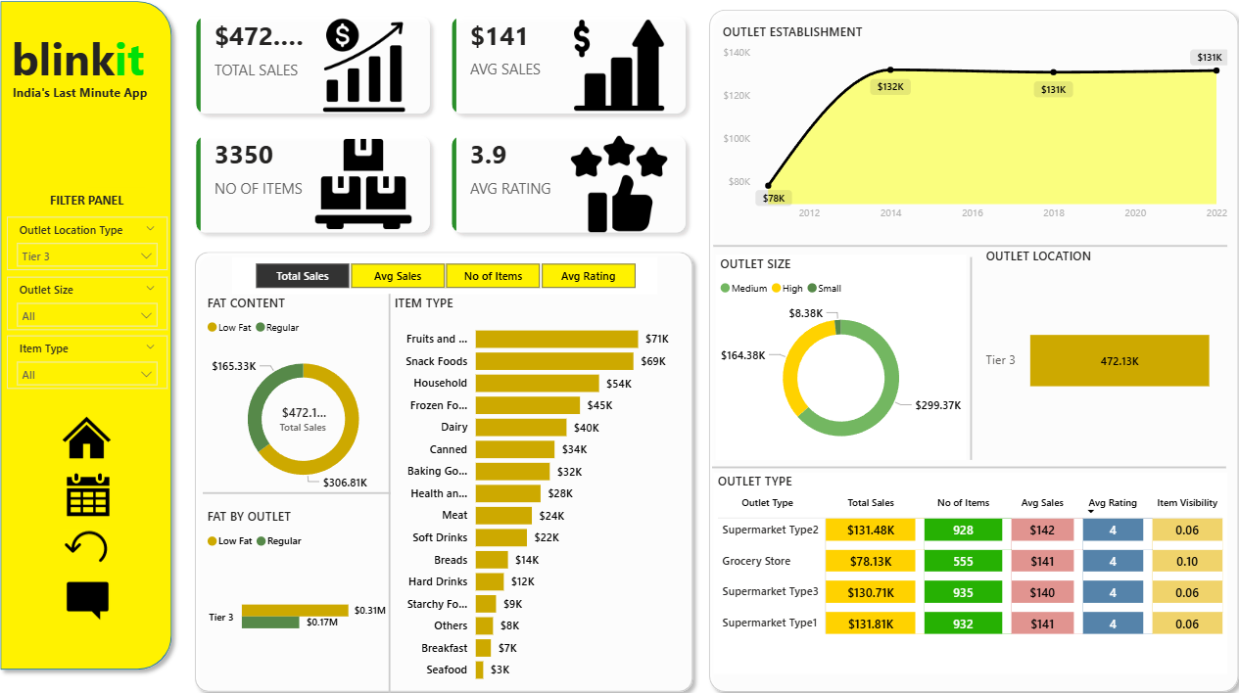
Sales Dashboard

Slide 6
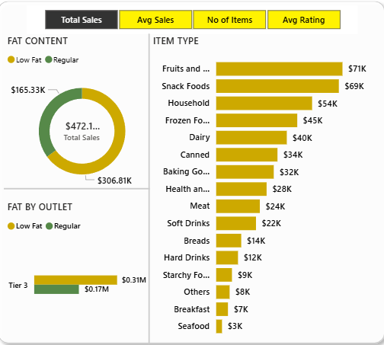
Total Sales – Key Highlights
Total sales reached $472K, with Regular fat products contributing the majority of revenue.
Fruits & Vegetables, Snack Foods, and Household items are the top-earning categories.
Tier-3 outlets generated the highest revenue, indicating stronger sales concentration in urban markets.
Average Sales – Key Highlights
Average sales per item show consistent performance across major categories.
High-value segments such as Fruits & Vegetables and Snack Foods outperform other groups.
Indicates stable customer demand for everyday consumable items.
Average Rating – Key Highlights
Customer ratings reflect overall positive product satisfaction across major categories.
High ratings in staple categories indicate trust and repeat purchase behavior.
Lower-rated items create opportunities for quality improvement and product refinement.

Slide 7
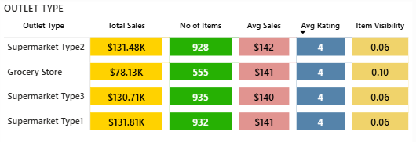
Total Sales – Key Highlights
Supermarket Type2, Type3, and Type1 are consistent top performers with sales around $130K+ each.
Grocery Stores lag behind significantly with only $78K, indicating lower footfall or product variety.
Supermarket formats clearly dominate revenue generation.
Number of Items – Key Highlights
Supermarkets (Type1/2/3) maintain a large inventory base of ~930+ items, supporting strong customer choice.
Grocery Stores offer only 555 items, signaling limited assortment.
Higher inventory breadth strongly correlates with higher sales in supermarket outlets.
Average Sales – Key Highlights
Avg sales remain very consistent across all outlet types, ranging between $140–$142.
Indicates stable customer spending behavior, irrespective of outlet format.
Minor variations suggest uniform pricing and demand levels across store types.
Average Rating – Key Highlights
All outlet types maintain a solid rating of 4, reflecting strong customer satisfaction.
Ratings consistency shows reliable service quality across store formats.
No major performance dips, indicating a well-balanced customer experience.
Item Visibility – Key Highlights
Supermarket types show low item visibility (0.06), suggesting optimized shelf placement.
Grocery Stores have higher visibility (0.10)—potentially due to fewer items or simpler layout.
Lower visibility in supermarkets may indicate better product rotation and space utilization.

Slide 8

Business Growth & Improvement Strategy
The analysis shows Supermarket outlets consistently outperform Grocery Stores, driven by larger inventory and stronger customer choice. Expanding product variety in low-performing outlets can boost overall sales.
High-performing categories like Fruits & Vegetables, Snack Foods, and Household Items should be prioritized with better stocking, targeted promotions, and bundling offers to maximize revenue.
All outlets maintain a strong customer rating of 4, showing a positive shopping experience. Introducing loyalty programs, personalized offers, and quality assurance can further enhance customer retention.

Slide 9
Items with lower visibility and lower sales can benefit from improved shelf placement, discounts, and digital in-app visibility to increase conversion.
Data suggests strong urban demand (Tier 3 outlets). Expanding into similar high-potential zones and optimizing supply chain routes will help increase profit margins.
Overall, with optimized inventory management, strategic pricing, and customer-focused engagement, the business can achieve sustained growth in sales, profitability, and consumer attraction.

Slide 10
CONCLUSION
The dashboard analysis shows that supermarkets outperform grocery stores due to larger inventories and stronger customer demand. Focusing on high-performing categories and optimizing product visibility can further boost sales. Enhancing customer engagement through targeted promotions and loyalty programs will drive repeat purchases. Overall, strategic inventory expansion and customer-focused initiatives can significantly improve revenue and business growth.

Slide 11

THANK YOU

