Slide 1
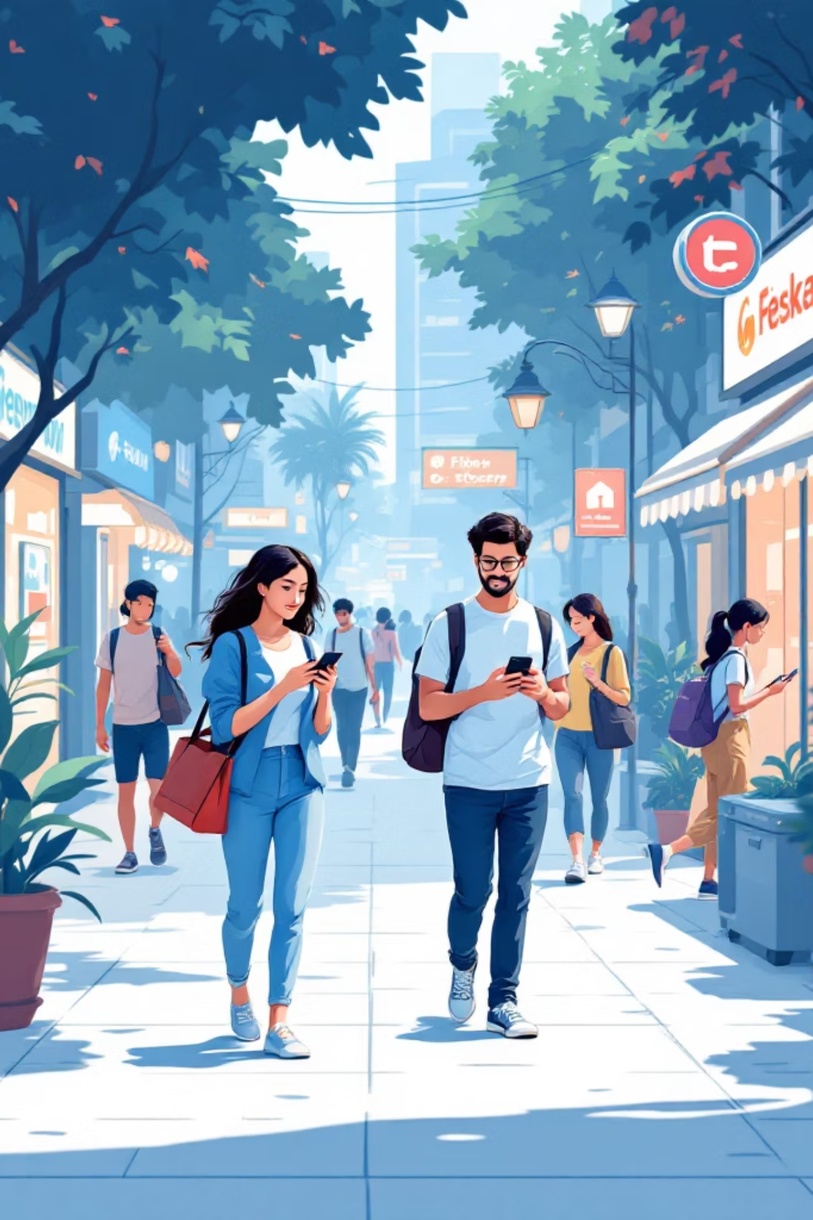
Scrolling to Spending:
Analysing Social Media Influence on Purchase Decisions Among Indian College Students
REGRESSION ANALYSIS
K-MEANS CLUSTERING
MBA BUSINESS ANALYTICS

Slide 2
Introduction
India's Social Media Economy Is Reshaping How Youth Buy
467M+
₹4.4T
Social Media Users
E-Commerce Market
in India as of 2024
current market size
73%
4.2hrs
Youth Influenced
Daily Screen Time
by online content
avg. for ages 18–25
Fastest-Growing User Base
Reshaped Discovery & Decision
An Underresearched Domain
India ranks among the world's largest social media markets, with youth aged 18–30 as the most active segment.
Influencer reels, peer sharing, and targeted ads have fundamentally altered how college students find and evaluate products.
This study fills the academic gap by applying quantitative methods to model and segment social-media-driven purchase behaviour in India.

Slide 3
PROBLEM STATEMENT
THE PROBLEM
RESEARCH GAP
1
Indian youth spend 4+ hours daily on social media, yet quantitative evidence on how this translates to actual purchase behavior remains sparse in Indian academic literature.
No existing Indian study combines SOR framework, factor analysis, multiple regression, AND K-Means clustering to holistically model AND segment social-media-driven purchase behavior among college students.
2
Brands and marketers invest heavily in influencer campaigns without clear data on which factors — influencer credibility, peer reviews, or ad exposure — drive buying decisions most.
3
Existing studies are largely qualitative or conducted in Western contexts, limiting their applicability to Indian college-going consumers.
RESEARCH QUESTION
"To what extent does social media usage — across platform type, content exposure, influencer trust, and peer influence — affect purchase intentions of Indian college students, and what distinct consumer segments emerge from these behavioral patterns?"
4
There is no evidence-based segmentation of Indian college students as social-media-driven consumers, making targeted marketing strategies guesswork.

Slide 4
Research Objectives & Hypotheses
3 Research Objectives
3 Research Hypotheses
Identify which social media factors significantly predict Purchase Intention among Indian college students.
Influencer Trust has a significant positive influence on Purchase Intention and Impulse Buying.
O1
H1
Identify which social media factors significantly predict impulse Buying among Indian college students.
Social Proof has a significant positive influence on Purchase Intention and Impulse Buying.
O2
H2
Segment Indian college students into distinct consumer groups using K-Means Cluster Analysis.
Social Media Attitude has a significant positive influence on Purchase Intention and Impulse Buying.
O3
H3
Each hypothesis is tested for BOTH dependent variables: Purchase Intention (O1) and Impulse Buying (O2) | O3 addressed by Cluster Analysis

Slide 5
Research Framework — SOR Model
STIMULUS
ORGANISM
RESPONSE
Social Media
Exposure
Internal
Processing
Buying
Behaviour
Instagram / YouTube
Influencer Trust (H1)
Purchase Intention (O1)
▶
▶
Influencer Posts
Social Proof (H2)
Impulse Buying (O2)
Ads & Reviews
SM Attitude (H3)
H1 (Influencer Trust), H2 (Social Proof), H3 (SM Attitude) tested as Organism variables → predicting Purchase Intention and Impulse Buying | O3: Clustering segments respondents

Slide 6
RESEARCH METHODOLOGY & DATA COLLECTION
Research Design
SURVEY STRUCTURE
Quantitative, cross-sectional descriptive research design using primary data collection.
A
Demographics
6 Qs
B
SM Usage
4 Qs
Population & Sample
College students aged 18–26 across Indian institutions. Sample size:200 respondents
C
Influencer Exposure
4 Qs
Sampling Method
D
Purchase Behavior
4 Qs
Convenience sampling via WhatsApp, Instagram, and college networks.
E
Likert Scale (1–5)
17 Qs
Data Collection Tool
ANALYSIS TOOLS
Structured Google Form with 35 questions across 5 sections: Demographics, Usage, Exposure, Behavior, Likert Scale.
✔ Google Forms → Data Collection
✔ Python → Statistical Analysis

Slide 7
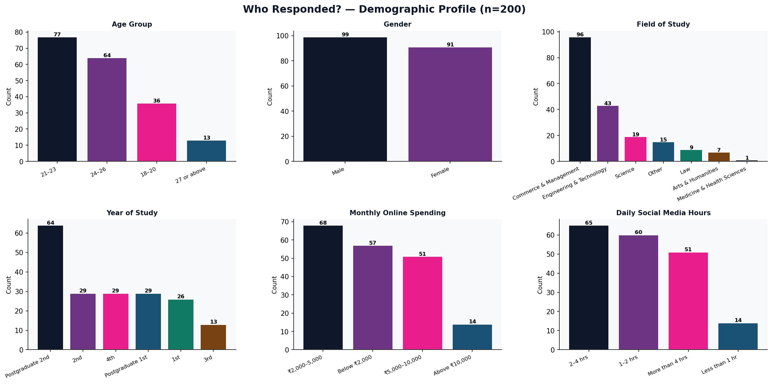
Who Responded? — Sample Profile (n = 200)

Slide 8
Multiple Linear Regression — What & Why
What does Regression tell us?
We tested TWO Dependent Variables
It tells us which social media factors actually predict buying behaviour — and by how much.
Think: which button, when pressed, actually moves the needle on purchases?
DV 1 — Purchase Intention (O1)
How likely is the student to intentionally buy a product they saw on social media?
How to Read the Results
R²
How much buying behaviour the model explains
DV 2 — Impulse Buying (O2)
β (Beta)
Direction & strength of each factor's effect
How likely is the student to buy something unplanned — just because they saw it on social media?
p-value
Is the effect real or just random chance?
p < 0.05
✅ Effect is statistically significant (real)
p ≥ 0.05
❌ Effect is not significant (not proven)
H1: Influencer Trust
H2: Social Proof
H3: SM Attitude

Slide 9
Regression 1 — What Drives Purchase Intention? (O1)
R² = 0.077
F p = 0.005
n = 200
Model explains 7.7%
of Purchase Intention
Overall model
is significant ✅
Respondents
analysed
Hypothesis Results — Purchase Intention
Hyp
Factor → Purchase Intention
Beta (β)
p-value
Result
H1
Influencer Trust → Purchase Intention
β = 0.119
p = 0.158
❌ Not Supported
H2
Social Proof → Purchase Intention
β = 0.219
p = 0.012
✅ SUPPORTED
H3
SM Attitude → Purchase Intention
β = 0.087
p = 0.265
❌ Not Supported
💡 Key Finding: Only Social Proof (H2) significantly predicts Purchase Intention. Peer reviews and community reactions are the real purchase drivers — not influencer trust or attitude alone.

Slide 10
Regression 2 — What Drives Impulse Buying? (O2)
R² = 0.091
F p = 0.001
n = 200
Model explains 9.1%
of Impulse Buying
Overall model
is significant ✅
Respondents
analysed
Hypothesis Results — Impulse Buying
Hyp
Factor → Impulse Buying
Beta (β)
p-value
Result
H1
Influencer Trust → Impulse Buying
β = 0.153
p = 0.090
❌ Not Supported
H2
Social Proof → Impulse Buying
β = 0.086
p = 0.347
❌ Not Supported
H3
SM Attitude → Impulse Buying
β = 0.250
p = 0.003
✅ SUPPORTED
💡 Key Finding: SM Attitude (H3) significantly predicts Impulse Buying. Students who view social media marketing positively are more likely to buy impulsively.

Slide 11
The Two-Pathway Finding
Social media influences Indian college students through TWO distinct pathways
PATHWAY 1 — H2 Supported
PATHWAY 2 — H3 Supported
Rational Buying
Impulse Buying
Social
Proof (H2)
→
Purchase
Intention
SM
Attitude (H3)
→
Impulse
Buying
β = 0.219 | p = 0.012 ✅
β = 0.250 | p = 0.003 ✅
Peer reviews, community reactions, and social proof from friends drive deliberate purchase decisions.
Students who view social media marketing positively are more likely to buy impulsively — without planning.

Slide 12
K-Means Clustering — What & Why (O3)
What does Clustering do? (Objective 3)
6 Consumer Segments Identified (O3 ✅)
It automatically groups 200 respondents into segments based on how similar their scores are.
Each cluster = a different type of social media buyer among Indian college students.
n = 37
n = 45
Impulse Prone
Moderate Scrollers
PI: 3.05 | IB: 3.65
PI: 2.38 | IB: 2.39
n = 34
n = 31
High Engagers
Low Trust Impulsive
How we chose K = 6 clusters
PI: 3.58 | IB: 3.46
PI: 2.64 | IB: 3.52
Elbow Method
Plot inertia vs K — look for the bend
Silhouette Score
Measures how well separated clusters are
n = 16
n = 27
Passive Scrollers
Intentional Buyers
Best K = 6
Gave highest silhouette score of 0.168
PI: 2.02 | IB: 1.66
PI: 4.11 | IB: 2.28
PI = Purchase Intention Score | IB = Impulse Buying Score | Scale: 1 (Low) to 5 (High) | O3: Distinct segments confirmed ✅

Slide 13
Hypothesis Testing — Complete Summary
Hyp
Statement
DV
Beta
p-value
Result
H1
Influencer Trust → Purchase Intention
PI
0.119
0.158
❌ Not Supported
H2
Social Proof → Purchase Intention
PI
0.219
0.012
✅ Supported
H3
SM Attitude → Purchase Intention
PI
0.087
0.265
❌ Not Supported
H1
Influencer Trust → Impulse Buying
IB
0.153
0.090
❌ Not Supported
H2
Social Proof → Impulse Buying
IB
0.086
0.347
❌ Not Supported
H3
SM Attitude → Impulse Buying
IB
0.250
0.003
✅ Supported
O3
Distinct consumer segments exist (K=6)
—
—
—
✅ Supported
✅ H2 supported for PI | H3 supported for IB | O3 confirmed — 6 segments
📌 Non-supported results show what does NOT drive buying — equally valuable as a finding

Slide 14
Conclusions & Recommendations
👥
Social Proof Drives
Purchase Intention (H2 ✅)
⚡
SM Attitude Drives
Impulse Buying (H3 ✅)
🎯
6 Distinct Buyer
Segments (O3 ✅)
What peers say on social media is the #1 driver of purchase intention. Not influencers. Not ads. Peer reviews and community reactions convert browsers into buyers.
Students who enjoy social media marketing are more likely to buy impulsively. Positive brand perception leads to unplanned purchases.
From High Engagers who buy most to Passive Scrollers who barely engage. One-size marketing does not fit all Indian college students.
Recommendations for Brands & Marketers
📣
Build Social Proof
Encourage UGC, reviews & peer referrals — this directly drives purchase intention.
💡
Build Positive SM Attitude
Create engaging content that builds brand affinity — this drives impulse buying.
🎯
Segment Your Marketing
Target High Engagers for conversions. Use different messages per segment.
📱
Focus on Instagram First
58% named Instagram most influential. Prioritise it over other platforms.

