Slide 1
PHARMACY2U Challenge A
Abhisri Ravi
Umar Khan
Siddhi Tandel
Atharva Khamkar

Slide 2
Data Preprocessing
Data conversion: It is much needed to sort the events to scale the gap between the refills. It is used to calculate the gaps between the refills, to calculate the expected supply duration with actual refill timing.
Temporal Sorting: Sorting based on service date to learn how regularly how often the patient refills, whether refill timing is getting worse, whether the past delays suggest future delays as well.
Handling Sparsity: here we have filled missing values with zeros to represent the absence of chronic conditions, doing so makes the features usable by the model
Encoding Categorical features: converts categorical values into numerical values so the models can process them, we use scikit-learn tree models for processing of the categorical values

Slide 3
Feature Engineering
Calculate the number of days between previous refill: this is important for us to calculate the number of days between the refills to notice a pattern, that is if the patient is at risk of refilling late or at failure to refill.
Chronic Condition Count: here we count the number of chronic conditions a patient has and use that as a complexity score. A patient with more chronic conditions may have the burden of forgetting to order multiple medication rather than ones with 1 or less chronic conditions.

Slide 4
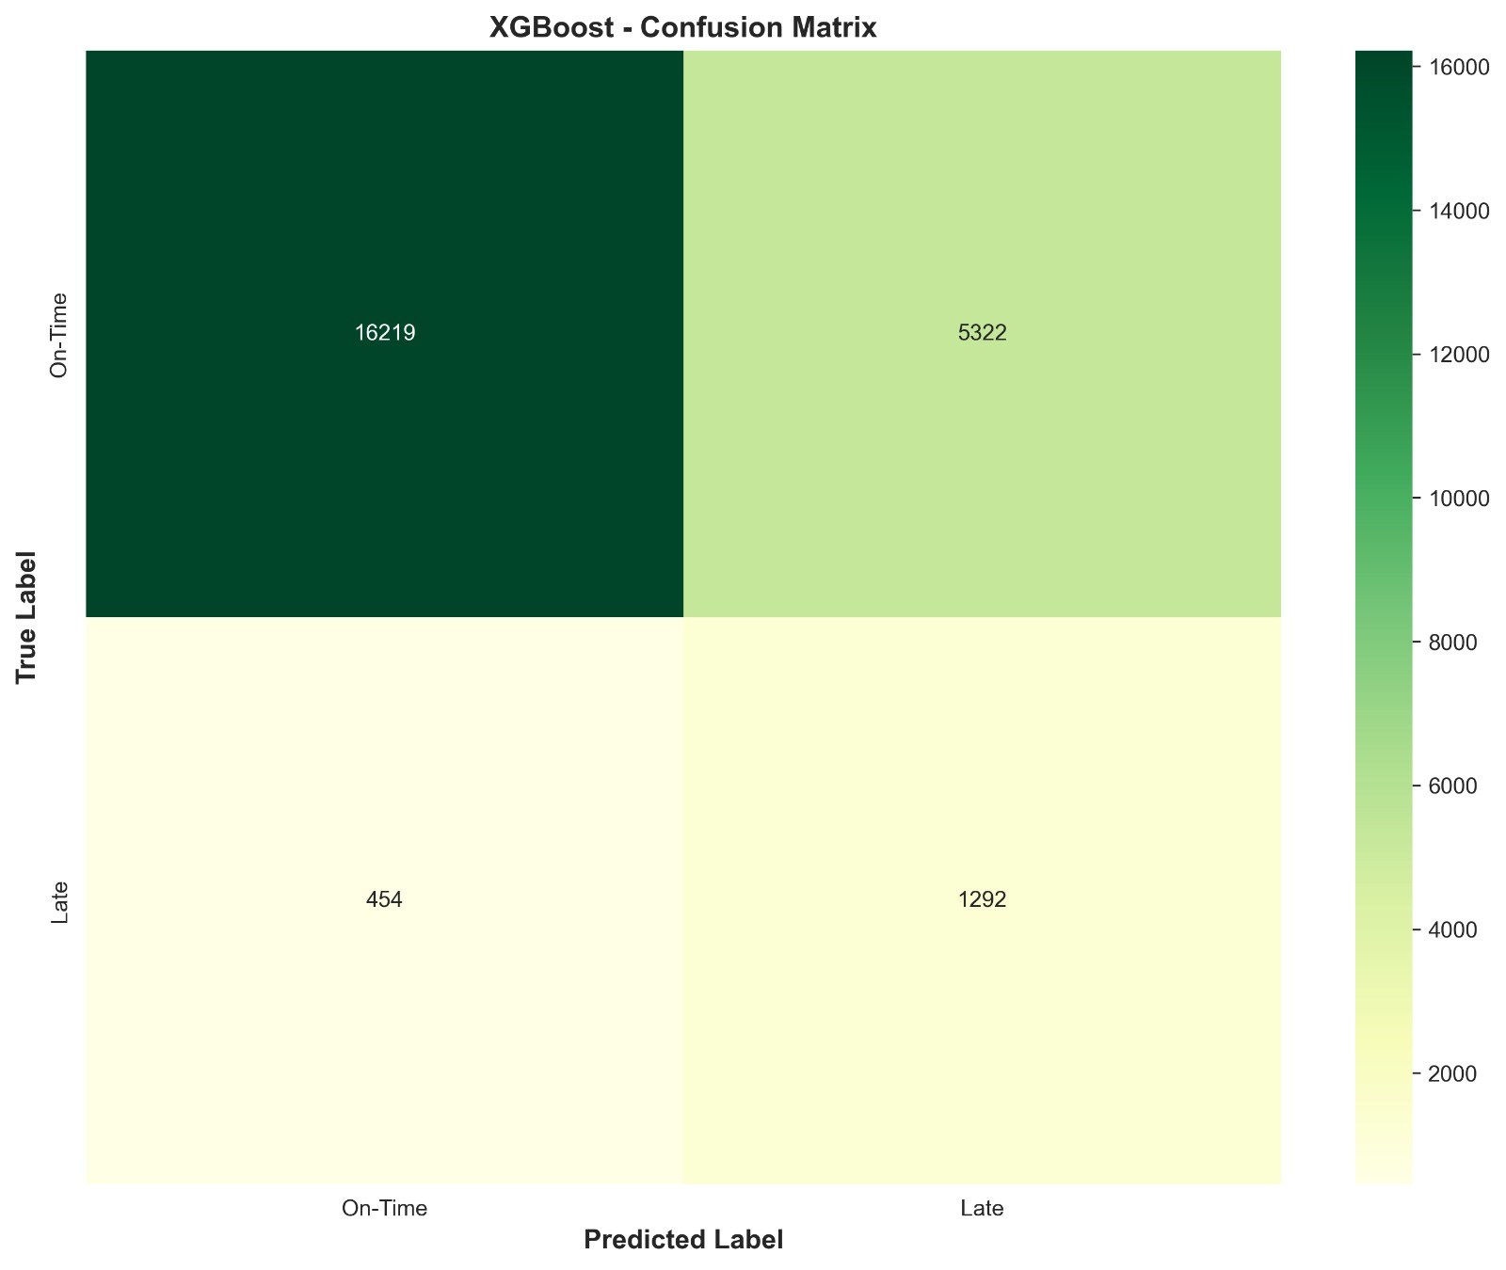
Model & VALIDATION
We trained XGBoost with scale_pos_weight=13 to handle the 7:93 imbalance. We compared against a Logistic Regression baseline with class weighting.
Validation: We used a time-based split ; training on fills before a cutoff date and testing on fills after it. This prevents the model from seeing future patient behaviour during training, which is the most common leakage mistake in prescription data.
Metrics: We report PR-AUC as our primary metric because ROC-AUC is misleadingly high on imbalanced data. Our PR-AUC is [X], compared to a baseline of 0.07 (the prevalence rate). We also ran a quick calibration check our predicted probabilities [are/need to be] reasonably calibrated in the 0.6–0.9 range."

Slide 5
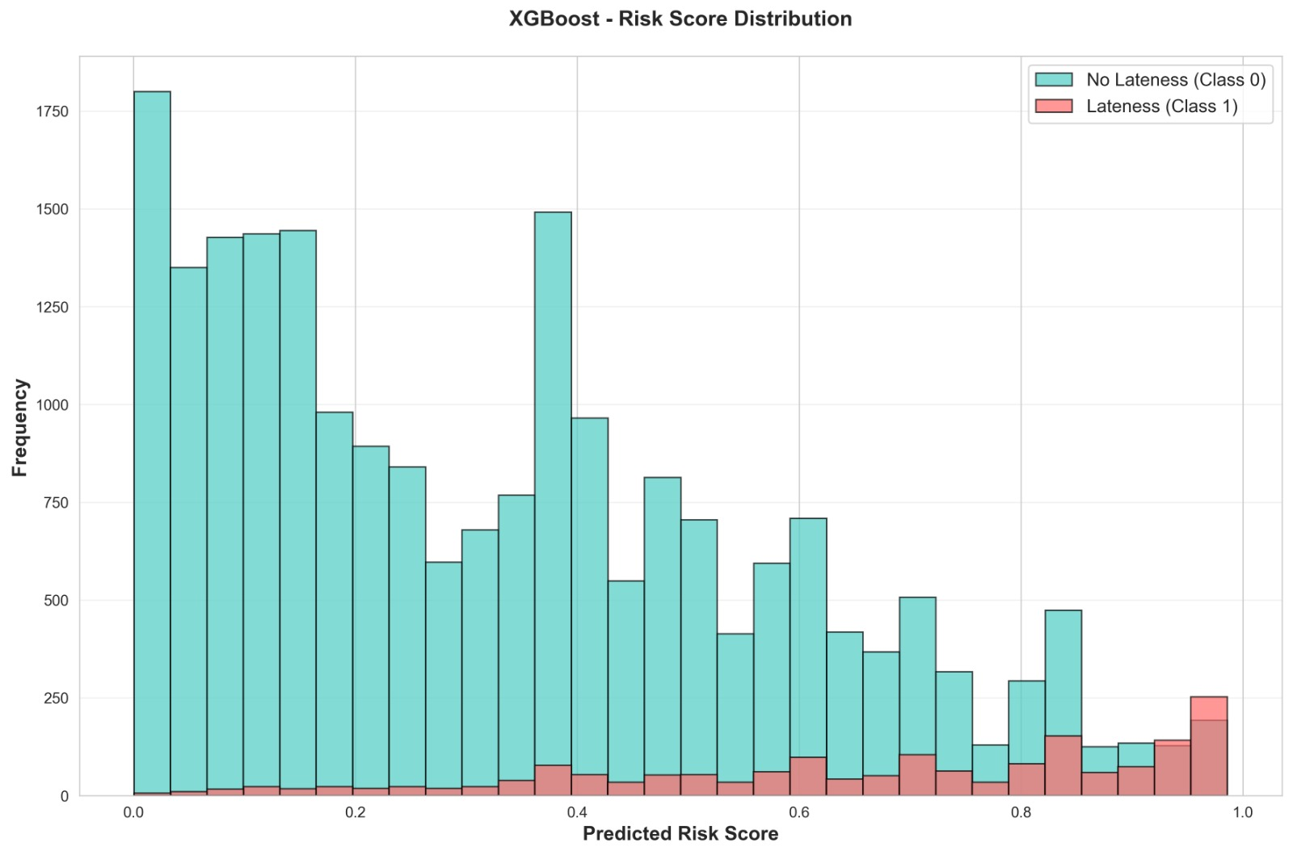
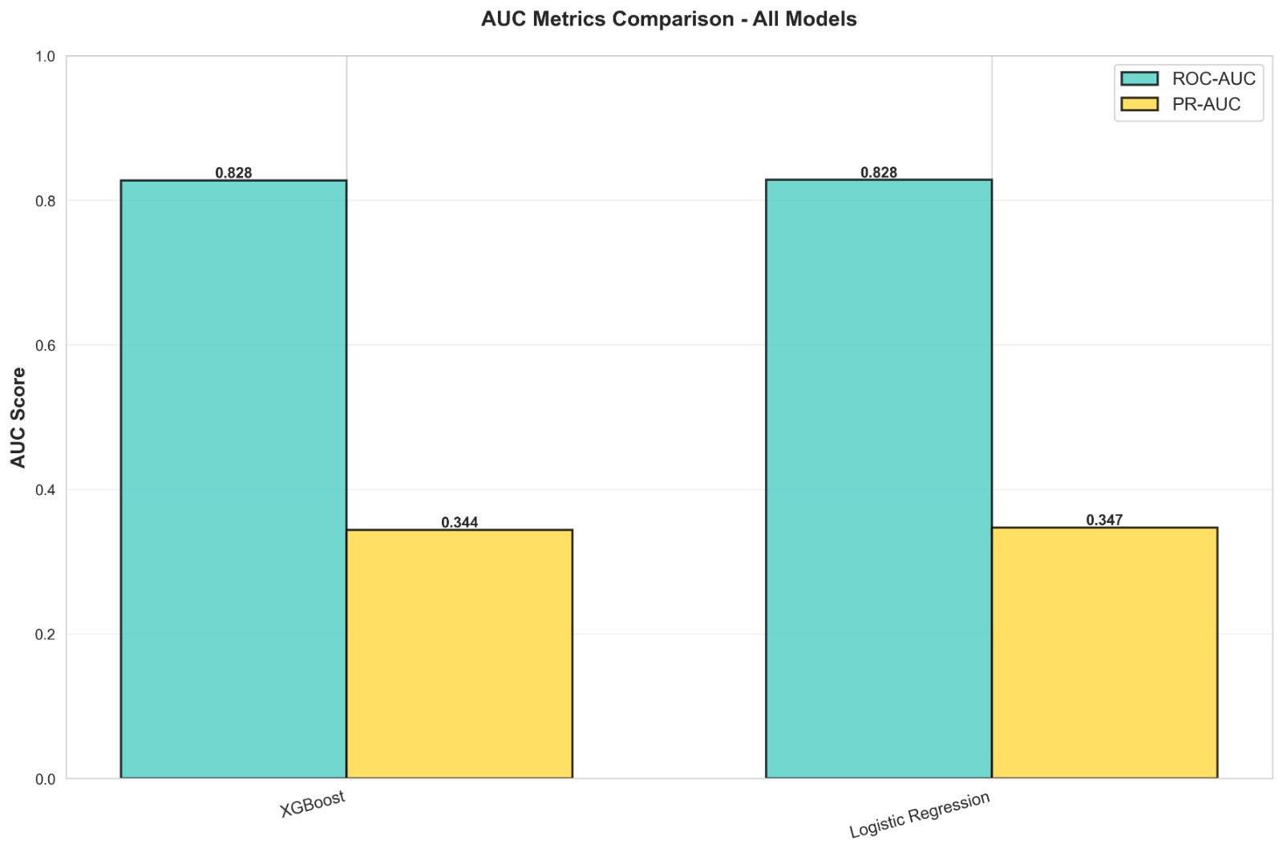

Slide 6
