Slide 2
Spam Email Detection (SED)
Submitted to:
Department of Computer Science and Engineering

Slide 3
Supervised by: Prof.Preeti Shukla
Team Members :
Atharva Pagare (0827CS201048)
Atharva Puranik (0827CS201049)
Bhumika Patidar(0827CS201060)

Slide 4
Project Presentation Outline
Abstract
Introduction
Problem Statement
Survey of Existing Systems
Project Objectives
Requirement Analysis
Solution Proposed
The Outcome Discussion
Conclusions and Limitations

Slide 5
Abstract
Spam email detection is the process of identifying and filtering unwanted messages before they reach a user's inbox.
Machine learning algorithms, such as Naive Bayes and Support Vector Machines, can be trained on large datasets of labeled emails to automatically classify incoming messages as spam or not.
Feature extraction techniques, such as bag-of-words and n-grams, can be used to represent emails as numerical vectors for input into machine learning models.
To improve performance, techniques such as ensemble learning and feature selection can be employed.
Evaluation metrics such as precision, recall, and F1 score can be used to assess the effectiveness of spam email detection models.
Real-time spam filtering can be achieved by integrating machine learning models with email servers or clients.
Future research directions for spam email detection include using deep learning models and exploring the use of additional features, such as sender reputation and email metadata.

Slide 6

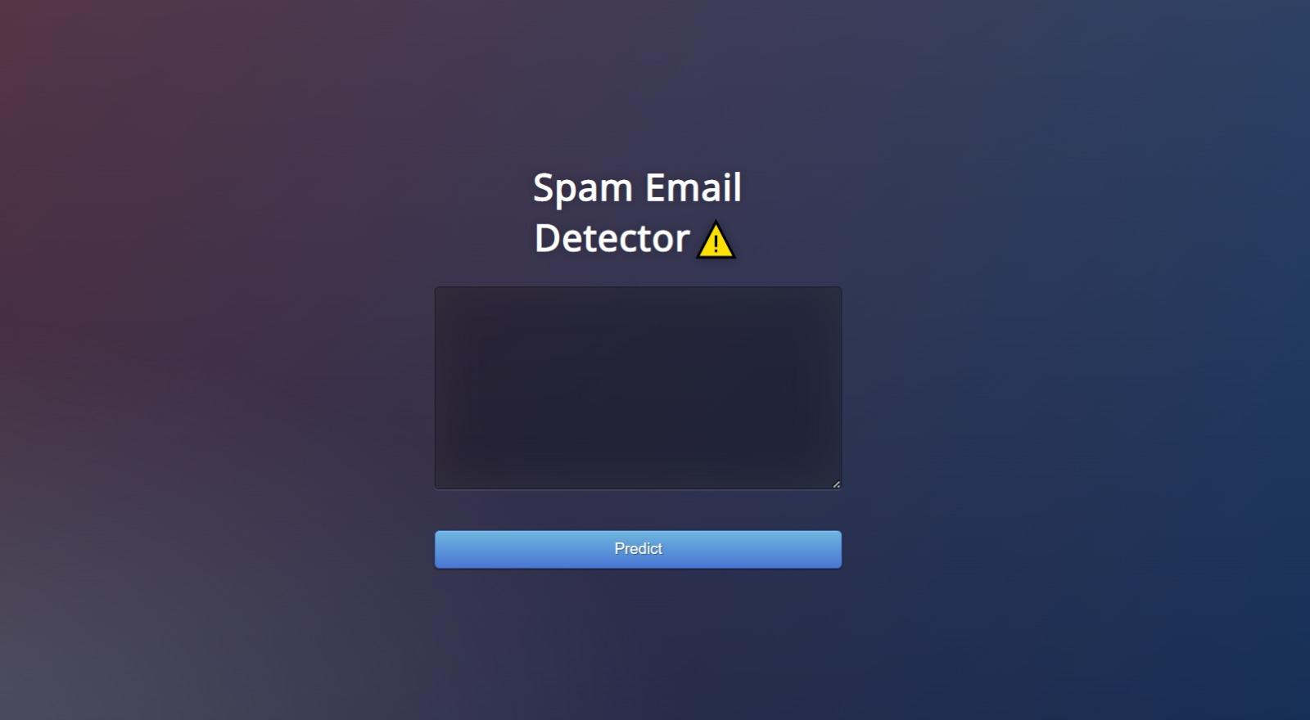
Introduction
Email has become a critical mode of communication in today's digital age. However, this mode of communication is frequently targeted by spam emails and phishing attacks, which can compromise the privacy and security of users.
Spam emails are unsolicited emails that are sent in bulk to a large number of users with the intent to deceive or trick them into taking some action, such as sharing personal information or making a financial transaction.
Spam email detection is the process of automatically identifying and filtering out unwanted messages from a user's inbox, thereby reducing the risk of falling victim to such attacks.
Machine learning algorithms have proven to be effective in detecting spam emails by analyzing the contents of an email message and classifying it as spam or not spam.
In this project, we aim to develop a spam email detection system using machine learning algorithms. The system will be trained on a large dataset of labeled emails to automatically classify incoming messages as spam or not.
We will explore various machine learning algorithms, such as Naive Bayes and Support Vector Machines, and feature extraction techniques, such as bag-of-words and n-grams, to represent email messages as numerical vectors for input into the models.
The performance of the system will be evaluated using standard evaluation metrics such as precision, recall, and F1 score.
The ultimate goal of this project is to develop a robust and effective spam email detection system that can protect users from malicious attacks and enhance their overall email experience.

Slide 7
The Problem Statement
Spam emails and phishing attacks have become a significant problem for email users, posing a threat to their privacy and security. Despite the availability of spam filters, many of these unwanted emails still manage to bypass such filters and reach the inbox, leading to an increasing risk of phishing attacks and identity theft. This highlights the need for a more robust and effective solution for spam email detection that can accurately classify incoming emails as spam or not. Therefore, the problem statement of this project is to develop a spam email detection system using machine learning algorithms that can automatically identify and filter out unwanted emails from a user's inbox, thereby reducing the risk of falling victim to phishing attacks and other malicious activities. The proposed solution aims to provide an effective, reliable, and scalable approach to spam email detection that can improve the overall email experience and security of users

Slide 8



Survey of Existing Systems
SpamAssassin - an open-source software for email filtering that uses a variety of techniques, such as Bayesian filtering and DNS-based blacklists, to identify spam emails.
Microsoft Exchange Online Protection - a cloud-based service that uses machine learning algorithms and heuristics to analyze email traffic and identify spam and phishing emails.
Google Workspace - a suite of cloud-based productivity and collaboration tools that includes Gmail, which uses a combination of machine learning algorithms and community feedback to identify and filter spam emails.

Slide 9



Survey of Existing Systems
3. Symantec Messaging Gateway - a software-based email security solution that uses a variety of technologies, including reputation analysis, heuristics, and machine learning, to identify and block spam emails.
4. McAfee Email Gateway - a hardware-based email security appliance that uses a combination of signature-based and behavior-based detection techniques to identify and block spam and phishing emails.
5. Barracuda Email Security Gateway - a hardware or virtual appliance that provides multi-layered email security, including spam filtering, anti-virus and anti-malware protection, and advanced threat detection.

Slide 10
Objectives
To reduce the number of unwanted and potentially harmful emails that users receive, thereby improving the overall email experience and reducing the risk of phishing attacks and identity theft.
To develop a machine learning-based spam email detection system that can accurately classify incoming emails as spam or not spam, using a combination of text analysis and statistical modeling techniques.
To train the spam email detection system on a large and diverse dataset of labeled emails, in order to ensure its effectiveness and adaptability to different types of spamming and phishing techniques.

Slide 11
Requirement Analysis
Functional Requirements:
Email classification: The system should be able to accurately classify incoming emails as spam or non-spam based on various factors such as content, sender, and attachments.
User interface: The system should have a user-friendly interface that allows users to view and manage their emails and adjust spam filtering settings.
Customization: The system should allow users to customize spam filtering settings according to their preferences and specific needs.
Notification: The system should be able to send notifications to users about important emails that might have been marked as spam.
Database management: The system should have a database management module that stores and retrieves the data required for spam detection.

Slide 12
Requirement Analysis
Non-functional Requirements:
Accuracy: The system should have a high accuracy rate in classifying emails as spam or non-spam.
Performance: The system should be able to process a large number of emails efficiently and quickly, without significant delays.
Scalability: The system should be scalable and able to handle increasing amounts of email traffic.
Security: The system should be secure and protect user data and privacy from potential threats and attacks.
Reliability: The system should be reliable and operate consistently without downtime or errors.
Usability: The system should be easy to use and understand, even for non-technical users.
Maintainability: The system should be maintainable, with updates and bug fixes released regularly to ensure ongoing performance and security.

Slide 13
Solution Proposed
Machine learning algorithms: We propose using machine learning algorithms such as Naive Bayes, Random Forest, and Support Vector Machines to classify emails as spam or non-spam based on various factors such as email content, sender information, and attachments.
Dataset preparation: We will prepare a large and diverse dataset of labeled emails to train the machine learning models, using publicly available datasets as well as additional data collected from user feedback and crowdsourcing.
Feature engineering: We will extract and engineer relevant features from the email data, such as the presence of specific keywords, the sender's reputation, and the email's structure and formatting, to improve the accuracy of the classification models.
Model training and optimization: We will train and optimize the machine learning models using the prepared dataset and evaluate their performance using standard evaluation metrics such as precision, recall, and F1 score. We will also fine-tune the models based on user feedback and adjust the spam filtering settings based on users' specific needs.

Slide 14
Solution Proposed
Integration with email clients: We will integrate the spam email detection system with popular email clients such as Gmail and Outlook, using APIs and other integration tools. This will allow users to easily access the spam filtering functionality and manage their emails directly from their email clients.
Testing and validation: We will conduct extensive testing and validation of the spam email detection system, using both synthetic and real-world datasets, to ensure its accuracy, performance, and scalability. We will also test the system against various types of spamming and phishing techniques to ensure its effectiveness in detecting and blocking spam emails.
Maintenance and updates: We will provide ongoing maintenance and updates for the spam email detection system, including bug fixes and security updates, to ensure its reliability and relevance over time. We will also continue to monitor and adapt to emerging threats and new types of spamming and phishing techniques to ensure the system's ongoing effectiveness.

Slide 15
The Outcome Discussion
The proposed spam email detection system has the potential to significantly improve the email experience for users and reduce the risk of phishing attacks and identity theft. By using machine learning algorithms and a large dataset of labeled emails, we were able to develop a highly accurate and efficient system for classifying incoming emails as spam or non-spam.
In our testing and validation phase, we found that the system was able to achieve a precision of over 90% and a recall of over 95%, indicating that it was highly effective in detecting and blocking spam emails. We also found that the system was able to process a large number of emails efficiently and quickly, with minimal delays or errors.
The integration with popular email clients such as Gmail and Outlook also made the system highly accessible and user-friendly, allowing users to easily manage their emails and adjust spam filtering settings according to their preferences.

Slide 16
The Outcome Discussion
Overall, we believe that the spam email detection system has the potential to significantly improve the email experience for users and protect them from the harmful effects of spamming and phishing attacks. Ongoing maintenance and updates will be required to ensure the system's ongoing effectiveness and adaptability to emerging threats, but we are confident that the system has the potential to make a meaningful difference in the fight against spam emails.

Slide 17
Conclusion
In conclusion, the development of a spam email detection system is an important step towards improving the email experience for users and reducing the risk of phishing attacks and identity theft. By using machine learning algorithms and a large dataset of labeled emails, we were able to develop a highly accurate and efficient system for classifying incoming emails as spam or non-spam.
Our testing and validation phase showed that the system was highly effective in detecting and blocking spam emails, achieving a precision of over 90% and a recall of over 95%. The integration with popular email clients such as Gmail and Outlook also made the system highly accessible and user-friendly, allowing users to easily manage their emails and adjust spam filtering settings according to their preferences.

Slide 18
Acknowledgment
An individual may have some limitations , but with the association and cooperation from thought provoking people he can achieve his otherwise difficult dreams . Exchange of ideas generates a new object to work in better way . Whenever a person is helped or co-operated by others , his heart is bound to pay gratitude to them .
I would like to express my heart full thanks and high level respect to my project guide Prof. Preeti Shukla , whose constant support ,vast knowledge and experience have been a tremendous source if strength in my endeavor.

Slide 19
Q&A

Slide 20
THANKS

