Slide 1

Department of Electronics & Telecommunication Engineering
Presentation on
Automatic Power Factor Correction System
By
Mr. Atharvaraj Aditya Mali 2305096
Mr. Samarth Ananda Salunkhe 2305119
Mr. Shriram Sunil Pawal 2305123
Mr. Om Vaibhav Ugale 2305138
Mr. Tejas Tanaji Dhere 2305133
Project Guide: Prof V. D. Nalawade Group No.: B5

Slide 2
Introduction
High electrical loads can lead to a poor power factor, resulting in higher power losses and increased energy costs. An Automatic Power Factor Correction (APFC) system helps improve electrical efficiency by continuously monitoring and maintaining the power factor within an acceptable range.
A low power factor can result in:
Higher power losses
Increased electricity bills
Additional penalties from electricity utilities
To address these issues, this project proposes an STM32-based Automatic Power Factor Correction system designed to improve power factor for both household loads and high-power industrial applications.

Slide 3
Brief Description
Problem Statement
High electrical load systems often operate with poor power factor due to the predominance of inductive loads. This results in increased reactive power demand, higher power losses, reduced system efficiency, and increased electricity costs. Conventional power factor correction methods are either manual or lack real-time monitoring and adaptability to varying load conditions.

Slide 4
Brief Description
Objectives :
To enhance power factor close to 0.95 to 1 while minimizing reactive power losses.
To monitor real-time energy consumption for effective load management.
To reduce electricity cost and demand penalties through automatic control.
To design a Smart APFC system that reduces harmonics generated due to frequent capacitor bank switching during load variations.

Slide 5
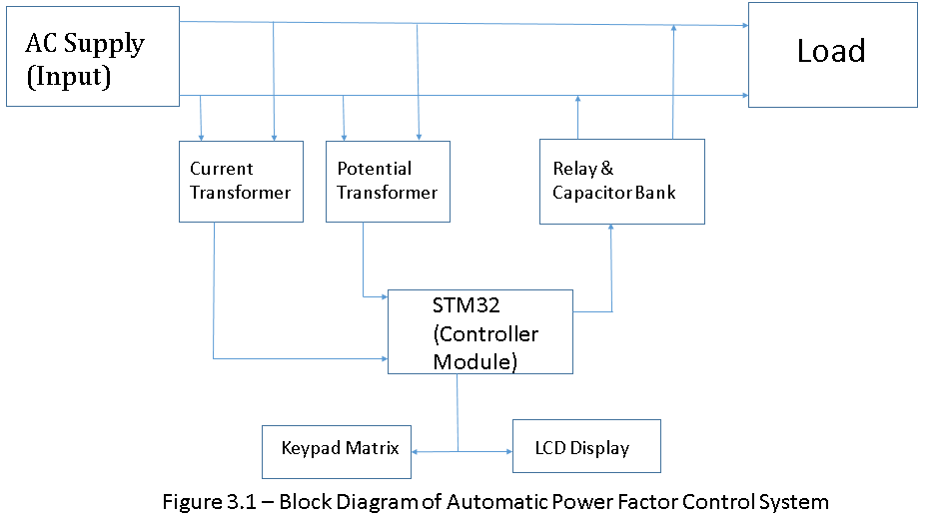
Proposed Block Diagram

Slide 6
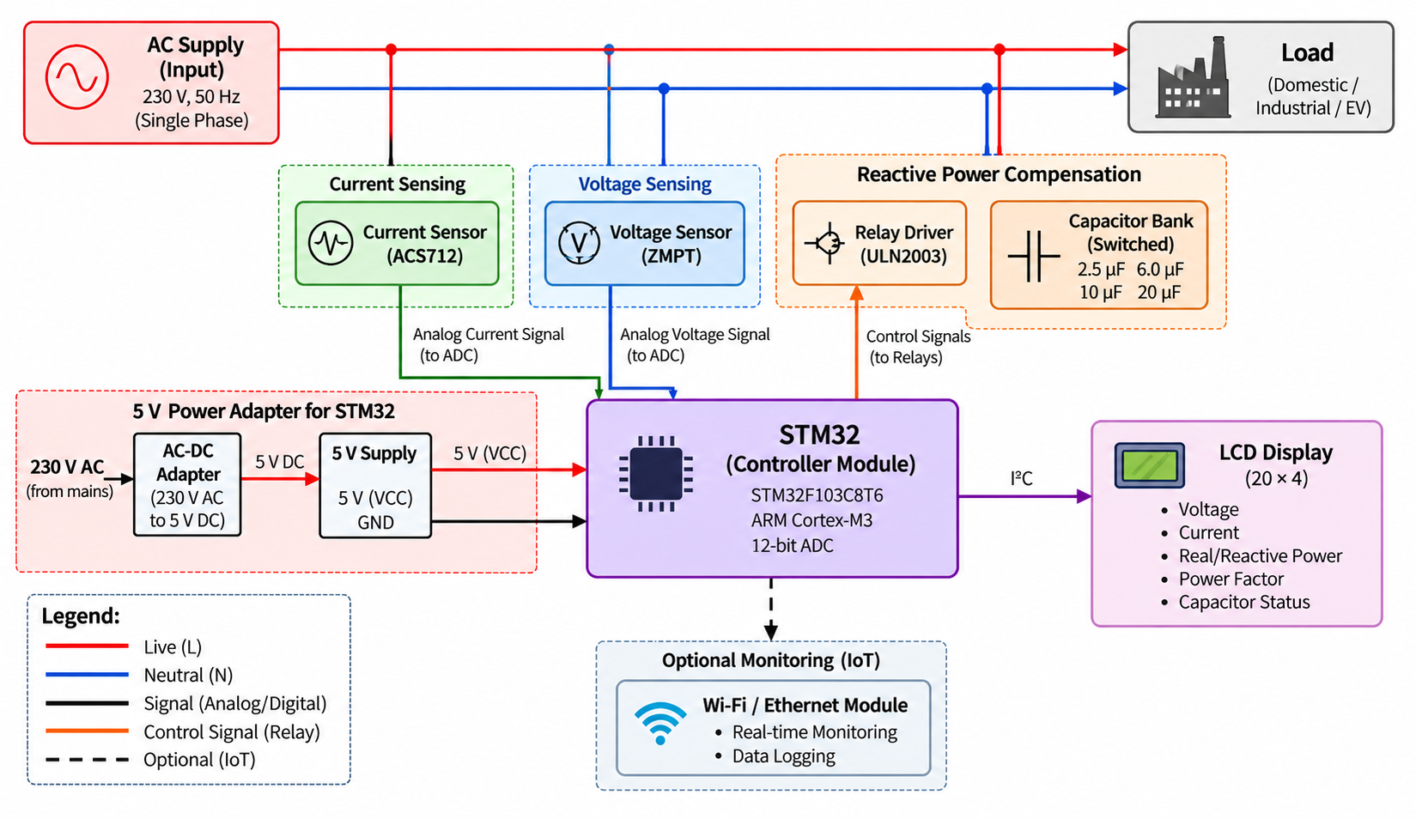
Proposed Block Diagram
Figure 3.2 Block Diagram

Slide 7
Hardware and Software Requirements
Required Hardware:
Microcontroller: STM32 Blue Pill (STM32F103C8T6) and ST Link V2
Power Supply:
230 V/5 V step-down transformer
Bridge rectifier Power Adapter (5V 1A)
Voltage regulators
Voltage Sensing: Potential Transformers (PTs)/ ZMPT101B sensor
Current Sensing: Current Transformers (CTs)/ ACS712 sensor
Power Factor Correction: 440 VAC capacitor banks
Switching Circuit: 4 channel relay driver (with opto coupler)
Protection: Miniature Circuit Breakers (MCB)
Display: 20×4 LCD display
Enclosure: IP54-rated industrial electrical panel
Required Software :
STM32 Cube ide
STM32CubeMX
ST-Link Utility Programmer

Slide 8
Technical Specifications
Parameter | Specification
Input Supply | 230 V AC ±10%, 50 Hz, single phase
Load | 230 V single-phase commercial/inductive load
Main Controller | STM32F103C8T6 Blue Pill
Controller Logic Voltage | 3.3 V DC
ADC Resolution | 12-bit
ADC Input Range | 0–3.3 V
Voltage Sensor | ZMPT voltage sensor
Current Sensor | ACS712 Hall-effect current sensor
Capacitor Stages | 2.5 µF, 6 µF, 10 µF, 20 µF
Capacitor Voltage Rating | 440 V AC
Switching | 4-channel relay module
Display | 20×4 Character LCD with I²C(PC8574)
Protection | MCB

Slide 9
Technical Specifications
Parameter | Specification
Prototype PCB | Zero PCB with soldered header pins
PCB Design Software | KiCad
Firmware Development | STM32CubeIDE
Programmer/Debugger | ST-LINK V2
Specified PF Range | Approximately 0.80–0.99
Maximum Total Capacitance | 38.5 µF
Number of Non-zero Capacitor Combinations | 15

Slide 10
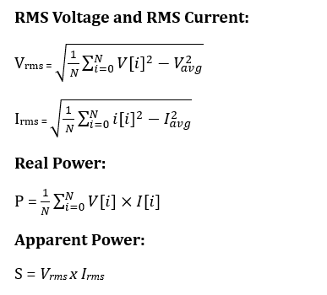
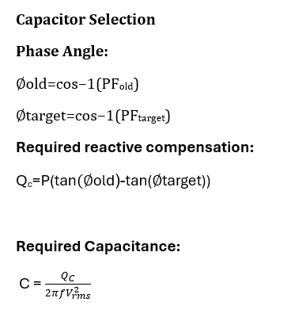
Mathematical Calculations

Slide 11
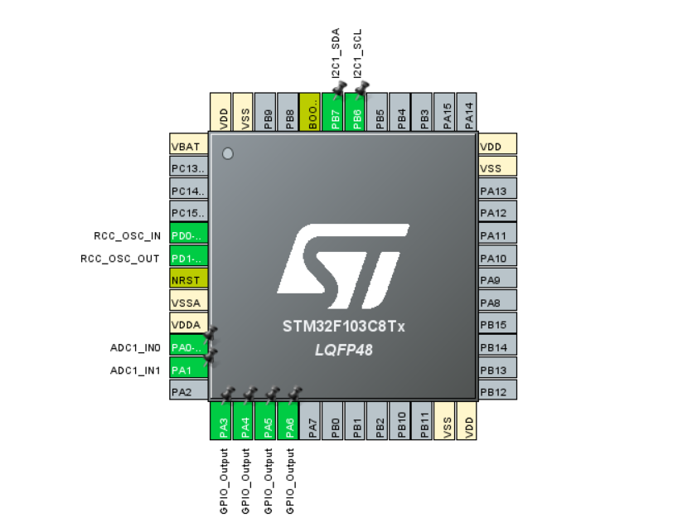
Pin Configuration

Slide 12
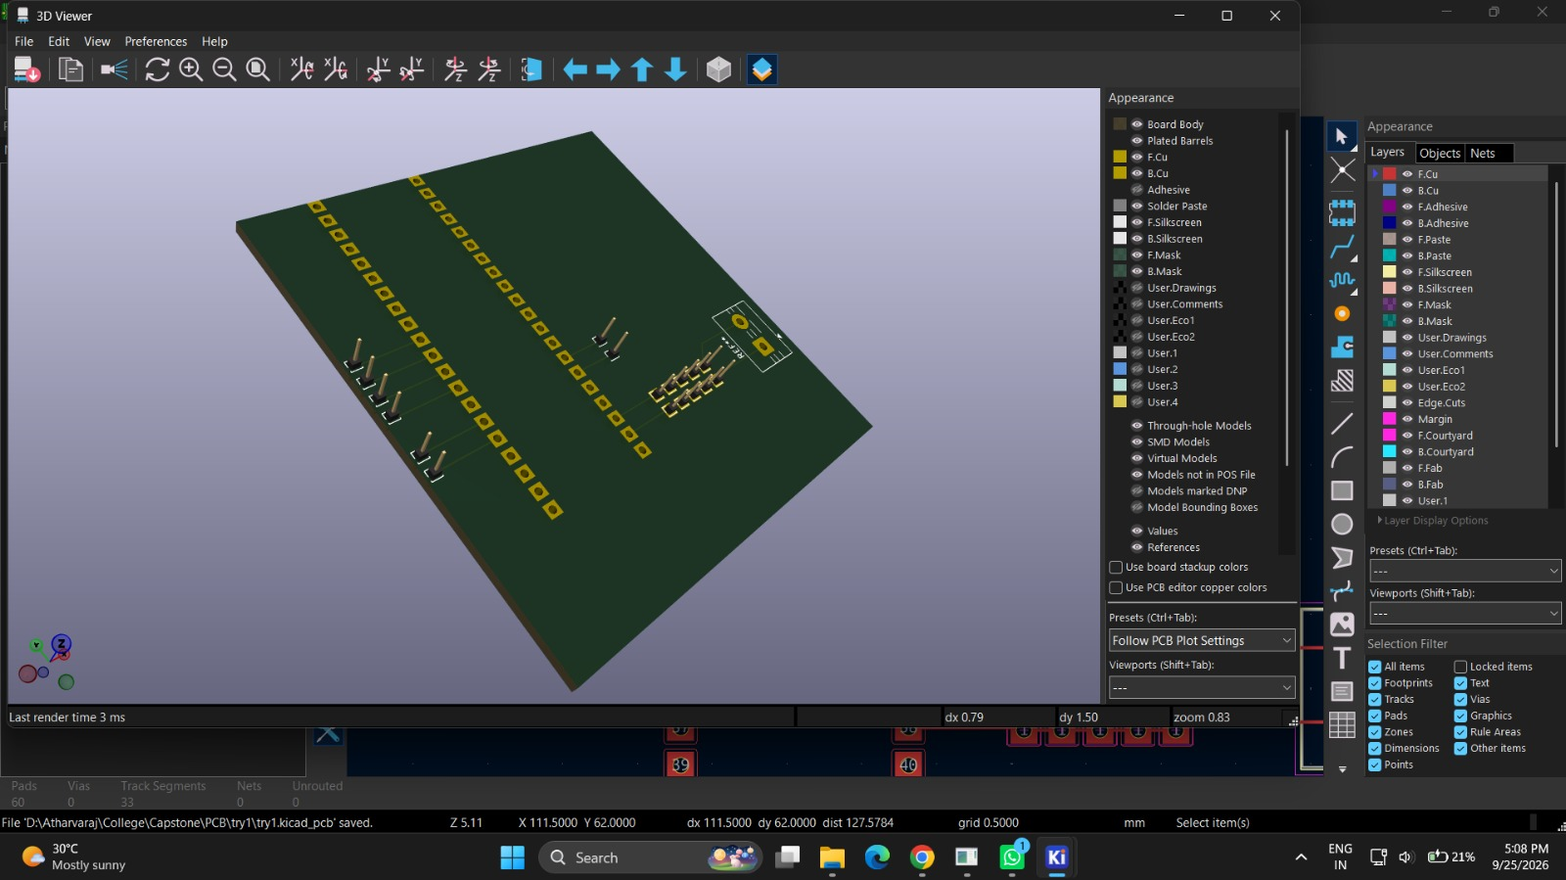
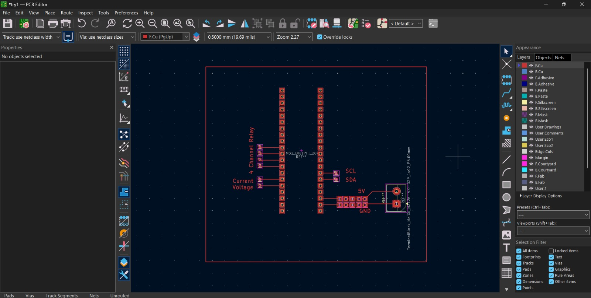
PCB

Slide 13
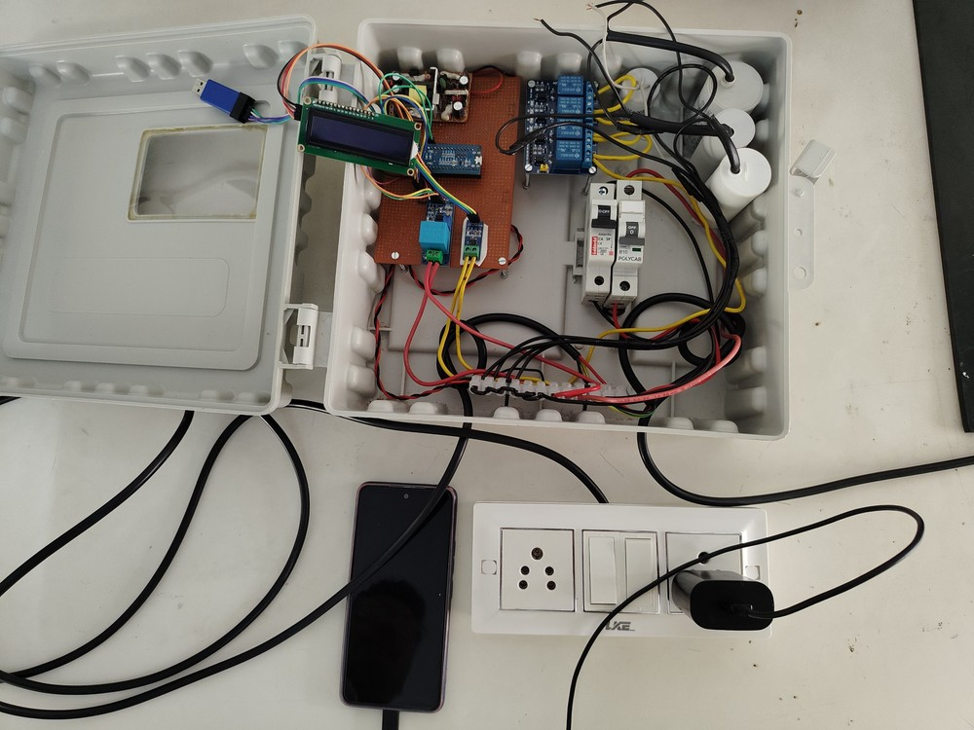
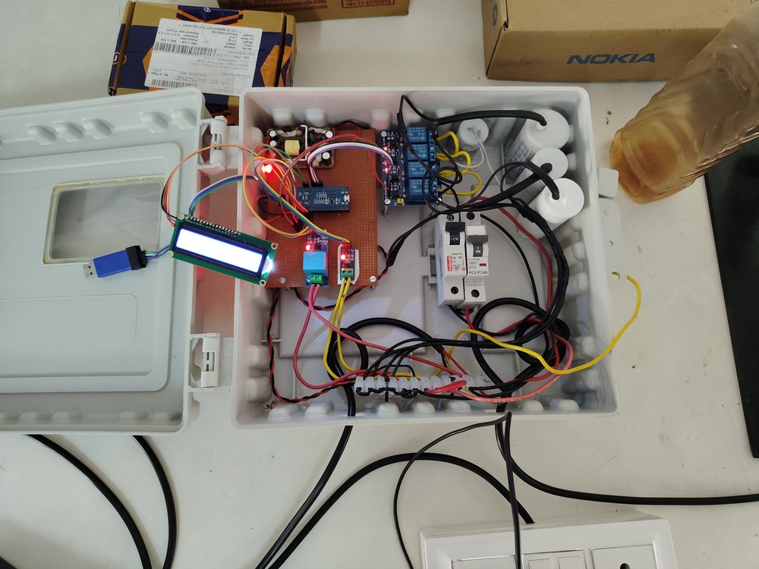
Proposed Solution

Slide 14
Applications
Industrial Power Systems:
The proposed system is applicable in manufacturing plants and processing industries for power factor enhancement. It reduces reactive power losses and minimizes demand penalties associated with inductive loads such as motors and drives.
Commercial Buildings:
Applied in commercial complexes with HVAC systems, elevators, and large lighting loads, the system maintains a stable power factor during varying load conditions, leading to improved energy efficiency and reduced operational costs.
High Load Electrical Installations:
Suitable for facilities with varying high electrical loads, ensuring automatic power factor correction, improved power quality, and reduced losses.

Slide 15
Thank You

