Slide 1
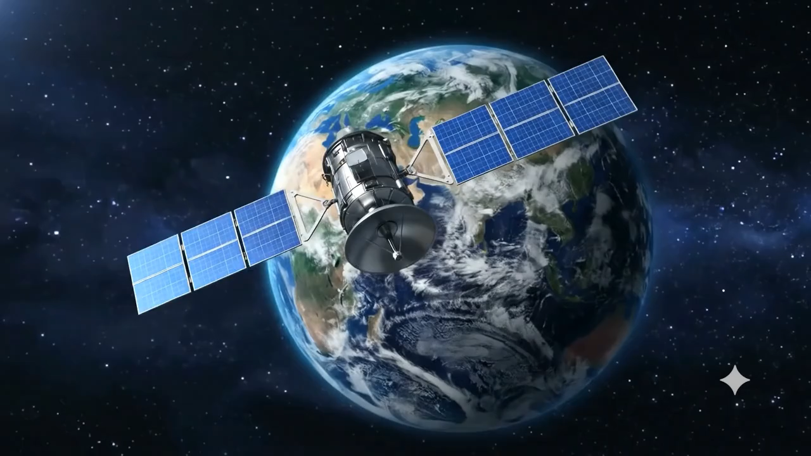
Notes:
[0:00–0:30] Open strong, look up, don't touch the laptop. "This is RS-VQA. In one line: ask satellite imagery anything — and trust the answer. It's an AI that answers plain-language questions about satellite images, shows you the exact objects behind each answer, and — unlike most AI — it knows when to say 'I'm not sure.' Let me show you why that last part changes everything."

Slide 2


RS·VQA
Remote-Sensing Visual Question Answering · FM-12a
Ask satellite imagery anything —
and trust the answer.
An AI that answers plain-language questions about satellite images, shows the evidence behind every answer, and knows when to say, “I’m not sure.”
Atharva Uday Kalase - 40509608
Notes:
[0:00–0:30] Open strong, look up, don't touch the laptop. "This is RS-VQA. In one line: ask satellite imagery anything — and trust the answer. It's an AI that answers plain-language questions about satellite images, shows you the exact objects behind each answer, and — unlike most AI — it knows when to say 'I'm not sure.' Let me show you why that last part changes everything."

Slide 3
THE PROBLEM
AI that's confidently wrong is worse than no AI
Today's vision AI, on a satellite image:
WHO FEELS IT
Hallucinates objects that aren't there
Disaster response
counting boats, blocked roads, damage
Miscounts what is there
Agriculture
Answers with total confidence — even when wrong
monitoring fields and infrastructure
Never admits doubt
Defence & security
identifying assets from overhead
In these fields, one confident wrong answer is costly
Notes:
[0:30–1:00] "General AI looks impressive — but on overhead satellite imagery it's unreliable. It invents objects, miscounts them, and answers with total confidence even when it's wrong. That's fine for a chatbot. It's dangerous for the people who actually rely on satellite imagery — disaster teams counting stranded boats, agriculture, defence. For them, a confident wrong answer costs time, money, and sometimes lives. The blocker to using AI here isn't intelligence — it's trust."

Slide 4
OUR SOLUTION
A specialist that answers — and verifies itself
RS-VQA is a satellite-image Q&A model, tuned for this domain and run entirely on-device.
It answers — plain-language questions about objects in an image — no GIS expertise needed.
1
It shows its evidence — overlays the objects it detected, so a human can verify the answer.
2
It abstains — when the evidence doesn't support the answer, instead of guessing.
3
Notes:
[1:00–1:30] "Our answer is not a bigger, general model — it's a focused specialist. RS-VQA does three things. One: it answers plain-language questions about a satellite image — anyone can use it, no GIS skills. Two: it shows its evidence — it overlays the objects it detected, so you can see what the answer is based on. And three, the important one: it abstains when the evidence doesn't back up the answer, instead of guessing. And it all runs on a single laptop — nothing leaves the building."

Slide 5
KEY FEATURES
Built for trust, not just answers
1
Ask in plain language
2
Answer + visible evidence
Natural questions about any satellite image.
Draws the detected objects behind each answer.
Benefit: No specialist tools or training — anyone can use it.
Benefit: People verify, not just trust — critical for decisions.
3
Knows when to abstain
4
Fully local & private
Flags and declines likely wrong answers at high precision.
Runs in 4-bit on a laptop GPU — offline.
Benefit: Avoids costly confident mistakes.
Benefit: No cloud, no data leaving site, no per-query cost.
Notes:
[1:30–2:15] Slow down — this is the core. "Four features, and each earns its place. Ask in plain language — natural questions, so anyone can use it, no specialist tools. Answer with visible evidence — it draws the objects it saw, so people verify rather than blindly trust; that's essential when a decision rides on it. Knows when to abstain — it flags and declines likely-wrong answers at high precision, so it avoids the costly confident mistake. And fully local — it runs on a laptop, offline, in 4-bit: your imagery never leaves site, and there's no per-query cost. Together these turn a clever demo into something you can actually deploy."

Slide 6


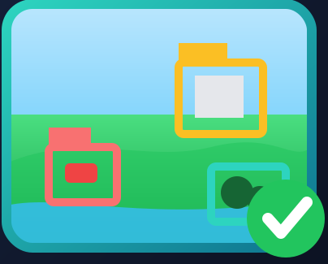

HOW IT WORKS
Four simple steps — no expertise required
1
2
3
4
Upload
Ask
Answer + evidence
Trust check
a satellite or aerial image
a question in plain English
get a clear answer with the detected objects shown
the system abstains if the evidence conflicts
The detector runs quietly in the background, so answers stay fast — the user just sees a clear answer and the evidence.
Notes:
[2:15–2:45] Walk left to right. "The experience is dead simple. Upload an image. Ask a question in plain English. You get a clear answer — with the objects it detected drawn right on the image. And behind the scenes, a trust check quietly abstains if the evidence doesn't line up. Four steps, no expertise, and the heavy lifting is invisible to the user. In the live demo you'll see the answer and the boxes appear together in one click."

Slide 7
WHAT MAKES IT STAND OUT
A small specialist beats a general giant
! Why this model Wins !
Domain fit beats scale
Our tuned model outperforms a general model four times its size.
Reliability, by design
It abstains instead of hallucinating — high-precision trust.
Private & on-device
No cloud, no data egress, no per-query cost.
Proven, not claimed
Validated by two independent scorers that agree.
Notes:
[2:45–3:20] "Here's the headline. Our specialised model, tuned for satellite imagery and running on a laptop, scores higher than a general model four times its size. The lesson: domain fit beats raw scale. On top of accuracy, we're reliable by design — we abstain instead of hallucinating. We're private and on-device — nothing goes to the cloud. And this isn't a cherry-picked number: two independent scoring methods agree on the ranking. Bigger isn't better here — fit-for-purpose is."

Slide 8
IMPACT & VALUE
What you actually get
Trustworthy answers
Fast to deploy
1
2
Verify with evidence; the system declines when unsure.
Runs on a laptop today; adapts to a new domain in under an hour.
Private by default
Scales cheaply
3
4
Sensitive imagery never leaves your environment.
No per-query cloud fees — cost doesn't grow with usage.
Notes:
[3:20–3:50] "So what do you actually get? Answers you can trust — backed by evidence, and honest when uncertain. Speed to deploy — it runs today on a laptop, and it adapts to a new type of imagery in under an hour. Privacy by default — your imagery stays with you. And it scales cheaply — because there are no per-query cloud fees, your cost doesn't balloon as usage grows. Practical value on day one, not a science project."

Slide 9
Trust is the feature.
RS-VQA answers questions about satellite imagery, shows its evidence, and knows when to abstain — privately, on a laptop, for free per query.
Next: a remote-sensing-tuned detector to make the evidence sharper — and a domain pilot on your imagery.
Atharva Uday Kalase · RS-VQA (FM-12a) · Where would reliable satellite Q&A create the most value for you?
Notes:
[3:50–4:20] Slow, confident, then stop. "Let me leave you with one line: trust is the feature. RS-VQA answers questions about satellite imagery, shows its evidence, and knows when to abstain — privately, on a laptop, with no per-query cost. The next step is a remote-sensing-tuned detector to sharpen the evidence, and a pilot on real imagery. So my question back to you is: where would reliable satellite Q&A create the most value for you?" — then stop talking and let them respond.

