Slide 1
Guidelines
Kindly use the given template for submitting your prototype(Make a copy of the template)
One team is only required to submit one project.
Follow this template while preparing your presentation.
You are welcome to add as many POCs and design concepts to support your project.
The project should be feasible and the team members should be capable enough, to come up with the fully functioning prototype of the same idea, if required.
In case of queries, kindly reach out to us at solutionchallengesupport@hack2skill.com
Note: Prototype must include cloud deployment and use at least one Google AI model or service (e.g., Gemini) as part of the solution.

Slide 2


Team Details
Team name: Samadhan Setu
Team leader name: Atharva Holsambre
Problem Statement: NGOs and volunteers often struggle to coordinate urgent community needs quickly, clearly, and fairly across locations.

Slide 3
Brief about your solution
Samadhan Setu is a smart volunteer coordination platform that helps NGOs capture community issues, identify urgency, and route tasks to the right volunteers.
The system combines task intake, live dashboards, map-based visibility, smart volunteer matching, prediction analytics, and a Gemini-powered assistant in one workflow.
It is designed for disaster relief, food support, medical outreach, education drives, and neighborhood development programs where fast action matters.

Slide 4
Opportunities
How different is it from any of the other existing ideas?
Samadhan Setu combines task creation, skill-based volunteer matching, heatmaps, predictive analytics, offline-safe reporting, and NGO verification in one product instead of splitting them across separate tools.
How will it be able to solve the problem?
It reduces response delay by structuring requests, tagging urgency automatically, surfacing the best-fit volunteers, and keeping every assignment visible until completion.
USP of the proposed solution
Gemini-powered guidance, smart matching using skills plus availability plus performance, geolocation-enabled task routing, and a complete volunteer-to-admin task lifecycle.

Slide 5
List of features offered by the solution
Volunteer and NGO authentication with role-based access
Voice-enabled task reporting for NGO users
Map pinning and Google Maps link generation for exact task location
AI-derived urgency, category, and escalation signals during task creation
Skill-based volunteer matching with availability and rating signals
Volunteer dashboard with open, assigned, and completed task stages
NGO admin dashboard with predictions, heatmap, leaderboard, and notifications
Offline task queue and cached task views for unstable connectivity
Gemini chatbot for platform guidance and volunteer support suggestions

Slide 6
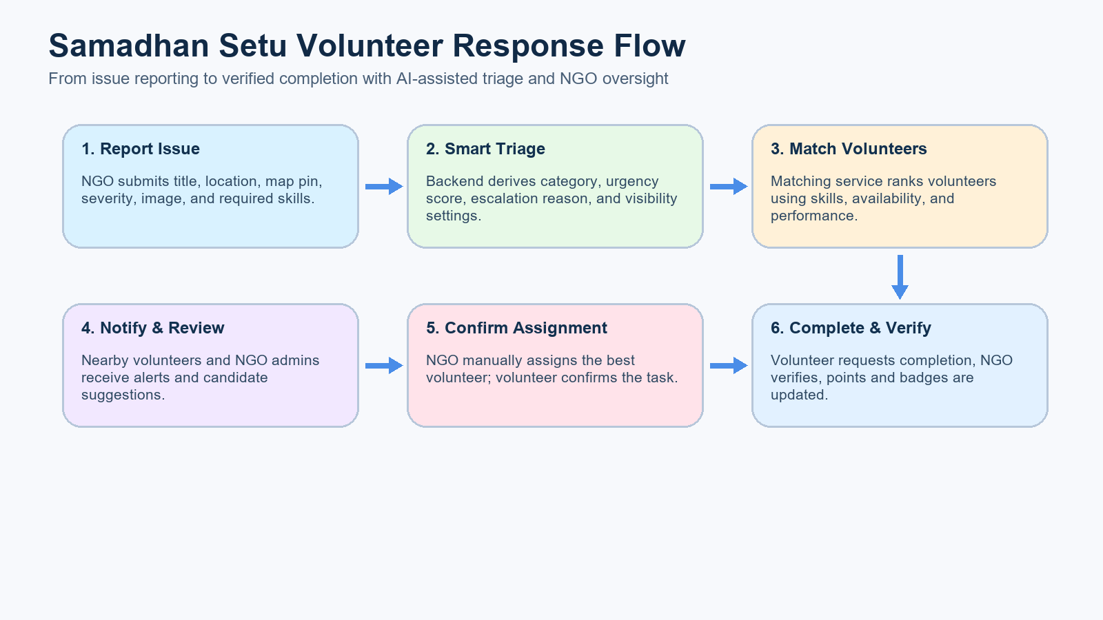
Process flow diagram or Use-case diagram
Shows the NGO-to-volunteer task lifecycle supported by Samadhan Setu.

Slide 7
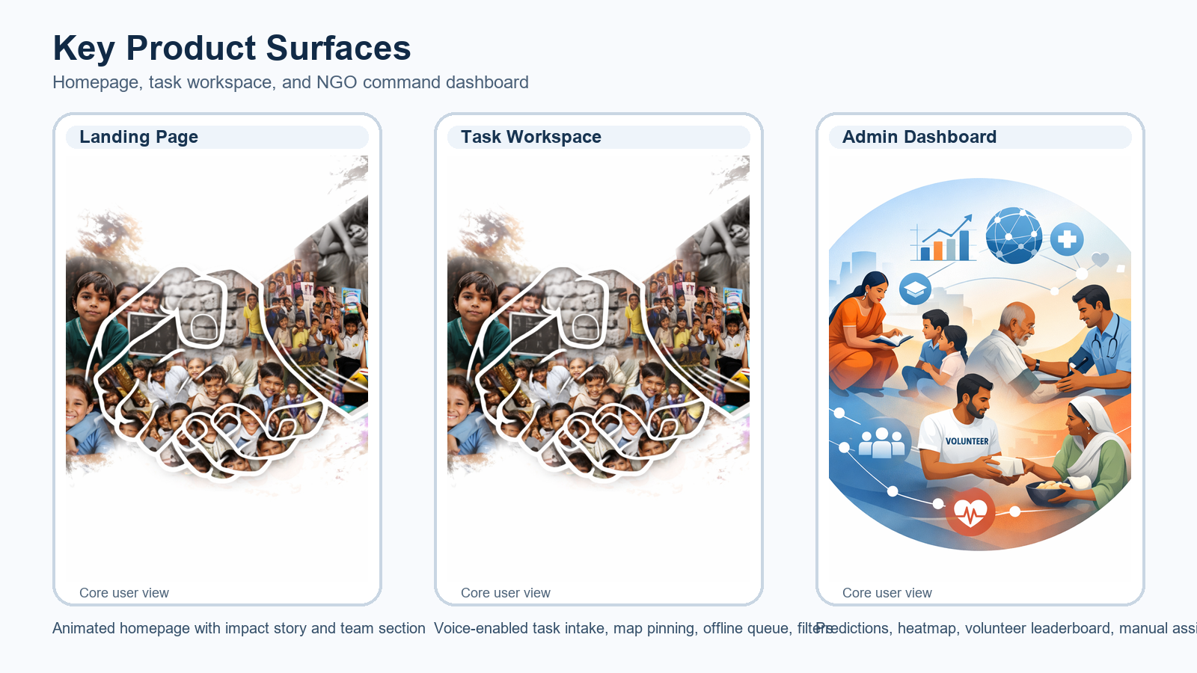
Wireframes/Mock diagrams of the proposed solution (optional)

Slide 8
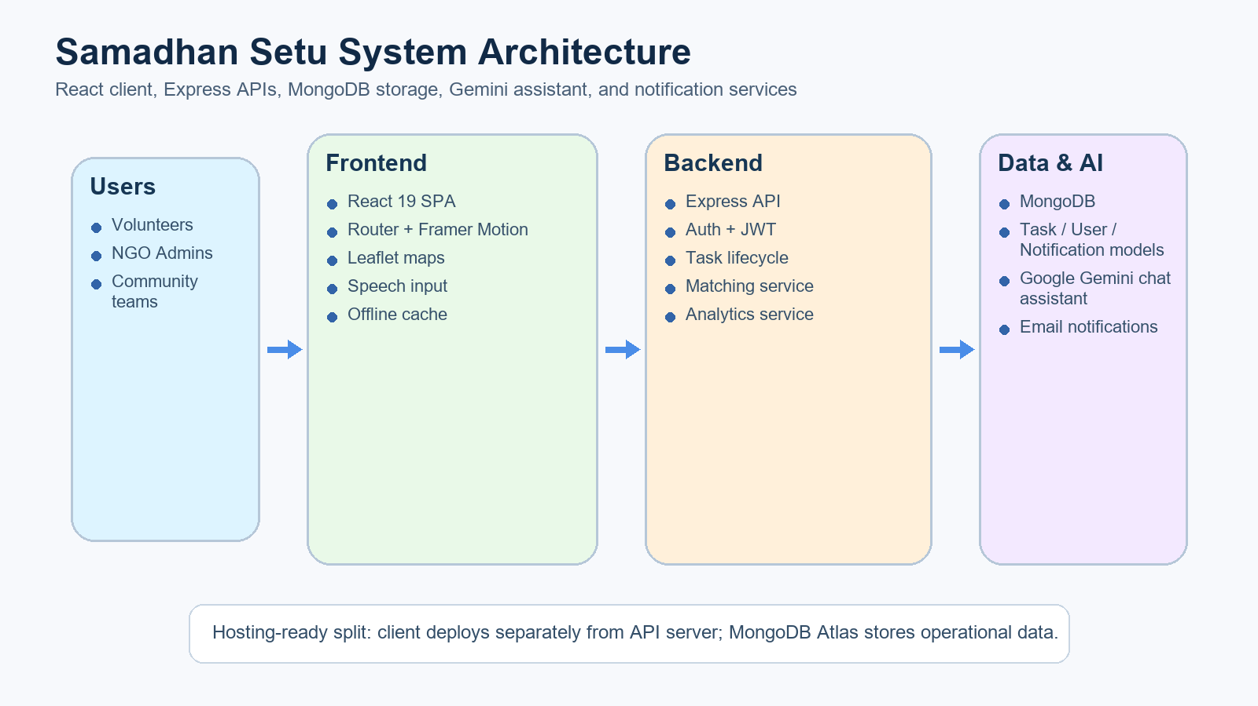
Architecture diagram of the proposed solution

Slide 9
Technologies to be used in the solution
Frontend: React 19, React Router, Framer Motion, React Leaflet, Chart.js
Backend: Node.js, Express, Multer, Nodemailer
Database: MongoDB / MongoDB Atlas
AI / Cloud service: Google Gemini via @google/generative-ai
Utilities: Browser SpeechRecognition, localStorage caching, JWT-based auth
Deployment plan: React client + Node/Express API + MongoDB Atlas cloud database

Slide 10
Estimated implementation cost (optional)
Development cost: Student prototype, built in-house by the team
Hosting: Vercel / Netlify for frontend and Render / Railway for backend
Database: MongoDB Atlas free or starter tier depending on traffic
AI usage: Gemini API usage cost depends on prompt volume and chosen model tier
Email alerts: Low-cost SMTP / Gmail app password based notifications for prototype
Estimated prototype operating cost: low to moderate for early-stage pilot deployment

Slide 11
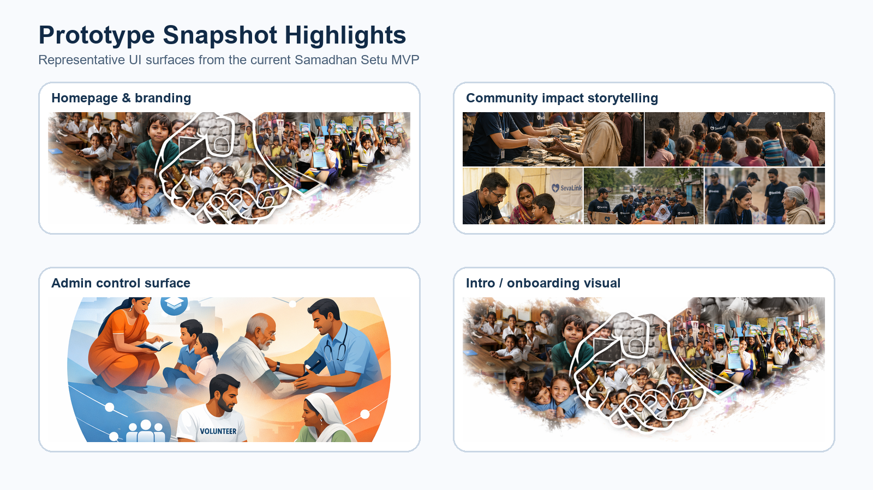
Snapshots of the MVP

Slide 12
Additional Details/Future Development (if any)
Add multilingual support for local communities and field volunteers
Integrate disaster-specific playbooks and suggested response checklists
Use stronger predictive models for resource forecasting by region and category
Add public beneficiary request forms and NGO-to-NGO collaboration workflows
Launch full cloud deployment with real-time notifications and mobile-friendly PWA packaging

Slide 13
Provide links to your:
1. GitHub Public Repository: https://github.com/Atharvax25/smart-volunteer-system
2. Demo Video Link (3 Minutes): To be added by team
3. MVP Link: To be added after public deployment
4. Working Prototype Link: Local prototype available from the project repository

Slide 15


