Slide 1

MindEase
Problem Statement: PS-XX
Domain: Healthcare
Team - MindEase
Atharv Kulshrestha
Project Lead • AI Integration • UI/UX
Avika Tanwar
Frontend Developer
HACK
MATRIX

Slide 2
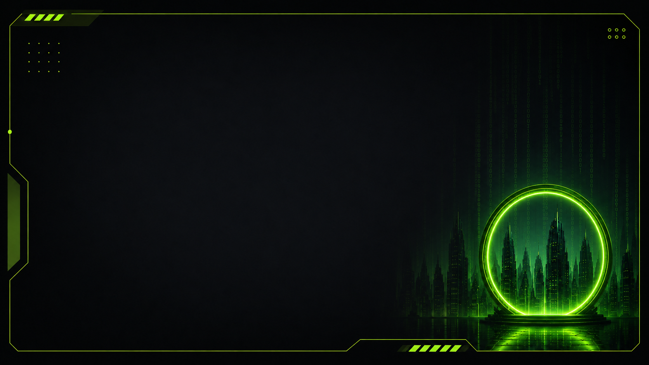
The Problem
Daily stress is often managed only after it becomes overwhelming.
Mental wellness tools are fragmented across journaling, mood tracking, meditation, and support.
Students and young professionals need low-friction habits they can sustain every day.
Who is affected?
Primary Users → Students & young professionals
Secondary Stakeholders → Families, educators & wellness teams
Broader Impact → Better emotional awareness and healthier daily coping habits
Problem Statement ID: PS-XX

Slide 3
WHY THIS PROBLEM EXISTS
• Mental wellness is often addressed only after stress or emotional problems become serious.
• Students and young professionals face academic pressure, work stress, social pressure, and emotional overload on a daily basis.
• Existing wellness tools are often fragmented across separate apps for journaling, mood tracking, meditation, music, and support.
• This makes consistent daily use difficult and reduces long-term engagement.
• Users often lack a simple way to understand their emotional patterns and identify which wellness activities actually help them.
• MindEase addresses this gap by bringing daily emotional check-ins, reflection, wellness activities, and personalized guidance into one platform.
->
Wellness is often treated as a response to distress rather than a daily practice.
->
Users switch between disconnected tools for mood, reflection, relaxation and support.
->
Without consistent habits, users get less visibility into their emotional patterns.
Current Approach:
Reactive support → fragmented experiences → friction → inconsistent use → limited long-term habit building

Slide 4
OUR SOLUTION
INTRODUCING MINDEASE 2.0
MindEase helps students and young professionals build daily mental-fitness habits by combining mood tracking, reflection, wellness activities and personalized AI guidance.
USER
↓
Mood / Journal / Activity input
↓
MINDEASE
↓
Context + mood history + wellness tools
↓
Personalized guidance & actionable activities
↓
Healthier daily habits
CORE CAPABILITIES
01 Emotional check-ins
Track mood and see patterns over time.
02 Guided reflection
Journal privately with prompts and AI-assisted reflection.
03 Personalized wellness
Connect insights with breathing, music, focus and AI support.
Three capabilities are highlighted because they form the core daily wellness loop.

Slide 5
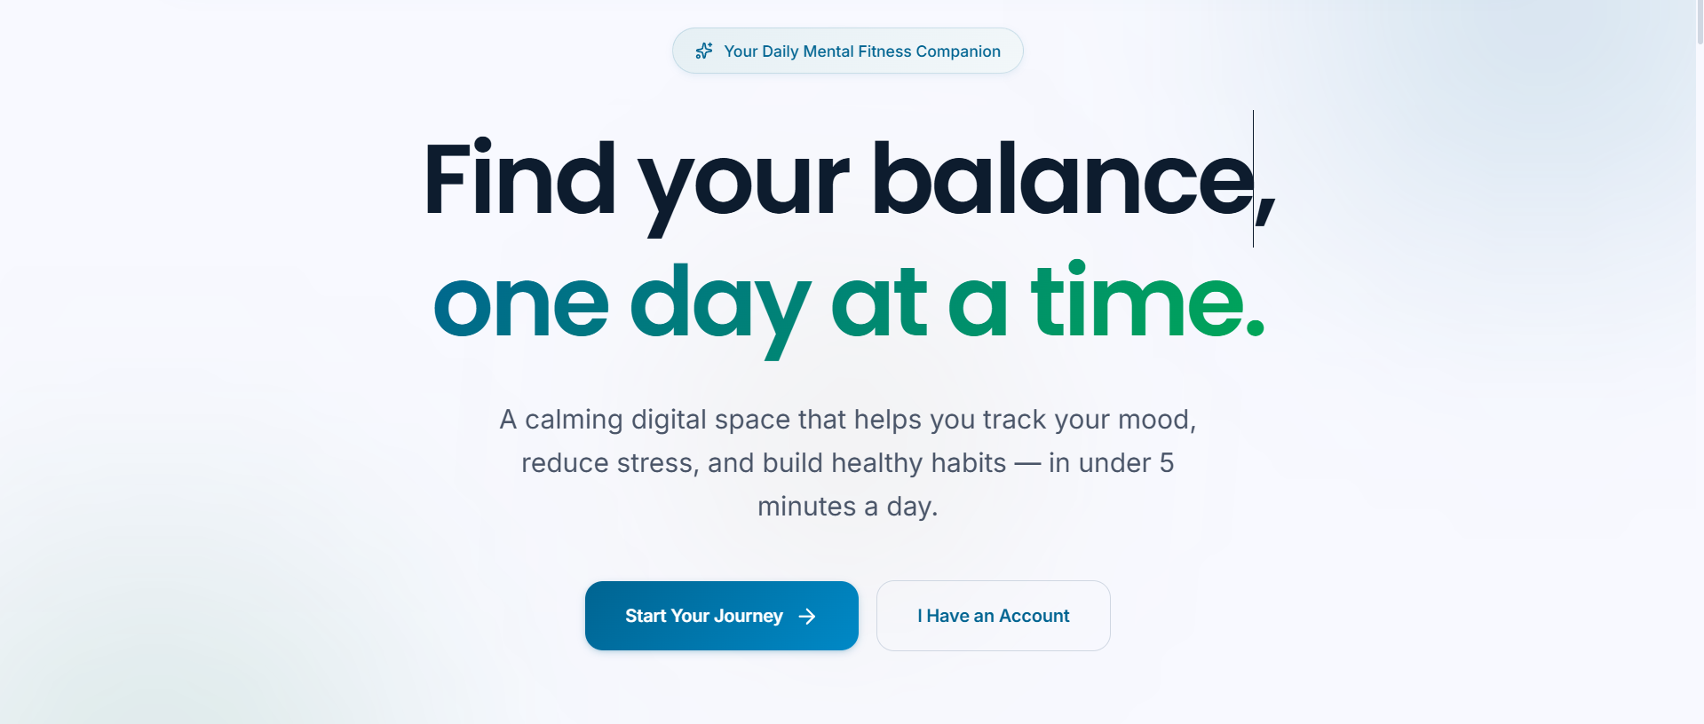
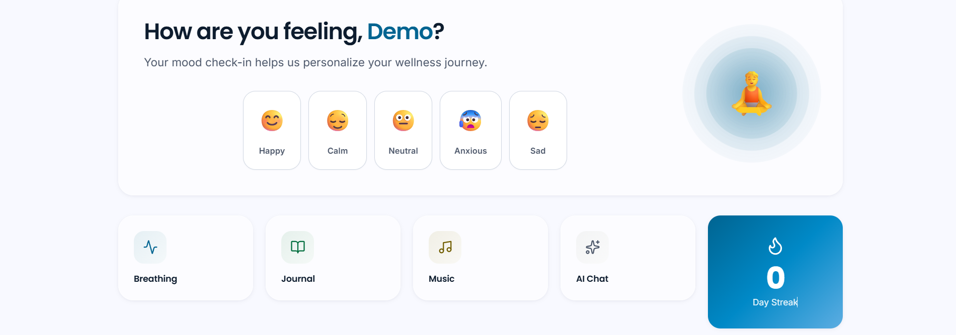
PROTOTYPE / PRODUCT EXPERIENCE
Landing Experience
USER JOURNEY
01 — INPUT
User checks in with a mood and can journal or choose a wellness activity.
02 — PROCESS
MindEase organizes mood context, history and available wellness actions.
03 — OUTPUT
The user receives a personalized dashboard, activity options and AI support.
04 — ACTION
The user completes an activity, reflects, and returns for the next daily check-in.
Dashboard Experience
Current prototype demonstrates the landing experience, mood check-in, dashboard, journal, music, breathing and AI Chat entry points.

Slide 6
WHAT MAKES US DIFFERENT?
WHY THIS APPROACH?
Dimension Existing approach MindEase
Daily habit loop Often fragmented ✓ Integrated
Mood tracking + reflection Separate tools ✓ Connected
Wellness activities Standalone tools ✓ In one flow
Personal context Limited continuity ✓ Mood history + journal context
Progress visibility Basic / scattered ✓ Dashboard & trend view
Low-friction daily use Varies ✓ Designed around short daily sessions
The differentiation is the connected workflow, not the use of AI alone. MindEase combines emotional check-ins, reflection, wellness actions and progress tracking into one daily experience.

Slide 7

CURRENT WORKFLOW
Technologies are separated into current implementation and planned architecture to avoid overstating the prototype.
USER
CURRENT IMPLEMENTATION
Frontend
React + Vite + JavaScript + CSS
State / App Context
Context API
Persistence
Browser Local Storage
Visualization
Recharts
AI
OpenAI API integration
PLANNED / FUTURE
Backend: FastAPI + Python
Database: Supabase
Technical
• Built with mature web technologies: React, Vite and JavaScript.
• Current persistence works through browser local storage.
• Recharts supports the analytics/dashboard layer.
• OpenAI API can support the AI companion layer.
Operational
• Runs as a web application with no special hardware.
• Current MVP focuses on a small, demonstrable daily wellness workflow.
• Future backend work can move persistence and authentication to managed services.
Hackathon MVP
• Landing page
• Mood check-in
• Dashboard
• Journal
• Breathing
• Music
• AI Chat entry point
REACT UI
MOOD / JOURNAL / ACTIVITY
CONTEXT + LOCAL STORAGE
AI / INSIGHTS
ACTIONABLE WELLNESS
Only list technologies that are genuinely part of the implementation.

Slide 8
FEASIBILITY + IMPACT
FEASIBILITY
IMPACT
• React, Vite, JavaScript, CSS, Recharts
• Local Storage for data
• AI Chat interface, OpenAI API planned
• FastAPI + Supabase planned
Operational
• Web browser + internet
• Netlify deployment
• No installation required
Hackathon MVP
• Mood tracking
• Dashboard
• Journal
• Breathing activities
• Music
• AI Chat interface
• Basic wellness insights
Who benefits?
Students and young professionals managing everyday stress and emotional overload.
What improves?
Consistency of emotional check-ins, reflection and access to simple coping activities.
Why does it matter?
A low-friction daily workflow can help users notice patterns earlier and build repeatable wellness habits.
Progression
Prototype → MVP → Pilot → Scale

Slide 9
IMPLEMENTATION ROADMAP
WHAT HAPPENS NEXT?
NOW
Hackathon Prototype
✓ Functional React/Vite UI
✓ Mood check-in
✓ Dashboard
✓ Journal
✓ Breathing & music
✓ AI Chat interface
✓ Initial validation
NEXT
MVP
• Strengthen AI personalization
• User testing
• Reliability
• Security & privacy review
• Better analytics
• Refine daily wellness loop
LATER
Deployment
• Backend services
• Secure authentication
• Persistent cloud data
• Real-world pilot
• Analytics
• University integrations
SCALE
• More users
• University wellness programs
• More locations
• Community features
• Smart notifications
Already built
vs.
Planned
Critical point
Clearly separate:
Already built
vs.
Planned

Slide 10
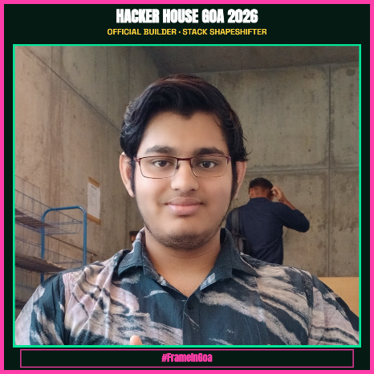

TEAM + EXECUTION
Why this team can execute the solution
The team combines product ownership, frontend engineering, UI/UX and AI integration to turn MindEase from a concept into a functional web prototype and continue it toward a testable MVP.
ATHARV KULSHRESTHA
Project Lead
AI Integration
UI/UX
Product & Architecture
AVIKA TANWAR
Frontend Developer
React / UI implementation
Frontend integration
Product experience

