Slide 1
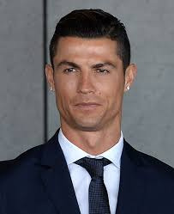
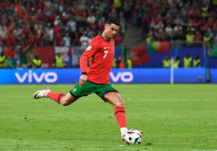
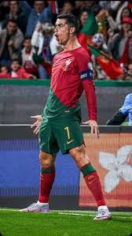
Career Analysis of Cristiano Ronaldo
Based on Exploratory Data Analysis (EDA)

Slide 2
Cristiano Ronaldo
Position: winger (usually on the left)
Nationality: Cristiano Ronaldo's nationality is Portuguese. He was born in Funchal, Madeira, Portugal, on February 5, 1985
Years active:
Cristiano Ronaldo has been active as a professional footballer from 2002 to the present. Here’s a breakdown:
2002: Ronaldo made his professional debut for Sporting CP.
2003–2009: Played for Manchester United.
2009–2018: Played for Real Madrid.
2018–2021: Played for Juventus.
2021–2022: Returned to Manchester United.
2023–Present: Playing for Al Nassr in Saudi Arabi

Slide 3
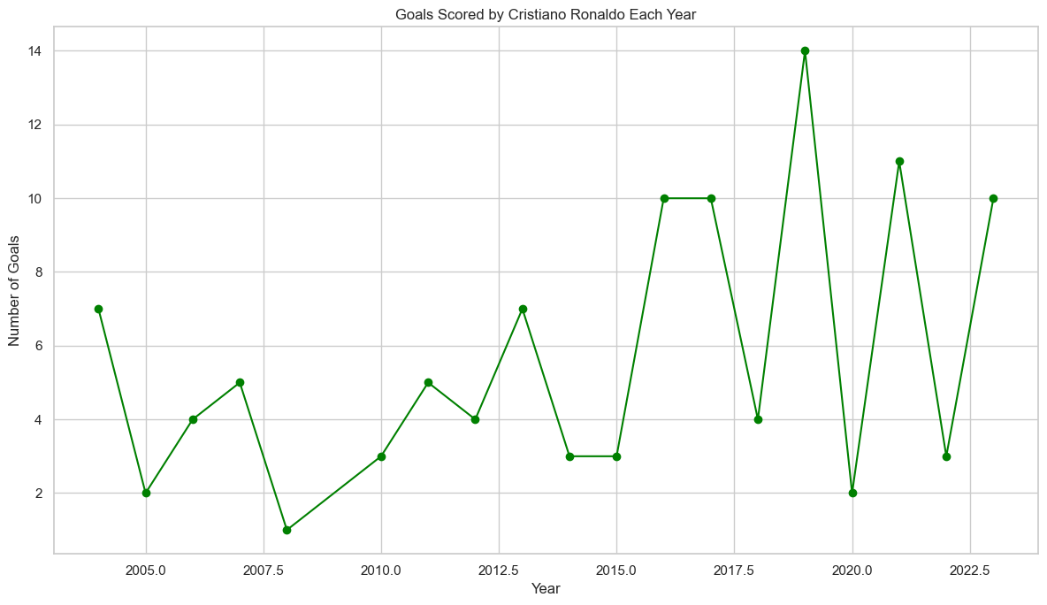
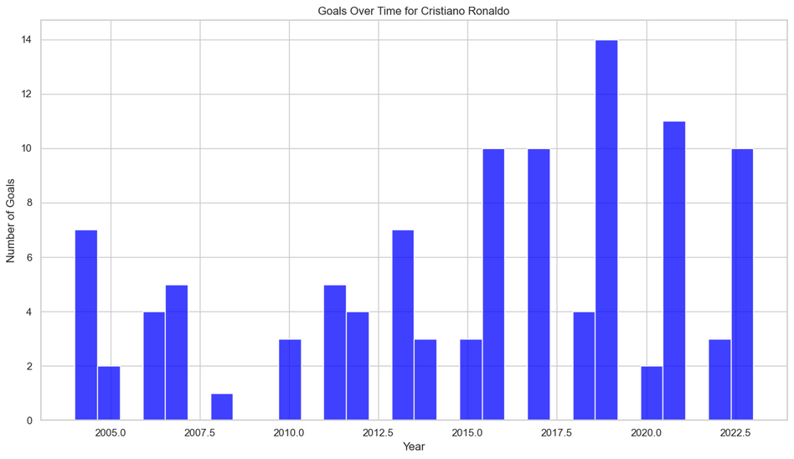
Goals scored by Cristiano Ronaldo over the years

Slide 4
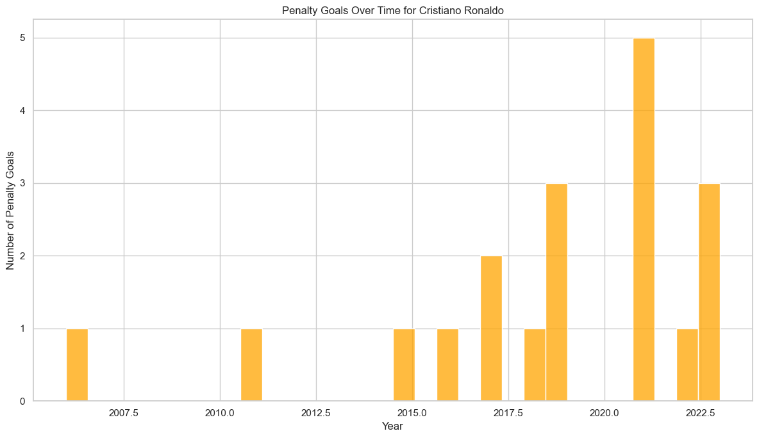
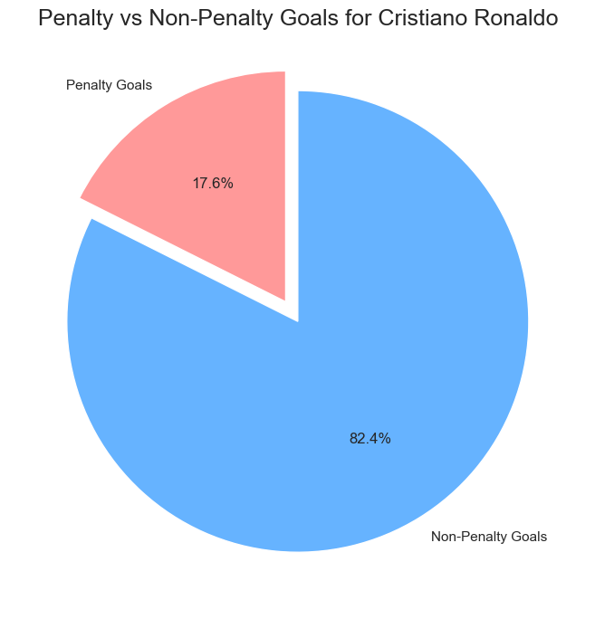
Penalties scored by Cristiano Ronaldo

Slide 5
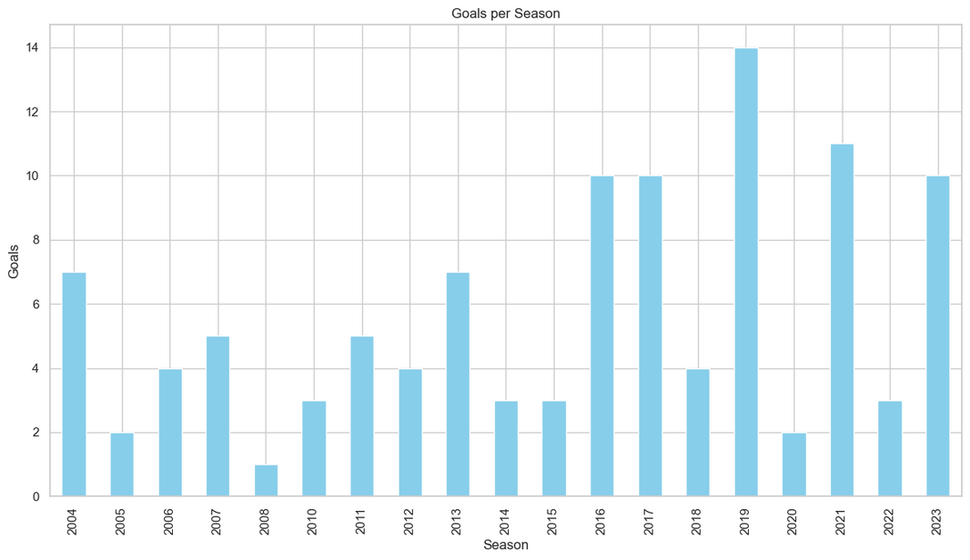
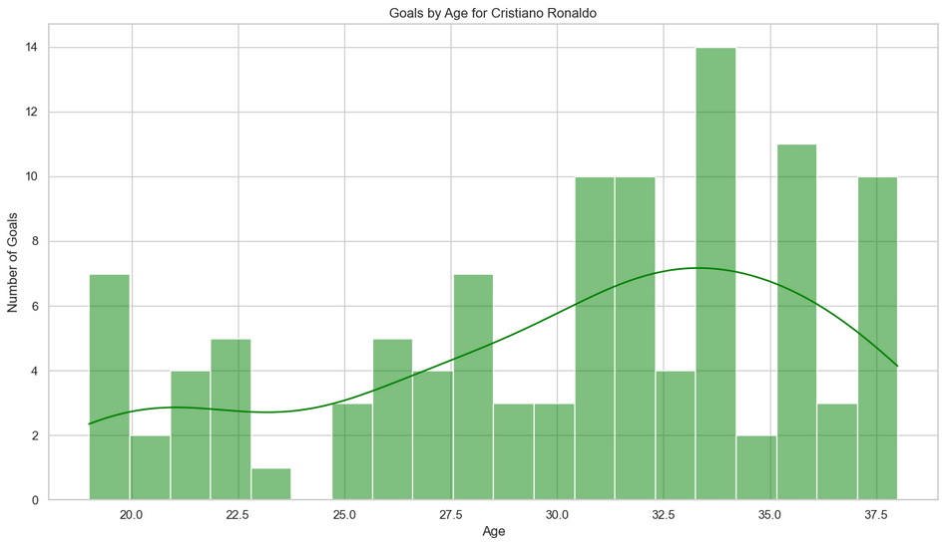
Goals per season

Slide 6
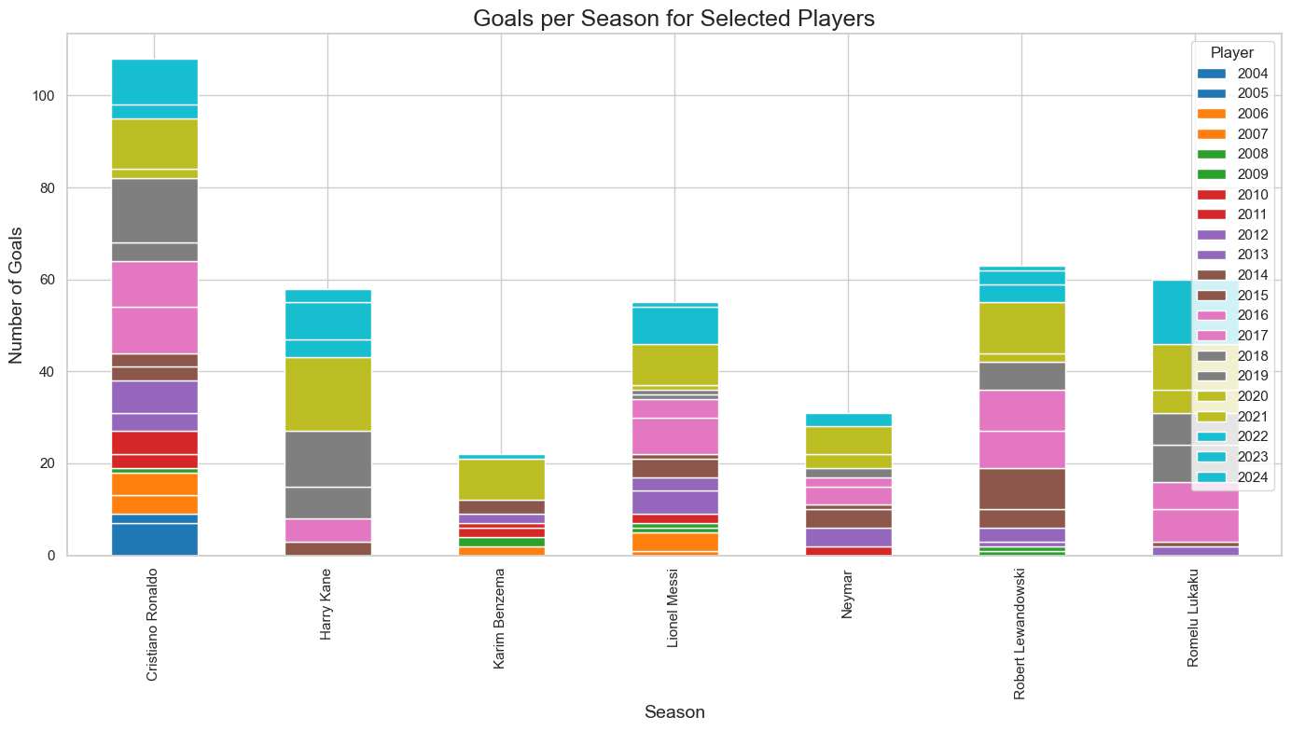

Slide 7
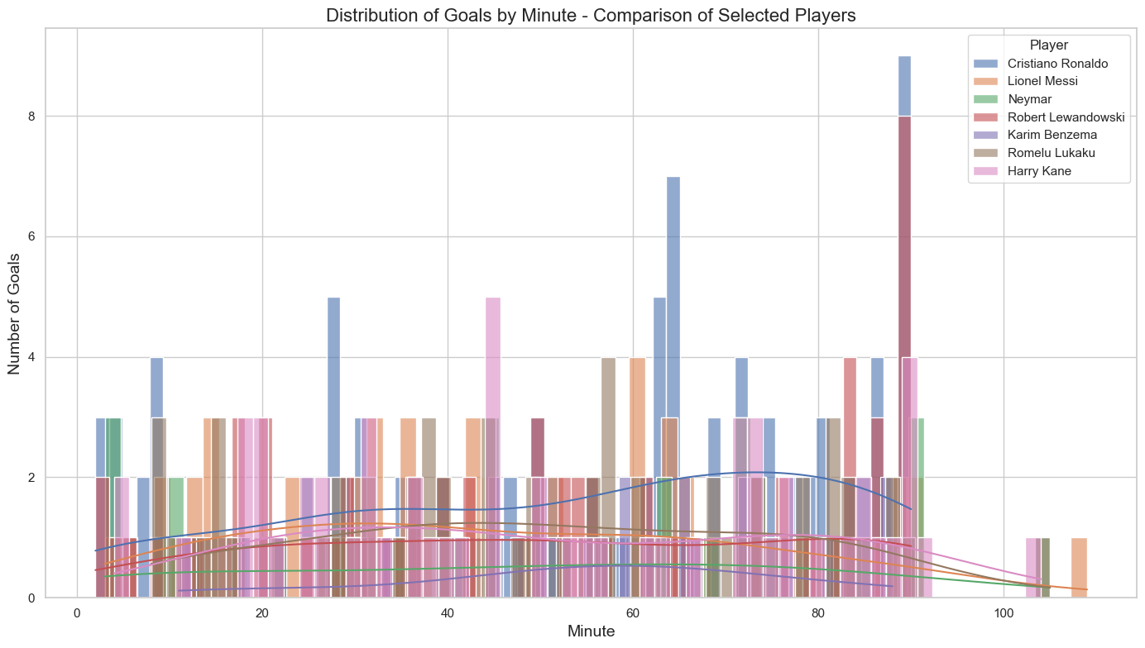

Slide 8
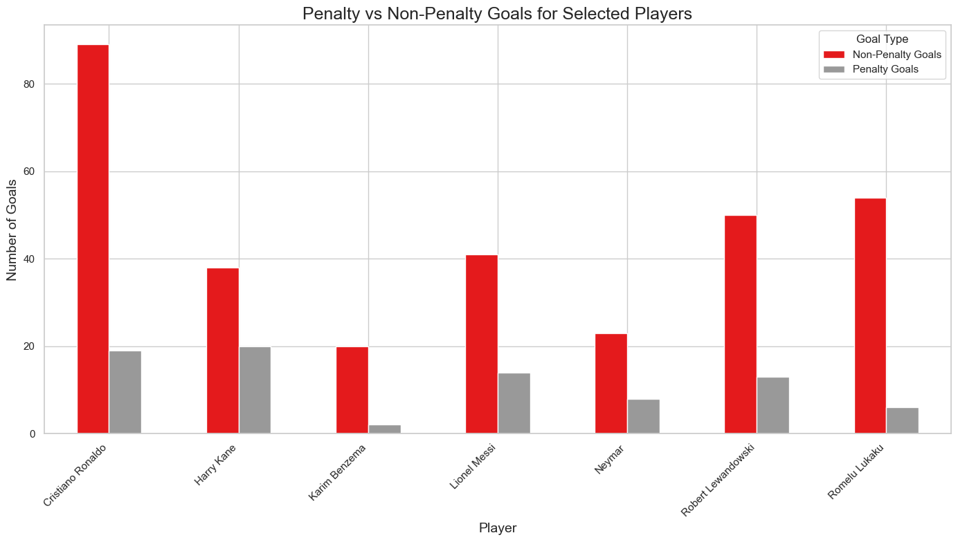

Slide 9
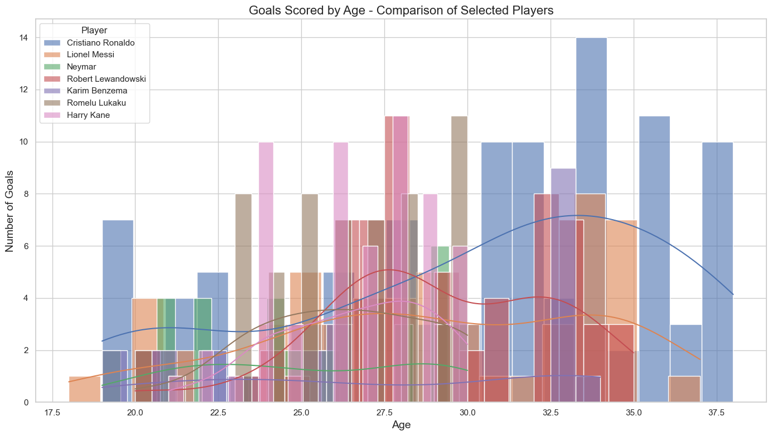

Slide 10

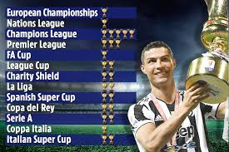
Trophies

