Slide 1

ZeroWaste Connect: Cloud-Based Food Redistribution System
Course Code: CSA1507
Course Name: Cloud Computing and Big Data Analysis
Presented By:
Athavan k(192524036)
Under the supervision:
Dr. Anuradha

Slide 2


Introduction
Food waste is a major global challenge, while millions of people still suffer from hunger and food insecurity.
Restaurants, hotels, supermarkets, and event organizers often have surplus edible food that is discarded due to the lack of an efficient redistribution system.
ZeroWaste Connect is a cloud-based platform that connects food donors with NGOs and food banks in real time.
The system enables donors to upload surplus food details, and nearby NGOs receive instant notifications to collect the food before it expires.
2

Slide 3
LITERATURE SURVEY
S.No | Author(s) & Year | Paper Title | Key Findings | Limitations
1 | Niina Sundin, Christine Persson Osowski, Ingrid Strid & Mattias Eriksson (2022) | Surplus Food Donation: Effectiveness, Carbon Footprint, and Rebound Effect | Food donation reduced food waste and achieved nearly twice the climate benefit of anaerobic digestion. | The study was based on a single charity in Sweden, making it difficult to generalize the findings to other countries. It also noted that rebound effects can reduce some of the environmental benefits.
2 | V. V. Pimple, S. Ambulkar, V. Sandalwar, B. Mendhe & H. Dadmal (2025) | Food Donation Management System with Real-Time User Data Tracking by Local Admin | Proposed a cloud-based food donation platform with real-time tracking to improve coordination between donors and NGOs. | The system focuses mainly on tracking and administration, with limited features for intelligent donor-recipient matching, route optimization, and demand prediction.
3 | Lakshmi Devaraj & P. Balasubramanian (2025) | Optimizing the Redistribution of Surplus Food in the Hospitality Sector: A Paradigm Shift Through the Implementation of Food Donation Systems for a Sustainable Future | Demonstrated that digital food donation systems improve surplus food redistribution and support sustainability in the hospitality sector. | The work primarily targets the hospitality industry and does not address large-scale integration with multiple stakeholders or advanced cloud analytics.
4 | Adarsh Karanth, Anand Kumar Hemareddy, Chethana G. T., Gowtham N. & Harshad Vilas Magadum (2025) | A Web-Based Food Donation and Redistribution Platform for Efficient Surplus Food Management | Developed a web-based platform that simplifies food donation and improves communication between donors and recipients. | The platform lacks AI-based recommendation, real-time logistics optimization, and scalability analysis for nationwide deployment.
5 | Nowshin Sharmile, Isaac A. Nuamah, Lauren Davis, Funda Samanlioglu, Steven Jiang & Carter Crain (2025) | Predicting and Optimizing the Fair Allocation of Donations in Hunger Relief Supply Chains | Introduced optimization models to improve fairness and efficiency in distributing donated food among food banks. | The research focuses on allocation optimization and does not provide a complete cloud-based donation platform with donor and NGO interaction.

Slide 4
Problem Statement
A significant amount of edible food is wasted every day by restaurants, hotels, supermarkets, and event organizers despite being safe for consumption.
Existing food donation processes are often manual, fragmented, and lack a centralized platform, making coordination between donors and NGOs inefficient.
The absence of real-time communication results in delays in food pickup, increasing the chances of food spoilage and wastage.
Many organizations do not have an efficient system to identify nearby donors or track the status of food donations.
4

Slide 5
.
Objective
To develop a cloud-based platform that connects food donors with NGOs and food banks for efficient surplus food redistribution.
To reduce food wastage by enabling real-time sharing and quick collection of surplus edible food.
To enable location-based matching between food donors and nearby recipient organizations.
To provide real-time notifications and donation tracking for improved coordination and transparency.
3

Slide 6
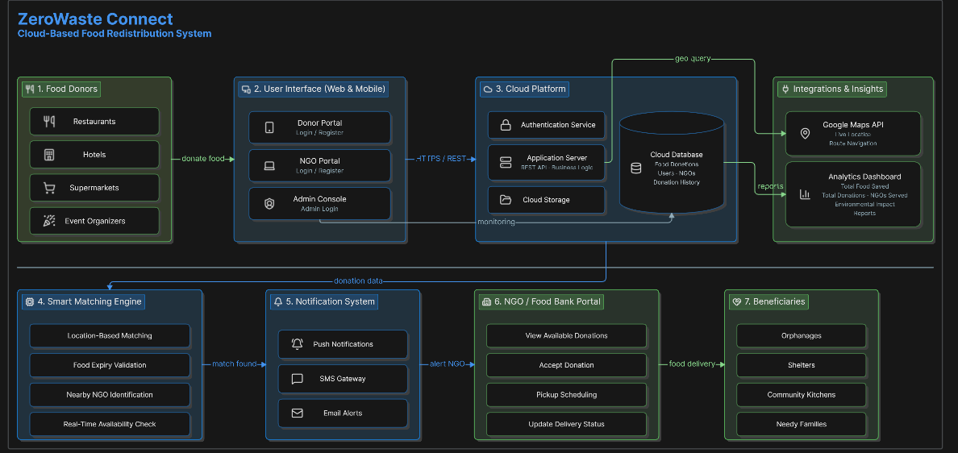
System Architecture
6

Slide 7
Proposed System
ZeroWaste Connect is a cloud-based food redistribution platform that provides a centralized system for connecting food donors, NGOs, and administrators in real time.
The system enables restaurants, hotels, supermarkets, and event organizers to upload details of surplus food, including quantity, location, and expiry time, through a web or mobile application.
A cloud-based matching engine automatically identifies nearby verified NGOs based on location, food availability, and pickup feasibility, ensuring timely collection before the food expires.
Real-time notifications, live donation tracking, and secure cloud storage improve communication, transparency, and efficient management of the entire food donation process.
7

Slide 8
Module 1: Food Donation management
Restaurants, hotels, supermarkets, and event organizers can create accounts and securely log in.
Donors can enter food details such as food type, quantity, location, preparation time, and expiry time.
The system displays the available surplus food and its current status.
All donor and food donation information is securely stored in the cloud database.
Donors can track whether their food has been accepted, collected, or delivered to the NGO

Slide 9
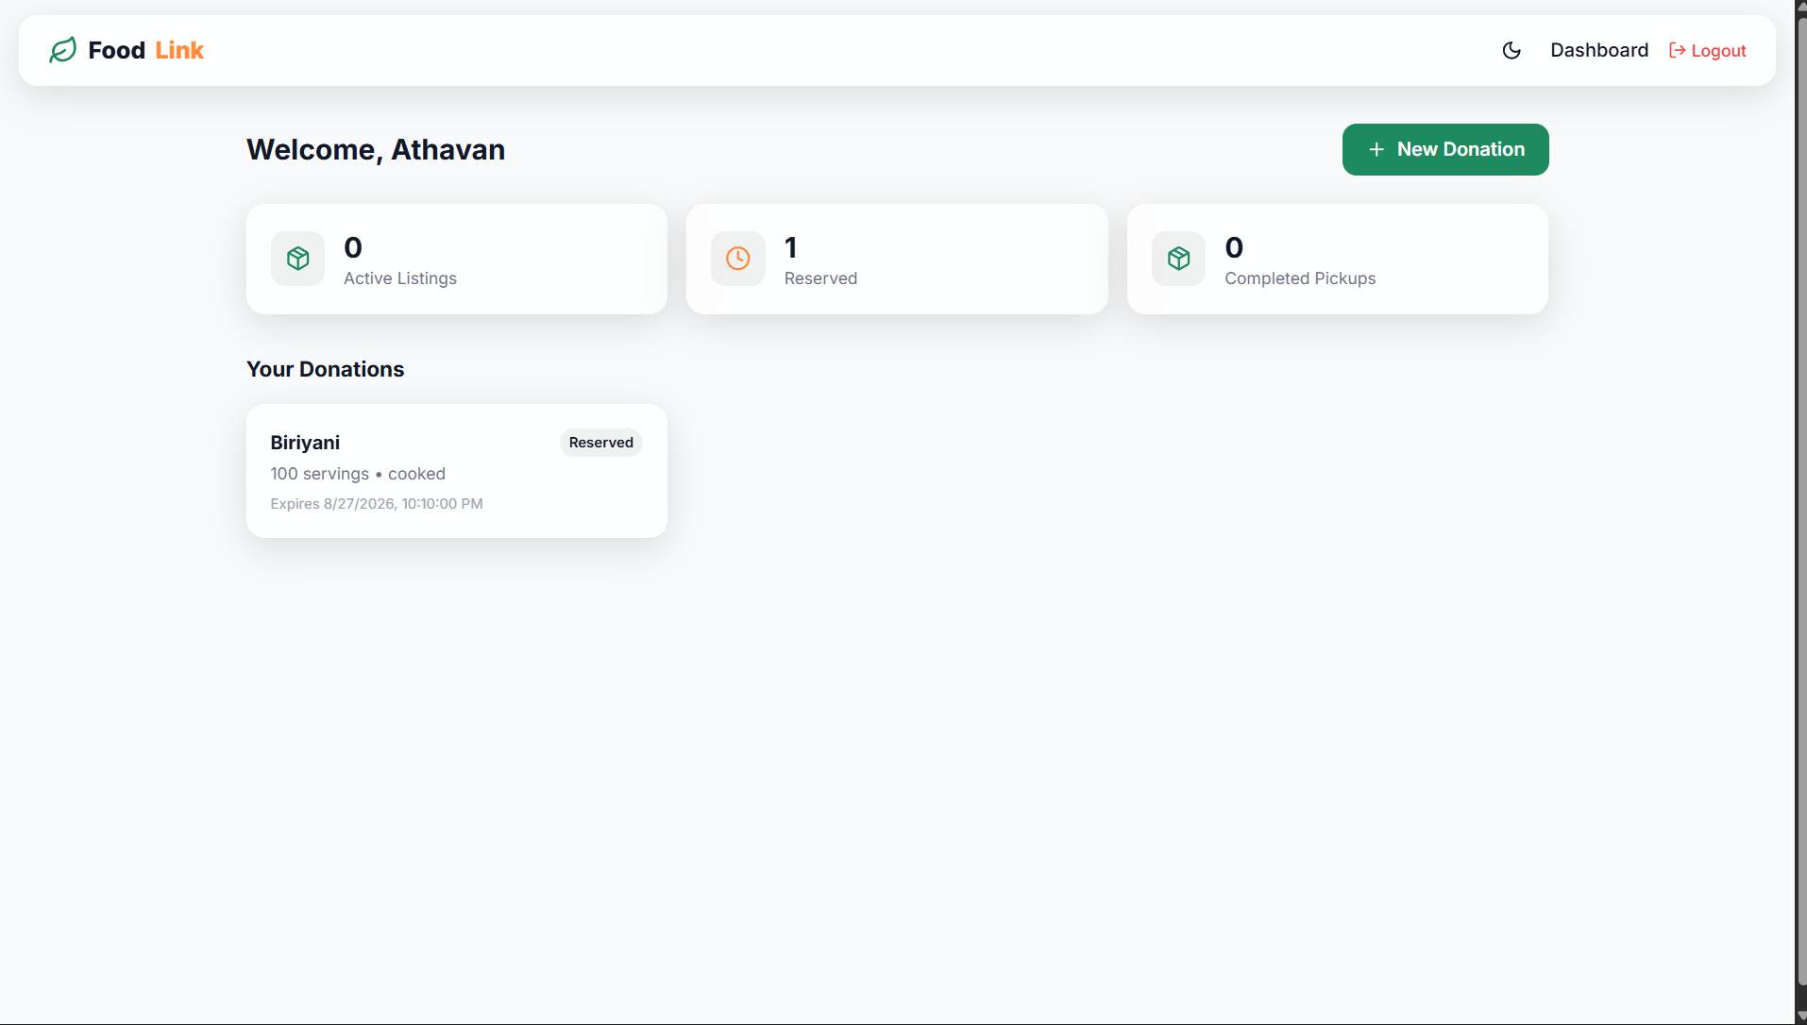

Slide 10
Module 2: Food Request and Distribution System
NGOs and food banks can register and securely access the platform.
NGOs can view nearby surplus food donations along with quantity, location, and expiry time.
The system identifies suitable nearby NGOs based on food availability and location.
NGOs can accept available donations and schedule the pickup.
NGOs can update the status from accepted → picked up → delivered, allowing the donor and admin to monitor the complete redistribution process
10

Slide 11
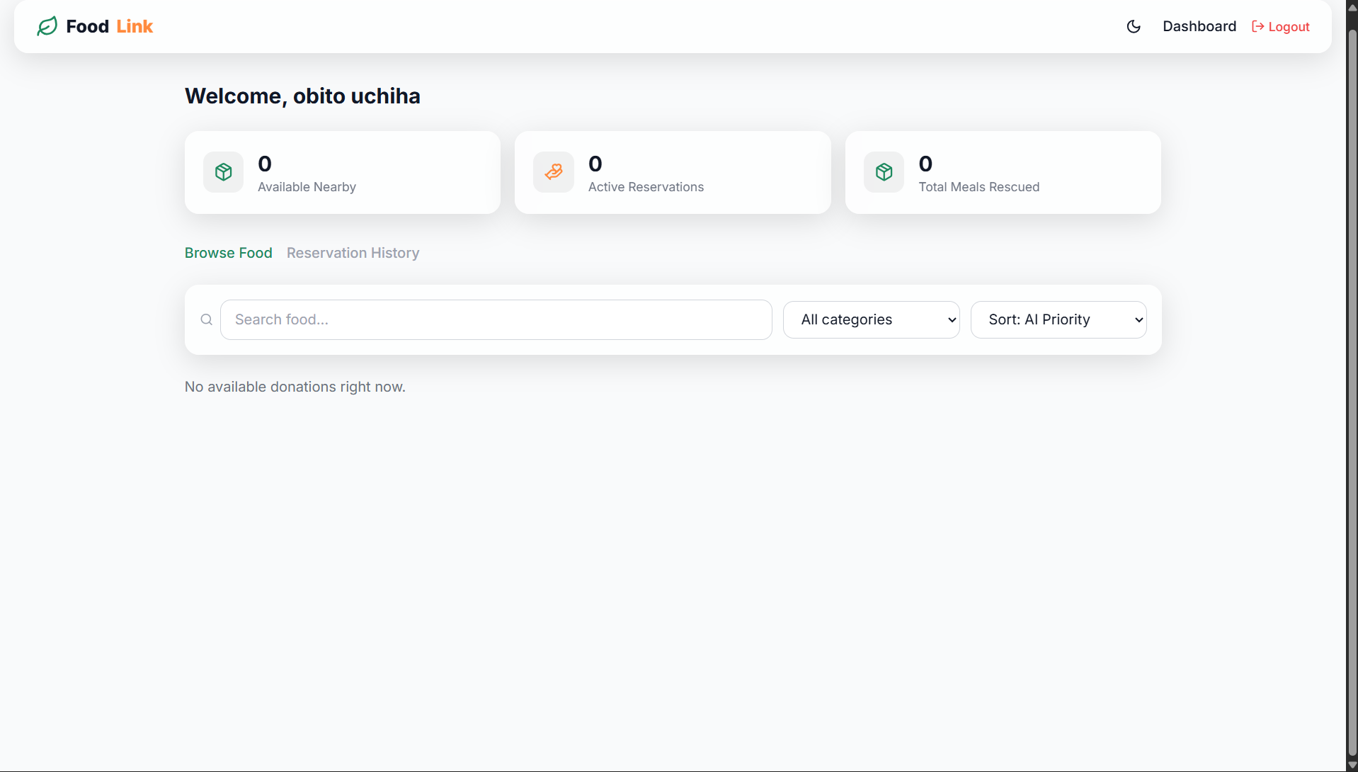

Slide 12
Conclusion
ZeroWaste Connect provides a cloud-based platform for efficiently connecting food donors with NGOs and beneficiaries.
It helps reduce food wastage by enabling timely collection and redistribution of surplus food.
The system improves coordination, transparency, and real-time monitoring of food donations and deliveries.
Cloud technology makes the platform scalable, accessible, and suitable for multiple locations.

Slide 13
SDG Goals
SDG | Goal | How ZeroWaste Connect Supports It
SDG 2 | Zero Hunger | Redistributes surplus edible food to NGOs, food banks, and people in need.
SDG 12 | Responsible Consumption and Production | Reduces food waste by efficiently redistributing unused edible food.
SDG 13 | Climate Action | Reducing food waste helps minimize greenhouse-gas emissions associated with food disposal.
SDG 11 | Sustainable Cities and Communities | Supports sustainable local communities through organized food redistribution.
SDG 17 | Partnerships for the Goals | Connects restaurants, supermarkets, NGOs, food banks, and community organizations through one platform.

Slide 14
Future scope
AI can predict food requirements at different locations and help match surplus food with people or organizations who need it.
The system can automatically match donors, NGOs, and beneficiaries based on food quantity, location, urgency, and expiry time.
IoT sensors can monitor food temperature, freshness, and storage conditions during transportation.
The platform can be expanded to connect restaurants, hotels, supermarkets, NGOs, food banks, and government organizations across multiple cities

Slide 15
Reference
United Nations Environment Programme, Food Waste Index Report 2024, UNEP, Nairobi, Kenya, 2024.
United Nations, Sustainable Development Goals: Goal 2 – Zero Hunger, United Nations, 2024.
United Nations, Sustainable Development Goals: Goal 12 – Responsible Consumption and Production, United Nations, 2024.
FAO, IFAD, UNICEF, WFP, and WHO, The State of Food Security and Nutrition in the World 2024, Food and Agriculture Organization of the United Nations, Rome, 2024.
M. R. Delgado, A. S. L. Lima, and J. M. C. Santos, “Food waste management and redistribution: A systematic review,” Journal of Cleaner Production, vol. 425, 2023.

Slide 16
THANK YOU

