Slide 1

ENABLING 6G AND BEYOND NETWORK FUNCTIONS FROM SPACE
PRESENTED BY: ATHEETHA ANIL KUMAR P p

Slide 2

AGENDA
Evolution from 4G to 6G
Vision of 6G
What is NTN?
Satellite Types
Integration of Networks
Global Coverage
Reliability and Resilience
Edge Computing in Space
Integrated Sensing and Communication

Slide 3

Introduction with List
Wireless communication has evolved rapidly over generations
5G improved speed and latency but depends on ground infrastructure
Limited connectivity in remote, rural, and disaster areas

Slide 4
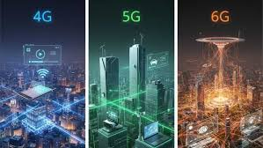
Evolution from 4G to 6G
4G enabled high-speed internet and multimedia services
5G introduced IoT, low latency, and smart applications
6G aims for ultra-high speed, intelligence, and global connectivity

Slide 5
Vision of 6G
Data rates in terabits per second
End-to-end latency less than 1 millisecond
AI-driven intelligent and self-optimizing networks

Slide 6
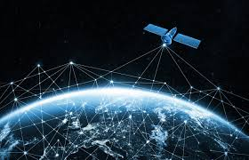
What is NTN? with List
Non-Terrestrial Networks include satellites, UAVs, and high-altitude platforms
Extend communication beyond Earth’s surface
Essential part of 6G architecture

Slide 7
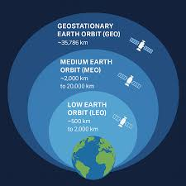
: Satellite Types
LEO: Low latency, closer to Earth, suitable for real-time communication
MEO: Moderate latency and coverage
GEO: High altitude, wide coverage but higher delay

Slide 8
Integration of Networks
Integration of space, aerial, and terrestrial networks
Seamless communication across all environments
Unified global network architecture

Slide 9

Global Coverage
Connectivity in remote and underserved regions
Supports maritime and aviation communication
Enables worldwide IoT connectivity

Slide 10
Reliability and Resilience
Provides backup during network failures
Independent of terrestrial infrastructure
Supports disaster management and emergency services

Slide 11
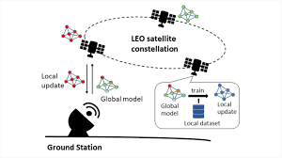
Edge Computing in Space
Data processing directly on satellites
Reduces latency and bandwidth usage
Enables real-time decision making

Slide 12
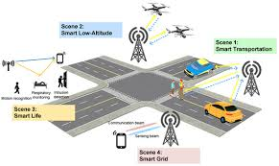
Integrated Sensing and Communication
Combines communication with sensing functions
Used for environmental monitoring and navigation
Improves efficiency and spectrum usage

Slide 13
: Key Technologies
AI and Machine Learning for intelligent network control
SDN and NFV for flexible and programmable networks
Inter-satellite links for direct satellite communication

Slide 14
Applications
Global internet access for all users
Smart transportation systems
Disaster management and environmental monitoring

Slide 15
Challenges
High cost of satellite deployment and maintenance
Complex handover due to satellite movement
Spectrum management and security issues

Slide 16
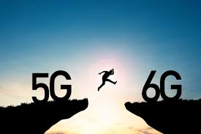
Conclusion
6G aims for global, intelligent connectivity
Space-based systems are essential for achieving this
Further research and development are required

Slide 17
Thank You! Any Questions?

