Slide 1
Petri nets in systems biology: creation, analysis and simulation
Oliver Shaw
School of Computing Science
26/04/04

Slide 2
Introduction
Strive towards holistic models of biological systems.
Increasing ammount of biological data available
Must utilise novel technices to construct, model, analyse and simulate these systems
1/30
Oliver Shaw, School of Computing Science
26/04/04

Slide 3
Outline
What are Petri nets?
Construction of networks
Analysis of structural and behavioural properties
Simulation using Stochastic Petri nets
Comparisons and issues
3/30
Oliver Shaw, School of Computing Science
26/04/04

Slide 4
Petri nets
From Thesis of C.A Petri 1966
Bipartite graph, contains Places, Transitions, directed arcs and tokens
2
2
4/30
Oliver Shaw, School of Computing Science
26/04/04

Slide 5
Petri net
A Petri net has an initial marking M₀
A transition t can fire if the marking of each input place p is greater or equal to the weight of the arc from p to t ( w(p, t) )
Firing a transition removes w(p, t) tokens from the input places and adds w(t, p) tokens to the output places
5/30
Oliver Shaw, School of Computing Science
26/04/04

Slide 6
Firing a Petri net
synchronisation
parallelism
choice
6/30
Oliver Shaw, School of Computing Science
26/04/04

Slide 7
Firing a Petri net 2
99
99
7/30
Oliver Shaw, School of Computing Science
26/04/04

Slide 8
Why Petri nets?
Visual representation
Model states and events
Well developed theory
Success in many areas
  Performance evaluation
  Communication protocols
  Asynchronous circuits
Good tool support www.daimi.au.dk/PetriNets/tools/
8/30
Oliver Shaw, School of Computing Science
26/04/04

Slide 9
Why Petri nets?
Model checking
Simulation
Abstraction
Hierarchical development
Transferability (PNML)
Higher level nets, Coloured nets, hybrid nets
<number>/30
Oliver Shaw, School of Computing Science
26/04/04

Slide 10
Construction of networks
Petri nets representing biological phenomina can be constructed in the following ways;
By hand
  Using experts knowledge, literature, etc,
Using some method to automatically create the network
  Eg, SARGE and microarray data,
Extraction from existing data sources,
  Eg, SBML from KEGG to PNML
10/30
Oliver Shaw, School of Computing Science
26/04/04

Slide 11
Construction of networks
SARGE (Simulated Annealing to Realise GEnetic networks)
  Clusters microarray data
  Creates putitative links between nodes
  Optimises the network using simulated annealing
  Dynamic layout of the network
  Under further construction to export to SBML/PNML
11/30
Oliver Shaw, School of Computing Science
26/04/04

Slide 12
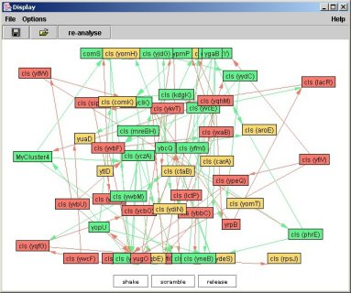
SARGE
12/30
Oliver Shaw, School of Computing Science
26/04/04

Slide 13
SBML 2 PNML
Systems Biology Markup Language
  Used by many research groups, hence there are many models available www.sbml.org
PNML Petri Net Markup Language
  In early days of develpoment, but growing tool support
Both formats designed for machine readability and exchange of models
13/30
Oliver Shaw, School of Computing Science
26/04/04

Slide 14
SBML 2 PNML
Both based on a simple base, adding further function as required
PNML
SBML
<place>
<transition>
<arc>
<Reaction>
<reactants>
<products>
14/30
Oliver Shaw, School of Computing Science
26/04/04

Slide 15
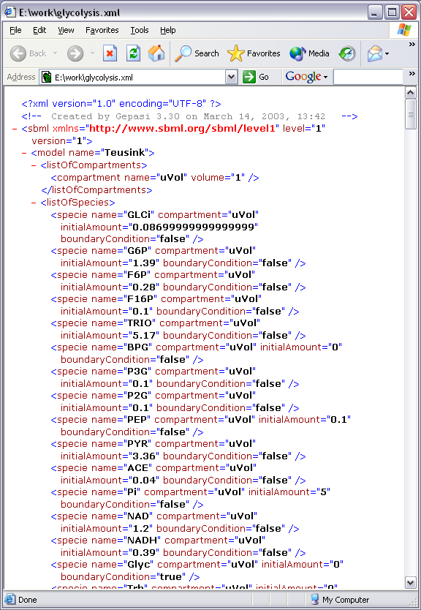
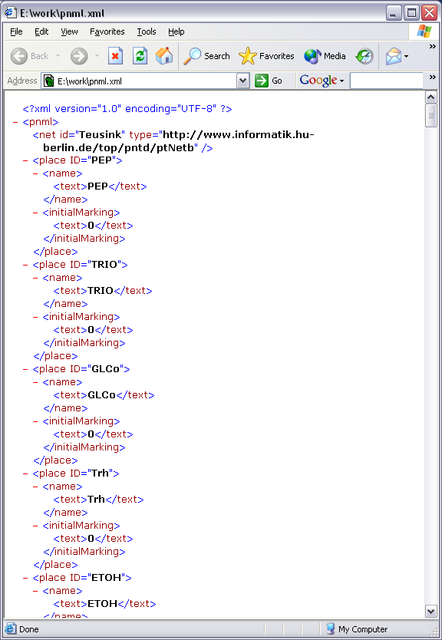
SBML 2 PNML
SBML
PNML
15/30
Oliver Shaw, School of Computing Science
26/04/04

Slide 16
SBML to PNML
PA
PC
SBML
PB
Reaction x
PC
Transition x R
Transition x
PNML
PA
PB

Slide 17
SBML 2 PNML
Problems,
  Graph layout algorithms
  Reaction modifiers, enzyme, inhibiotor ????
  Providence of data?
  Modularity?
All these and many more
under development!
17/30
Oliver Shaw, School of Computing Science
26/04/04

Slide 18
Petri net properties
Petri nets have a strong mathematical base
Properties obtainable vary from the information held in the net
+ marking
+ reaction rates
Connectivity
Structural
properties
Behavioural
properties
Stochastic
Simulation
18/30
Oliver Shaw, School of Computing Science
26/04/04

Slide 19
Structural properties
Obtainable form network connectuivity
P-invariants
  Set of Places that retain the same marking no matter what transitions fire
  Conservation of a post translational modification?
T-invariants
  Set of transitions that when fired returns the net to its origional marking
  Reversible reaction?
19/30
Oliver Shaw, School of Computing Science
26/04/04

Slide 20
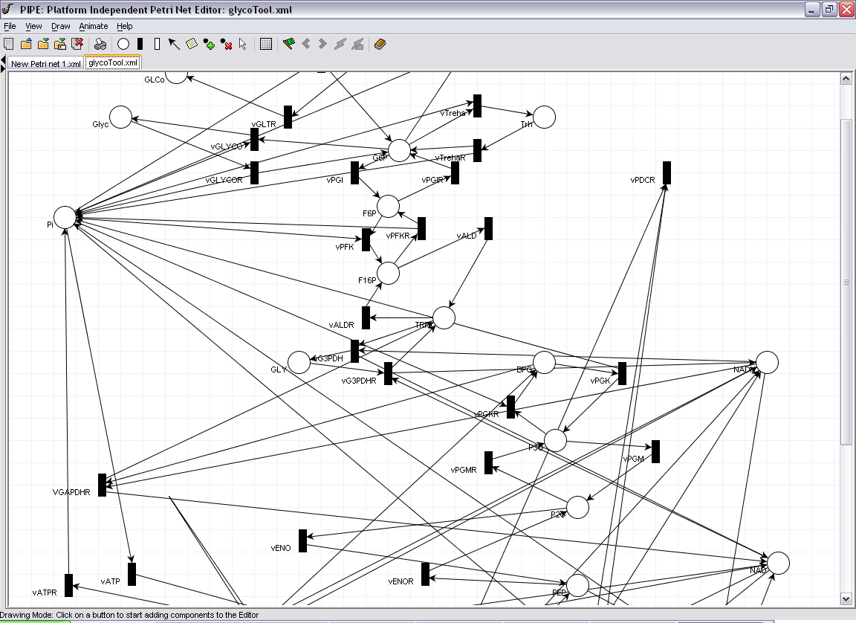
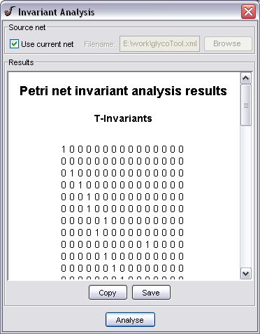
Structural properties
20/30
Oliver Shaw, School of Computing Science
26/04/04

Slide 21
Behavioural properties
With knowledge of initial concentrations we can analyse behavioural properties
Boundedness
  Is a given concentration exceeded?
Reachability
  Can a certain state be obtained?
    Complete or subset of marking?
Liveness
  L1 liveness, can a transition be fired from an initial marking?
21/30
Oliver Shaw, School of Computing Science
26/04/04

Slide 22
Biological meaning?
Boundedness
  Can a toxic concentration be reached?
Liveness
  Pick out unused pathways
Reachability
  Have knockout experiments to find weak points in the network
22/30
Oliver Shaw, School of Computing Science
26/04/04

Slide 23
Simulation of networks
Many methods available!!
Individual Based Models (IBM’s)
Ordinary differential equations (ODE’s)
Markov models
  Gillespie algorithm
  Gibson-Bruck
  Tau leap
  Stochastic Petri nets?
23/30
Oliver Shaw, School of Computing Science
26/04/04

Slide 24
Need accurate
concentrations!!!
Need accurate rates
for ALL reactions!!!

Slide 25
Stochastic Petri Nets (SPN)
Add a random, exponentially sampled delay to each transition
  Algorithm (assumes no two transitions can fire at exactly the same time)
    Assign delays to each transition
    Count down clock to the next transition firing
    Update marking of places in reaction
    Goto 1
With optimisation, equivalent to the Gibson algorithm
24/30
Oliver Shaw, School of Computing Science
26/04/04

Slide 26
SPN plus points
Accurate exact simulation method
Good performance, faster than Gillespie, ≈ Gibson, slower than tau leap.
Builds on flow of modelling technique
Good tool support
Coupled with a visual communication aid (i.e. Petri nets)
25/30
Oliver Shaw, School of Computing Science
26/04/04

Slide 27
Simulation problems
Where do we get the rates from?
  Modeling at this fine grained level requires a LOT of rates!
“…major, perhaps insurmountable, difficulties must be over come before whole cell models based on extensions to current “low-level” modelling and simulation methodologies, which emphasize kinetics of coupled reaction systems, will be feasible. Problems include lack of quantitative data on molecular concentrations and kinetic parameters…”
(McAdams and Shapiro (2003) Science 301)
26/30
Oliver Shaw, School of Computing Science
26/04/04

Slide 28
What are we trying to do?
Complete, all encompassing final model of the system?!?
Applicability of modeling technique?
Understanding of the system?
  Fitting to experimental data
  Perturbation of the system
  Comparison with lab results
27/30
Oliver Shaw, School of Computing Science
26/04/04

Slide 29
Solutions?
“Ballpark” figures?
“fuzzy parameterisation”?
Sensitivity analysis?
Heuristics?
  Genetic programming?
  Simulated annealing?
Ask for more lab data?
Petri nets can still be used to gain insightful information into the model
28/30
Oliver Shaw, School of Computing Science
26/04/04

Slide 30
Summary
Petri nets are a graphical and mathematical tool to analysing complex concurrent networks
They have a well developed tool support and have been successful in other areas of modelling
Allow a network to be analysed simply from network connectivity
Are a good tool for simulation of the network with stochastic Petri nets
  But need to parameterise the network
29/30
Oliver Shaw, School of Computing Science
26/04/04

Slide 31
Aknowledgements
Dr Anil Wipat and Dr Jason Steggles
Dr Koelmans, Prof Harwood,
BBSRC
30/30, Phew!
Oliver Shaw, School of Computing Science
26/04/04

Slide 32
Thank you
Any questions?
30/30, Phew!
Oliver Shaw, School of Computing Science
26/04/04

