Slide 1
GSERM: Text Mining & NLP Intros
Ted Kwartler

Slide 2


Slide 3










Ted Kwartler
MBA
Work
Teaching
Advisory Roles

Slide 4
Introductions…post online for your Teaching Staff
Name
Location
Background
Why are you taking this course?
Are you working on VM, local or cloud?

Slide 5
Syllabus Review
https://github.com/kwartler/GSERM_Text_Remote_student/blob/master/GSERM_NLP_syllabus_remote.docx
Assignment | Due Date 5pm | %
1. Skillset Assessment | Jan 12 | 5%
2. Homework I | Jan 13 | 10%
3. CASE I. NBA Fan Engagement | Jan 20 | 20%
4. Case II. E-Sports Marketing | Jan 25 | 30%
5. Homework II | Jan 30 (not a class) | 10%
6. Written Assignment | Jan 30 (not a class) | 15%
Class Participation | NA | 10%
Plan that your Jan 22-24 weekend is miserable…but you get 2 credits in 3 weeks!

Slide 6
Community Learning Expectations
I expect:
Kindness > Cleverness
Active learning & participation
To make adjustments along the way so learning will be engaging & fun
Academic rigor
My goal for your learning experience is that the topics are:
Interesting
Applicable as a future business leader
Perspective building as a consumer affected by these methods

Slide 7
My style
You learn from being challenged
This is a intensive 7 class course requiring programing.
It can be uncomfortable learning something new.
Discomfort means you are applying/challenging yourself. It’s ok and expected.
The professor doesn’t give everyone the top scores & no extra credit.
You earn the actual grade but I am fair and reasonable
“Homework/reading is taking hours & I want to go to social activities.”
You are a graduate student at a top business school. Socialize later.

Slide 8

Some motivation
If you are struggling, ask Prof help, evening labs, lunchtime office hours, email or even smoke signals, whatever it takes to succeed.
Focus on your learning outcomes
Don’t focus on your grade
You own the level of effort & engagement in your learning
I am focused on your learning outcomes
I don’t care if you need a specific grade to graduate
I take my role seriously mirroring your effort & engagement to support learning

Slide 9
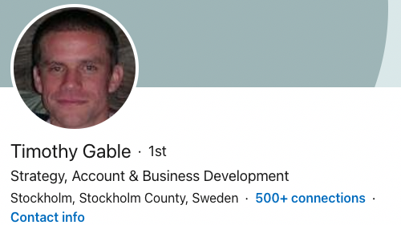
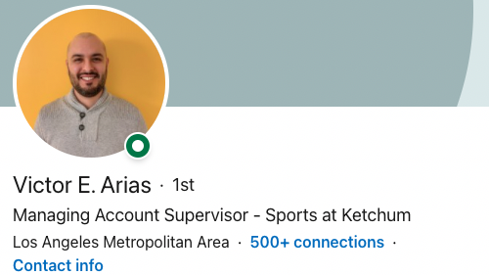
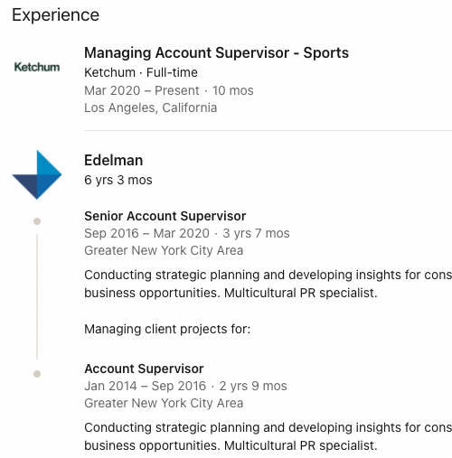
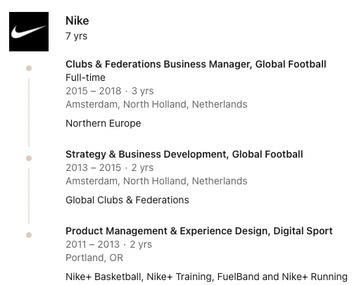
Class Theme: Text Mining in Marketing
Case I: NBA Fan Engagement Over Time
Case II: E-Sports Exploration

