Slide 1


Slide 2
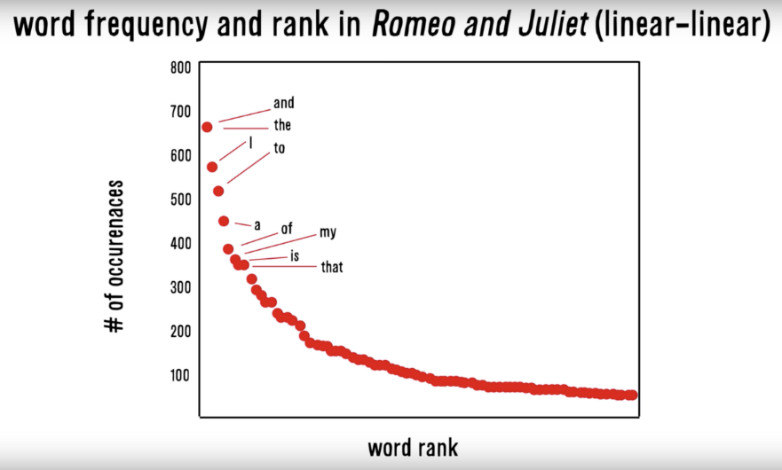
Zipf’s Law: Our words are less diverse than we think
Another Example
Many words in natural language but also a steep decline in actual usage.
Follows a predictable pattern.

Slide 3
Why do we see Zipf’s law in linguistics?
Principle of Least Effort Theory
Humans will choose a path of least resistance
Humans seek to minimize effort for a task
Therefore, even if we know 000s of words, we will use as few as possible to communicate.

Slide 4
Polarity
To what extent is a document positive or negative.

Slide 5
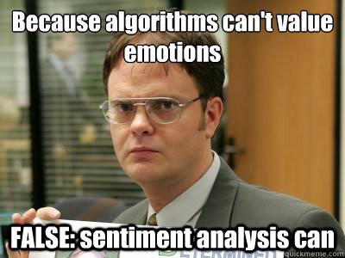
Let’s see if we can do it

Slide 6
How would you rate the polarity?
I loathe Aldi.
loathe
-1

Slide 7
How would you rate the polarity?
I love Carrefour. They are the best.
love
best
+2

Slide 8
How would you rate the polarity?
I like shopping at Migros but hate the location.
like
hate
+2

Slide 9
How did you do that?
-1
I loathe Aldi.
I love Carrefour. They are the best.
I like shopping at Migros but hate the location.
+2
+1
-1
0
You know groups of positive and negative words. These could be called a polarity lexicon

Slide 10
Simple Sentiment Polarity
Zipf’s Law
Many words in natural language but there is steep decline in everyday usage. Follows a predictable pattern.

Slide 11
Simple Sentiment Polarity
Zipf’s Law
Lexicon
Many words in natural language but there is steep decline in everyday usage. Follows a predictable pattern.
Because of Zipf’s Law you can have pos/neg lexicons that do not encompass all possible terms.
library(qdap)
polarity()
library(tidytext) & library(dplyr)
inner_join()

Slide 12
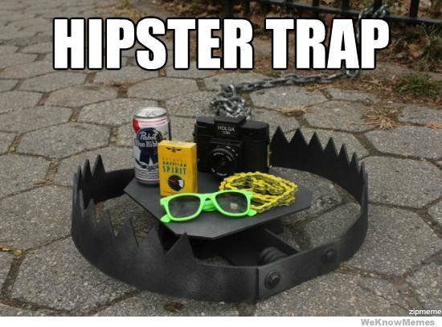
Differences between Polarity & Emotion
Polarity isn’t an emotion
Surprise is an emotion
Some emotions can be positive & negative
Surprise! You won the lottery!!

Slide 13
Differences between Polarity & Emotion
Polarity isn’t an emotion
Surprise is an emotion
Some emotions can be positive & negative
Surprise! You were hit by a bus!!

Slide 14
A bit more complex polarity
Scoring
Identify a polarized word from a lexicon
Identify “context cluster”
ID Neutral Words
ID Amplifiers “very”
ID de-amplifiers i.e. “hardly”
ID Negators i.e. “not”
Assign Values
Neutral Words = 0
Amplifiers = 0.8
De-amplifiers = -0.8
ID Negators = -1 *
Sum Values
Divide Sum by sqrt of word count – accounts for length of document “how dense the polarity is”
Let’s open ﻿A_polarity_math.R to see it in action.

