Slide 1
Quick Webscraping
Ted Kwartler

Slide 2

Web Scraping
R and other languages let you extract information from websites. This is called “web scraping”.

Slide 3

Questionable Practice
Websites don’t like you taking information for various reasons. Always respect terms of service and any blocking software.

Slide 4
Web-scraping
Everything in a webpage is “client” side (interpreted by your computer), therefore you can get anything you see.
Each scrape is literally custom software
Webpages have different styles, object names, and complexity…always check for an API first.

Slide 5

Web Scraping Example
IMDB.com
Internet Movie Database
Owned by Amazon.com
Realistically messy but doesn’t stop scraping

Slide 6

Getting some data
D_webScraping.R

Slide 7
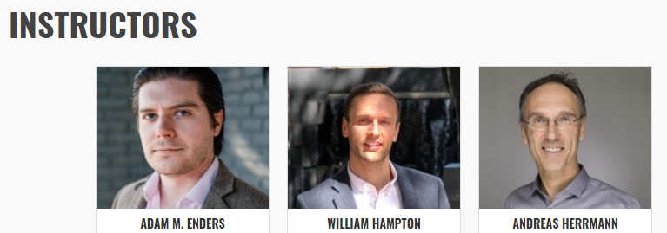


Let’s get the dirt on University of St Gallen profs.
Open a “headless” browser to the instructor page. Programatically find all appropriate URLS which is represented by each picture.
…
…

Slide 8

After ID’ing the links go to each bio
Open a “headless” browser to the instructor page. Find all appropriate URLS which is represented by each picture.
Loop through all ID’ed URLs to get the bio of each professor.
…
…

Slide 9

Let’s get the dirt on our profs.
E_webScraping_multipleURLS.R
Open a “headless” browser to the instructor page. Find all appropriate URLS which is represented by each picture.
Loop through all ID’ed URLs to get the bio of each professor.
Extract the bio text from each page and organize

Slide 10
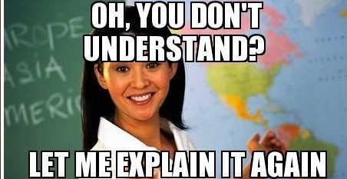
Appendix – Odds N Ends

Slide 11
Miscellaneous – Optical Character Recognition
F_OCR_w_tesseract.R
OCR – Optical Character Recognition
Identify letters in pictures.

Slide 12
Reading in other file formats
So far we have read in CSV (comma separated values) files.
Often you will be asked to use other data sources.
.txt (plain text)
.doc & .docx (Microsoft Word)
.xls & .xlsx (Microsoft Excel
R can even interpret PDF, image and other less popular files (ie SPSS).

Slide 13
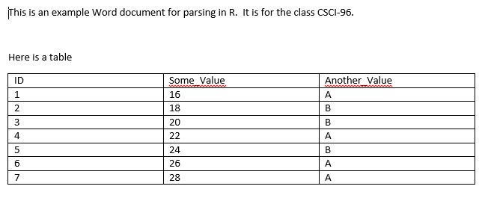
Let’s Practice
G_readDOCX.R
Get tables
Get simple text
Extracting Text
Parse the Table

Slide 14
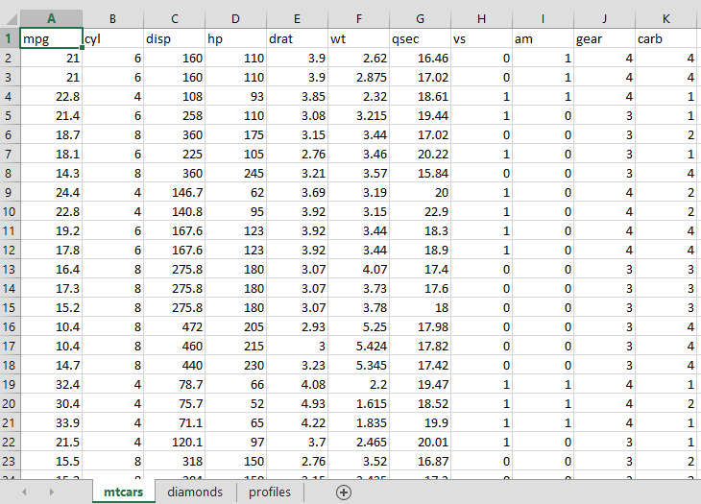
Let’s Practice
H_read_xlsx.R
List all worksheets
Read in individual sheets
Get the table data
Identify all Worksheets

Slide 15
PDFs
I_readPDFs.R
Formatting is really tough. May require a lot of string manipulation

Slide 16
TXT Files
I_readTXT.R
Reads line by line, table formatting can be hard without strsplit

