Slide 1


Dept. of MCA
E-BOOK SHOP
By :-
Batch B2 group 5
30-Ritika Joshi
32-Deepak Kamble
33-Chetna Khandagale
35-Mayuri Kulkarni
38-Kushagra Mishra
Guide Name :-
Prof. Aparna Sawant
Notes:
Chetna
‹#›

Slide 2

Aim & Objective
Aim:
The main aim of this project is to create a web based platform that enables the user to purchase books online. The aim here is to eliminate the problems in the manual system and provide a digital solution to purchasing books.
Using ‘Bibliomac’ the Ebook shop ,the user can purchase books online instead of going out to a bookstore .
‹#›
Notes:
Chetna

Slide 3
Objectives:
The objective of the project is to design and develop a web based application to purchase books for reading.
The e-book store provides readers with online purchase ability through a web browser.
The objective here is to make a fully functional online book store system that allows its users to search and purchase a book online based on category,author, genre. The selected books will be displayed in tabular form and then user can pick and order one or more books through online payment.
Notes:
Chetna

Slide 4
Scope of the Project
The system shall have different users and different roles will be assigned with related permissions. The system shall have an admin which would have authority to create, update, delete e-books from the list and also change their categories. The user shall be able to search the e-books with maximum search options such as by author name, by title , by genres etc. The user then shall have an option to read the digital copy of book as per their purchase.
‹#›
Notes:
deepak

Slide 5

Feasibility of the project
Feasibility study includes consideration of all possible ways to provide a solution to the given problem. The proposed solution should satisfy all the user requirements and should be flexible enough so that future changes can be easily done based on the future upcoming requirements.
Technical Feasibility:
This project is developed using PHP, HTML, CSS, Bootstrap , JS and MySQL is used for database requirements. The project is developed in Microsoft Windows platform. All the resources needed for the development of the software as well as the maintenance of the same is available with the user.
Notes:
deepak

Slide 6
Flowchart of the Modules
View list of e-Books
User
Search and Sort books
Purchase Books
Type of User
Create, Update, Delete e-books
Admin
View book orders
update / delete book categories
‹#›
Notes:
deepak

Slide 7
Outputs
The Following contains the screenshots of:
Login Page
Signup Page
Admin Login
Admin Dashboard
User Dashboard
Shopping Cart Page

Slide 8
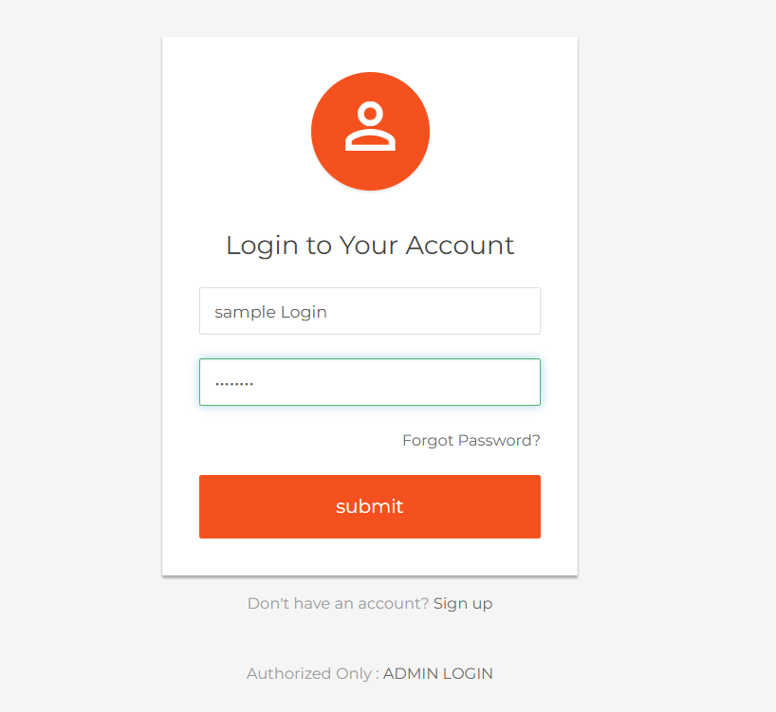
USER LOGIN PAGE

Slide 9
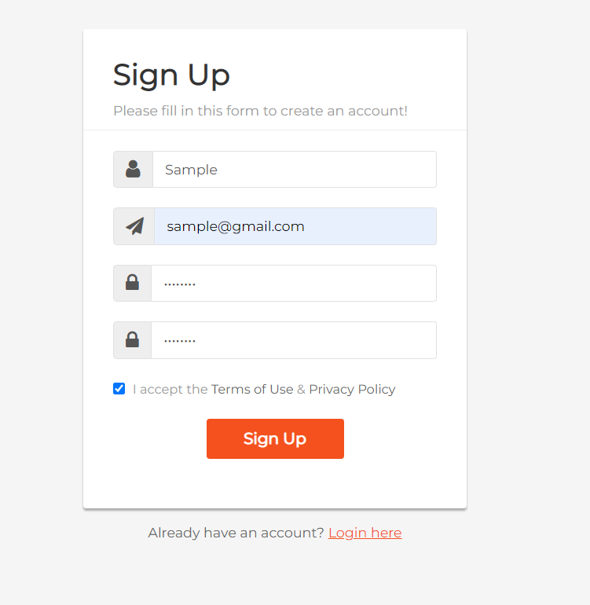
USER SIGN UP PAGE

Slide 10
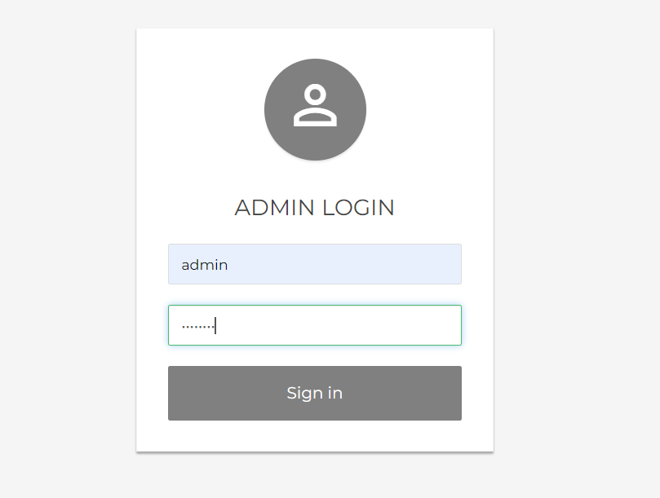
ADMIN LOGIN PAGE

Slide 11
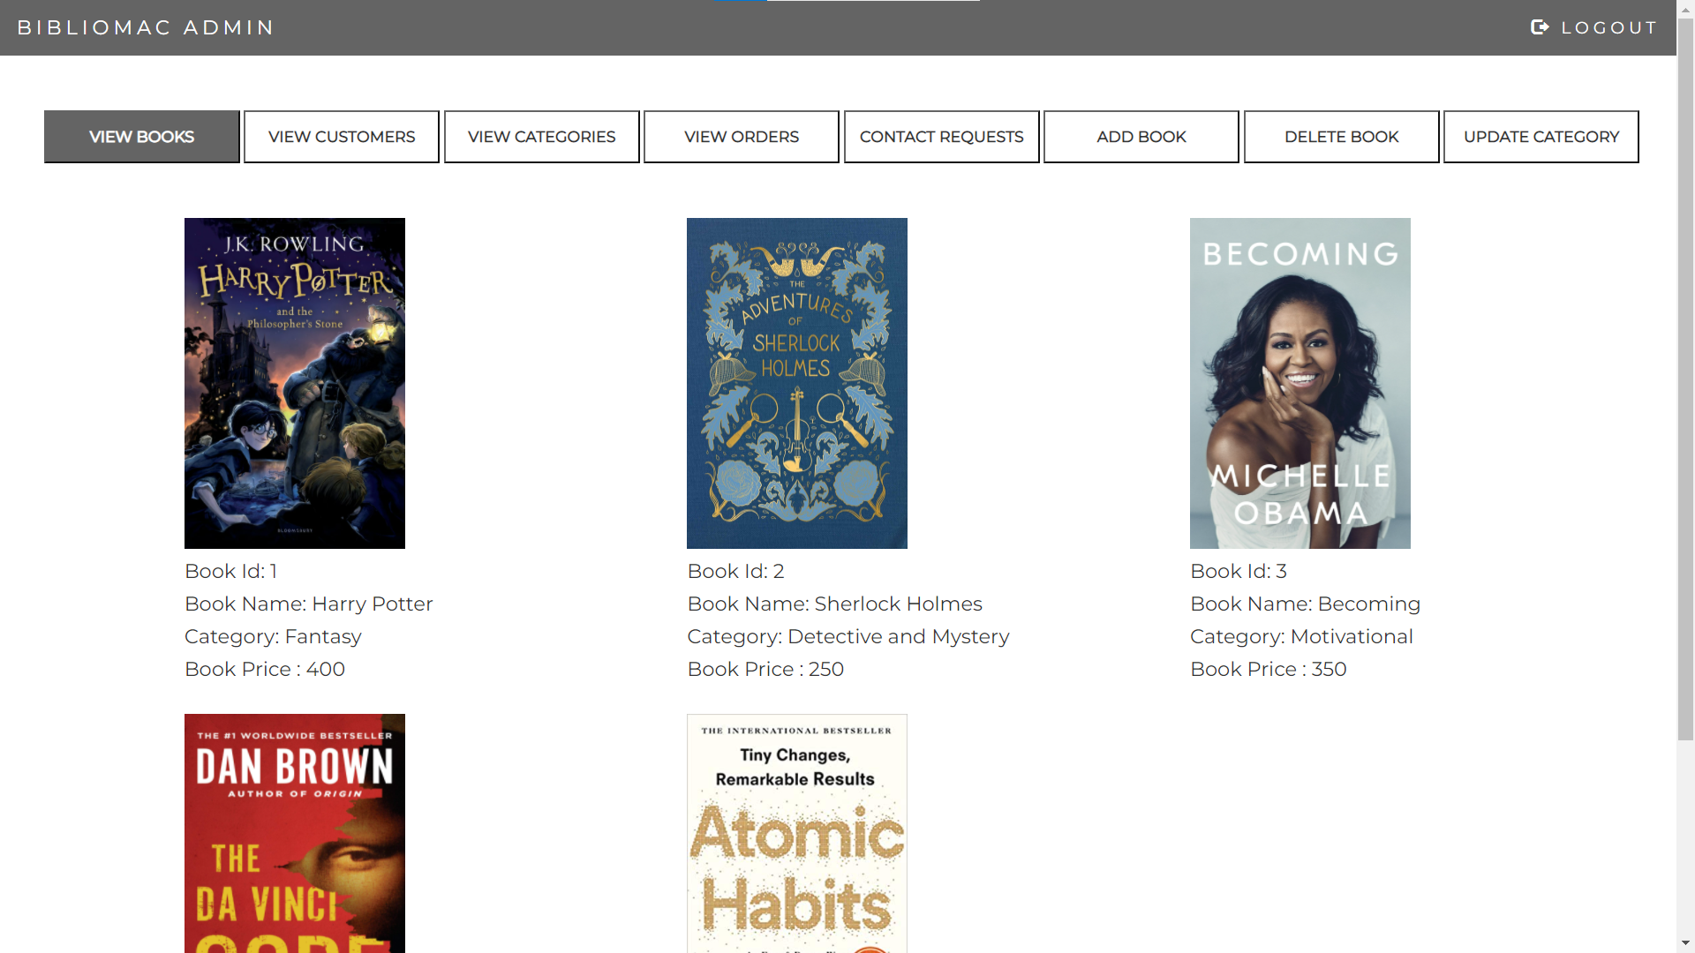
ADMIN DASHBOARD

Slide 12
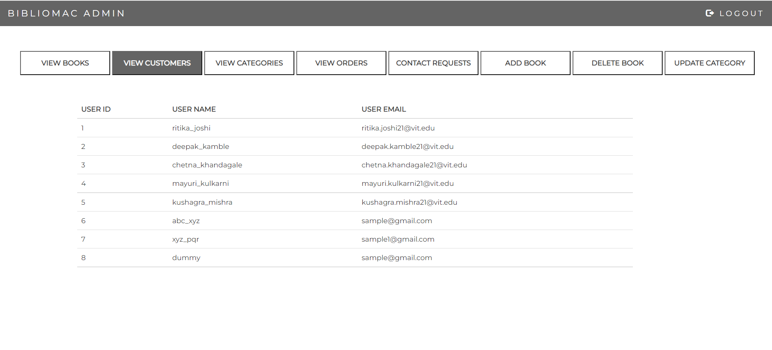
ADMIN DASHBOARD

Slide 13
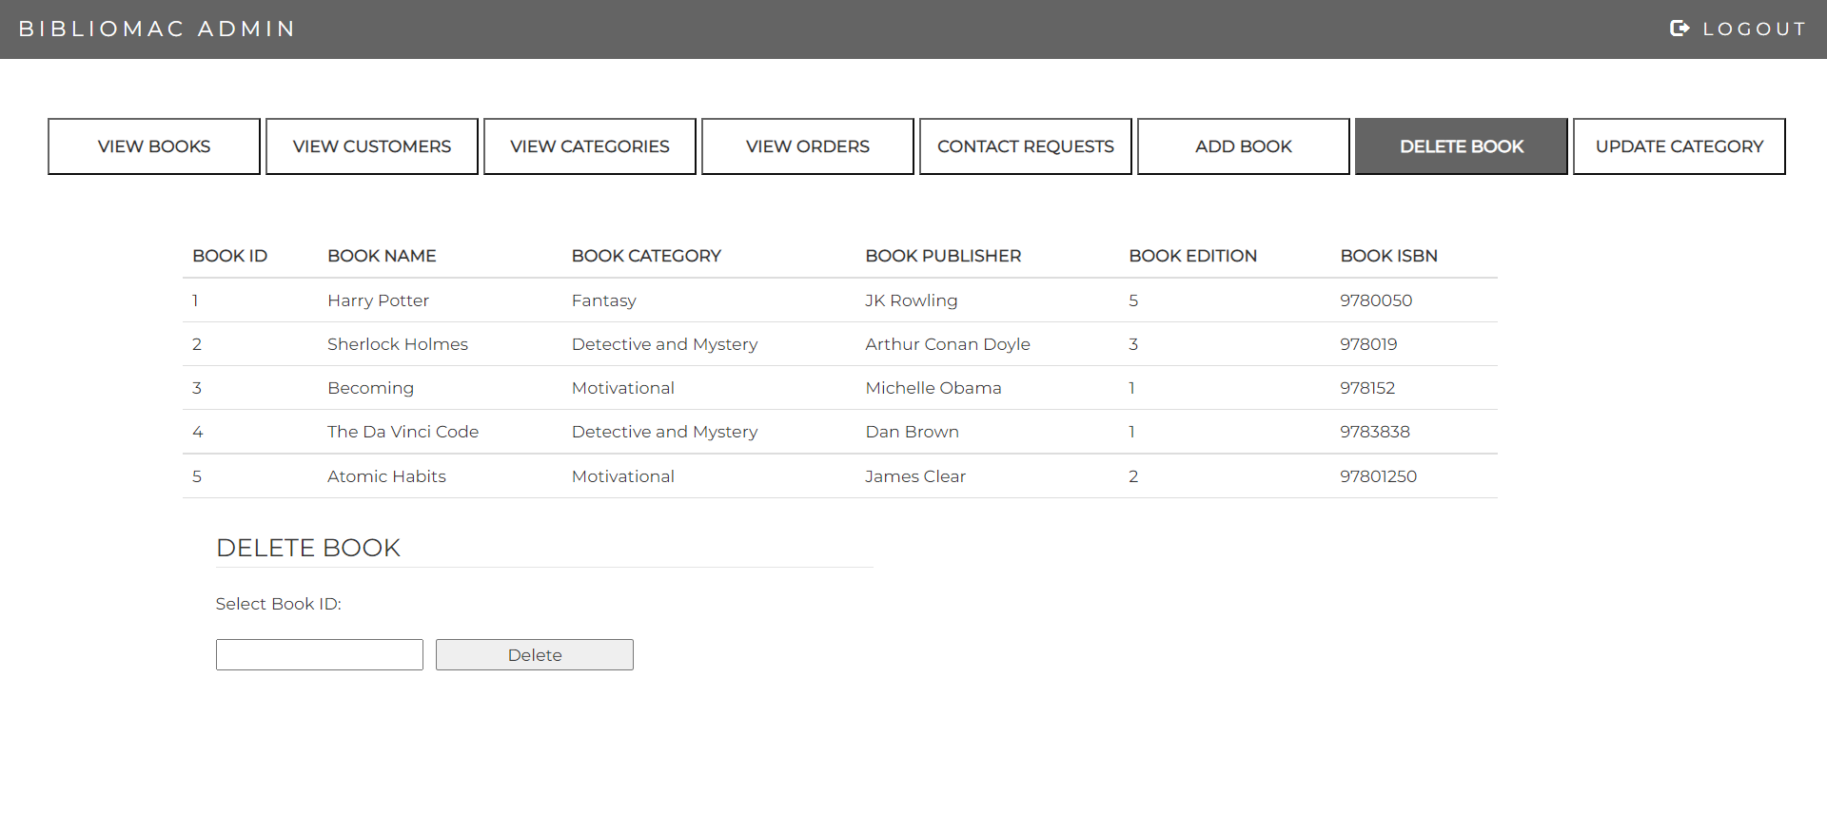
ADMIN DASHBOARD

Slide 14
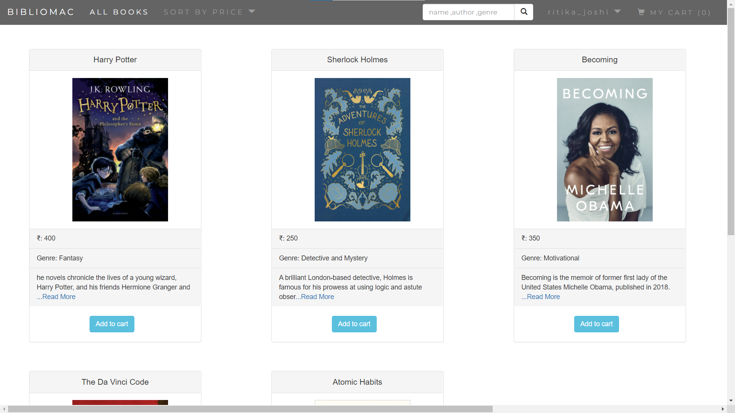
USER DASHBOARD

Slide 15
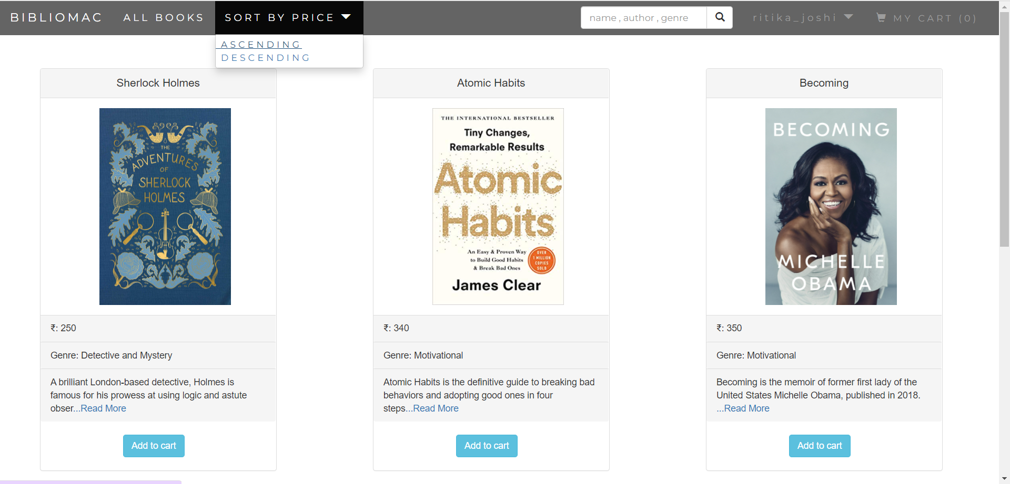
USER DASHBOARD

Slide 16
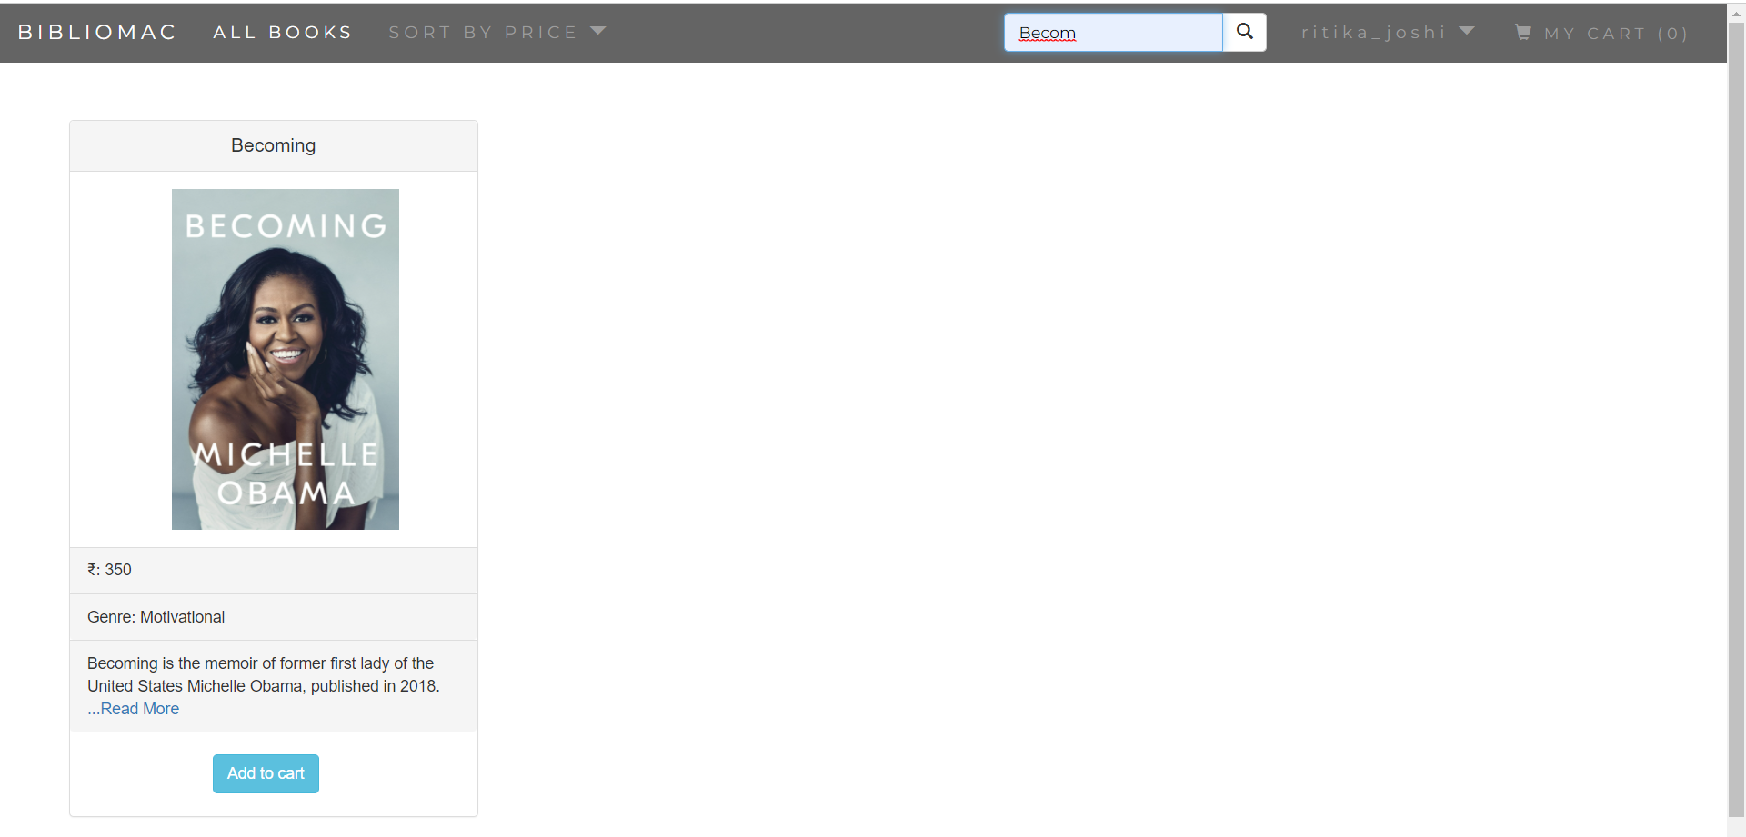
USER DASHBOARD (SEARCH BAR)

Slide 17
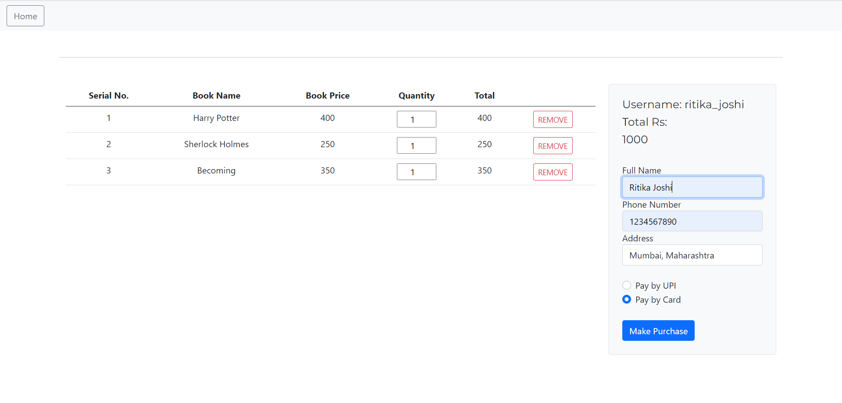
USER SHOPPING CART

Slide 18
Thank You

