Slide 1
Tutorial
interactive "shell"
basic types: numbers, strings
container types: lists, dictionaries, tuples
variables
control structures
functions & procedures
classes & instances
modules & packages
exceptions
files & standard library
what's new in Python 2.0 and beyond

Slide 2
Payeasy Python Tutorial
Kevin #613

Slide 3
Agenda
Introduction of Python
Data type
Flow control
Exercises1 – list compression
Functions
Exercises2 – automatic reboot server program
Install packages
Exercises3 – getting data from the ecshop web
Etc…

Slide 4
Introduction of Python

Slide 5

Who create Python ?
Guido van Rossum
2005 work for Google
Google search engine
Rietveld
2012 work for Dropbox
Server side programming
Today
Make decision of Python arch

Slide 6
What is Python ?
Python is an interpreted, object-oriented, high-level programming language with elegant syntax
Widely used by scientists and corporations in all fields
Supported by many 3rd-party libraries (currently 48,054 on the main python package website)
Free !

Slide 7
Python 語言
動態語言(Dynamic Language)
於執行時期(Runtime)執行程式碼(不用編譯)
Dynamic Type: 函式與變數都不需要宣告類型
直譯式語言(Interpreted Language)
每次執行後可以直接看到結果
物件導向語言(OOP)
可執行於多平台

Slide 8
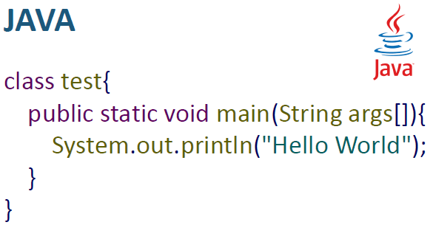
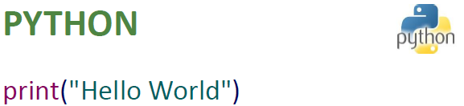
Python 語言 – 簡單易用

Slide 9
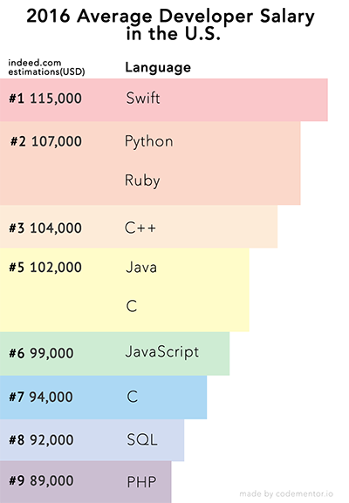
Python 語言 – 薪情看漲

Slide 10

Python 語言 – 新創公司的最愛

Slide 11
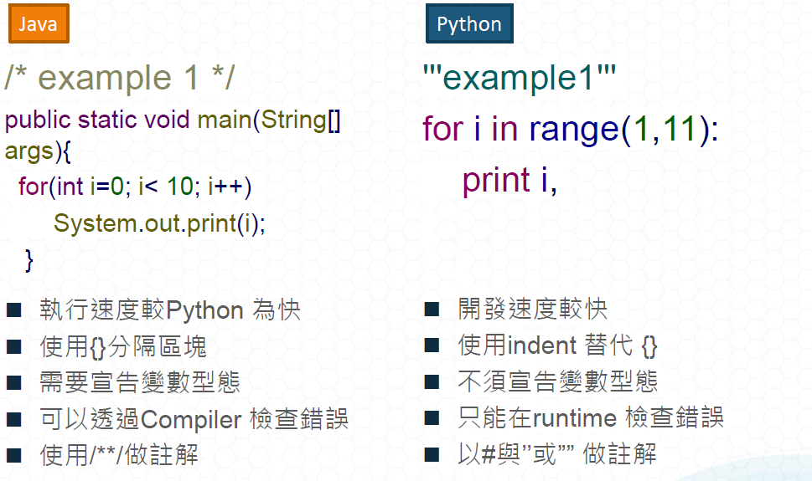
Python 語言 – v.s JAVA

Slide 12

How to Install ?
Python.org
Anaconda ( Recommend )

Slide 13
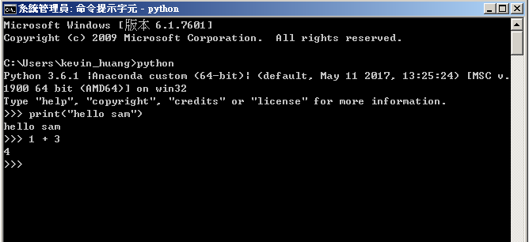
Python 語言 - 直譯式
不用編譯，即時看到結果

Slide 14
Python 語言 – 動態語言
不用宣告型態，簡潔易用
>>>a=2
>>>b=3
>>>a+b

Slide 15
Python 語言 – 動態語言
非相同的資料型態，無法做運算
>>> a = 1 + "hello“
>>> print(a)

Slide 16

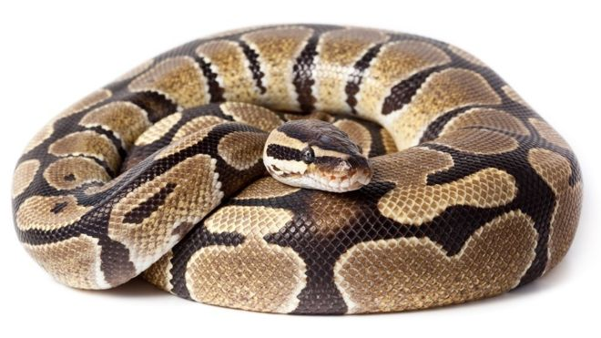
What can Python do ?
Web application
Instagram, Youtube, Spotify, Quora, Google Search…
Data analysis
Netflex, Uber, Payeasy...
GUI tools, Hardware
Normal tools, Robots, Raspberry PI...
System administration
Work flow control, Network application...

Slide 17


Slide 18
How to select IDE ?
For web, GUI tools, Hardware develop
Pycharm, Visual studio code, Visual studio
For data analysis
Jupyter notebook ( this course ), Spyder

Slide 19
Data Type

Slide 20
Everything is an object
Everything in Python is an object
Are not declared, just assigned
The variable is created the first time you assign it a value
Exercise :
>>> x = 7
>>> x
7
>>> x = 'hello'
>>> x
'hello'
>>>

Slide 21
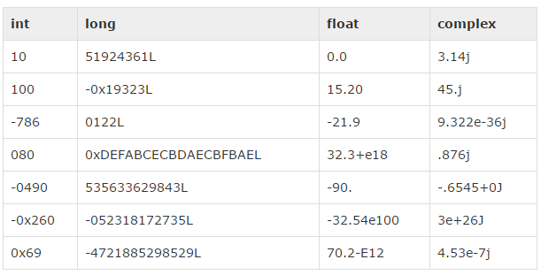
Basic data type - numbers
Number data types store numeric values. They are immutable data types, means that changing the value of a number data type results in a newly allocated object
Notes:
Hex(id(a))

Slide 22
What is Python Interpreter ?
Execute without compiler
The interpreter provides an interactive environment to play with the language
Exercise :
>>> print(‘Hello Sam!’)

Slide 23
Basic data type - strings
Strings are amongst the most popular types in Python. We can create them simply by enclosing characters in quotes. Python treats single quotes the same as double quotes
Exercise :
>>> mail = 'sam_liao@payeasy.com.tw'
Notes:
Find, replace, split

Slide 24
Container data type - lists
The list is a most versatile data type available in Python which can be written as a list of comma-separated values (items) between square brackets. Important thing about a list is that items in a list need not be of the same type
Exercise :
>>> person = ['sam', 613, 183.8]
>>> person2 = list()
Notes:
Dir(person), index, remove, append

Slide 25
Container data type - tuples
A tuple is a sequence of immutable Python objects. Tuples are sequences, just like lists. The differences between tuples and lists are, the tuples cannot be changed unlike lists and tuples use parentheses, whereas lists use square brackets
Exercise :
>>> person2 = ('kevin', 617, 155.2)

Slide 26
Container data type - dictionary
Python dict data type is quite like JSON format with KEYS and VALUES
KEYS are unique within a dictionary while VALUES may not be. The values of a dictionary can be of any type, but the keys must be of an immutable data type
>>> member = {'MEM_NUM' : 12345, 'MEM_NAME' : ‘kevin'}
Notes:
Dict.values(), keys, get, dict[‘’] = ‘’ , dict.update({})

Slide 27
Flow Control

Slide 28
Python loops
For loops are traditionally used when you have a piece of code which you want to repeat n number of times
While loops, like the for loops, but unlike a for loop, the while loop will not run n times, but until a defined condition is met
a = range(0, 4)
for i in a:
print('現在數字跑到 :' + str(i))
a = 0
while a <= 3:
print('現在數字跑到 :' + str(a))
a += 1

Slide 29
Compare loops with Java and Python
Python
##a = range(0, 4)
for i in range(0, 4):
print('現在數字跑到 :' + str(i))
( ## is comments in Python )
Java
int i;
for (i = 1; i <= 3; i++) {
System.out.println('現在數字跑到 :' + i);
}

Slide 30
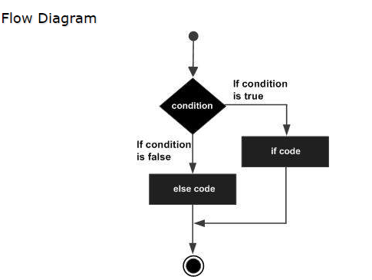
Python if , elif , else
if expression:
statement(s)
else:
statement(s)

Slide 31
Compare if, else with Java and Python
Python
if a > b :
a = b
b = c
Exercise
Java
if ( a > b )
{
a = b;
b = c;
}
>>> x = 7
>>> y = 6
>>> if x > y:
print('x is bigger than y‘)
else:
print('y is bigger than x‘)

Slide 32
Exercises

Slide 33
Exercise1
Extract member’s mail from member_with_error and correct it then append it to new list names member_without_error
Exercise :
>>> member_with_error = ['sam_liao@payez.com.tw', 'kevin_chen@payez.com.tw', ‘I_LOVE_SAM', 'jc_wang@payez.com.tw', '456']
>>> ['sam_liao@payeasy.com.tw', 'kevin_huang@payeasy.com.tw',
'jc_wang@payeasy.com.tw']

Slide 34
Exercise1
從變數 member_with_error 裡面把不屬於 mail 的字串拿掉，並且指派到新變數 member_without_error
Exercise :
>>> member_with_error = ['sam_liao@payez.com.tw', 'kevin_chen@payez.com.tw', ‘I_LOVE_SAM', 'jc_wang@payez.com.tw', '456']
>>> ['sam_liao@payeasy.com.tw', 'kevin_huang@payeasy.com.tw',
'jc_wang@payeasy.com.tw']

Slide 35
Exercise1 - Hint
1. create list variable member_without_error to store data
2. for loop member_with_error to iterate string
3. use if else to find out which string should be processed
4. replace string to correct one
5. append correct string to member_without_error
Notes:
member_with_error = ['sam_liao@payez.com.tw', 'kevin_chen@payez.com.tw', 'I_LOVE_SAM', 'jc_wang@payez.com.tw', '456']
member_without_error = list()
for member in member_with_error:
if member.find('payez') != -1:
correct_member = member.replace('payez', 'payeasy')
member_without_error.append(correct_member)

Slide 36
Pythonic way
Pythonic means : 写法简练，明确，优雅，绝大部分时候执行效率高，代码越少也就越不容易出错。我认为好的程序员在写代码时，应该追求代码的正确性，简洁性和可读性，这恰恰就是 pythonic 的精神所在
List_one = [2, 3, 4] ➔ List_two = [4, 6, 8]
List_two = list()
For i in List_one:
List_two.append(I * 2)
List_two = [I * 2 for i in List_one]
Notes:
listtwo = [2*i for i in listone if i > 2]

Slide 37
Pythonic Exercise1
Exercise :
>>> member_with_error = ['sam_liao@payez.com.tw', 'kevin_chen@payez.com.tw', 'I_LOVE_SAM', 'jc_wang@payez.com.tw', '456']
>>> ['sam_liao@payeasy.com.tw', 'kevin_huang@payeasy.com.tw',
'jc_wang@payeasy.com.tw']

Slide 38
Pythonic Exercise2
Extract company domain from staffs and append it to new list names staffs_domain
Exercise :
>>> staffs = [['sam', 613, 'sam_liao@payez.com.tw'],
['charlotte', 712, 'charlotte_wang@payeasy.com.tw'],
['kevin', 617, 'kevin_huang@康迅.公司.台灣']]
>>> ['payez.com.tw', 'payeasy.com.tw', '康迅.公司.台灣']

Slide 39
Functions

Slide 40
Python function
A function is a block of organized, reusable code that is used to perform a single, related action. Functions provide better modularity for your application and a high degree of code reusing
def functionname( parameters ):
function_suite
return [expression]
def add(a, b):
sum = a + b
return sum

Slide 41
Exercise2
Purpose : a program to reboot remote server
Stuff :
1. connect to remote host by ssh ?
2. execute OS command to remote host ?
3. tell me when remote host reboot successfully ?
4. etc… ?

Slide 42
Install Packages

Slide 43
How to install packages ?
pip install package_name

Slide 44
Install package fabric3
pip install fabric3

Slide 45
from fabric.api import run, env, local, reboot, env
from fabric.network import disconnect_all
env.hosts = ['kevin@10.10.110.151']
ping_host = ''.join(env.hosts).split('@')[1]
def task_reboot():
run('sudo -S reboot') == -1
# run('ls -l')
def task_ping():
local('ping ', ping_host, ' -t')
task_reboot()

