Slide 1
Where’d that Car-go?
Mostafa Mohsen, Ather hassan, Ryan woodard, Christopher Vishnu
Here to make our marc on the world

Slide 2

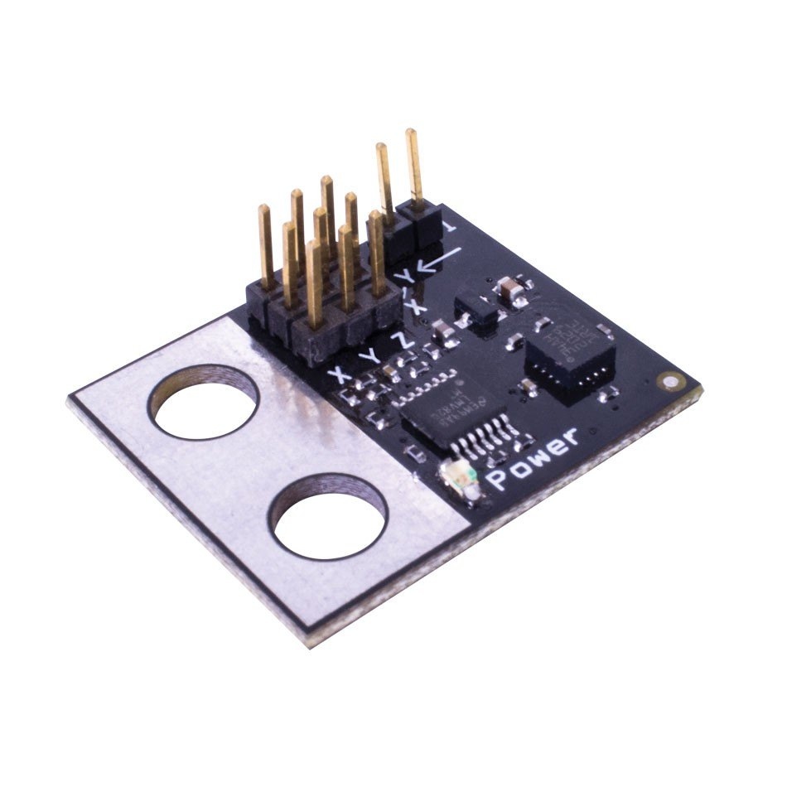
Hardware Solutions
Accelerometers and gyroscopes can be used to detect unexpected movement
Low cost and effective
Almost no energy cost

Slide 3
Machine Learning
We need an effective method to track drivers location along the route
Algorithm learns how to map frequently driven routes
This results in an extremely accurate way to measure if drivers are on track

Slide 4
Risk Analysis
AI can be used to reduce the risk of thefts
The algorithm learns from previous thefts and maps out high risk areas
This allows the supply chain to stay a step ahead of the thieves

