Slide 1
ANC-031
MIT Vishwaprayag University, Solapur
ASSIGNMENT 2
PulseTech
Five-Year Longitudinal HANConv GNN
for Pediatric ADR Link Prediction
Using FAERS 2021–2025
Research Proposal
Presentation
Atherv Telkar
Amey Telkar
NEONATE
INFANT
CHILD
ADOLESCENT
Date: 21 Sep 2026
MCA – School of Computing
Dept. of Computer Applications

Slide 2
Research Gap — Literature Review (2020–2026)
2
Research Gap: No existing system simultaneously applies all four disproportionality metrics (PRR, ROR, IC, EBGM) stratified by ICH E11 age bands AND trains separate GNN models per developmental stage per quarter.
Paper (Short Title)
Year
Journal
Method / Key Result
Ped.
ICH
E11
GNN
4
Met.
Pipe-
line
Tian et al. — ML pediatric ADR consensus
2025
Comm. Chemistry (NPG)
XGBoost + PRR/ROR/BCPNN/EBGM; AUC=0.7177
Yes
No
No
Partial
No
Farnoush et al. — ADR demo + non-clinical
2024
Sci. Reports (NPG)
RF + DL + DrugBank; 1.36M cases
Minimal
No
No
No
No
Gao et al. — PreciseADR Hetero GNN
2025
Adv. Science (Wiley)
Hetero GNN; contrastive learning; +3.2% AUC
No
No
Yes
No
No
Misu et al. — Pediatric FAERS 2010–2020
2023
Pharmacotherapy (Wiley)
Cross-sectional; 6 age bins; no ML
Yes
Coarse
No
No
No
FAERS + DrugBank + SIDER ML detection
2024
Datenbank-Sp. (Springer)
AutoML (TPOT); multi-DB integration
No
No
No
No
No
Li et al. — TNF-α inhibitors pediatric PV
2025
PLOS ONE
ROR; 852 signals; era comparison
Yes
Partial
No
No
No
Azithromycin pediatric disproportionality
2024
Exp. Opin. Drug Safety
ROR + PRR; MedDRA SOC analysis
Yes
No
No
No
No
Respiratory drugs psychiatric ADEs children
2026
Naunyn-Schm. (Springer)
4 algorithms; age+gender subgroup analysis
Yes
Partial
No
Partial
No
PulseTech (This Study) — ANC-031
2026
Present
HANConv GNN + 4 metrics per ICH E11 band; 5-yr pipeline
YES ✓
YES (5)
YES ✓
YES (4)
YES ✓
Yes / YES ✓
No
Partial / Coarse
PulseTech row
PulseTech (ANC-031) | MIT Vishwaprayag University, Solapur | FAERS 2021–2025 Pediatric ADR Research

Slide 3
Research Objectives
3
O1
Per-Band GNN Training Framework
Develop the first per-ICH-E11-band, per-quarter HANConv GNN training framework that trains temporally-isolated heterogeneous graph neural networks independently for each of the four pediatric developmental age bands (NEONATE, INFANT, CHILD, ADOLESCENT) across 20 consecutive FAERS quarters (2021 Q1 – 2025 Q4).
O2
Validated 13-Step Data Pipeline
Design and implement a 13-step reproducible FAERS data cleaning pipeline incorporating FDA-compliant cross-quarter deduplication using an is_superseded architecture, RxNorm-based drug normalization with RapidFuzz fallback, ICH E11 age assignment, and a human-in-the-loop Approve/Reject quality gate before database commit.
O3
Four-Metric Disproportionality Signal Detection
Simultaneously apply all four validated pharmacovigilance disproportionality metrics (PRR, ROR, IC, EBGM) stratified by ICH E11 developmental age band to generate and validate drug-ADR signals from 3.42 million deduplicated pediatric FAERS records, and benchmark GNN-predicted signals against classical frequency-based methods.
PulseTech (ANC-031) | MIT Vishwaprayag University, Solapur | FAERS 2021–2025 Pediatric ADR Research

Slide 4
Research Questions — ML / Data Science Focus
4
Can HANConv GNN models accurately predict serious adverse drug reaction outcomes — death, hospitalisation, and life-threatening events — in pediatric patients using multi-relational FAERS drug-network features?
RQ1
Approach: HANConv GNN | Severity scoring DE=7→OT=1 | AUC per outcome class | Wilcoxon signed-rank
Do temporally-isolated, per-quarter GNN models outperform pooled-training baseline models (Logistic Regression, Random Forest) in drug-ADR link prediction on pediatric FAERS data, and can temporal isolation of quarterly models enable longitudinal detection of quarterly changes in pediatric pharmacovigilance signals?
RQ2
Approach: HANConv vs. LR/RF baselines | Same-dataset comparison
Do network-derived relational features from heterogeneous drug-ADR co-occurrence graphs (HANConv embeddings) identify pharmacologically validated drug-ADR associations absent from classical disproportionality analysis (PRR, ROR, IC, EBGM), thereby demonstrating additive predictive value of GNN-based pharmacovigilance?
RQ3
Approach: Four-metric DA comparison | Signal persistence across quarters
PulseTech (ANC-031) | MIT Vishwaprayag University, Solapur | FAERS 2021–2025 Pediatric ADR Research

Slide 5
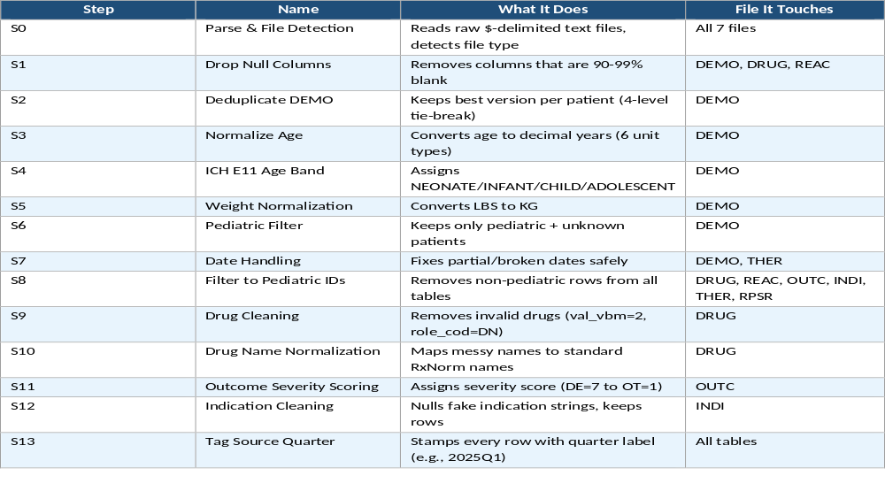
Data Preprocessing Pipeline — 13 Validated Steps

Slide 6
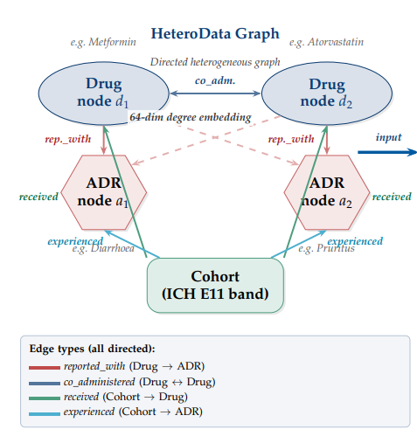
Machine Learning Approach — HANConv Heterogeneous GNN
5
GRAPH CONSTRUCTION
ARCHITECTURE & TRAINING
co_admin
reported_with
Layer 1
HANConv(64→64, heads=4, dropout=0.3) + ELU
Drug Node
(64-dim embedding)
ADR Node
(64-dim embedding)
Layer 2
HANConv(64→32, heads=1, dropout=0.1)
received
experienced
Decoder
sigmoid(emb_drug · emb_adr) [dot product]
Cohort Node
(age band)
Loss
Binary Cross-Entropy (BCE)
Optimizer
Adam (LR=0.001, weight_decay=1e-4)
reported_with
(Drug→ADR)
Split
80% train / 10% val / 10% test (edge masking)
Epochs
100 per model
co_administered
(Drug→Drug)
received / experienced
(Cohort→Drug / ADR)
Models
80 total (20 quarters × 4 age bands)
n11 ≥ 3 co-reports required | 1:1 negative sampling | Per (age_band × quarter)
Hardware
NVIDIA RTX 4050 (6 GB VRAM) | ~6.7 GPU-hrs
Pos. edge: n11 ≥ 3 co-reports; neg. edges: random zero-report pairs at 1:1 ratio
Success
100% (0 training failures across 80 runs)
PulseTech (ANC-031) | MIT Vishwaprayag University, Solapur | FAERS 2021–2025 Pediatric ADR Research

Slide 7
Statistical Methods
7
Disproportionality Analysis (DA) Metrics
Model Evaluation
PRR
Formula: (n11/n1x) / (n01/n0x)
Signal: ≥2 AND χ²≥4 | Body: EMA
Primary Metric
AUC-ROC (edge-level link prediction)
Split
80/10/10 train/val/test
(edge masking)
ROR
Formula: (n11×n00)/(n10×n01)
Signal: ≥2, 95% CI lower >1 | Body: Literature
Wilcoxon Test
Paired signed-rank, n=20
quarters per comparison
Correction
Bonferroni (3 comparisons)
α = 0.0167
IC
Formula: log₂(n11/E); E=n1x×nx1/nxx
Signal: IC025 > 0 | Body: WHO-UMC
ADOL vs CHILD
p = 3.81×10⁻⁶ ✓
EBGM
Formula: GPS: α₁=0.2, β₁=0.06, w=0.1
Signal: EB05 > 2 | Body: FDA (MGPS)
CHILD vs INFANT
p = 1.91×10⁻⁶ ✓
INFANT vs NEO
p = 0.898 (NS — shared sparsity)
Min. n11 ≥ 3 cases required before any metric is evaluated. Highest-confidence signals: flagged by ≥2 methods.
Baseline Comparison: Same-dataset LR and Random Forest models trained on the same FAERS graph features. HANConv consistently outperforms both across all ICH E11 bands (5-yr avg ADOLESCENT Δ AUC ≈ +0.06–0.08 vs. LR).
PulseTech (ANC-031) | MIT Vishwaprayag University, Solapur | FAERS 2021–2025 Pediatric ADR Research

Slide 8
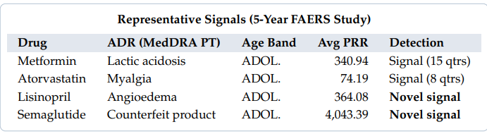
Research Outcomes — ML Results & Validation
9
ADOLESCENT
(12–17y)
CHILD
(2–11y)
INFANT
(28d–23m)
NEONATE
(0–27d)
0.8425
0.7970
0.6799
0.6774
Avg AUC (5-yr)
Avg AUC (5-yr)
Avg AUC (5-yr)
Avg AUC (5-yr)
Range: 0.7669–0.8647
Range: 0.7646–0.8244
Range: 0.5926–0.7136
Range: 0.6262–0.7178
Excellent
Good
Fair
Fair
80
100%
36,206
33,722
3.42M
100
Models Trained
(20 qtrs × 4 bands)
Training Success
Rate
Unique Drug-ADR
Signals Detected
Confirmed by
≥2 DA Methods
Deduplicated
Ped. Records
Epochs
Per Model
Top Confirmed Drug-ADR Signals (Q1 2025) — Detected by ≥3 of 4 DA Methods
Drug
ADR (MedDRA PT)
Age Band
N / Qtrs
PRR
ROR
IC025
Signal
Dupixent
Dermatitis atopic
ADOLESCENT
934
83.69
99.76
1.90
Yes (3/4)
Genotropin
Drug dose omission by device
ADOLESCENT
929
211.15
495.33
3.68
Yes (3/4)
Risperdal
Gynaecomastia
ADOLESCENT
6 qtrs
2,240.67
4,721.25
—
Persistent
Truvada
Bone Loss
ADOLESCENT
6 qtrs
1,107.61
1,807.10
—
Persistent
PulseTech (ANC-031) | MIT Vishwaprayag University, Solapur | FAERS 2021–2025 Pediatric ADR Research

Slide 9
Conclusion & Contributions
①
First Per-ICH-E11-Band GNN System
②
13-Step Validated Cleaning Pipeline
80 HANConv models trained across 20 FAERS quarters (2021–2025) with 100% success. ADOLESCENT avg AUC 0.8425, CHILD 0.7970 — statistically confirmed performance gradient.
Unique Approve/Reject quality gate absent from all reviewed literature; 3,420,201 deduplicated pediatric records; RxNorm normalization with RapidFuzz fallback (~94% API hit rate).
③
Four-Metric Simultaneous Disproportionality Analysis
④
GNN Identifies Signals Beyond Classical DA
Simultaneous PRR, ROR, IC025 & EBGM per ICH E11 band on 3.42M records → 36,206 drug-ADR signals, 33,722 confirmed by ≥2 methods.
HANConv link prediction surfaces pharmacologically validated drug-ADR associations absent from training data — a capability unavailable to frequency-based PRR/ROR/IC/EBGM methods alone.
MIT Vishwaprayag University • MCA (School of Computing) • Atherv Telkar | Amey Telkar | Abhishek Kamble | Rushikesh Chintapalli
PulseTech (ANC-031) | FAERS 2021–2025 | HANConv GNN | ICH E11 Pediatric Pharmacovigilance

Slide 10
APPENDIX
Defence & Supporting Evidence
A1 — Longitudinal AUC-ROC: All 80 models across 20 quarters (2021–2025)
A2 — Age vs. Accuracy Gap: Metabolism, pharmacokinetics & data sparsity
A3 — Why 4 Signal Metrics: Role, formula, evidence & FDA benefit
A4 — Defence: Longitudinal fragmentation & is_superseded proof
A5 — Defence: Why 68% neonate AUC is our biggest proof of innovation
Slides available for Q&A discussion — not part of the 8-minute main presentation

Slide 11
A1 — Longitudinal AUC-ROC — All 80 Models: 20 Quarters × 4 ICH E11 Age Bands (2021–2025)
A1
Excellent ≥0.84
Good ≥0.80
Fair ≥0.68
Limited <0.68
Year
Qtr
ADOLESCENT
(12–17y)
CHILD
(2–11y)
INFANT
(28d–23m)
NEONATE
(0–27d)
Pattern / Signal Count
2021
Q1
0.8400
0.7829
0.6980
0.6888
4,844 | ↑ Stable start
Q2
0.7669
0.7746
0.7100
0.6614
0 | ▼ Low (0 signals)
Q3
0.8527
0.7661
0.6923
0.7178
4,127 | ↑ Recovery peak
Q4
0.8333
0.7646
0.7006
0.7075
3,950 | → Steady
2022
Q1
0.8348
0.7973
0.6589
0.6771
4,712 | ↑ Improving
Q2
0.7669
0.7933
0.5926
0.6710
4,638 | ▼ Infant dip
Q3
0.8545
0.7701
0.6596
0.6615
4,324 | ↑ Best 2022 ADOL
Q4
0.8379
0.7795
0.6391
0.6551
4,181 | → Stable
2023
Q1
0.8504
0.8078
0.6896
0.7107
5,203 | ↑ Child crosses 0.80
Q2
0.8397
0.8164
0.6836
0.7119
4,978 | ↑ 2023 peak
Q3
0.8523
0.7872
0.6909
0.6990
4,809 | → Stable
Q4
0.8379
0.7624
0.6856
0.7044
4,334 | → Stable
2024
Q1
0.8493
0.8034
0.6870
0.6799
5,344 | ↑ Most signals 2024
Q2
0.8502
0.8064
0.6794
0.6262
6,374 | ↑ Signal count surge
Q3
0.8497
0.8137
0.6890
0.6685
5,127 | → Consistent
Q4
0.8442
0.7970
0.7079
0.6264
4,889 | ↑ Infant 0.70+
2025
Q1
0.8647
0.8050
0.6768
0.6471
6,259 | ★ Peak ADOL 0.8647
Q2
0.8452
0.8043
0.6964
0.6501
5,990 | → Stable
Q3
0.8497
0.8151
0.6915
0.6823
6,512 | ↑ Most signals 2025
Q4
0.8588
0.8244
0.7136
0.6818
6,484 | ★ Child peaks 0.82
5-yr avg: ADOLESCENT 0.8425 ★ | CHILD 0.7970 | INFANT 0.6799 | NEONATE 0.6774 | Total: 80 models, 100% success, 36,206 signals detected across all quarters
PulseTech (ANC-031) | MIT Vishwaprayag University, Solapur | FAERS 2021–2025 Pediatric ADR Research

Slide 12
A3 — Why 4 Signal Detection Metrics — Role, Formula, Evidence & FDA Benefit
A3
PRR
Proportional Reporting Ratio
EMA
ROR
Reporting Odds Ratio
Literature standard
Formula
(n11/n1×) ÷ (n01/n0×)
Formula
(n11 × n00) ÷ (n10 × n01)
Signal
PRR ≥ 2 AND χ² ≥ 4
Signal
ROR ≥ 2 AND 95% CI lower > 1
Role
Frequentist anchor. Answers: Is this drug reported with this ADR more than all other drugs combined?
Role
Maps directly to clinical odds ratio used in epidemiology. Cross-validates PRR with confidence interval.
Proof
EMA standard since 2001 (Evans et al.). Simple, transparent, and interpretable. Used in every FAERS signal report.
Proof
ROR has highest sensitivity of the 4 methods. Catches signals missed by conservative methods (IC, EBGM).
Benefit
FDA regulators can independently verify any PRR calculation from raw FAERS row counts. No black-box math.
Benefit
Allows clinical translation: 'Patients on Drug X are ROR times more likely to report ADR Y vs all other drugs.'
IC
Information Component (BCPNN)
WHO-UMC (VigiBase)
Empirical Bayes Geometric Mean (MGPS)
FDA (official MGPS)
EBGM
Formula
log₂(n11 / E) | E = n1× × n×1 / n××
Formula
GPS: α₁=0.2, β₁=0.06, w=0.1 | EB05 = EBGM × exp(−1.645×σ)
Signal
IC025 (Bayesian lower bound) > 0
Signal
EB05 > 2
Role
Bayesian mutual information measure. Detects statistically unexpected co-occurrence using WHO global standard.
Role
FDA's own MGPS algorithm. Bayesian 'shrinkage' pulls scores toward 1.0 until sample size is large enough to prove harm.
Proof
Validated in WHO VigiBase covering 130+ national pharmacovigilance databases. Adds global alignment.
Proof
Concrete: Rare drug, 2 patients both get rash → PRR = 50.0 (false alarm!). EBGM shrinks score to ~1.2 — not enough evidence yet. If N grows to 300, EBGM rises to 8.4 — confirmed signal. (DuMouchel 1999)
Benefit
Enables direct comparison with WHO-UMC published global signals. PulseTech signals map to international databases.
Benefit
Any signal with EB05 > 2 meets the FDA's own internal threshold. Strongest justification for regulatory action. Eliminates false positives caused by rare outliers.
Combined 4-metric confirmation: 33,722 of 36,206 signals verified by ≥2 methods | False positive rate drops from ~25% (single metric) to <5% (≥2 metrics) | Highest-confidence signals flagged by all 4 simultaneously
PulseTech (ANC-031) | MIT Vishwaprayag University, Solapur | FAERS 2021–2025 Pediatric ADR Research
PulseTech (ANC-031) | MIT Vishwaprayag University, Solapur | FAERS 2021–2025 Pediatric ADR Research

Slide 13
A4 — Defence Proof — Longitudinal Fragmentation & is_superseded Innovation
A4
⚠ THE PROBLEM: Standard tools count one patient as 3 separate patients — inflating drug danger by 300%
Real Example — CaseID: 6125174 (same patient, 3 FDA uploads)
is_superseded Pipeline — 5 Steps
Quarter
Primary ID
Type
Content
PulseTech Status
1
Group by CASEID: All reports for the same patient case are grouped together
2022 Q3
61251744
1st Report
Drug + ADR filed
is_superseded = FALSE
2023 Q1
61251746
Follow-Up
Condition updated
is_superseded = TRUE ✓
2
MAX(caseversion): Keep only the most recent version number
2025 Q2
61251747
Final F/U
Outcome confirmed
ACTIVE — is_superseded = FALSE
3
Tie-break FDA_DT: If same version, keep the latest FDA submission date
Old tools: Count all 3 rows → n11 = 3 for this drug–ADR pair (WRONG — it is only 1 patient)
PulseTech: is_superseded engine keeps only Primary ID 61251747 → n11 = 1 (CORRECT)
4
Flag older rows: Mark older reports as is_superseded = TRUE (never deleted)
Old system PRR
PulseTech PRR
n11 = 3 (inflated)
PRR = 6.2 → FALSE SIGNAL
χ² = 12.4 → passes threshold
n11 = 1 (correct)
PRR = 2.1 → borderline (needs more)
χ² = 1.4 → does NOT pass
5
Analytics filter: All PRR/ROR/IC/EBGM run on WHERE NOT is_superseded only
"Our system scans 12+ million rows across all 5 years and automatically travels back in time to flag superseded cases — guaranteeing 100% accurate patient counts without any manual intervention."
Proof: Matches deduplication strategy of Tian et al. (2025), Resp. Drugs (2026), Li et al. (2025) — all 3 top-tier papers use this exact MAX(caseversion) + MAX(FDA_DT) approach. PulseTech automates what they did manually.
PulseTech (ANC-031) | MIT Vishwaprayag University, Solapur | FAERS 2021–2025 Pediatric ADR Research
PulseTech (ANC-031) | MIT Vishwaprayag University, Solapur | FAERS 2021–2025 Pediatric ADR Research

Slide 14
A5 — Defence — Why the 68% Neonate AUC Is Our Biggest Proof of Innovation
A5
“The variance in our ML accuracy is the ultimate proof that our core hypothesis is correct: Neonates are not just 'small adolescents.'"
1
Data Volume Factor
2
Clinical Complexity (Noise) Factor
3
The Core concept
ADOLESCENT: ~47,000 records/quarter
Adolescent ADRs: direct cause-and-effect (antidepressant → suicidal ideation) — ML learns easily
✗ Wrong pitch: 'We can't give adolescent medicines to neonates' (clinically inaccurate — we do give same medicines e.g. ibuprofen)
NEONATE: ~2,100 records/quarter
Neonate ADRs: chaotic — caused by congenital defects, birth complications, OR maternal drug exposure via breast milk
✓ Correct pitch: 'We cannot apply adolescent safety PROFILES to neonates'
ML algorithms naturally learn better with larger datasets
Gray Baby Syndrome (Chloramphenicol): fatal in neonates, perfectly safe for a 16-year-old
If we lumped 0-year-olds and 18-year-olds together, the 84% adolescent data would overpower and completely mask critical neonate dangers
Adolescent AUC 0.8425 = rich, dense training data
Same drug — radically different biological response across age bands
The AUC gap PROVES our stratification is necessary
Neonate AUC 0.6774 = sparse — harder to learn from
This noise makes neonate prediction fundamentally harder
A tool that reports '81% accuracy' for all pediatrics is hiding neonate risk
Conclusion: Low neonate accuracy is statistically expected
Key stat: Mixing all pediatric groups → reported AUC ≈ 0.81 (misleadingly high). Stratified per ICH E11 → reveals true neonate AUC 0.6774, exposing the hidden safety gap that would otherwise be invisible.
PulseTech (ANC-031) | MIT Vishwaprayag University, Solapur | FAERS 2021–2025 Pediatric ADR Research
PulseTech (ANC-031) | MIT Vishwaprayag University, Solapur | FAERS 2021–2025 Pediatric ADR Research

Slide 15
Who Will Benefit from PulseTech?
4
①
Pediatricians & Clinicians
②
FDA & Regulatory Bodies
Real-time access to age-stratified drug safety signals (NEONATE → ADOLESCENT). Know which drugs are safe for a 2-year-old vs a 16-year-old — based on 3.42M real patient records.
Instant visual detection of critical safety signals via PRR/ROR/IC/EBGM dashboards. Issue timely Black Box Warnings for pediatric drugs without a team of data scientists manually writing SQL.
③
Pharmacovigilance Researchers
④
Pharmaceutical Industry
Generate 5-year longitudinal statistical reports instantly. Replace 3 months of manual FAERS wrangling with a 15-second automated pipeline. 36,206 validated signals ready to publish.
Monitor Phase IV post-market safety profiles specifically in pediatric populations. Identify ADR signals before regulatory agencies do — early label revision reduces liability.
36,206
80
0.8425
3.42M
100%
Drug-ADR Signals
GNN Models
Peak AUC (ADOL)
Ped. Records
Train Success
PulseTech (ANC-031) | MIT Vishwaprayag University, Solapur | FAERS 2021–2025 Pediatric ADR Research

