Slide 1
Intelligent Agents

Slide 2
Agents
An agent is anything that can be viewed as perceiving its environment through sensors and acting upon that environment through actuators
Human agent:
eyes, ears, and other organs for sensors;
hands, legs, mouth, and other body parts for
actuators
Robotic agent:
cameras and infrared range finders for sensors; various motors for actuators

Slide 3
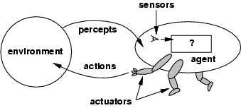
Agents and environments
The agent function maps from percept histories to actions:
[f: P* → A]
The agent program runs on the physical architecture to produce f
agent = architecture + program

Slide 4
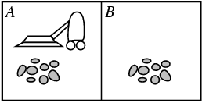
Vacuum-cleaner world
Percepts: location and state of the environment, e.g., [A,Dirty], [B,Clean]
Actions: Left, Right, Suck, NoOp

Slide 5
Rational agents
Rational Agent: For each possible percept sequence, a rational agent should select an action that is expected to maximize its performance measure, based on the evidence provided by the percept sequence and whatever built-in knowledge the agent has.
Performance measure: An objective criterion for success of an agent's behavior
E.g., performance measure of a vacuum-cleaner agent could be amount of dirt cleaned up, amount of time taken, amount of electricity consumed, amount of noise generated, etc.

Slide 6
Rational agents
Rationality is distinct from omniscience (all-knowing with infinite knowledge)
Agents can perform actions in order to modify future percepts so as to obtain useful information (information gathering, exploration)
An agent is autonomous if its behavior is determined by its own percepts & experience (with ability to learn and adapt)
without depending solely on build-in knowledge

Slide 7
Task Environment
Before we design an intelligent agent, we must specify its “task environment”:
PEAS:
Performance measure
Environment
Actuators
Sensors

Slide 8
PEAS
Example: Agent = taxi driver
Performance measure: Safe, fast, legal, comfortable trip, maximize profits
Environment: Roads, other traffic, pedestrians, customers
Actuators: Steering wheel, accelerator, brake, signal, horn
Sensors: Cameras, sonar, speedometer, GPS, odometer, engine sensors, keyboard

Slide 9
PEAS
Example: Agent = Medical diagnosis system
Performance measure: Healthy patient, minimize costs, lawsuits
Environment: Patient, hospital, staff
Actuators: Screen display (questions, tests, diagnoses, treatments, referrals)
Sensors: Keyboard (entry of symptoms, findings, patient's answers)

Slide 10
PEAS
Example: Agent = Part-picking robot
Performance measure: Percentage of parts in correct bins
Environment: Conveyor belt with parts, bins
Actuators: Jointed arm and hand
Sensors: Camera, joint angle sensors

Slide 11
Environment types
Fully observable (vs. partially observable): An agent's sensors give it access to the complete state of the environment at each point in time.
Deterministic (vs. stochastic): The next state of the environment is completely determined by the current state and the action executed by the agent. (If the environment is deterministic except for the actions of other agents, then the environment is strategic)
Episodic (vs. sequential): An agent’s action is divided into atomic episodes. Decisions do not depend on previous decisions/actions.

Slide 12
Environment types
Static (vs. dynamic): The environment is unchanged while an agent is deliberating. (The environment is semidynamic if the environment itself does not change with the passage of time but the agent's performance score does)
Discrete (vs. continuous): A limited number of distinct, clearly defined percepts and actions.
How do we represent or abstract or model the world?
Single agent (vs. multi-agent): An agent operating by itself in an environment.

Slide 13
task environm. | observable | determ./ stochastic | episodic/ sequential | static/ dynamic | discrete/ continuous | agents
crossword puzzle | fully | determ. | sequential | static | discrete | single
chess with clock | fully | strategic | sequential | semi | discrete | multi
poker | partial | stochastic | sequential | static | discrete | multi
back gammon | fully | stochastic | sequential | static | discrete | multi
taxi driving | partial | stochastic | sequential | dynamic | continuous | multi
medical diagnosis | partial | stochastic | sequential | dynamic | continuous | single
image analysis | fully | determ. | episodic | semi | continuous | single
partpicking robot | partial | stochastic | episodic | dynamic | continuous | single
refinery controller | partial | stochastic | sequential | dynamic | continuous | single
interact. Eng. tutor | partial | stochastic | sequential | dynamic | discrete | multi

Slide 14
Agent types
Five basic types in order of increasing generality:
Table Driven agent
Simple reflex agents
Model-based reflex agents
Goal-based agents
Utility-based agents

Slide 15
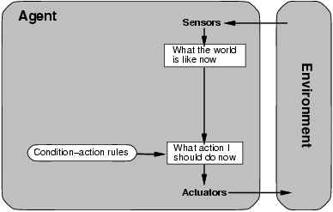
Table Driven Agent.
current state of decision process
Impractical
table lookup
for entire history

Slide 16
Simple reflex agents
Fast but too simple
NO MEMORY
Fails if environment
is partially observable
example: vacuum cleaner world

Slide 17
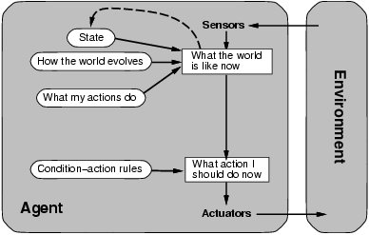
Model-based reflex agents
description of
current world state
Models the world by:
modeling how the world chances
how it’s actions change the world
sometimes it is unclear what to do
without a clear goal

Slide 18
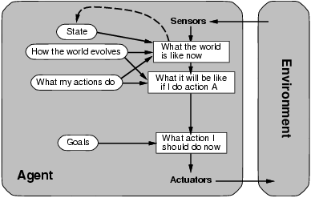
Goal-based agents
Goals provide reason to prefer one action over the other.
We need to predict the future: we need to plan & search

Slide 19
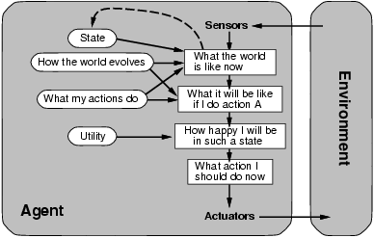
Utility-based agents
Some solutions to goal states are better than others.
Which one is best is given by a utility function.
Which combination of goals is preferred?

Slide 20
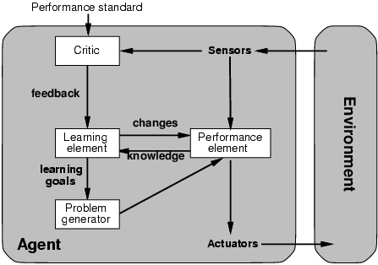
Learning agents
How does an agent improve over time?
By monitoring it’s performance and suggesting
better modeling, new action rules, etc.
Evaluates
current
world
state
changes
action
rules
“old agent”
model world
and
decide on
actions to be
taken
suggests
explorations

