Slide 1
Optimal Decisions in Games

Slide 2
Multi-agent Environments
Environments where agents have to consider the decisions of other agents
• Introduces per force contingencies
• Introduces competitivity
• Introduces adversality

Slide 3
AI usually considers
Deterministic
Turn-taking
Two player
Perfect information
Zero-sum games

Slide 4
A Real-time Example
Actual games are interesting because they are much bigger than toy-problems
Chess
Branching factor of around 35
Most games go to 50 moves each player
About 35**100 nodes in the game tree
About 10**40 distinct positions

Slide 5
Multi-agent Environments
Pruning
• Fundamental tool
• Ignore portions of the search tree that are irrelevant
Heuristic evaluation functions
• Stand-in for the chance to win in a certain situation

Slide 6
Formal definition of a Game
• Set of States — S
• Initial state — S0
• Player(s) — whose move is it?
• Action(s) — what are the legal moves
• Result(s, a) — the state resulting from an action
• Terminal-Test(s) — is this a terminal state??
• Utiliity(s,p) — objective / payoff function for each terminal state and player

Slide 7
Example game tree

Slide 8
Optimal Decisions in Games

Slide 9
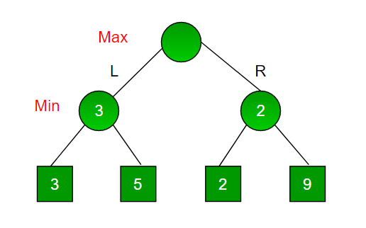
Min-max algorithm
A Search Problem
A Backtracking Algorithm
Best Move Strategy
Uses DFS search
Example Game Tree

Slide 10
Typical game set up
• Two players: MAX and MIN
• MAX movers first
• End-states with pay-off
• MAX wants to maximize the pay-off
• MIN wants to minimize the pay-off

Slide 11
Optimal Decisions in Games
Task for MAX:
• Find a strategy
• MAX determines his move in the initial state
• MAX determines his move in each state that MIN can reach from MAX’s move etc

Slide 12
Two-ply game
MAX moves in the upper
and lower layer
MIN moves in the middle layer
MIN in B chooses b1 — 3
MIN in C chooses c1 — 2
MIN in D chooses d3 — 2
MAX therefore selects
action a1

Slide 13
Strategy is MIN-MAX strategy

Slide 14
Min-max algorithm
• Proceed to the leaves
• Then back-up according to formula
• Can be extended to n-player games

Slide 15
Min-max algorithm

