Slide 1
Heuristic Search
HILL CLIMBING

Slide 2
Heuristic Search Techniques
Direct techniques (blind search) are not always possible (they require too much time or memory).
Weak techniques can be effective if applied correctly on the right kinds of tasks.
  Typically require domain specific information.

Slide 3
Example: 8 Puzzle
1
2
3
1
2
3
7
8
4
8
4
6
5
7
6
5

Slide 4
Which move is best?
1
2
3
GOAL
1
2
3
8
4
7
8
4
7
6
5
6
5
left
up
right
1
2
3
1
2
3
1
2
3
7
8
4
7
8
4
7
4
6
5
6
5
6
8
5

Slide 5
8 Puzzle Heuristics
Blind search techniques used an arbitrary ordering (priority) of operations.
Heuristic search techniques make use of domain specific information - a heuristic.
What heurisitic(s) can we use to decide which 8-puzzle move is “best” (worth considering first).

Slide 6
8 Puzzle Heuristics
For now - we just want to establish some ordering to the possible moves (the values of our heuristic does not matter as long as it ranks the moves).
Later - we will worry about the actual values returned by the heuristic function.

Slide 7
A Simple 8-puzzle heuristic
Number of tiles in the correct position.
  The higher the number the better.
  Easy to compute (fast and takes little memory).
  Probably the simplest possible heuristic.

Slide 8
Another approach
Number of tiles in the incorrect position.
  This can also be considered a lower bound on the number of moves from a solution!
  The “best” move is the one with the lowest number returned by the heuristic.
  Is this heuristic more than a heuristic (is it always correct?).
    Given any 2 states, does it always order them properly with respect to the minimum number of moves away from a solution?

Slide 9
1
2
3
GOAL
1
2
3
8
4
7
8
4
7
6
5
6
5
left
up
right
1
2
3
1
2
3
1
2
3
7
8
4
7
8
4
7
4
6
5
6
5
6
8
5
h=2
h=4
h=3

Slide 10
Another 8-puzzle heuristic
Count how far away (how many tile movements) each tile is from it’s correct position.
Sum up this count over all the tiles.
This is another estimate on the number of moves away from a solution.

Slide 11
1
2
3
GOAL
1
2
3
8
4
7
8
4
7
6
5
6
5
left
up
right
1
2
3
1
2
3
1
2
3
7
8
4
7
8
4
7
4
6
5
6
5
6
8
5
h=2
h=4
h=4

Slide 12
Techniques
There are a variety of search techniques that rely on the estimate provided by a heuristic function.
In all cases - the quality (accuracy) of the heuristic is important in real-life application of the technique!

Slide 13
Generate-and-test
Very simple strategy - just keep guessing.
do while goal not accomplished
  generate a possible solution
  test solution to see if it is a goal
Heuristics may be used to determine the specific rules for solution generation.
Notes:
Generating a solution may mean moving in the state space, or perhaps constructing a path through the state space. The path may end at a goal state, in which case we are done.
If a systematic mechanism for generation is used the algorithm can always find the best solution.
Random generation may work in some domains.
Depth first search since complete solutions are generated before they can be tested.

Slide 14
Example - Traveling Salesman Problem (TSP)
Traveler needs to visit n cities.
Know the distance between each pair of cities.
Want to know the shortest route that visits all the cities once.
n=80 will take millions of years to solve exhaustively!

Slide 15
TSP Example
A
B
6
1
2
5
3
D
C
4
Notes:
ABCD = 18
BACD = 13 - take it
ABCD = 18 - nope
BCAD - 11 - take it (is the optimum)
CBAD - 18
BACD - 13
BCDA - 18
DCAB - 13 nope

Slide 16
Generate-and-test Example
TSP - generation of possible solutions is done in lexicographical order of cities:
  1. A - B - C - D
  2. A - B - D - C
  3. A - C - B - D
  4. A - C - D - B
  ...
A
B
C
D
B
C
D
C
D
B
D
C
B
D
C
D
B
B
C
Notes:
Characteristics with generate-and-test:
Requires that an entire possible solution is generated at each step, which may
be expensive
It may be difficult to develop a generation scheme that provides a
good order.
The big problem is that the algorithm is blind - it does not make use of any
knowledge that becomes available during the search.
1. Can modify to use brand-and-bound techniques to skip some solutions.
2. Perhaps we can use information about the likelyhood of success to change
the generated possible solutions.
IMPORTANT: TSP is a bad example because it is hard to see the state space. Consider a problem like the water jug problem and describe how this algorithm would work in that domain.

Slide 17
Hill Climbing
Variation on generate-and-test:
  generation of next state depends on feedback from the test procedure.
  Test now includes a heuristic function that provides a guess as to how good each possible state is.
There are a number of ways to use the information returned by the test procedure.
Notes:
The term hill climbing assumes we are talking about finding a maximum, but the concepts apply to minimization problems as well.
Remember that the heuristic is a rule of thumb or guess based on less than complete information. We assume that construction of a perfect heuristic is impossible (otherwise it would be the search).

Slide 18
Hill Climbing
“Gradient ascent”
solution
Note: solutions shown
here as max not min.
Often used for numerical optimization problems.
How does it work?

Slide 19
Hill Climbing
A hill-climbing algorithm is a local search algorithm that moves continuously upward (increasing) until the best solution is attained.
This algorithm comes to an end when the peak is reached.

Slide 20
Hill Climbing
This algorithm has a node that comprises two parts: state and value. It begins with a non-optimal state (the hill’s base) and upgrades this state until a certain precondition is met.
The heuristic function is used as the basis for this precondition. The process of continuous improvement of the current state of iteration can be termed as climbing. This explains why the algorithm is termed as a hill-climbing algorithm.

Slide 21
Simple Hill Climbing
Use heuristic to move only to states that are better than the current state.
Always move to better state when possible.
The process ends when all operators have been applied and none of the resulting states are better than the current state.
Notes:
Always climb uphill whenever you can, without looking around.
Climbing a mountain in the dark - test one direction and if it is uphill take a step in that direction. If you find that there is no uphill move in any direction you are done (at the top of the mountain).

Slide 22
Simple Hill Climbing
Function Optimization
y = f(x)
y
x
Notes:
Assuming the heuristic can be viewed as a function of the current state, all heuristic search can be modeled as function optimization in which we wish to
maximize/minimize the value of the heuristic function.
NOTES:
must define the operators!
Small move left, big move left, large moves, etc.
Change the order of operators and see what happens.
“climbing” vs. “descending” - same problem.

Slide 23
Algorithm for Simple Hill climbing
Step 1 : Evaluate the initial state. If it is a goal state then stop and return success. Otherwise, make initial state as current state.
Step 2 : Loop until the solution state is found or there are no new operators present which can be applied to the current state.
a) Select a state that has not been yet applied to the current state and apply it to produce a new state.

Slide 24
Algorithm for Simple Hill climbing
b) Perform these to evaluate new state
i. If the current state is a goal state, then stop and return success.
ii. If it is better than the current state, then make it current state and proceed further.
iii. If it is not better than the current state, then continue in the loop until a solution is found.
Step 3 : Exit.

Slide 25
Simple Hill Climbing Example
TSP - define state space as the set of all possible tours.
Operators exchange the position of adjacent cities within the current tour.
Heuristic function is the length of a tour.
Notes:
Note the transformation of the state space into one that involves a potential solution at each state. This will result in something different than if we
define the state space as incomplete tours!

Slide 26
TSP Hill Climb State Space
ABCD
Initial State
Swap 1,2
Swap 2,3
Swap 3,4
Swap 4,1
BACD
ACBD
ABDC
DBCA
Swap 1,2
Swap 3,4
Swap 2,3
Swap 4,1
CABD
ABCD
ACDB
DCBA
Notes:
Lots of loops
Each tour has many representations (toy problem)!

Slide 27
Potential Problems with Simple Hill Climbing
Will terminate when at local optimum.
The order of application of operators can make a big difference.
Can’t see past a single move in the state space.

Slide 28
Steepest-Ascent Hill Climbing
A variation on simple hill climbing.
Instead of moving to the first state that is better, move to the best possible state that is one move away.
The order of operators does not matter.
Not just climbing to a better state, climbing up the steepest slope.
Notes:
Go through examples:
function optimization - choice of points fixes valley problem.
Multidimensional problems
TSP - new order of states. Example will find best right awat.

Slide 29
AI Hill Climbing
Steepest-Ascent Hill Climbing
current ← start node
loop do
  neighbor ← a highest-valued successor of current
  if neighbor.Value <= current.Value then return current.State
  current ← neighbor
end loop

Slide 30
Hill Climbing Termination
Local Optimum: all neighboring states are worse or the same.
Plateau - all neighboring states are the same as the current state.
Ridge - local optimum that is caused by inability to apply 2 operators at once.
Notes:
Example of ridge is clear in the water jug problem.
Need to define a heuristic for the water jug problem that takes this in to account.

Slide 31

Problem: depending on initial state, can get stuck in local maxima

Slide 32
Local maximum: A local maximum is a solution that surpasses other neighboring solutions or states but is not the best possible solution.
Global maximum: This is the best possible solution achieved by the algorithm.
Current state: This is the existing or present state.
Flat local maximum: This is a flat region where the neighboring solutions attain the same value.
Shoulder: This is a plateau whose edge is stretching upwards.

Slide 33
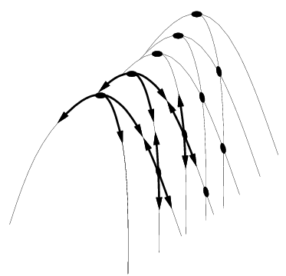
Hill Climbing Problems
  Local maxima
  Plateaus
  Diagonal ridges
What is it sensitive to?
Does it have any advantages?

Slide 34
Problems in different regions in Hill climbing
Local maximum : At a local maximum all neighboring states have a values which is worse than the current state. Since hill-climbing uses a greedy approach, it will not move to the worse state and terminate itself. The process will end even though a better solution may exist.
To overcome local maximum problem
Utilize backtracking technique. Maintain a list of visited states. If the search reaches an undesirable state, it can backtrack to the previous configuration and explore a new path.

Slide 35
Problems in different regions in Hill climbing
Plateau : On plateau all neighbors have same value . Hence, it is not possible to select the best direction.
To overcome plateaus : Make a big jump. Randomly select a state far away from the current state. Chances are that we will land at a non-plateau region.

Slide 36
Problems in different regions in Hill climbing
Ridge : Any point on a ridge can look like peak because movement in all possible directions is downward. Hence the algorithm stops when it reaches this state.
To overcome Ridge : In this kind of obstacle, use two or more rules before testing. It implies moving in several directions at once.

Slide 37
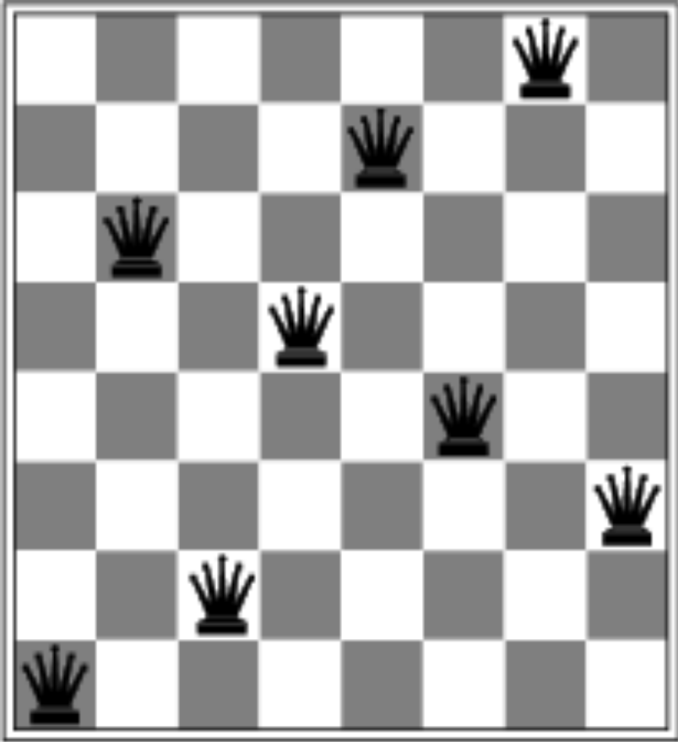
A local minimum with h = 1. Need h = 0
How to find global minimum (or maximum)?

Slide 38
Solving the Problems
Allow backtracking (What happens to complexity?)
Stochastic hill climbing: choose at random from uphill moves, using steepness for a probability
Random restarts: “If at first you don’t succeed, try, try again.”
Several moves in each of several directions, then test
Jump to a different part of the search space

Slide 39
Heuristic Dependence
Hill climbing is based on the value assigned to states by the heuristic function.
The heuristic used by a hill climbing algorithm does not need to be a static function of a single state.
The heuristic can look ahead many states, or can use other means to arrive at a value for a state.
Notes:
The point is that the hill climbing is with respect to the heuristic function, which may not be directly related to the immediate value of a single state.
Example: TSP - could have a heuristic that looks at the path 4 cities ahead.
Example: Could devise a heuristic that looks for ridges in the simple evaluation space and adds a “ridge factor”.
Example: Can use constraints to modify the heuristic function - penalties for points that are not feasible.
Can transform the optimization function to one with better characteristics (perhaps fewer local optimum), although at a cost. The search is basically a bunch of calls to the heuristic function, so the cost of this function is critical.

Slide 40
Best-First Search
Combines the advantages of Breadth-First and Depth-First searchs.
  DFS: follows a single path, don’t need to generate all competing paths.
  BFS: doesn’t get caught in loops or dead-end-paths.
Best First Search: explore the most promising path seen so far.

Slide 41
Best-First Search (cont.)
While goal not reached:
  1. Generate all potential successor states and add to a list of states.
  2. Pick the best state in the list and go to it.
Similar to steepest-ascent, but don’t throw away states that are not chosen.
Notes:
Space requirements are a problem...
Modified version called “beam search” keeps on the N most promising states around.

Slide 42
Simulated Annealing
Based on physical process of annealing a metal to get the best (minimal energy) state.
Hill climbing with a twist:
  allow some moves downhill (to worse states)
  start out allowing large downhill moves (to much worse states) and gradually allow only small downhill moves.
Notes:
Proability of jumping to a state of higher energy is given by exponential function p = exp(-deltaE/t).

Slide 43
Simulated Annealing
Variant of hill climbing (so up is good)
Tries to explore enough of the search space early on, so that the final solution is less sensitive to the start state
May make some downhill moves before finding a good way to move uphill.

Slide 44
Simulated Annealing
Comes from the physical process of annealing in which substances are raised to high energy levels (melted) and then cooled to solid state.
The probability of moving to a higher energy state, instead of lower is
p = e^(-ΔE/kT)
where ΔE is the positive change in energy level, T is the temperature, and k is Bolzmann’s constant.
heat cool

Slide 45
Simulated Annealing (cont.)
The search initially jumps around a lot, exploring many regions of the state space.
The jumping is gradually reduced and the search becomes a simple hill climb (search for local optimum).
Notes:
Algorithm:
use next operator to generate a new state.
Evaluate the state (heuristic function)
with probability p(t), move to the better state.
P(t) is roughly exponentially decreasing with respect to time (number of steps).

Slide 46
Simulated Annealing
7
6
2
4
3
5
1
Notes:
Marble analogy - increased temperature means we are shaking the curve around so that it can bound out of troughs. As temperature decreases - bounces are not so high, so we get trapped by the largest peaks...

Slide 47
Simulated Annealing Applications
Basic Problems
  Traveling salesman
  Graph partitioning
  Matching problems
  Graph coloring
  Scheduling
Engineering
  VLSI design
    Placement
    Routing
    Array logic minimization
    Layout
  Facilities layout
  Image processing
  Code design in information theory

