Slide 1
Artificial Neural Networks

Slide 2
Biological Inspirations

Slide 3
Biological Inspirations
Humans perform complex tasks like vision, motor control, or language understanding very well.
One way to build intelligent machines is to try to imitate the (organizational principles of) human brain.

Slide 4
Human Brain
The brain is a highly complex, non-linear, and parallel computer, composed of some 10¹¹ neurons that are densely connected (~10⁴ connection per neuron).
A neuron is much slower (10⁻³sec) compared to a silicon logic gate (10⁻⁹sec)
– Complex perceptual decisions are arrived at quickly (within a few hundred milliseconds)
Plasticity: Some of the neural structure of the brain is present at birth, while other parts are developed through learning, especially in early stages of life, to adapt to the environment (new inputs).

Slide 5
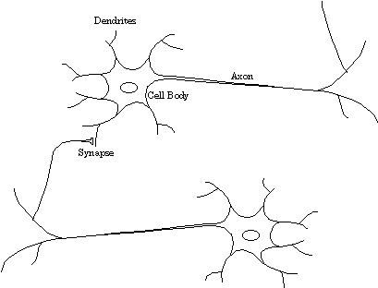
Biological Neuron
dendrites: nerve fibres carrying electrical signals to the cell
cell body: computes a non-linear function of its inputs
axon: single long fiber that carries the electrical signal from the cell body to other neurons
synapse: the point of contact between the axon of one cell and the dendrite of another, regulating a chemical connection whose strength affects the input to the cell.

Slide 6
Artificial Neural Networks
Computational models inspired by the human brain:
Massively parallel, distributed system, made up of simple processing units (neurons)
Synaptic connection strengths among neurons are used to store the acquired knowledge.
Knowledge is acquired by the network from its environment through a learning process

Slide 7
Properties of ANNs
Learning from examples
labeled or unlabeled
Adaptivity
changing the connection strengths to learn things
Non-linearity
the non-linear activation functions are essential
Fault tolerance
if one of the neurons or connections is damaged, the whole network still works quite well
Thus, they might be better alternatives than classical solutions for problems characterised by:
high dimensionality, noisy, imprecise or imperfect data; and
a lack of a clearly stated mathematical solution or algorithm

Slide 8
Characteristics of Problems to apply ANN
Instances are represented by many attribute-value pairs
The target function output may be discrete-valued, real-valued, or a vector of several real- or discrete-valued attributes
The training examples may contain errors.
Long training times are acceptable
Fast evaluation of the learned target function may be required
The ability of humans to understand the learned target function is not important

Slide 9
Neuron Model and
Network Architectures

Slide 10
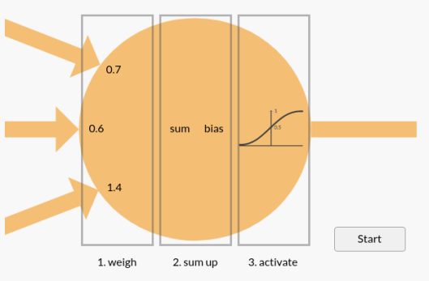

Inside the Perceptron

Slide 12
Bias
n
a_{i} = f (n_{i}) = f (Σw_{ij}x_{j} + b_{i})
j = 1
An artificial neuron:
computes the weighted sum of its input (called its net input)
adds its bias
passes this value through an activation function
We say that the neuron “fires” (i.e. becomes active) if its output is above zero.

Slide 13
Bias
Bias can be incorporated as another weight clamped to a fixed input of +1.0
This extra free variable (bias) makes the neuron more powerful.
n
a_{i} = f (n_{i}) = f (Σw_{ij}x_{j}) = f(w_{i}.x_{j})
j = 0

Slide 14



Activation functions
Also called the squashing function as it limits the amplitude of the output of the neuron.
Many types of activations functions are used:
– linear: a = f(n) = n
– threshold: (hardlimiting)
a = {1 if n >= 0
0 if n < 0
– sigmoid:
a = 1/(1+e^{-n})
– ...

Slide 15
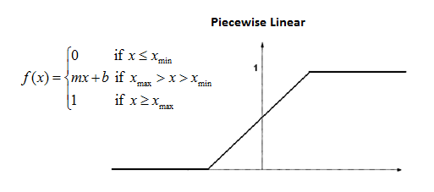
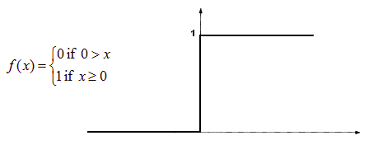
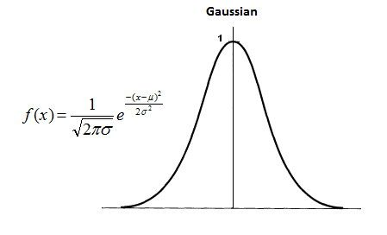
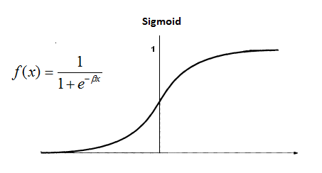
Activation functions
1. Step function
2. Ramp function
3. Sigmoid function
4. Gaussian function

Slide 16
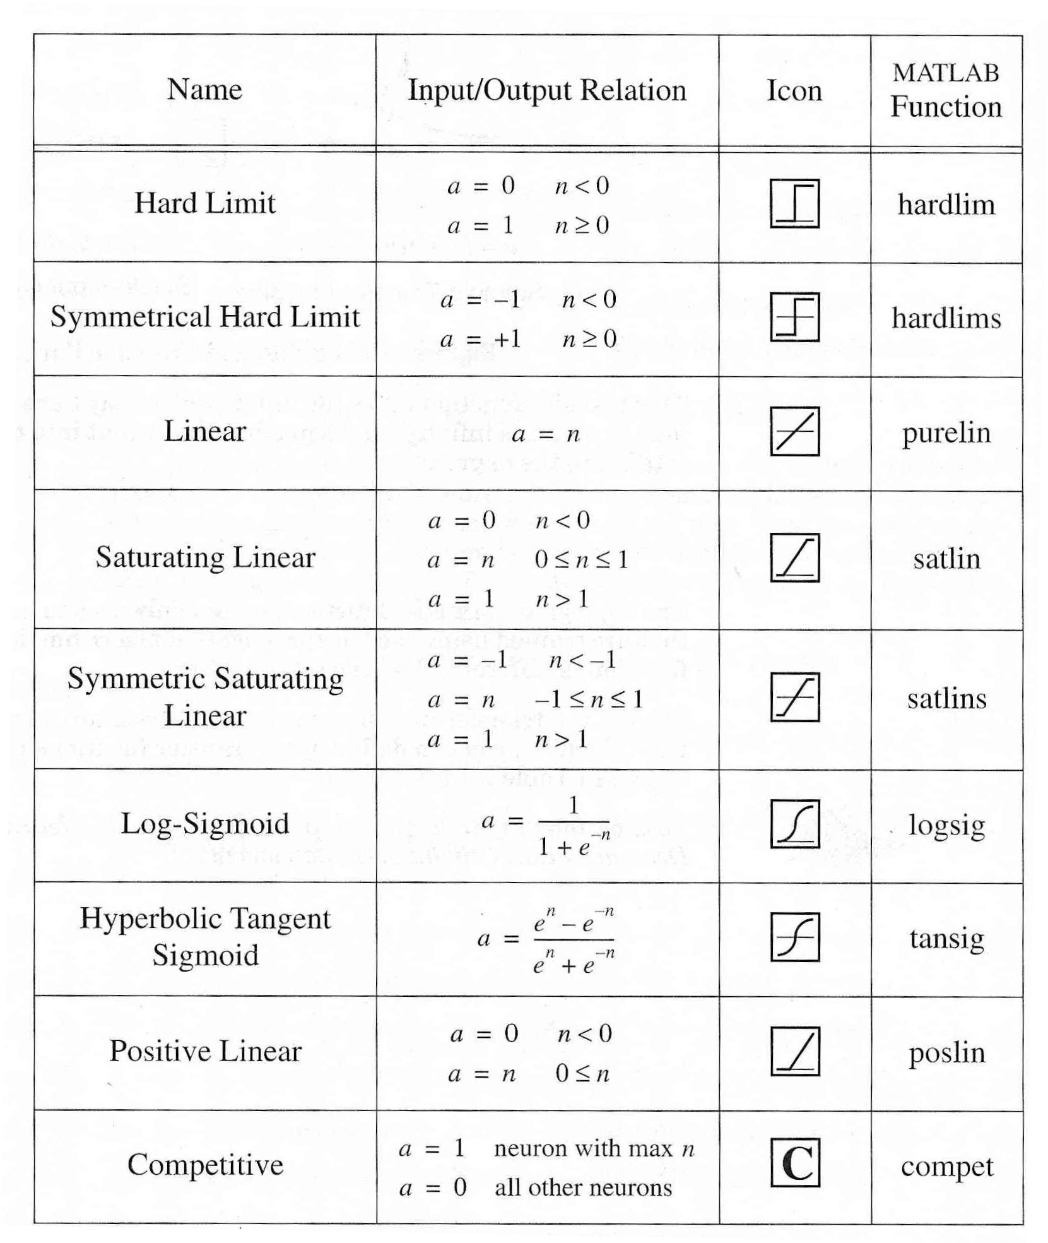
Activation Functions

Slide 17
Single Layer Feed-forward
– Input layer projecting into the output layer
Input layer
of
source nodes
Output layer
of
neurons

Slide 18
Single layer Perceptron
o
x
Single layer perceptrons learn linear decision boundaries
o
o
x₂
x: class I (y = 1)
o: class II (y = -1)
0
0
0
0
+ + + + + +
0
0
x
x
0
x₁
o
x
x: class I (y = 1)
o: class II (y = -1)

Slide 19
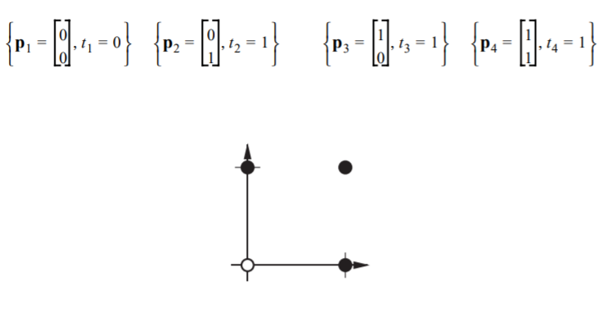

Boolean OR
input x1 | input x2 | ouput
0 | 0 | 0
0 | 1 | 1
1 | 0 | 1
1 | 1 | 1
x₂
+
+
w₀= −0.5
OR
W₀ - ?
W₁ - ?
W₂ - ?
1
−
+
x₁
w₁=1
w₂=1
x₁
x₂

Slide 20
Boolean AND
input x1 | input x2 | ouput
0 | 0 | 0
0 | 1 | 0
1 | 0 | 0
1 | 1 | 1
x₂
w₀= −1.5
−
+
1
w₁=1
w₂=1
AND
x₁
x₂
x₁
−
−

Slide 21
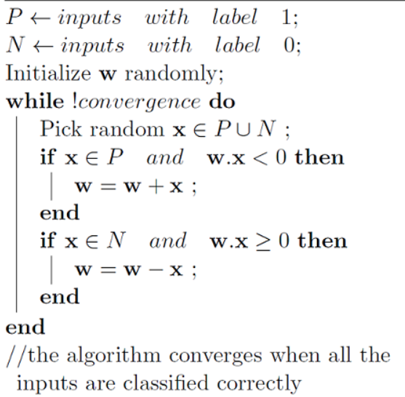
Perceptron Learning Algorithm

Slide 22
Perceptron learning
If the n-th member of the training set, x(n), is correctly classified by the weight vector w(n) computed at the n-th iteration of the algorithm, no correction is made to the weight vector, i.e:
▫ w(n+1) = w(n)
▫ w(n+1) = w(n)
if w^{T}x(n) > 0 and x(n) belongs to class C₁
if w^{T}x(n) ≤ 0 and x(n) belongs to class C₂
Otherwise the weight vector of the perceptron is updated:
▫ w(n+1) = w (n) - ŋ(n)x(n)
if w^{T}(n)x(n) >0 and x(n) belongs to class C₂
if w^{T}(n)x(n) ≤ 0 and x(n) belongs to class C₁
▫ w(n+1) = w (n) + ŋ(n)x(n)
learning-rate parameter ŋ(n) controls the adjustment applied to the weight vector at iteration n.

Slide 23
Learning algorithm
Epoch: Presentation of the entire training set to the neural network. In the case of the AND function an epoch consists of four sets of inputs being presented to the network (i.e. [0,0], [0,1], [1,0], [1,1])
Error: The error value is the amount by which the value output by the network differs from the target value. For example, if we required the network to output 0 and it outputs a 1, then Error = -1

Slide 24
Example
Consider the 2-dimensional training set C₁ ∪ C₂,
C₁ = {(1, 1, 1), (1, 1, -1), (1, 0, -1)} with class label 1
C₂ = {(1, -1,-1), (1, -1,1), (1, 0,1)} with class label 0
Train a perceptron on C₁ ∪ C₂
First pass is as follows with (W₀,W₁,W₂)=(1,0,0) initial values
Input | Weight | Desired | Actual | Update? | New weight
(1, 1, 1) | (1, 0, 0) | 1 | 1 | No | (1, 0, 0)
(1, 1, -1) | (1, 0, 0) | 1 | 1 | No | (1, 0, 0)
(1,0, -1) | (1, 0, 0) | 1 | 1 | No | (1, 0, 0)
(1,-1, -1) | (1, 0, 0) | 0 | 1 | Yes¹ | (0, 1, 1)
(1,-1, 1) | (0, 1, 1) | 0 | 0 | No | (0, 1, 1)
(1, 0, 1) | (0, 1, 1) | 0 | 1 | Yes² | (-1, 1, 0)
_{1. W=W-X} (1,0,0) – 1*(1,-1,-1) = (0,1,1)
2. W=W-X (0,1,1) – 1*(1,0, 1) = (-1,1,0)

Slide 25
Example
C1: {(1, 1, 1), (1, 1, -1), (1, 0, -1)}
C2: {(1, -1,-1), (1, -1,1), (1, 0,1)}
Fill out this table sequentially (Second pass):
Input Weight |  | Desired Actual Update? New Weight
(1, 1, 1) | (-1, 1, 0) | 1 | 0 | Yes¹ | (0, 2, 1)
(1, 1, -1) | (0, 2, 1) | 1 | 1 | No | (0, 2, 1)
(1,0, -1) | (0, 2, 1) | 1 | 0 | Yes² | (1, 2, 0)
(1,-1, -1) | (1, 2, 0) | 0 | 0 | No | (1, 2, 0)
(1,-1, 1) | (1, 2, 0) | 0 | 0 | No | (1, 2, 0)
(1, 0, 1) | (1, 2, 0) | 0 | 1 | Yes³ | (0, 2, -1)
_{1. W=W-X} (-1,1,0) + 1*(1,1,1) = (0,2,1)
2. W=W-X (0,2,1) + 1*(1,0,-1) = (1,2,0)
3. W=W-X (1,2,0) – 1*(1,0, 1) = (0,2,-1)
Notes:
44

Slide 26
Example
C1: {(1, 1, 1), (1, 1, -1), (1, 0, -1)}
C2: {(1, -1,-1), (1, -1,1), (1, 0,1)}
Fill out this table sequentially (Third pass):
Input | Weight | Desired | Actual | Update? | New weight
(1, 1, 1) | (0, 2, -1) | 1 | 1 | No | (0, 2, -1)
(1, 1, -1) | (0, 2, -1) | 1 | 1 | No | (0, 2, -1)
(1,0, -1) | (0, 2, -1) | 1 | 1 | No | (0, 2, -1)
(1,-1, -1) | (0, 2, -1) | 0 | 0 | No | (0, 2, -1)
(1,-1, 1) | (0, 2, -1) | 0 | 0 | No | (0, 2, -1)
(1, 0, 1) | (0, 2, -1) | 0 | 0 | No | (0, 2, -1)
At epoch 3 no weight changes.
⇒ stop execution of algorithm.
Final weight vector: (0, 2, -1).
⇒ decision hyperplane is 2x₁ - x₂ = 0.

Slide 27


Example: final results
x₂
-
- ¹
+
Decision boundary:
C₂
2x₁ - x₂ = 0
-1
1/2
1
2
x₁
w
-
+
-1
+
C₁

Slide 28
Representation Capability of NNs
Single layer nets have limited representation power (linear separability problem).
Few simple Boolean function can be represented by a network with a single hidden layer.
Cannot represent bounded continuous function using single layer

Slide 29
Boolean XOR
input x1 | input x2 | ouput
0 | 0 | 0
0 | 1 | 1
1 | 0 | 1
1 | 1 | 0
x₂
+
−
XOR
−
+
x₁

Slide 30
Boolean XOR
XOR
o
−0.5
input x1 | input x2 | ouput
0 | 0 | 0
0 | 1 | 1
1 | 0 | 1
1 | 1 | 0
1
−1
OR
AND
−0.5
h₁
h₁
−1.5
1
1
1
1
x₁
x₁

Slide 31

Different Network Topologies
Multi-layer feed-forward networks
One or more hidden layers.
Input projects only from previous layers onto a layer.
typically, only from one layer to the next
2-layer or
1-hidden layer fully connected network
Input layer
Hidden layer
Output layer

Slide 32
Different Network Topologies
Recurrent networks
– A network with feedback, where some of its inputs are connected to some of its outputs (discrete time).
Input layer
Output layer

Slide 33
Applications of ANNs
ANNs have been widely used in various domains for:
Pattern recognition
Function approximation
Associative memory
– ...

Slide 34
Artificial Neural Networks
Early ANN Models:
Perceptron, ADALINE, Hopfield Network
Current Models:
Deep Learning Architectures
Multilayer feedforward networks (Multilayer perceptrons)
Radial Basis Function networks
Self Organizing Networks
– ...

Slide 35
How to Decide on a Network Topology?
# of input nodes?
Number of features
# of output nodes?
Suitable to encode the output representation
transfer function?
Suitable to the problem
# of hidden nodes?
Not exactly known

