Slide 1
Solving problems by searching

Slide 2
Why Search?
To achieve goals or to maximize our utility we need to predict what the result of our actions in the future will be.
There are many sequences of actions, each with their own utility.
We want to find, or search for, the best one.

Slide 3
Example: Romania
On holiday in Romania; currently in Arad.
Flight leaves tomorrow from Bucharest
Formulate goal:
  be in Bucharest
Formulate problem:
  states: various cities
  actions: drive between cities
Find solution:
  sequence of cities, e.g., Arad, Sibiu, Fagaras, Bucharest

Slide 4

Example: Romania

Slide 5

Problem-solving agents

Slide 6
Problem types
Static / Dynamic
Previous problem was static: no attention to changes in environment
Observable / Partially Observable / Unobservable
Previous problem was observable: it knew its initial state
Deterministic / Stochastic
Previous problem was deterministic: no new percepts were necessary, we can predict the future perfectly
Discrete / continuous
Previous problem was discrete: we can enumerate all possibilities

Slide 7

Example: vacuum world
Observable, start in #5. Solution?

Slide 8
Example: vacuum world
Observable, start in #5.
Solution? [Right, Suck]
Unobservable, start in
{1,2,3,4,5,6,7,8} e.g.,
Solution?

Slide 9
Example: vacuum world
Unobservable, start in
{1,2,3,4,5,6,7,8} e.g.,
Solution?
[Right,Suck,Left,Suck]

Slide 10
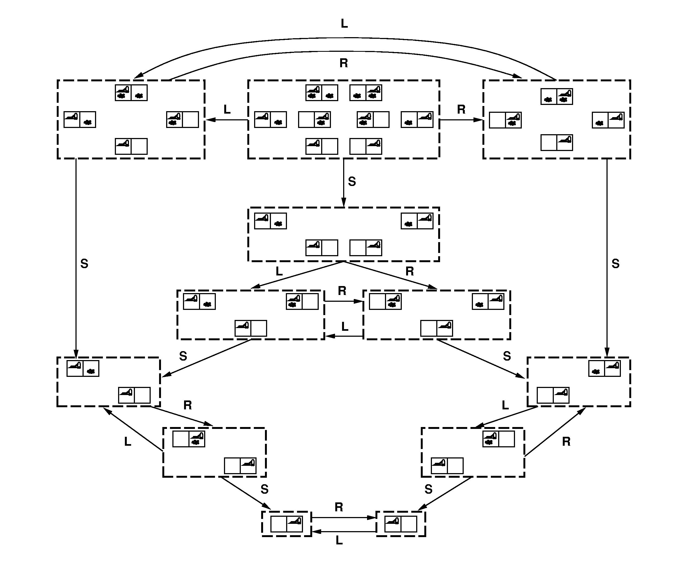

Slide 11
Problem Formulation
A problem is defined by four items:
initial state e.g., "at Arad“
actions or successor function S(x) = set of action–state pairs
  e.g., S(Arad) = {<Arad → Zerind, Zerind>, … }
goal test,
e.g., x = "at Bucharest, Checkmate(x)
path cost (additive)
  e.g., sum of distances, number of actions executed, etc.
  c(x,a,y) is the step cost, assumed to be ≥ 0
A solution is a sequence of actions leading from the initial state to a goal state

Slide 12
Selecting a state space
Real world is absurdly complex
  → state space must be abstracted for problem solving
(Abstract) state = set of real states
(Abstract) action = complex combination of real actions
  e.g., "Arad → Zerind" represents a complex set of possible routes, detours, rest stops, etc.
For guaranteed realizability, any real state "in Arad“ must get to some real state "in Zerind“
(Abstract) solution =
  set of real paths that are solutions in the real world
Each abstract action should be "easier" than the original problem

Slide 13

Vacuum world state space graph
states?
actions?
initial state?
goal test?
path cost?

Slide 14
Vacuum world state space graph
states? integer: dirt and robot location
initial state? any
actions? Left, Right, Suck
goal test? no dirt at all locations
path cost? 1 per action

Slide 15

Example: The 8-puzzle
states?
Initial State?
actions?
goal test?
path cost?

Slide 16
Example: The 8-puzzle
states? locations of tiles
initial state? given
actions? move blank left, right, up, down
goal test? = goal state (given)
path cost? 1 per move
[Note: optimal solution of n-Puzzle family is NP-hard]

Slide 17
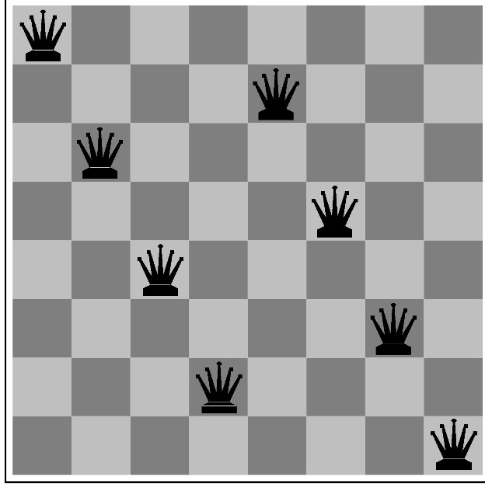
Example: 8-Queens
states?
initial state?
actions?
goal test?
path cost?

Slide 18
Example: 8-Queens
states? -any arrangement of n<=8 queens
-arrangements of n<=8 queens in leftmost n
columns, 1 per column, such that no queen
attacks any other.
initial state? no queens on the board
actions? -add queen to any empty square
-add queen to leftmost empty square such that
it is not attacked by other queens.
goal test? 8 queens on the board, none attacked.
path cost? 1 per move

Slide 19

Example: robotic assembly
states?: real-valued coordinates of robot joint angles parts of the object to be assembled
initial state?: rest configuration
actions?: continuous motions of robot joints
goal test?: complete assembly
path cost?: time to execute

Slide 20
Tree search algorithms
Basic idea:
  offline, simulated exploration of state space by generating successors of already-explored states (a.k.a.~expanding states)

Slide 21

Tree search example

Slide 22

Tree search example

Slide 23


Tree search example

Slide 24

Implementation: states vs. nodes
A state is a (representation of) a physical configuration
A node is a data structure constituting part of a search tree contains info such as: state, parent node, action, path cost g(x), depth
The Expand function creates new nodes, filling in the various fields and using the SuccessorFn of the problem to create the corresponding states.

Slide 25
Search strategies
A search strategy is defined by picking the order of node expansion
Strategies are evaluated along the following dimensions:
  completeness: does it always find a solution if one exists?
  time complexity: number of nodes generated
  space complexity: maximum number of nodes in memory
  optimality: does it always find a least-cost solution?
Time and space complexity are measured in terms of
  b: maximum branching factor of the search tree
  d: depth of the least-cost solution
  m: maximum depth of the state space (may be ∞)

Slide 26
https://www.youtube.com/watch?v=laLS8gHzROg
missionaries and cannibals problem

