Slide 1
Uninformed Search
BFS
DFS

Slide 2
Complexity
We often want to characterize algorithms independent of their
implementation.
“This algorithm took 1 hour and 43 seconds on my laptop”.
Is not very useful, because tomorrow computers are faster.
Better is:
“This algorithm takes O(nlog(n)) time to run and O(n) to store”.
because this statement is abstracts away from irrelevant details.
Time(n) = O(f(n)) means:
Time(n) < constant f(n) for n>n0 for some n0
Space(n) idem.
n is some variable which characterizes the size of the problem,
e.g. number of data-points, number of dimensions, branching-factor
of search tree, etc.
Worst case analysis versus average case analyis

Slide 3
Uninformed search strategies
Uninformed: While searching you have no clue whether one non-goal state is better than any other. Your search is blind.
Various blind strategies:
Breadth-first search
Uniform-cost search
Depth-first search
Iterative deepening search

Slide 4

Breadth-first search
Expand shallowest unexpanded node
Implementation:
  fringe is a first-in-first-out (FIFO) queue, i.e., new successors go at end of the queue.
Is A a goal state?

Slide 5

Breadth-first search
Expand shallowest unexpanded node
Implementation:
  fringe is a FIFO queue, i.e., new successors go at end
Expand:
fringe = [B,C]
Is B a goal state?

Slide 6

Breadth-first search
Expand shallowest unexpanded node
Implementation:
  fringe is a FIFO queue, i.e., new successors go at end
Expand:
fringe=[C,D,E]
Is C a goal state?

Slide 7

Breadth-first search
Expand shallowest unexpanded node
Implementation:
  fringe is a FIFO queue, i.e., new successors go at end
Expand:
fringe=[D,E,F,G]
Is D a goal state?

Slide 8
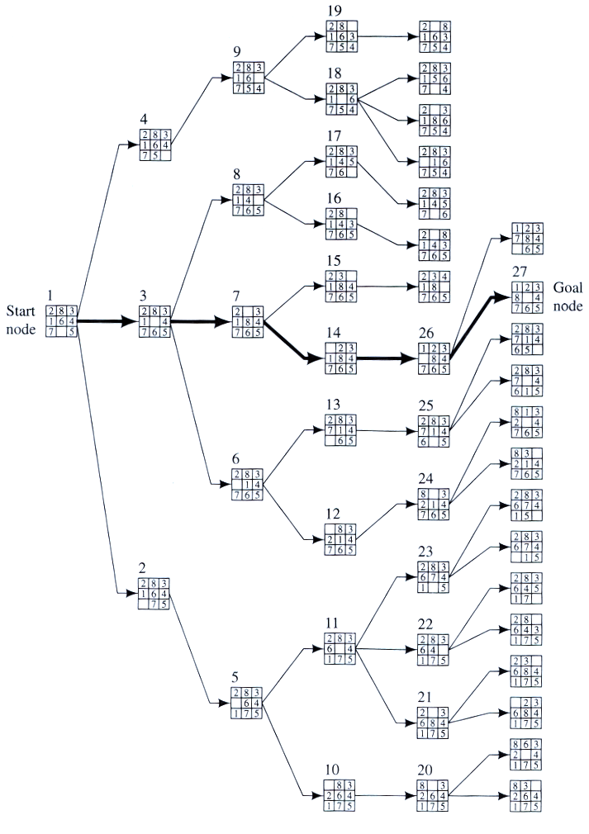
Example
BFS

Slide 9
Properties of breadth-first search
Complete? Yes it always reaches goal (if b is finite)
Time? 1+b+b²+b³+… +b^{d} + (b^{d+1}-b)) = O(b^{d+1})
(this is the number of nodes we generate)
Space? O(b^{d+1}) (keeps every node in memory,
either in fringe or on a path to fringe).
Optimal? Yes (if we guarantee that deeper solutions are less optimal, e.g. step-cost=1).
Space is the bigger problem (more than time)

Slide 10

Depth-first search
Expand deepest unexpanded node
Implementation:
  fringe = Last In First Out (LIFO) queue, i.e., put successors at front
Is A a goal state?

Slide 11

Depth-first search
Expand deepest unexpanded node
Implementation:
  fringe = LIFO queue, i.e., put successors at front
queue=[B,C]
Is B a goal state?

Slide 12

Depth-first search
Expand deepest unexpanded node
Implementation:
  fringe = LIFO queue, i.e., put successors at front
queue=[D,E,C]
Is D = goal state?

Slide 13

Depth-first search
Expand deepest unexpanded node
Implementation:
  fringe = LIFO queue, i.e., put successors at front
queue=[H,I,E,C]
Is H = goal state?

Slide 14

Depth-first search
Expand deepest unexpanded node
Implementation:
  fringe = LIFO queue, i.e., put successors at front
queue=[I,E,C]
Is I = goal state?

Slide 15

Depth-first search
Expand deepest unexpanded node
Implementation:
  fringe = LIFO queue, i.e., put successors at front
queue=[E,C]
Is E = goal state?

Slide 16

Depth-first search
Expand deepest unexpanded node
Implementation:
  fringe = LIFO queue, i.e., put successors at front
queue=[J,K,C]
Is J = goal state?

Slide 17

Depth-first search
Expand deepest unexpanded node
Implementation:
  fringe = LIFO queue, i.e., put successors at front
queue=[K,C]
Is K = goal state?

Slide 18

Depth-first search
Expand deepest unexpanded node
Implementation:
  fringe = LIFO queue, i.e., put successors at front
queue=[C]
Is C = goal state?

Slide 19

Depth-first search
Expand deepest unexpanded node
Implementation:
  fringe = LIFO queue, i.e., put successors at front
queue=[F,G]
Is F = goal state?

Slide 20

Depth-first search
Expand deepest unexpanded node
Implementation:
  fringe = LIFO queue, i.e., put successors at front
queue=[L,M,G]
Is L = goal state?

Slide 21

Depth-first search
Expand deepest unexpanded node
Implementation:
  fringe = LIFO queue, i.e., put successors at front
queue=[M,G]
Is M = goal state?

Slide 22
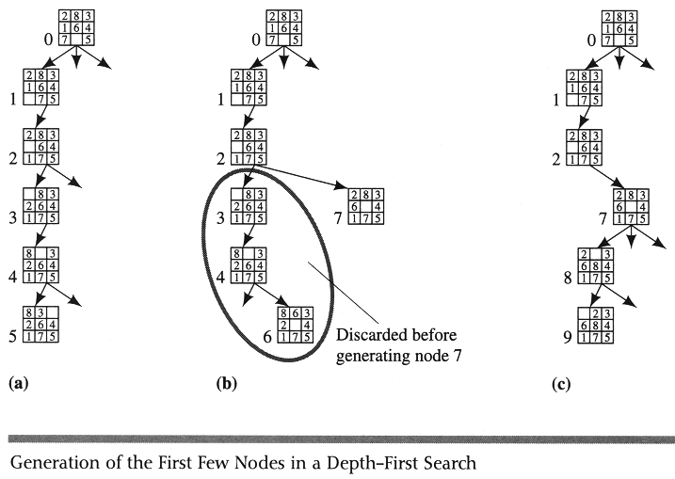
Example DFS

Slide 23
Properties of depth-first search
Complete? No: fails in infinite-depth spaces
Can modify to avoid repeated states along path
Time? O(b^{m}) with m=maximum depth
terrible if m is much larger than d
  but if solutions are dense, may be much faster than
  breadth-first
Space? O(bm), i.e., linear space! (we only need to
remember a single path + expanded unexplored nodes)
Optimal? No (It may find a non-optimal goal first)

Slide 24
Visualisation of BFS and DFS
https://www.youtube.com/watch?v=x-VTfcmrLEQ
https://www.youtube.com/watch?v=NUgMa5coCoE

Slide 25
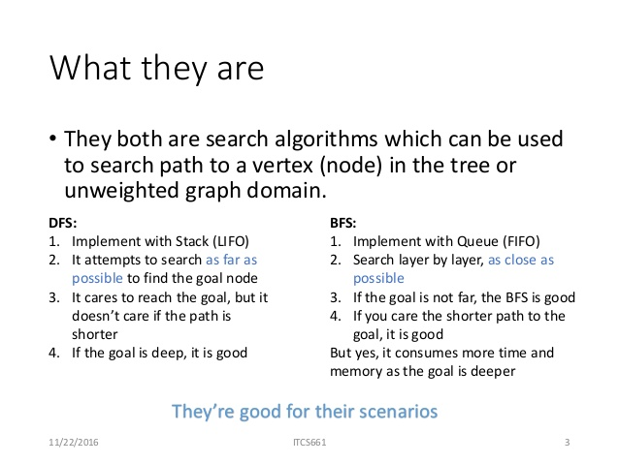
BFS Vs DFS

Slide 26
QUIZ-1
Login to kahoot.it
Enter game pin:
Enter your name:

