Slide 1
Syntax Analysis
Part I
Chapter 4

Slide 2
Position of a Parser in the Compiler Model
Token,
tokenval
Source
Program
Lexical
Analyzer
Parser
and rest of
front-end
Intermediate
representation
Get next
token
Lexical error
Syntax error
Semantic error
Symbol Table

Slide 3
The Parser
A parser implements a C-F grammar as a recognizer of strings
The role of the parser in a compiler is twofold:
  To check syntax
    And to report syntax errors accurately
  To invoke semantic actions
    For static semantics checking, e.g. type checking of expressions, functions, etc.
    For syntax-directed translation of the source code to an intermediate representation

Slide 4
Syntax-Directed Translation
One of the major roles of the parser is to produce an intermediate representation (IR) of the source program using syntax-directed translation methods
Possible IR output:
  Abstract syntax trees (ASTs)
  Control-flow graphs (CFGs) with triples, three-address code, or register transfer list notation
  WHIRL (SGI Pro64 compiler) has 5 IR levels!

Slide 5
Error Handling
A good compiler should assist in identifying and locating errors
  Lexical errors: important, compiler can easily recover and continue
  Syntax errors: most important for compiler, can almost always recover
  Static semantic errors: important, can sometimes recover
  Dynamic semantic errors: hard or impossible to detect at compile time, runtime checks are required
  Logical errors: hard or impossible to detect

Slide 6
Error Handling
The error handler in the parser has the following goals:
  It should report the presence of errors clearly & accurately.
  It should recover from each error quickly enough to be able to detect the subsequent errors.
  It should not significantly slow down the processing of correct programs.

Slide 7
Viable-Prefix Property
The viable-prefix property of parsers allows early detection of syntax errors
  Goal: detection of an error as soon as possible without further consuming unnecessary input
  How: detect an error as soon as the prefix of the input does not match a prefix of any string in the language
Error is
detected here
Error is
detected here
…
for (;)
…
…
DO 10 I = 1;0
…
Prefix
Prefix

Slide 8
Error Recovery Strategies
Panic mode
  Discard input until a token in a set of designated synchronizing tokens is found
Phrase-level recovery
  Perform local correction on the input to repair the error
Error productions
  Augment grammar with productions for erroneous constructs
Global correction
  Choose a minimal sequence of changes to obtain a global least-cost correction

Slide 9
Grammars (Recap)
Context-free grammar is a 4-tuple
G = (N, T, P, S) where
  T is a finite set of tokens (terminal symbols)
  N is a finite set of nonterminals
  P is a finite set of productions of the form
  α → β
  where α ∈ (N∪T)* N (N∪T)* and β ∈ (N∪T)*
  S ∈ N is a designated start symbol

Slide 10
Notational Conventions Used
Terminals
a,b,c,… ∈ T
specific terminals: 0, 1, id, +
Nonterminals
A,B,C,… ∈ N
specific nonterminals: expr, term, stmt
Grammar symbols
X,Y,Z ∈ (N∪T)
Strings of terminals
u,v,w,x,y,z ∈ T*
Strings of grammar symbols
α,β,γ ∈ (N∪T)*

Slide 11
Derivations (Recap)
The one-step derivation is defined by
α A β ⇒ α γ β
where A → γ is a production in the grammar
In addition, we define
  ⇒ is leftmost ⇒_{lm} if α does not contain a nonterminal
  ⇒ is rightmost ⇒_{rm} if β does not contain a nonterminal
  Transitive closure ⇒* (zero or more steps)
  Positive closure ⇒⁺ (one or more steps)
The language generated by G is defined by
L(G) = {w ∈ T* | S ⇒⁺ w}

Slide 12
Derivation (Example)
Grammar G = ({E}, {+,*,(,),-,id}, P, E) with
productions P = E → E + E
E → E * E
E → ( E )
E → - E
E → id
Example derivations:
E ⇒ - E ⇒ - id
E ⇒_{rm} E + E ⇒_{rm} E + id ⇒_{rm} id + id
E ⇒* E
E ⇒* id + id
E ⇒⁺ id * id + id

Slide 13
Chomsky Hierarchy: Language Classification
A grammar G is said to be
  Regular if it is right linear where each production is of the form
  A → w B or A → w
  or left linear where each production is of the form
  A → B w or A → w
  Context free if each production is of the form
  A → α
  where A ∈ N and α ∈ (N∪T)*
  Context sensitive if each production is of the form
  α A β → α γ β
  where A ∈ N, α,γ,β ∈ (N∪T)*, |γ| > 0
  Unrestricted

Slide 14
Chomsky Hierarchy
L(regular) ⊂ L(context free) ⊂ L(context sensitive) ⊂ L(unrestricted)
Where L(T) = { L(G) | G is of type T }
That is: the set of all languages
generated by grammars G of type T
Examples:
Every finite language is regular! (construct a FSA for strings in L(G))
L₁ = { a^{n}b^{n} | n ≥ 1 } is context free
L₂ = { a^{n}b^{n}c^{n} | n ≥ 1 } is context sensitive

Slide 15
Parsing
Universal (any C-F grammar)
  Cocke-Younger-Kasimi
  Earley
Top-down (C-F grammar with restrictions)
  Recursive descent (predictive parsing)
  LL (Left-to-right, Leftmost derivation) methods
Bottom-up (C-F grammar with restrictions)
  Operator precedence parsing
  LR (Left-to-right, Rightmost derivation) methods
    SLR, canonical LR, LALR

Slide 16
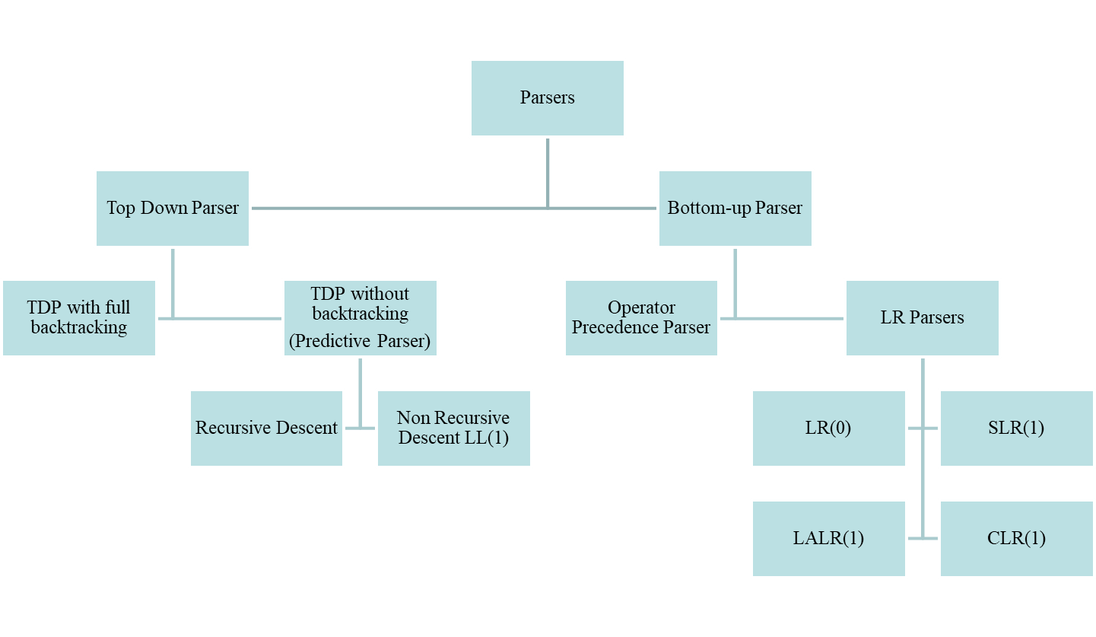
Parser

Slide 17
Grammar:
S →aABe
A→ Abc | b
B → d
w = abbcde

Slide 18
Top Down Parsing
The Parse tree is generated from top to bottom (I,e from root to leaves)
It follows LMD for an input string
Decision making is done when a variable is seen and decides based on the question what production to use?
It creates the nodes of the parse tree in preorder
Bottom Up Parsing
The Parse tree is generated starting from leaves (bottom) working up towards the root (top)
It follows RMD for an input string in reverse.
Decision making is done when a terminal is seen and decides based on the question when to reduce?

Slide 19
Top-Down Parsing
LL methods (Left-to-right, Leftmost derivation) and recursive-descent parsing
Grammar:
E → T + T
T → ( E )
T → - E
T → id
Leftmost derivation:
E ⇒_{lm} T + T
⇒_{lm} id + T
⇒_{lm} id + id
E
E
E
E
T
T
T
T
T
T
+
id
+
id
+
id

Slide 20
Problems with Top Down Parsing
Backtracking
Left Recursion
Left Factoring
Ambiguity

Slide 21
Backtracking
Backtracking is a technique in which , for expansion of a non-terminal symbol, we choose one alternative & if some mismatch occurs, we try another alternative, if any.
A backtracking parser will try different production rules to find the match for the input string by backtracking each time
It is more powerful than Predictive parsing but slower & requires exponential time in general.
Hence backtracking is not preferred for practical compilers

Slide 22
Backtracking
Drawback in backtracking:
We need to move some levels upward in order to check the possibilities.
This increases a lot of overheads in the implementation of parsing. And thus it becomes necessary to eliminate the backtracking by modifying the grammar.

Slide 23
Left Recursion (Recap)
Productions of the form
A → A α
| β
| γ
are left recursive
When one of the productions in a grammar is left recursive then a predictive parser loops forever on certain inputs

Slide 24
A General Systematic Left Recursion Elimination Method
Input: Grammar G with no cycles or ε-productions
Arrange the nonterminals in some order A₁, A₂, …, A_{n}
for i = 1, …, n do
for j = 1, …, i-1 do
replace each
A_{i} → A_{j} γ
with
A_{i} → δ₁ γ | δ₂ γ | … | δ_{k} γ
where
A_{j} → δ₁ | δ₂ | … | δ_{k}
enddo
eliminate the immediate left recursion in A_{i}
enddo

Slide 25
Immediate Left-Recursion Elimination
Rewrite every left-recursive production
A → A α
| β
| γ
| A δ
into a right-recursive production:
A → β A_{R}
| γ A_{R}
A_{R} → α A_{R}
| δ A_{R}
| ε

Slide 26
Immediate Left-Recursion Elimination
1. Elimination of Left recursion
E → E+T
| T
Solution:
E → TE_{R}
E_{R} → +TE_{R}
| ε

Slide 27
Immediate Left-Recursion Elimination
2. Elimination of Left recursion
S → S0S1S
| 01
Solution:
3. Elimination of Left recursion
S → (L) | x
L→ L,S | S
Solution:

Slide 28
Immediate Left-Recursion Elimination
3. Elimination of Left recursion
A→ A α1| Aα2 | Aα3…
| β1|β2|β3…
Solution:

Slide 29
Left Factoring
When a nonterminal has two or more productions whose right-hand sides start with the same grammar symbols, the grammar is not LL(1) and cannot be used for predictive parsing
Replace productions
A → α β₁ | α β₂ | … | α β_{n} | γ
with
A → α A_{R} | γ
A_{R} → β₁ | β₂ | … | β_{n}

Slide 30
Left Factoring
S → iEtS
| iEtSeS
| a
E → |b
w= iEtiEtSeS
Solution
2. S → aSSbS
| aSaSb
| abb
|b
Solution

Slide 31
Left Factoring
3. S → bSSaaS
| bSSaSb
| bSb
|a
Solution

Slide 32
Ambiguous Grammar
E → E + E
| E * E
| id
w= id + id * id
LMD-1
E=>E+E
=>id+E
=>id+E*E
=>id+id*E
=>id+id*id
LMD-2
E=>E*E
=>E+E*E
=>id+E*E
=>id+id*E
=>id+id*id
RMD-1
E=>E+E
=>E+E*E
=>E+E*id
=>E+id*id
=>id+id*id
RMD-2
E=>E*E
=>E*id
=>E+E*id
=>E+id*id
=>id+id*id

Slide 33
UnAmbiguous Grammar
E → E + E
| E * E
| id
E → E + T | T
T → T * F | F
F → id
Rules:
If operator is left associative, then retain left recursion (A→Aα) and
remove right recursion in the production
E → E + E is changed to E → E + T
2. If operator is right associative, then retain right recursion(A→αA) and
remove left recursion in the production
E → E ^ E is changed to E → T ^ E
3. Precedence levels of operator is taken care by placing productions
starting from lowest precedence level(i,e top) to highest precedence
(bottom)

Slide 34
Example
(id) .> (*,/) .> (+,-) are precedence levels
*,/,+,- all are left associative

Slide 35
Example
(id) .> (^) .> (*,/ ).> (+,-) are precedence levels
*,/,+,- all are left associative
^ is right associative

Slide 36
Example
(T,F) .> (and) .> (or) are precedence levels
and, or are left associative
bexpr →bexpr or bexpr
| bexpr and bexpr
| not bexpr
| T
| F

Slide 37
Example
Dangling-else problem:
S →if Expr then S
| if Expr then S else S
|other
derive w=if E then if E then S else S

Slide 38
Example
Unambiguous grammar for Dangling-else:
Stmt →Matched_stmt
|Open_stmt
Matched_stmt →if expr then Matched_stmt else Matched_stmt
| other
Open_stmt → if expr then stmt
| if expr then Matched_stmt else Open_stmt

Slide 39
Predictive Parsing
Eliminate left recursion from grammar
Left factor the grammar
Compute FIRST and FOLLOW
Two variants:
  Recursive (recursive-descent parsing)
  Non-recursive (table-driven parsing)

Slide 40
Predictive Parser
The Predictive parser tries to predict the next construction using one or more look-ahead symbols i,e input symbols.
No backtracking required.
Types
Recursive descent parser
Non recursive descent parser or LL(1)

Slide 41
Recursive Descent Parser
A parser that uses a collection of recursive procedures for parsing the given input string is called Recursive Descent Parser.

Slide 42
FIRST (Revisited)
FIRST(α) = { the set of terminals that begin all
strings derived from α }
FIRST(a) = {a} if a ∈ T
FIRST(ε) = {ε}
FIRST(A) = ∪_{A→α} FIRST(α) for A→α ∈ P
FIRST(X₁X₂…X_{k}) =
if for all j = 1, …, i-1 : ε ∈ FIRST(X_{j}) then
add non-ε in FIRST(X_{i}) to FIRST(X₁X₂…X_{k})
if for all j = 1, …, k : ε ∈ FIRST(X_{j}) then
add ε to FIRST(X₁X₂…X_{k})

Slide 43
FIRST (Revisited)
FIRST(X)
If X is a terminal, then FIRST(X) is {X}
Ex: FIRST(+)={+}
If X is a non terminal,
  If there is a null production X→ ε, then add ε to FIRST(X)
  If there is no null productions, i,e X →Y₁Y₂….Y_{k} then
  FIRST(X) = FIRST(Y₁Y₂….Y_{k} ) =FIRST(Y₁)
  if Y₁ → ε then
  FIRST(X)=FIRST(Y₁) ∪ FIRST(Y₂….Y_{k} )

Slide 44
FOLLOW
FOLLOW(B) = { the set of terminals that can
immediately follow nonterminal B }
FOLLOW(B) =
for all (A → α B β) ∈ P do
add FIRST(β) -{ε} to FOLLOW(B)
for all (A → α B β) ∈ P and ε ∈ FIRST(β) do
add FOLLOW(A) to FOLLOW(B)
for all (A → α B) ∈ P do
add FOLLOW(A) to FOLLOW(B)
if A is the start symbol then
add $ to FOLLOW(A)

Slide 45
FIRST and FOLLOW
1.
S→ABCDE
A→ a | ε
B → b| ε
C → c
D → d | ε
E → e | ε

Slide 46
FIRST and FOLLOW
FIRST
{a,b,c}
{a, ε}
{b, ε}
{c}
{d, ε}
{e, ε}
FOLLOW
{$}
{b,c}
{c}
{d,e,$}
{e,$}
{$}
S→ABCDE
A→ a | ε
B → b| ε
C → c
D → d | ε
E → e | ε

Slide 47
FIRST and FOLLOW
2.
S→Bb |Cd
B→ aB | ε
C →cC| ε

Slide 48
FIRST and FOLLOW
2.
S→Bb |Cd
B→ aB | ε
C →cC| ε
FIRST
{a,b,c,d}
{a, ε}
{c, ε}
FOLLOW
{$}
{b}
{d}

Slide 49
FIRST and FOLLOW
3.
E→T E¹
E¹→ + T E¹ | ε
T → F T¹
T¹→* F T¹| ε
F →id | (E)

Slide 50
FIRST and FOLLOW
3.
E→T E¹
E¹→ + T E¹ | ε
T → F T¹
T¹→* F T¹| ε
F →id | (E)
FOLLOW
{$, )}
{$, )}
{+, $, )}
{+, $, )}
{*, +, $, )}
FIRST
{id, (}
{+, ε}
{id, (}
{*, ε}
{id, (}

Slide 51
FIRST and FOLLOW
4.
S→ACB | CbB | Ba
A→ da | BC
B → g | ε
C→ h | ε

Slide 52
FIRST and FOLLOW
4.
S→ACB | CbB | Ba
A→ da | BC
B → g | ε
C→ h | ε
FIRST
{d,g,h,b,a,ε}
{d,g,h, ε}
{g, ε}
{h, ε}
FOLLOW
{$}
{h,g, $}
{$,a,h,g}
{g,b,$,h}

Slide 53
FIRST and FOLLOW
5.
S→aABb
A → c | ε
B→ d | ε
6.
S→aBDh
B → cC
C → bC| ε
D → EF
E→ g | ε
F→ f | ε

Slide 54
LL(1) Grammar
A grammar G is LL(1) if it is not left recursive and for each collection of productions
A → α₁ | α₂ | … | α_{n}
for nonterminal A the following holds:
1. FIRST(α_{i}) ∩ FIRST(α_{j}) = ∅ for all i ≠ j
2. if α_{i} ⇒* ε then
2.a. α_{j} ⇒* ε for all i ≠ j
2.b. FIRST(α_{j}) ∩ FOLLOW(A) = ∅
for all i ≠ j

Slide 55
Non-LL(1) Examples
Grammar | Not LL(1) because:
S → S a | a | Left recursive
S → a S | a | FIRST(a S) ∩ FIRST(a) ≠ ∅
S → a R | ε R → S | ε | For R: S ⇒* ε and R ⇒* ε
S → a R a R → S | ε | For R: FIRST(S) ∩ FOLLOW(R) ≠ ∅

Slide 56
Recursive-Descent Parsing (Recap)
Grammar must be LL(1)
Every nonterminal has one (recursive) procedure responsible for parsing the nonterminal’s syntactic category of input tokens
When a nonterminal has multiple productions, each production is implemented in a branch of a selection statement based on input look-ahead information

Slide 57
Basic steps for construction of RD parser
If the i/p symbol is non-terminal, a call to the procedure corresponding to the non-terminal is made.
If the i/p symbol is terminal, it is matched to the look-ahead from i/p.
The look-ahead pointer has to be advanced on matching of the i/p symbol.
If the production rule has many alternatives, all those alternatives have to be combined to a single body of the procedure.
The parser should be activated by a procedure corresponding to the start symbol.

Slide 58
Using FIRST and FOLLOW in a Recursive-Descent Parser
procedure rest();
begin
if lookahead in FIRST(+ term rest) then
match(‘+’); term(); rest()
else if lookahead in FIRST(- term rest) then
match(‘-’); term(); rest()
else if lookahead in FOLLOW(rest) then
return
else error()
end;
expr → term rest
rest → + term rest
| - term rest
| ε
term → id
where FIRST(+ term rest) = { + }
FIRST(- term rest) = { - }
FOLLOW(rest) = { $ }

Slide 59
Recursive-Descent Parser
E()
{
if (l == ‘i’)
{
match(‘i’);
E¹ ();
}
}
E¹()
{
if (l == ‘+’)
{
match(‘+’);
match(‘i’);
E¹ ();
}
else
return;
}
match(char t)
{
if (l == t)
l=getchar();
else
printf(“error”);
}
E→ i E¹
E¹ → + i E¹
| ε
main()
{
E();
if(l == ‘$’)
printf(“Parsing Success”);
}

Slide 60
E→ T E¹
E¹ → + T E¹ | ε
T → F T¹
T¹ →* F T¹ | ε
F →(E) | id
id + id * id

Slide 61
Advantages and Limitations
Advantages:
RDP are simple to build
RDP can be constructed with the help of parse tree.
Limitations:
Not very efficient as compared to other parsing techniques.
There are chances that the program for RDP parser may enter into
an infinite loop for some input.
It cannot provide good error messaging
It is difficult to parse the string if lookhead symbol is arbitrarily
long.

Slide 62
Non-Recursive Predictive Parsing: Table-Driven Parsing
Given an LL(1) grammar G = (N, T, P, S) construct a table M[A,a] for A ∈ N, a ∈ T and use a driver program with a stack
input
 | a | + | b | $
stack
Predictive parsing
program (driver)
X
Y
Z
$
output
Parsing table
M

Slide 63
Constructing an LL(1) Predictive Parsing Table
for each production A → α do
for each a ∈ FIRST(α) do
add A → α to M[A,a]
enddo
if ε ∈ FIRST(α) then
for each b ∈ FOLLOW(A) do
add A → α to M[A,b]
enddo
endif
enddo
Mark each undefined entry in M error

Slide 64
Example Table
A → α | FIRST(α) | FOLLOW(A)
E → T E_{R} | ( id | $ )
E_{R} → + T E_{R} | + | $ )
E_{R} → ε | ε
T → F T_{R} | ( id | + $ )
T_{R} → * F T_{R} | * | + $ )
T_{R} → ε | ε
F → ( E ) | ( | * + $ )
F → id | id | * + $ )
E → T E_{R}
E_{R} → + T E_{R} | ε
T → F T_{R}
T_{R} → * F T_{R} | ε
F → ( E ) | id
 | id | + | * | ( | ) | $
E | E → T E_{R} |  |  | E → T E_{R}
E_{R} |  | E_{R} → + T E_{R} |  |  | E_{R} → ε | E_{R} → ε
T | T → F T_{R} |  |  | T → F T_{R}
T_{R} |  | T_{R} → ε | T_{R} → * F T_{R} |  | T_{R} → ε | T_{R} → ε
F | F → id |  |  | F → ( E )

Slide 65
LL(1) Grammars are Unambiguous
Ambiguous grammar
S → i E t S S_{R} | a
S_{R} → e S | ε
E → b
A → α | FIRST(α) | FOLLOW(A)
S → i E t S S_{R} | i | e $
S → a | a
S_{R} → e S | e | e $
S_{R} → ε | ε
E → b | b | t
Error: duplicate table entry
 | a | b | e | i | t | $
S | S → a |  |  | S → i E t S S_{R}
S_{R} |  |  | S_{R} → ε S_{R} → e S |  |  | S_{R} → ε
E |  | E → b

Slide 66
Predictive Parsing Program (Driver)
push($)
push(S)
a := lookahead
repeat
X := pop()
if X is a terminal or X = $ then
match(X) // moves to next token and a := lookahead
else if M[X,a] = X → Y₁Y₂…Y_{k} then
push(Y_{k}, Y_{k-1}, …, Y₂, Y₁) // such that Y₁ is on top
… invoke actions and/or produce IR output …
else error()
endif
until X = $

Slide 67
Example Table-Driven Parsing
Stack
$E
$E_{R}T
$E_{R}T_{R}F
$E_{R}T_{R}id
$E_{R}T_{R}
$E_{R}
$E_{R}T+
$E_{R}T
$E_{R}T_{R}F
$E_{R}T_{R}id
$E_{R}T_{R}
$E_{R}T_{R}F*
$E_{R}T_{R}F
$E_{R}T_{R}id
$E_{R}T_{R}
$E_{R}
$
Input
id+id*id$
id+id*id$
id+id*id$
id+id*id$
+id*id$
+id*id$
+id*id$
id*id$
id*id$
id*id$
*id$
*id$
id$
id$
$
$
$
Production applied
E → T E_{R}
T → F T_{R}
F → id
T_{R} → ε
E_{R} → + T E_{R}
T → F T_{R}
F → id
T_{R} → * F T_{R}
F → id
T_{R} → ε
E_{R} → ε

Slide 68
Error Conditions
There are 2 error conditions in Predictive parser:
The top of the stack (terminal symbol) does not match the next
input symbol.
2. The referred predictive parsing table entry is blank.
Error recovery in Predictive parser
Panic mode: Either skip symbols or ignore top of stack & proceed
until synchronizing set of tokens appear on both i/p & stack.
Phrase level recovery: Pointer to error routines at blank space in table.
Error routine will change, insert or delete symbols on i/p & issue
appropriate error messages.
Error productions: Augment the grammar to generate erroneous
construct
Global corrections: It will find related string ‘y’ & make insertion,
deletion or any changes required to transfer ‘x’ to ‘y’ as small as
possible

Slide 69
Panic Mode Recovery
Add synchronizing actions to
undefined entries based on FOLLOW
FOLLOW(E) = { ) $ }
FOLLOW(E_{R}) = { ) $ }
FOLLOW(T) = { + ) $ }
FOLLOW(T_{R}) = { + ) $ }
FOLLOW(F) = { + * ) $ }
Pro: Can be automated
Cons: Error messages are needed
 | id | + | * | ( | ) | $
E | E → T E_{R} |  |  | E → T E_{R} | synch | synch
E_{R} |  | E_{R} → + T E_{R} |  |  | E_{R} → ε | E_{R} → ε
T | T → F T_{R} | synch |  | T → F T_{R} | synch | synch
T_{R} |  | T_{R} → ε | T_{R} → * F T_{R} |  | T_{R} → ε | T_{R} → ε
F | F → id | synch | synch | F → ( E ) | synch | synch
synch: the driver pops current nonterminal A and skips input till
synch token or skips input until one of FIRST(A) is found

Slide 70
Phrase-Level Recovery
Change input stream by inserting missing tokens
For example: id id is changed into id * id
Pro: Can be fully automated
Cons: Recovery not always intuitive
Can then continue here
 | id | + | * | ( | ) | $
E | E → T E_{R} |  |  | E → T E_{R} | synch | synch
E_{R} |  | E_{R} → + T E_{R} |  |  | E_{R} → ε | E_{R} → ε
T | T → F T_{R} | synch |  | T → F T_{R} | synch | synch
T_{R} | insert * | T_{R} → ε | T_{R} → * F T_{R} |  | T_{R} → ε | T_{R} → ε
F | F → id | synch | synch | F → ( E ) | synch | synch
insert *: driver inserts missing * and retries the production

Slide 71
Error Productions
Add “error production”:
T_{R} → F T_{R}
to ignore missing *, e.g.: id id
E → T E_{R}
E_{R} → + T E_{R} | ε
T → F T_{R}
T_{R} → * F T_{R} | ε
F → ( E ) | id
Pro: Powerful recovery method
Cons: Manual addition of productions
 | id | + | * | ( | ) | $
E | E → T E_{R} |  |  | E → T E_{R} | synch | synch
E_{R} |  | E_{R} → + T E_{R} |  |  | E_{R} → ε | E_{R} → ε
T | T → F T_{R} | synch |  | T → F T_{R} | synch | synch
T_{R} | T_{R} → F T_{R} | T_{R} → ε | T_{R} → * F T_{R} |  | T_{R} → ε | T_{R} → ε
F | F → id | synch | synch | F → ( E ) | synch | synch

Slide 72
Processing steps for Predictive Parser
Elimination of left recursion.
Elimination of left factoring (common prefixes).
Predictive parser can be implemented with the following major
components.
  An i/p buffer to hold the string to parse
  An o/p buffer to display the actions taken by parser
  A stack data structure used to hold the grammar symbol during parsing
  A predictive parsing table
  A parser program.

Slide 73
Is grammar LL(1)
S → AaAb| BbBa
A → ε
B → ε

Slide 74
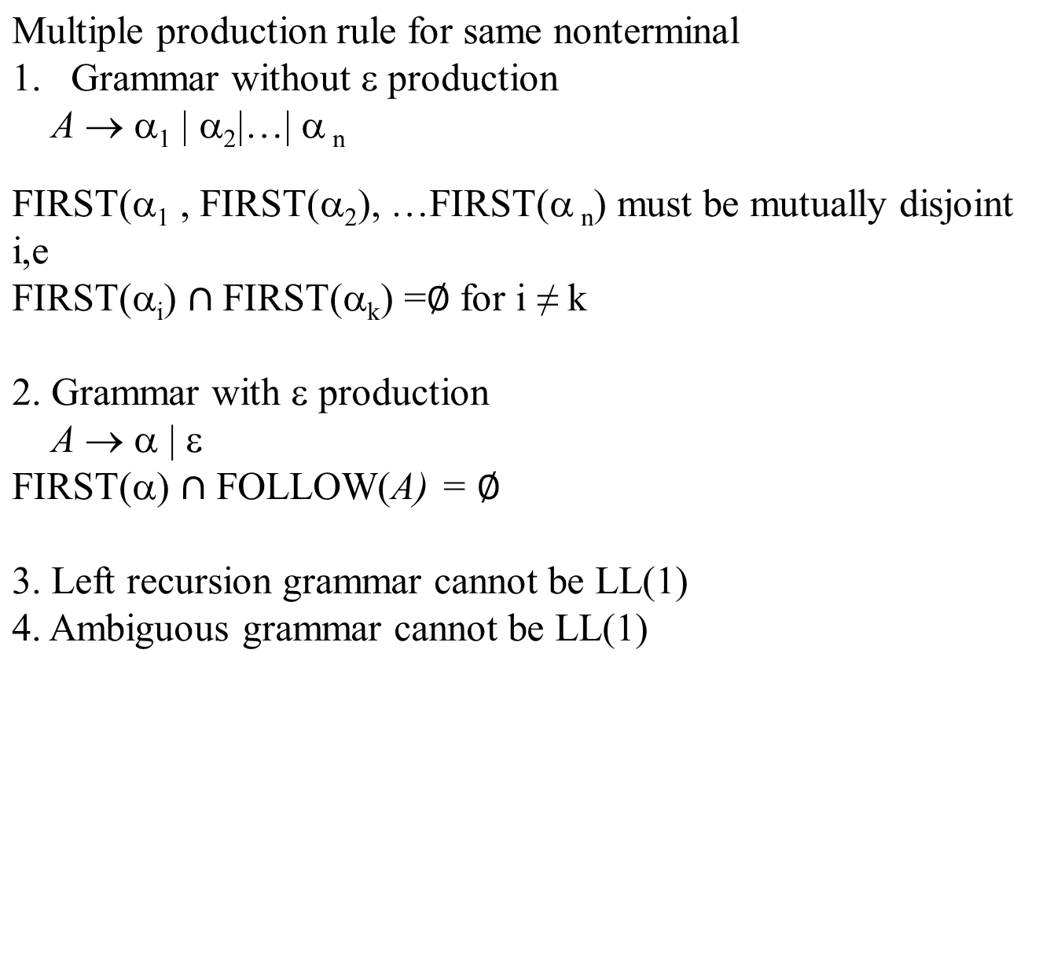
Rules to check LL(1)

Slide 75
Is grammar LL(1)
S → aSbS
| bSaS
| ε

Slide 76
Is grammar LL(1)
S → aABb
A → c | ε
B → d | ε

Slide 77
Is grammar LL(1)
S → A | a
A → a

Slide 78
Is grammar LL(1)
S → aB | ε
B → bC | ε
C→ cS | ε

Slide 79
Is grammar LL(1)
S → AB
A → a | ε
B→ b | ε

Slide 80
Is grammar LL(1)
S → aSA | ε
A → c | ε

Slide 81
Is grammar LL(1)
S → A
A → Bb | Cd
B → aB | ε
C→ cC | ε

Slide 82
Is grammar LL(1)
S → aAa | ε
A → abS | ε

Slide 83
Is grammar LL(1)
S → i E t S S¹ | a
S¹ → eS | ε
E → b

Slide 84
Disadvantages in LL(1)
LL(1) can parse only small class of grammars
After eliminating left recursion & left factoring of grammar it
looses its redability and becomes difficult for further usage.
Predictive parser is used for control constructs
Operator precedence parser is used for Expressions.
If an LR parser generator is available, one can get all the benefits
of PP and operator precedence parser automatically.

Slide 85
H.W
S → CC
C → cC | d

