Slide 1
Syntax-Directed Translation
Part I
Chapter 5

Slide 2
The Structure of our Compiler Revisited
Character
stream
Lexical analyzer
Token
stream
Syntax-directed
translator
IC
Lex specification
Yacc specification
with semantic rules
C specification

Slide 3
SDT is an extension of CFGs.
This helps the compiler designer to translate the language constructs directly by attaching semantic rules or subroutines.
SDT Grammar + Semantic rules
Why?
  To help Semantic Analyzer & Intermediate Code generator, we need
  Semantic Rules :
  E → E₁ + T E.val := E₁.val + T.val
  Semantic Actions:
  E → E₁ + T {print ‘+’}

Slide 4
There are 2 ways of defining semantic rules.
SDD –Syntax Directed Definition
It is augmented grammar that specifies the values of attributes by associating semantic rules with grammar productions.
SDT -- Syntax Directed Translation
It specifies the order in which semantic rules are to be evaluated by embedding program fragments called semantic actions within production body.
With SDD/SDT , we parse the i/p by creating parse tree & traverse the parse tree as needed to evaluate semantic actions at the parse tree nodes.
Evaluation of semantic rules may result in –
Storing information in Symbol Table
Issue error diagnostics
Or other activities

Slide 5
Syntax-Directed Definitions
A syntax-directed definition (or attribute grammar) binds a set of semantic rules to productions
Terminals and nonterminals have attributes holding values set by the semantic rules
A depth-first traversal algorithm traverses the parse tree thereby executing semantic rules to assign attribute values
After the traversal is complete the attributes contain the translated form of the input

Slide 6
Attribute Grammar
Each grammar symbol is assigned certain attributes
Each production is augmented with semantic rules which are used to define attribute values
A grammar symbol can have ‘n’ attributes like
type,
value,
address,
pointer,
string

Slide 7
Example Attribute Grammar
Production
Semantic Rule
L → E n
E → E₁ + T
E → T
T → T₁ * F
T → F
F → ( E )
F → digit
print(E.val)
E.val := E₁.val + T.val
E.val := T.val
T.val := T₁.val * F.val
T.val := F.val
F.val := E.val
F.val := digit.lexval
Note: all attributes in
this example are of
the synthesized type

Slide 8
Example Annotated Parse Tree
L
E.val = 16
E.val = 14
T.val = 2
E.val = 9
T.val = 5
F.val = 5
T.val = 9
F.val = 5
F.val = 9
Note: all attributes in
this example are of
the synthesized type
9
+
5
+
2
n

Slide 9
Annotating a Parse Tree With Depth-First Traversals
procedure visit(n : node);
begin
for each child m of n, from left to right do
visit(m);
evaluate semantic rules at node n
end

Slide 10
Depth-First Traversals (Example)
L
print(16)
E.val = 16
E.val = 14
T.val = 2
E.val = 9
T.val = 5
F.val = 5
T.val = 9
F.val = 5
F.val = 9
Note: all attributes in
this example are of
the synthesized type
9
+
5
+
2
n

Slide 11
Example Desk Calculator (Top down approach)
Production
Semantic Rules
T -> FT’
T’ -> *FT’1
3) T’ -> ε
F -> digit
T’.inh = F.val
T.val = T’.syn
T’1.inh = T’.inh*F.val
T’.syn = T’1.syn
T’.syn = T’.inh
F.val = F.val = digit.lexval

Slide 12
Attributes
Attribute values typically represent
  Numbers (literal constants)
  Strings (literal constants)
  Memory locations, such as a frame index of a local variable or function argument
  A data type for type checking of expressions
  Scoping information for local declarations
  Intermediate program representations

Slide 13
Synthesized Versus Inherited Attributes
Given a production
A → α
then each semantic rule is of the form
b := f(c₁,c₂,…,c_{k})
where f is a function and c_{i} are attributes of A and α, and either
  b is a synthesized attribute of A
  b is an inherited attribute of one of the grammar symbols in α

Slide 14
Synthesized Versus Inherited Attributes
Synthesized Attribute
The value of a synthesized attribute at a node is computed from the values of attributes at the child nodes in the parse tree.
A → XYZ
if A.s = f(X.s | Y.s | Z.s) then ‘.s’ is called synthesized attribute.
Inherited Attribute
The value of an inherited attribute is computed from the values of attributes at the siblings & that of parent node.
A → XYZ
if Y.i= f(X.i | Z.i | A.i) then ‘.i’ is called Inherited attribute.

Slide 15
Synthesized Versus Inherited Attributes (cont’d)
Production
Semantic Rule
inherited
D → T L
T → int
…
L → id
L.in := T.type
T.type := ‘integer’
…
… := L.in
synthesized

Slide 16
S-Attributed Definitions
A syntax-directed definition that uses synthesized attributes exclusively is called an S-attributed definition (or S-attributed grammar)
A parse tree of an S-attributed definition is annotated with a single bottom-up traversal
Yacc/Bison only support S-attributed definitions

Slide 17
Example Attribute Grammar in Yacc
%token DIGIT
%%
L : E ‘\n’ { printf(“%d\n”, $1); }
;
E : E ‘+’ T { $$ = $1 + $3; }
| T { $$ = $1; }
;
T : T ‘*’ F { $$ = $1 * $3; }
| F { $$ = $1; }
;
F : ‘(’ E ‘)’ { $$ = $2; }
| DIGIT { $$ = $1; }
;
%%
Synthesized attribute of parent node F

Slide 18
Bottom-up Evaluation of
S-Attributed Definitions in Yacc
Stack
$
$ 3
$ F
$ T
$ T *
$ T * 5
$ T * F
$ T
$ E
$ E +
$ E + 4
$ E + F
$ E + T
$ E
$ E n
$ L
val
_
3
3
3
3 _
3 _ 5
3 _ 5
15
15
15 _
15 _ 4
15 _ 4
15 _ 4
19
19 _
19
Input
3*5+4n$
*5+4n$
*5+4n$
*5+4n$
5+4n$
+4n$
+4n$
+4n$
+4n$
4n$
n$
n$
n$
n$
$
$
Action
shift
reduce F → digit
reduce T → F
shift
shift
reduce F → digit
reduce T → T * F
reduce E → T
shift
shift
reduce F → digit
reduce T → F
reduce E → E + T
shift
reduce L → E n
accept
Semantic Rule
$$ = $1
$$ = $1
$$ = $1
$$ = $1 * $3
$$ = $1
$$ = $1
$$ = $1
$$ = $1 + $3
print $1

Slide 19
Example Attribute Grammar with Synthesized+Inherited Attributes
Production
Semantic Rule
D → T L
T → int
T → real
L → L₁ , id
L → id
L.in := T.type
T.type := ‘integer’
T.type := ‘real’
L₁.in := L.in; addtype(id.entry, L.in)
addtype(id.entry, L.in)
Synthesized: T.type, id.entry
Inherited: L.in

Slide 20
Acyclic Dependency Graphs for Attributed Parse Trees
A.a
A → X Y
A.a := f(X.x, Y.y)
X.x
Y.y
A.a
X.x := f(A.a, Y.y)
X.x
Y.y
A.a
Direction of
value dependence
Y.y := f(A.a, X.x)
X.x
Y.y

Slide 21
Dependency Graphs with Cycles?
Edges in the dependency graph determine the evaluation order for attribute values
Dependency graphs cannot be cyclic
A.a
A.a := f(X.x)
X.x := f(Y.y)
Y.y := f(A.a)
X.x
Y.y
Error: cyclic dependence

Slide 22
Example Annotated Parse Tree
D
T.type = ‘real’
L.in = ‘real’
real
L.in = ‘real’
,
id₃.entry
L.in = ‘real’
,
id₂.entry
id₁.entry

Slide 23
Example Annotated Parse Tree with Dependency Graph
D
T.type = ‘real’
L.in = ‘real’
real
L.in = ‘real’
,
id₃.entry
L.in = ‘real’
,
id₂.entry
id₁.entry

Slide 24
Evaluation Order
A topological sort of a directed acyclic graph (DAG) is any ordering m₁, m₂, …, m_{n} of the nodes of the graph, such that if m_{i}→m_{j} is an edge, then m_{i} appears before m_{j}
Any topological sort of a dependency graph gives a valid evaluation order of the semantic rules

Slide 25
Example Parse Tree with Topologically Sorted Actions
D
Topological sort:
1. Get id₁.entry
2. Get id₂.entry
3. Get id₃.entry
4. T₁.type=‘real’
5. L₁.in=T₁.type
6. addtype(id₃.entry, L₁.in)
7. L₂.in=L₁.in
8. addtype(id₂.entry, L₂.in)
9. L₃.in=L₂.in
10. addtype(id₁.entry, L₃.in)
T₁.type = ‘real’
4
5
L₁.in = ‘real’
6
real
7
L₂.in = ‘real’
,
id₃.entry
8
3
9
L₃.in = ‘real’
10
,
2
id₂.entry
1
id₁.entry

Slide 26
Evaluation Methods
Parse-tree methods determine an evaluation order from a topological sort of the dependence graph constructed from the parse tree for each input
Rule-base methods the evaluation order is pre-determined from the semantic rules
Oblivious methods the evaluation order is fixed and semantic rules must be (re)written to support the evaluation order (for example S-attributed definitions)

Slide 27
L-Attributed Definitions
The example parse tree on slide 18 is traversed “in order”, because the direction of the edges of inherited attributes in the dependency graph point top-down and from left to right
More precisely, a syntax-directed definition is L-attributed if each inherited attribute of X_{j} on the right side of A → X₁ X₂ … X_{n} depends only on
  the attributes of the symbols X₁, X₂, …, X_{j-1}
  the inherited attributes of A
A.a
Shown: dependences
of inherited attributes
X₁.x
X₂.x

Slide 28
L-Attributed Definitions (cont’d)
L-attributed definitions allow for a natural order of evaluating attributes: depth-first and left to right
Note: every S-attributed syntax-directed definition is also L-attributed
A → X Y
A
X.i := A.i
Y.i := X.s
A.s := Y.s
X.i:=A.i
A.s:=Y.s
X
Y
Y.i:=X.s

Slide 29
S-Attribute Definition
It uses only synthesized attributes.
Semantic actions is placed at the right hand side of productions
Attributes are generally evaluated during bottom-up parsing
L-Attribute Definition
It allows both. But if an inherited , the restriction is that each inherited attribute is restricted to inherit either from parent or from left sibling.
Semantic actions can be placed anywhere on RHS.
Attributes are evaluated by traversing the parse tree depth first & left to right.

Slide 30
Applications of SDT
Syntax tree construction
Type checking
Intermediate code generation

Slide 31
S-Attributed Definitions for Generating Abstract Syntax Trees
Production
E → E₁ + T
E → E₁ - T
E → T
T → ( E )
T → T₁ * id
T → T₁ / id
T → id
T → num
Semantic Rule
E.nptr := mknode(‘+’, E₁.nptr, T.nptr)
E.nptr := mknode(‘-’, E₁.nptr, T.nptr)
E.nptr := T.nptr
E.nptr := T.nptr
T.nptr := mknode(‘*’, T₁.nptr, mkleaf(id, id.entry))
T.nptr := mknode(‘/’, T₁.nptr, mkleaf(id, id.entry))
T.nptr := mkleaf(id, id.entry)
T.nptr := mkleaf(num, num.val)

Slide 32
Construct syntax tree for a-4+c using S-attributed definition

Slide 33
L-Attributed Definitions for Generating Abstract Syntax Trees
Production
Semantic Rules
E -> TE’
E’ -> + TE1’
E’ -> -TE1’
E’ -> ∈
T -> (E)
T -> id
T -> num
E.node=E’.syn
E’.inh=T.node
E1’.inh=new node(‘+’, E’.inh,T.node)
E’.syn=E1’.syn
E1’.inh=new node(‘+’, E’.inh,T.node)
E’.syn=E1’.syn
E’.syn = E’.inh
T.node = E.node
T.node=new Leaf(id,id.entry)
T.node = new Leaf(num,num.val)

Slide 34
Construct syntax tree for a-4+c using L-attributed definition and Top down parsing

Slide 35
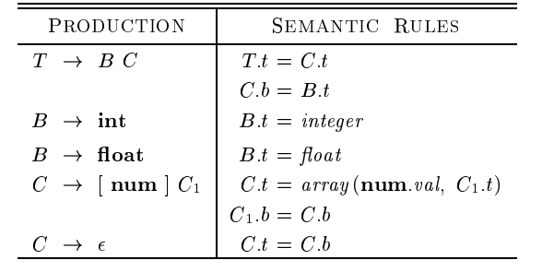
The structure of a Type
Ex: array type
int [2][3]

Slide 36
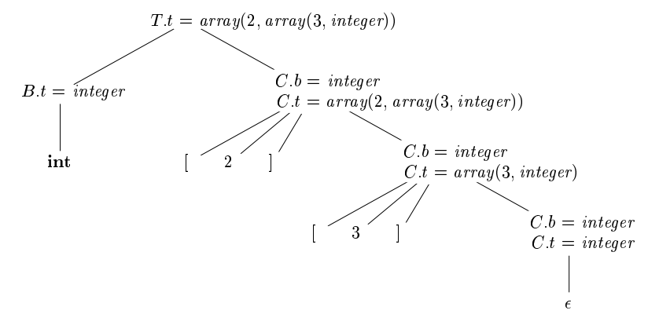

Slide 37
Syntax directed translation schemes
An SDT is a Context Free grammar with program fragments embedded within production bodies
Those program fragments are called semantic actions
They can appear at any position within production body
Any SDT can be implemented by first building a parse tree and then performing the actions in a left-to-right depth first order

Slide 38
Using Translation Schemes for L-Attributed Definitions
Production
Semantic Rule
D → T L
T → int
T → real
L → L₁ , id
L → id
L.in := T.type
T.type := ‘integer’
T.type := ‘real’
L₁.in := L.in; addtype(id.entry, L.in)
addtype(id.entry, L.in)
Translation Scheme
D → T { L.in := T.type } L
T → int { T.type := ‘integer’ }
T → real { T.type := ‘real’ }
L → { L₁.in := L.in } L₁ , id { addtype(id.entry, L.in) }
L → id { addtype(id.entry, L.in) }

Slide 39
Postfix translation schemes
Simplest SDDs are those that we can parse the grammar bottom-up and the SDD is s-attributed
For such cases we can construct SDT where each action is placed at the end of the production and is executed along with the reduction of the body to the head of that production
SDT’s with all actions at the right ends of the production bodies are called postfix SDT’s

Slide 40
Example of postfix SDT
L -> E n {print(E.val);}
E -> E1 + T {E.val=E1.val+T.val;}
E -> T {E.val = T.val;}
T -> T1 * F {T.val=T1.val*F.val;}
T -> F {T.val=F.val;}
F -> (E) {F.val=E.val;}
F -> digit {F.val=digit.lexval;}

Slide 41
Parse-Stack implementation of postfix SDT’s
In a shift-reduce parser we can easily implement semantic action using the parser stack
For each nonterminal (or state) on the stack we can associate a record holding its attributes
Then in a reduction step we can execute the semantic action at the end of a production to evaluate the attribute(s) of the non-terminal at the left side of the production
And put the value on the stack in replace of the rightside of production

Slide 42
Example
L -> E n {print(stack[top-1].val);
top=top-1;}
E -> E1 + T {stack[top-2].val=stack[top-2].val+stack.val;
top=top-2;}
E -> T
T -> T1 * F {stack[top-2].val=stack[top-2].val+stack.val;
top=top-2;}
T -> F
F -> (E) {stack[top-2].val=stack[top-1].val
top=top-2;}
F -> digit

Slide 43
SDT’s with actions inside productions
For a production B->X {a} Y
  If the parser is bottom-up then we perform action “a” as soon as this occurrence of X appears on the top of the parser stack
  If the parser is top down we perform “a” just before we expand Y
Sometimes we cant do things as easily as explained above
One example is when we are parsing this SDT with a bottom-up parser
L -> E n
E -> {print(‘+’);} E1 + T
E -> T
T -> {print(‘*’);} T1 * F
T -> F
F -> (E)
F -> digit {print(digit.lexval);}

Slide 44
SDT’s with actions inside productions (cont)
L
Any SDT can be implemented as follows
  Ignore the actions and produce a parse tree
  Examine each interior node N and add actions as new children at the correct position
  Perform a postorder traversal and execute actions when their nodes are visited
E
{print(‘+’);}
E
+
T
T
F
{print(‘*’);}
{print(4);}
T
*
F
digit
{print(5);}
F
digit
{print(3);}
digit

Slide 45
Eliminating Left Recursion from a Translation Scheme
A → A₁ Y { A.a := g(A₁.a, Y.y) }
A → X { A.a := f(X.x) }
A → X { R.i := f(X.x) } R { A.a := R.s }
R → Y { R₁.i := g(R.i, Y.y) } R₁ { R.s := R₁.s }
R → ε { R.s := R.i }

Slide 46
Eliminating Left Recursion from a Translation Scheme (cont’d)
A.a = g(g(f(X.x), Y₁.y), Y₂.y)
A.a = g(f(X.x), Y₁.y)
Y₂
A.a = f(X.x)
Y₁
X

Slide 47
Eliminating Left Recursion from a Translation Scheme (cont’d)
A
X
R₁.i = f(X.x)
Y₁
R₂.i = g(f(X.x), Y₁.y)
Y₂
R₃.i = g(g(f(X.x), Y₁.y), Y₂.y)
1. Flow of inherited
attribute values
ε

Slide 48
Eliminating Left Recursion from a Translation Scheme (cont’d)
A.s = R₁.s = g(g(f(X.x), Y₁.y), Y₂.y)
X
R₁.s = R₂.s = g(g(f(X.x), Y₁.y), Y₂.y)
Y₁
R₂.s = R₃.s = g(g(f(X.x), Y₁.y), Y₂.y)
Y₂
R₃.s = R₃.i = g(g(f(X.x), Y₁.y), Y₂.y)
2. Flow of synthesized
attribute values
ε

Slide 49
SDT’s for L-Attributed definitions
Rules to convert an L-attributed SDD into an SDT :
  Embed the action that computes the inherited attributes for a nonterminal A immediately before that occurrence of A. if several inherited attributes of A are dependent on one another in an acyclic fashion, order them so that those needed first are computed first
  Place the action of a synthesized attribute for the head of a production at the end of the body of the production

Slide 50
Example
Production
Semantic rules
S -> while (C) S1 L1=new();
L2=new();
S1.next=L1;
C.false=S.next;
C.true=L2;
S.code=label||L1||C.code||label||L2||S1.code
SDT for WHILE statement
S -> while ( {L1=new();L2=new();C.false=S.next;C.true=L2;}
C) {S1.next=L1;}
S1{S.code=label||L1||C.code||label||L2||S1.code;}

Slide 51
Implementing L-Attributed SDDs
On the fly code generation
Use a RDP
Implement an SDT in conjunction with a LL Parser
Implement an SDT in conjunction with a LR Parser

Slide 52
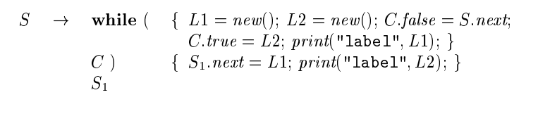
On the fly-code generation

Slide 53
Implementing L-Attributed Definitions in Top-Down Parsers
void D()
{ Type Ttype = T();
Type Lin = Ttype;
L(Lin);
}
Type T()
{ Type Ttype;
if (lookahead == INT)
{ Ttype = TYPE_INT;
match(INT);
} else if (lookahead == REAL)
{ Ttype = TYPE_REAL;
match(REAL);
} else error();
return Ttype;
}
void L(Type Lin)
{ … }
Attributes in L-attributed
definitions implemented
in translation schemes are
passed as arguments to
procedures (inherited)
or returned (synthesized)
D → T { L.in := T.type } L
T → int { T.type := ‘integer’ }
T → real { T.type := ‘real’ }
Output:
synthesized
attribute
Input:
inherited
attribute

Slide 54
Implementing Translation Schemes in Bottom-Up Parsers
Insert marker nonterminals to remove embedded actions from translation schemes, that is
A → X { actions } Y
is rewritten with marker nonterminal N into
A → X N Y
N → ε { actions }
Problem: inserting a marker nonterminal may introduce a conflict in the parse table
Problem: how to propagate inherited attributes?

Slide 55
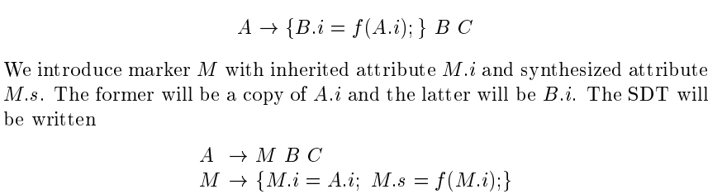
Translation Schemes using Marker Nonterminals

Slide 56
Translation Schemes using Marker Nonterminals
Need a stack to keep track of gotos to backpatch!
(to handle nested if-then)
S → if E {push(pc); emit(ifeq, 0) }
then S { backpatch(top(), pc-top()); pop() }
Synthesized attribute
(automatically stacked in shift-reduce parser!)
Insert marker nonterminal
S → if E M then S { backpatch(M.loc, pc-M.loc) }
M → ε { M.loc := pc; emit(ifeq, 0) }

Slide 57
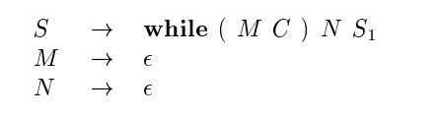
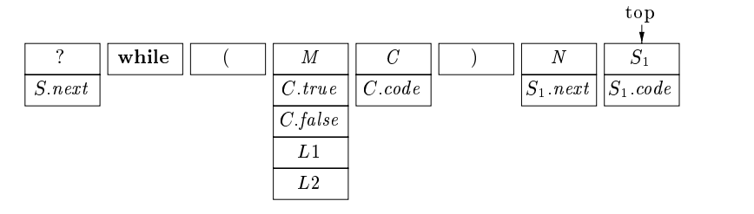
Translation Schemes using Marker Nonterminals

Slide 58
Translation Schemes using Marker Nonterminals in Yacc
S : IF E M THEN S { backpatch($3, pc-$3); }
;
M : /* empty */ { $$ = pc;
emit3(ifeq, 0);
}
;
…

Slide 59
Replacing Inherited Attributes with Synthesized Lists
D → T L { for all id ∈ L.list : addtype(id.entry, T.type) }
T → int { T.type := ‘integer’ }
T → real { T.type := ‘real’ }
L → L₁ , id { L.list := L₁.list + [id] }
L → id { L.list := [id] }
D
T.type = ‘real’
L.list = [id₁,id₂,id₃]
real
L.list = [id₁,id₂]
,
id₃.entry
L.list = [id₁]
,
id₂.entry
id₁.entry

Slide 60
Replacing Inherited Attributes with Synthesized Lists in Yacc
%{
typedef struct List
{ Symbol *entry;
struct List *next;
} List;
%}
%union
{ int type;
List *list;
Symbol *sym;
}
%token <sym> ID
%type <list> L
%type <type> T
%%
D : T L { List *p;
for (p = $2; p; p = p->next)
addtype(p->entry, $1);
}
;
T : INT { $$ = TYPE_INT; }
| REAL { $$ = TYPE_REAL; }
;
L : L ‘,’ ID
{ $$ = malloc(sizeof(List));
$$->entry = $3;
$$->next = $1;
}
| ID { $$ = malloc(sizeof(List));
$$->entry = $1;
$$->next = NULL;
}
;

Slide 61
Concrete and Abstract Syntax Trees
A parse tree is called a concrete syntax tree
An abstract syntax tree (AST) is defined by the compiler writer as a more convenient intermediate representation
E
+
E
+
T
id
*
T
T
*
id
id
id
id
id
Concrete syntax tree
Abstract syntax tree

Slide 62
Generating Abstract Syntax Trees
Synthesize
AST
E.nptr
E.nptr
+
T.nptr
T.nptr
T.nptr
*
id
id
id
+
id
*
id
id

Slide 63
S-Attributed Definitions for Generating Abstract Syntax Trees
Production
E → E₁ + T
E → E₁ - T
E → T
T → T₁ * id
T → T₁ / id
T → id
Semantic Rule
E.nptr := mknode(‘+’, E₁.nptr, T.nptr)
E.nptr := mknode(‘-’, E₁.nptr, T.nptr)
E.nptr := T.nptr
T.nptr := mknode(‘*’, T₁.nptr, mkleaf(id, id.entry))
T.nptr := mknode(‘/’, T₁.nptr, mkleaf(id, id.entry))
T.nptr := mkleaf(id, id.entry)

Slide 64
Generating Abstract Syntax Trees with Yacc
%{
typedef struct Node
{ int op; /* node op */
Symbol *entry; /* leaf */
struct Node *left, *right;
} Node;
%}
%union
{ Node *node;
Symbol *sym;
}
%token <sym> ID
%type <node> E T F
%%
E : E ‘+’ T { $$ = mknode(‘+’, $1, $3); }
| E ‘-’ T { $$ = mknode(‘-’, $1, $3); }
| T { $$ = $1; }
;
T : T ‘*’ F { $$ = mknode(‘*’, $1, $3); }
| T ‘/’ F { $$ = mknode(‘/’, $1, $3); }
| F { $$ = $1; }
;
F : ‘(’ E ‘)’ { $$ = $2; }
| ID { $$ = mkleaf($1); }
;
%%

Slide 65
Eliminating Left Recursion from a Translation Scheme
A → A₁ Y { A.a := g(A₁.a, Y.y) }
A → X { A.a := f(X.x) }
A → X { R.i := f(X.x) } R { A.a := R.s }
R → Y { R₁.i := g(R.i, Y.y) } R₁ { R.s := R₁.s }
R → ε { R.s := R.i }

Slide 66
Eliminating Left Recursion from a Translation Scheme (cont’d)
A.a = g(g(f(X.x), Y₁.y), Y₂.y)
A.a = g(f(X.x), Y₁.y)
Y₂
A.a = f(X.x)
Y₁
X

Slide 67
Eliminating Left Recursion from a Translation Scheme (cont’d)
A
X
R₁.i = f(X.x)
Y₁
R₂.i = g(f(X.x), Y₁.y)
Y₂
R₃.i = g(g(f(X.x), Y₁.y), Y₂.y)
1. Flow of inherited
attribute values
ε

Slide 68
Eliminating Left Recursion from a Translation Scheme (cont’d)
A.s = R₁.s = g(g(f(X.x), Y₁.y), Y₂.y)
X
R₁.s = R₂.s = g(g(f(X.x), Y₁.y), Y₂.y)
Y₁
R₂.s = R₃.s = g(g(f(X.x), Y₁.y), Y₂.y)
Y₂
R₃.s = R₃.i = g(g(f(X.x), Y₁.y), Y₂.y)
2. Flow of synthesized
attribute values
ε

Slide 69
Generating Abstract Syntax Trees with Predictive Parsers
E → E₁ + T { E.nptr := mknode(‘+’, E₁.nptr, T.nptr) }
E → E₁ - T { E.nptr := mknode(‘-’, E₁.nptr, T.nptr) }
E → T { E.nptr := T.nptr }
T → id { T.nptr := mkleaf(id, id.entry) }
E → T { R.i := T.nptr } R { E.nptr := R.s }
R → + T {R₁.i := mknode(‘+’, R.i, T.nptr) } R₁ { R.s := R₁.s }
R → - T {R₁.i := mknode(‘-’, R.i, T.nptr) } R₁ { R.s := R₁.s }
R → ε { R.s := R.i }
T → id { T.nptr := mkleaf(id, id.entry) }

Slide 70
Generating Abstract Syntax Trees with Predictive Parsers (cont’d)
Node *R(Node *i)
{ Node *s, *i1;
if (lookahead == ‘+’)
{ match(‘+’);
s = T();
i1 = mknode(‘+’, i, s);
s = R(i1);
} else if (lookahead == ‘-’)
{ …
} else
s = i;
return s;
}

