Slide 1
Static Checking and Type Systems
Chapter 6

Slide 2
The Structure of our Compiler Revisited
Syntax-directed
static checker
Character
stream
Lexical analyzer
Token
stream
Java
bytecode
Syntax-directed
translator
Lex specification
Yacc specification
JVM specification
Type
checking
Code
generation

Slide 3
Static versus Dynamic Checking
Static checking: the compiler enforces programming language’s static semantics
  Program properties that can be checked at compile time
Dynamic semantics: checked at run time
  Compiler generates verification code to enforce programming language’s dynamic semantics

Slide 4
Static Checking
Typical examples of static checking are
  Type checks
  Flow-of-control checks
  Uniqueness checks
  Name-related checks

Slide 5
Type Checking, Overloading, Coercion, Polymorphism
class X { virtual int m(); } *x;
class Y: public X { virtual int m(); } *y;
int op(int), op(float);
int f(float);
int a, c[10], d;
d = c + d; // FAIL
*d = a; // FAIL
a = op(d); // OK: static overloading (C++)
a = f(d); // OK: coersion of d to float
a = x->m(); // OK: dynamic binding (C++)
vector<int> v; // OK: template instantiation

Slide 6
Flow-of-Control Checks
myfunc()
{ …
break; // ERROR
}
myfunc()
{ …
switch (a)
{ case 0:
…
break; // OK
case 1:
…
}
}
myfunc()
{ …
while (n)
{ …
if (i>10)
break; // OK
}
}

Slide 7
Uniqueness Checks
myfunc()
{ int i, j, i; // ERROR
…
}
cnufym(int a, int a) // ERROR
{ …
}
struct myrec
{ int name;
};
struct myrec // ERROR
{ int id;
};

Slide 8
Name-Related Checks
LoopA: for (int I = 0; I < n; I++)
{ …
if (a[I] == 0)
break LoopB; // Java labeled loop
…
}

Slide 9
One-Pass versus Multi-Pass Static Checking
One-pass compiler: static checking in C, Pascal, Fortran, and many other languages is performed in one pass while intermediate code is generated
  Influences design of a language: placement constraints
Multi-pass compiler: static checking in Ada, Java, and C# is performed in a separate phase, sometimes by traversing a syntax tree multiple times

Slide 10
Type Expressions
Type expressions are used in declarations and type casts to define or refer to a type
  Primitive types, such as int and bool
  Type constructors, such as pointer-to, array-of, records and classes, templates, and functions
  Type names, such as typedefs in C and named types in Pascal, refer to type expressions

Slide 11
Graph Representations for Type Expressions
int *f(char*,char*)
fun
fun
args
pointer
args
pointer
pointer
pointer
int
pointer
int
char
char
char
Tree forms
DAGs

Slide 12
Cyclic Graph Representations
Source program
struct Node
{ int val;
struct Node *next;
};
struct
val
next
int
pointer
Internal compiler representation of the Node type: cyclic graph

Slide 13
Name Equivalence
Each type name is a distinct type, even when the type expressions that the names refer to are the same
Types are identical only if names match
Used by Pascal (inconsistently)
type link = ^node;
var next : link;
last : link;
p : ^node;
q, r : ^node;
With name equivalence in Pascal:
p ≠ next
p ≠ last
p = q = r
next = last

Slide 14
Structural Equivalence of Type Expressions
Two types are the same if they are structurally identical
Used in C/C++, Java, C#
=
pointer
pointer
struct
struct
val
next
val
next
int
pointer
int

Slide 15
Structural Equivalence of Type Expressions (cont’d)
Two structurally equivalent type expressions have the same pointer address when constructing graphs by sharing nodes
struct Node
{ int val;
struct Node *next;
};
struct Node s, *p;
p = &s; // OK
*p = s; // OK
p = s; // ERROR
p
&s
*p
s
pointer
struct
val
next
int

Slide 16
Constructing Type Graphs
Type *mkint() construct int node if not already
constructed
Type *mkarr(Type*,int) construct array-of-type node
if not already constructed
Type *mkptr(Type*) construct pointer-of-type node
if not already constructed

Slide 17
Syntax-Directed Definitions for Constructing Type Graphs
%union
{ Symbol *sym;
int num;
Type *typ;
}
%token INT
%token <sym> ID
%token <num> NUM
%type <typ> type
%%
decl : type ID { addtype($2, $1); }
| type ID ‘[’ NUM ‘]’ { addtype($2, mkarr($1, $4)); }
;
type : INT { $$ = mkint(); }
| type ‘*’ { $$ = mkptr($1); }
| /* empty */ { $$ = mkint(); }
;
int keyword from lexer
identifier from lexer with sym table ptr
literal value (int) from lexer

Slide 18
Type Systems
A type system defines a set of types and rules to assign types to programming language constructs
Informal type system rules, for example “if both operands of addition are of type integer, then the result is of type integer”

Slide 19
A Simple Language Example
P → D ; S
D → D ; D
⎟ id : T
T → boolean
⎟ char
⎟ integer
⎟ array [ num ] of T
⎟ ^ T
S → id := E
⎟ if E then S
⎟ while E do S
⎟ S ; S
E → true
⎟ false
⎟ literal
⎟ num
⎟ id
⎟ E and E
⎟ E + E
⎟ E [ E ]
⎟ E ^
Pointer to T
Pascal-like pointer dereference operator

Slide 20
Simple Language Example: Declarations
D → id : T { addtype(id.entry, T.type) }
T → boolean { T.type := boolean }
T → char { T.type := char }
T → integer { T.type := integer }
T → array [ num ] of T₁ { T.type := array(1..num.val, T₁.type) }
T → ^ T₁ { T.type := pointer(T₁)
Parametric types:
type constructor

Slide 21
Simple Language Example: Checking Statements
S → id := E { S.type := (if id.type = E.type then void else type_error) }
Note: the type of id is determined by scope’s environment:
id.type = lookup(id.entry)

Slide 22
Simple Language Example: Checking Statements (cont’d)
S → if E then S₁ { S.type := (if E.type = boolean then S₁.type
else type_error) }

Slide 23
Simple Language Example: Statements (cont’d)
S → while E do S₁ { S.type := (if E.type = boolean then S₁.type
else type_error) }

Slide 24
Simple Language Example: Checking Statements (cont’d)
S → S₁ ; S₂ { S.type := (if S₁.type = void and S₂.type = void
then void else type_error) }

Slide 25
Simple Language Example: Checking Expressions
E → true { E.type = boolean }
E → false { E.type = boolean }
E → literal { E.type = char }
E → num { E.type = integer }
E → id { E.type = lookup(id.entry) }
…

Slide 26
Simple Language Example: Checking Expressions (cont’d)
E → E₁ + E₂ { E.type := (if E₁.type = integer and E₂.type = integer
then integer else type_error) }

Slide 27
Simple Language Example: Checking Expressions (cont’d)
E → E₁ and E₂ { E.type := (if E₁.type = boolean and E₂.type = boolean
then boolean else type_error) }

Slide 28
Simple Language Example: Checking Expressions (cont’d)
E → E₁ [ E₂ ] { E.type := (if E₁.type = array(s, t) and E₂.type = integer
then t else type_error) }
Note: parameter t is set with the unification of
E₁.type = array(s, t)

Slide 29
Simple Language Example: Checking Expressions (cont’d)
E → E₁ ^ { E.type := (if E₁.type = pointer(t) then t
else type_error) }
Note: parameter t is set with the unification of
E₁.type = pointer(t)

Slide 30
A Simple Language Example: Functions
T → T -> T
E → E ( E )
Function type declaration
Function call
Example:
v : integer;
odd : integer -> boolean;
if odd(3) then
v := 1;

Slide 31
Simple Language Example: Function Declarations
T → T₁ -> T₂ { T.type := function(T₁.type, T₂.type) }
Parametric type:
type constructor

Slide 32
Simple Language Example: Checking Function Invocations
E → E₁ ( E₂ ) { E.type := (if E₁.type = function(s, t) and E₂.type = s
then t else type_error) }

Slide 33
Type Conversion and Coercion
Type conversion is explicit, for example using type casts
Type coercion is implicitly performed by the compiler to generate code that converts types of values at runtime (typically to narrow or widen a type)
Both require a type system to check and infer types from (sub)expressions

Slide 34
Syntax-Directed Definitions for Type Checking in Yacc
%{
enum Types {Tint, Tfloat, Tpointer, Tarray, … };
typedef struct Type
{ enum Types type;
struct Type *child; // at most one type parameter
} Type;
%}
%union
{ Type *typ;
}
%type <typ> expr
%%
…

Slide 35
Syntax-Directed Definitions for Type Checking in Yacc (cont’d)
…
%%
expr : expr ‘+’ expr { if ($1->type != Tint
|| $3->type != Tint)
semerror(“non-int operands in +”);
$$ = mkint();
emit(iadd);
}

Slide 36
Syntax-Directed Definitions for Type Coercion in Yacc
…
%%
expr : expr ‘+’ expr
{ if ($1->type == Tint && $3->type == Tint)
{ $$ = mkint(); emit(iadd);
}
else if ($1->type == Tfloat && $3->type == Tfloat)
{ $$ = mkfloat(); emit(fadd);
}
else if ($1->type == Tfloat && $3->type == Tint)
{ $$ = mkfloat(); emit(i2f); emit(fadd);
}
else if ($1->type == Tint && $3->type == Tfloat)
{ $$ = mkfloat(); emit(swap); emit(i2f); emit(fadd);
}
else semerror(“type error in +”);
$$ = mkint();
}

Slide 37
Checking L-Values and R-Values in Yacc
%{
typedef struct Node
{ Type *typ; // type structure
int islval; // 1 if L-value
} Node;
%}
%union
{ Node *rec;
}
%type <rec> expr
%%
…

Slide 38
Checking L-Values and R-Values in Yacc
expr : expr ‘+’ expr
{ if ($1->typ->type != Tint || $3->typ->type != Tint)
semerror(“non-int operands in +”);
$$->typ = mkint();
$$->islval = FALSE;
emit(…);
}
| expr ‘=’ expr
{ if (!$1->islval || $1->typ != $3->typ)
semerror(“invalid assignment”);
$$->typ = $1->typ;
$$->islval = FALSE;
emit(…);
}
| ID
{ $$->typ = lookup($1);
$$->islval = TRUE;
emit(…);
}

Slide 39
Type Inference and Polymorphic Functions
Many functional languages support polymorphic type systems
For example, the list length function in ML:
fun length(x) = if null(x) then 0 else length(tl(x)) + 1
length([“sun”, “mon”, “tue”]) + length([10,9,8,7])
returns 7

Slide 40
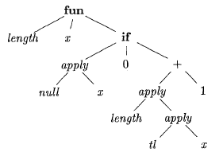
Type Inference and Polymorphic Functions
Abstract syntax tree for the function definition
fun length(x) = if null(x) then 0 else
length(tl(x)+1)
This is a polymorphic function
in ML language

Slide 41
Type Inference and Polymorphic Functions
The type of fun length is:
∀α.list(α) → integer
We can infer the type of length from its body:
fun length(x) = if null(x) then 0 else length(tl(x)) + 1
where
null : ∀α.list(α) → bool
tl : ∀α.list(α) → list(α)
and the return value is 0 or length(tl(x)) + 1, thus
length: ∀α.list(α) → integer

Slide 42
Example Type Inference
Append concatenates two lists recursively:
fun append(x, y) = if null(x) then y
else cons(hd(x), append(tl(x), y))
where
null : ∀α.list(α) → bool
hd : ∀α.list(α) → α
tl : ∀α.list(α) → list(α)
cons : ∀α.(α × list(α)) → list(α)

Slide 43
Type Inference: Substitutions, Instances, and Unification
The use of a paper-and-pencil post system for type checking/inference involves substitution, instantiation, and unification
Similarly, in the type inference algorithm, we substitute type variables by types to create type instances
A substitution S is a unifier of two types t₁ and t₂ if S(t₁) = S(t₂)

Slide 44
Unification
An AST representation of append([], [1, 2])
apply
append :∀α.(list(α) × list(α)) → list(α)
( × ) : (σ, τ)
[] : list(φ)
[ , ] : list(ψ)
1 : integer
2 : integer

Slide 45
Unification
An AST representation of append([], [1, 2])
apply
append :∀α.(list(α) × list(α)) → list(α)
( × ) : (σ, τ)
Unify by the following substitutions:
σ = list(φ) = list(ψ)
⇒ φ = ψ
[] : list(φ)
[ , ] : list(ψ)
τ = list(ψ) = list(integer)
⇒ φ = ψ = integer
1 : integer
2 : integer
σ = τ = list(α) ⇒ α = integer

Slide 46
Control Flow
boolean expressions are often used to:
Alter the flow of control.
Compute logical values.

Slide 47
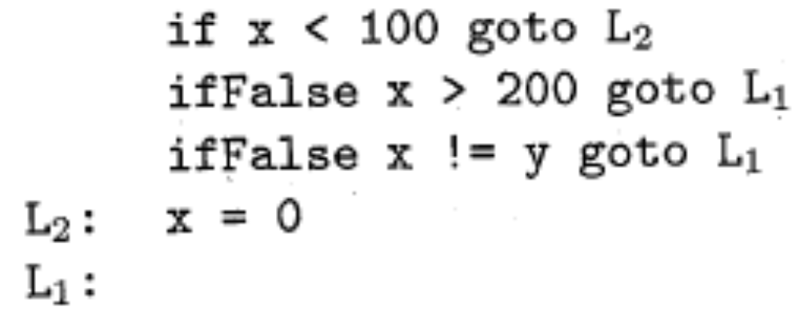
Short-Circuit Code

Slide 48
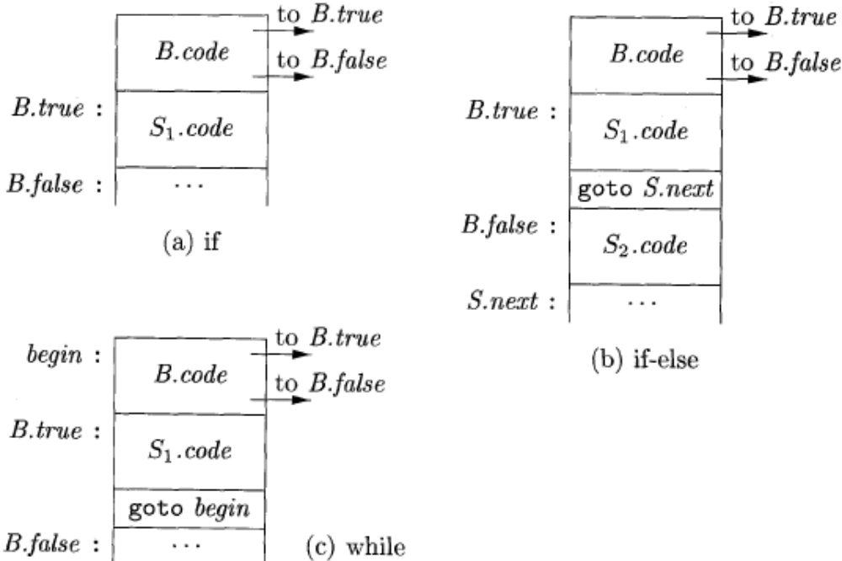
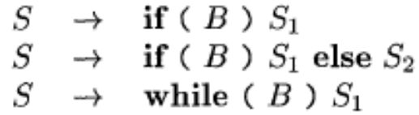
Flow-of-Control Statements

Slide 49
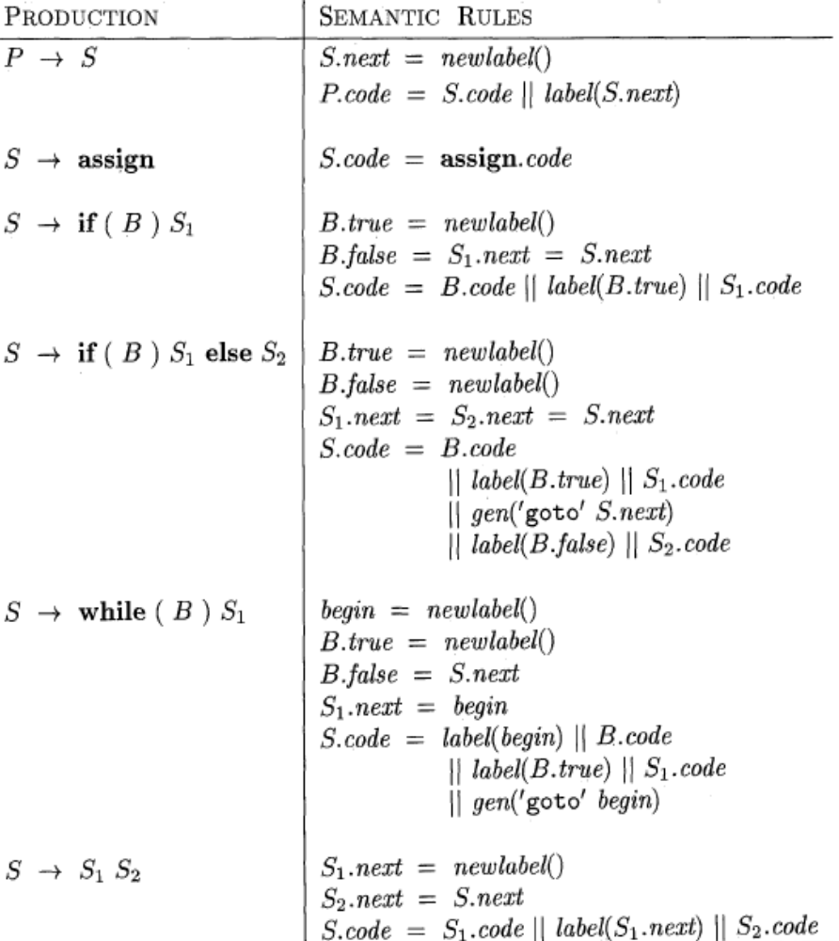
SYNTAX-DIRECTED DEFINITION

Slide 50
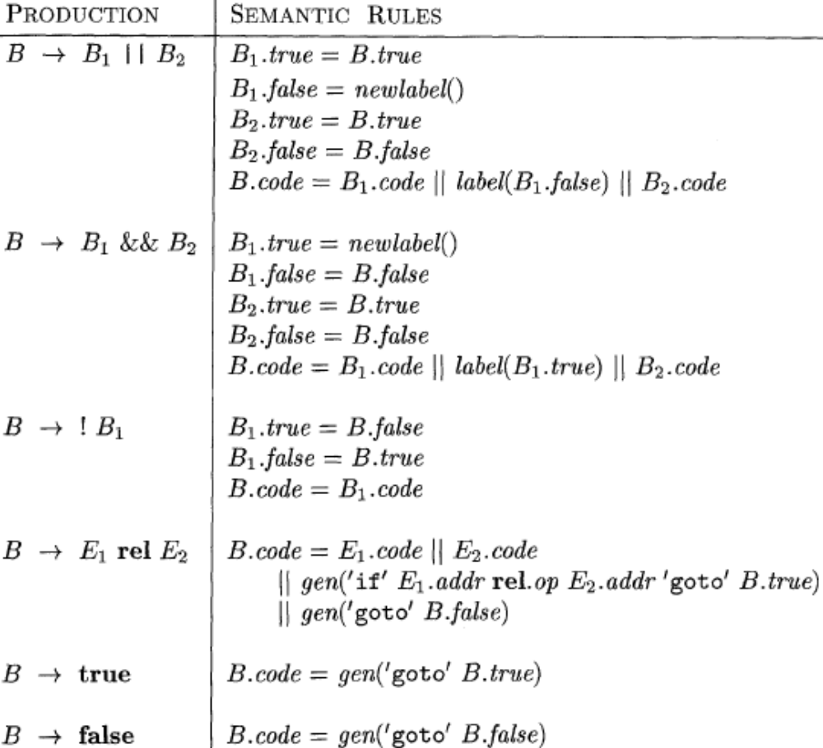
Generating three-address code for booleans

Slide 51
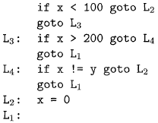
translation of a simple if-statement

Slide 52
Translating Logical and Relational Expressions
t1 := not c
t2 := b and t1
t3 := a or t2
a or b and not c
if a < b goto L1
t1 := 0
goto L2
L1: t1 := 1
L2:
a < b

Slide 53
Backpatching
Previous codes for Boolean expressions insert symbolic labels for jumps
It therefore needs a separate pass to set them to appropriate addresses
We can use a technique named backpatching to avoid this
We assume we save instructions into an array and labels will be indices in the array
For nonterminal B we use two attributes B.truelist and B.falselist together with following functions:
  makelist(i): create a new list containing only I, an index into the array of instructions
  Merge(p1,p2): concatenates the lists pointed by p1 and p2 and returns a pointer to the concatenated list
  Backpatch(p,i): inserts i as the target label for each of the instruction on the list pointed to by p

Slide 54
Translating Short-Circuit Expressions Using Backpatching
E → E or M E
| E and M E
| not E
| ( E )
| id relop id
| true
| false
M → ε
Synthesized attributes:
E.truelist backpatch list for jumps on true
E.falselist backpatch list for jumps on false
M.quad location of current three-address quad

Slide 55
Backpatch Operations with Lists
makelist(i) creates a new list containing three-address location i, returns a pointer to the list
merge(p₁, p₂) concatenates lists pointed to by p₁ and p₂, returns a pointer to the concatenates list
backpatch(p, i) inserts i as the target label for each of the statements in the list pointed to by p

Slide 56
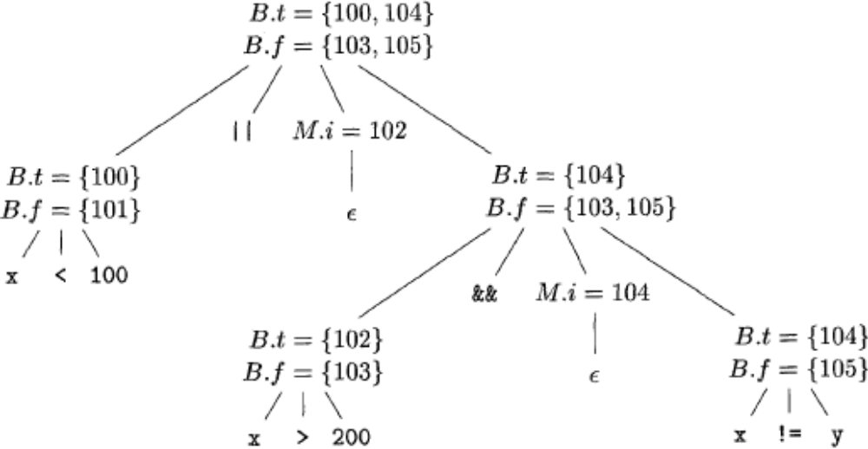
Backpatching for Boolean Expressions
Annotated parse tree for x < 100 || x > 200 && x ! = y

Slide 57
Backpatching with Lists: Example
100: if a < b goto _
101: goto _
102: if c < d goto _
103: goto _
104: if e < f goto _
105: goto _
a < b or c < d and e < f
backpatch
100: if a < b goto TRUE
101: goto 102
102: if c < d goto 104
103: goto FALSE
104: if e < f goto TRUE
105: goto FALSE

Slide 58
Backpatching with Lists: Translation Scheme
M → ε { M.quad := nextquad() }
E → E₁ or M E₂
{ backpatch(E₁.falselist, M.quad);
E.truelist := merge(E₁.truelist, E₂.truelist);
E.falselist := E₂.falselist }
E → E₁ and M E₂
{ backpatch(E₁.truelist, M.quad);
E.truelist := E₂.truelist;
E.falselist := merge(E₁.falselist, E₂.falselist); }
E → not E₁ { E.truelist := E₁.falselist;
E.falselist := E₁.truelist }
E → ( E₁ ) { E.truelist := E₁.truelist;
E.falselist := E₁.falselist }

Slide 59
Backpatching with Lists: Translation Scheme (cont’d)
E → id₁ relop id₂
{ E.truelist := makelist(nextquad());
E.falselist := makelist(nextquad() + 1);
emit(‘if’ id₁.place relop.op id₂.place ‘goto _’);
emit(‘goto _’) }
E → true { E.truelist := makelist(nextquad());
E.falselist := nil;
emit(‘goto _’) }
E → false { E.falselist := makelist(nextquad());
E.truelist := nil;
emit(‘goto _’) }

Slide 60
Flow-of-Control Statements and Backpatching: Grammar
S → if E then S
| if E then S else S
| while E do S
| begin L end
| A
L → L ; S
| S
Synthesized attributes:
S.nextlist backpatch list for jumps to the
next statement after S (or nil)
L.nextlist backpatch list for jumps to the
next statement after L (or nil)
Jumps
out of S₁
S₁ ; S₂ ; S₃ ; S₄ ; S₅ …
100: Code for S1
200: Code for S2
300: Code for S3
400: Code for S4
500: Code for S5
backpatch(S₁.nextlist, 200)
backpatch(S₂.nextlist, 300)
backpatch(S₃.nextlist, 400)
backpatch(S₄.nextlist, 500)

Slide 61
Flow-of-Control Statements and Backpatching
S → A { S.nextlist := nil }
S → begin L end
{ S.nextlist := L.nextlist }
S → if E then M S₁
{ backpatch(E.truelist, M.quad);
S.nextlist := merge(E.falselist, S₁.nextlist) }
L → L₁ ; M S { backpatch(L₁.nextlist, M.quad);
L.nextlist := S.nextlist; }
L → S { L.nextlist := S.nextlist; }
M → ε { M.quad := nextquad() }
A → … Non-compound statements, e.g. assignment, function call

Slide 62
Flow-of-Control Statements and Backpatching (cont’d)
S → if E then M₁ S₁ N else M₂ S₂
{ backpatch(E.truelist, M₁.quad);
backpatch(E.falselist, M₂.quad);
S.nextlist := merge(S₁.nextlist,
merge(N.nextlist, S₂.nextlist)) }
S → while M₁ E do M₂ S₁
{ backpatch(S₁,nextlist, M₁.quad);
backpatch(E.truelist, M₂.quad);
S.nextlist := E.falselist;
emit(‘goto M₁.quad’) }
N → ε { N.nextlist := makelist(nextquad());
emit(‘goto _’) }

Slide 63
Translating Procedure Calls
S → call id ( Elist )
Elist → Elist , E
| E
call foo(a+1, b, 7)
t1 := a + 1
t2 := 7
param t1
param b
param t2
call foo 3

Slide 64
Translating Procedure Calls
S → call id ( Elist ) { for each item p on queue do
emit(‘param’ p);
emit(‘call’ id.place |queue|) }
Elist → Elist , E { append E.place to the end of queue }
Elist → E { initialize queue to contain only E.place }

Slide 65
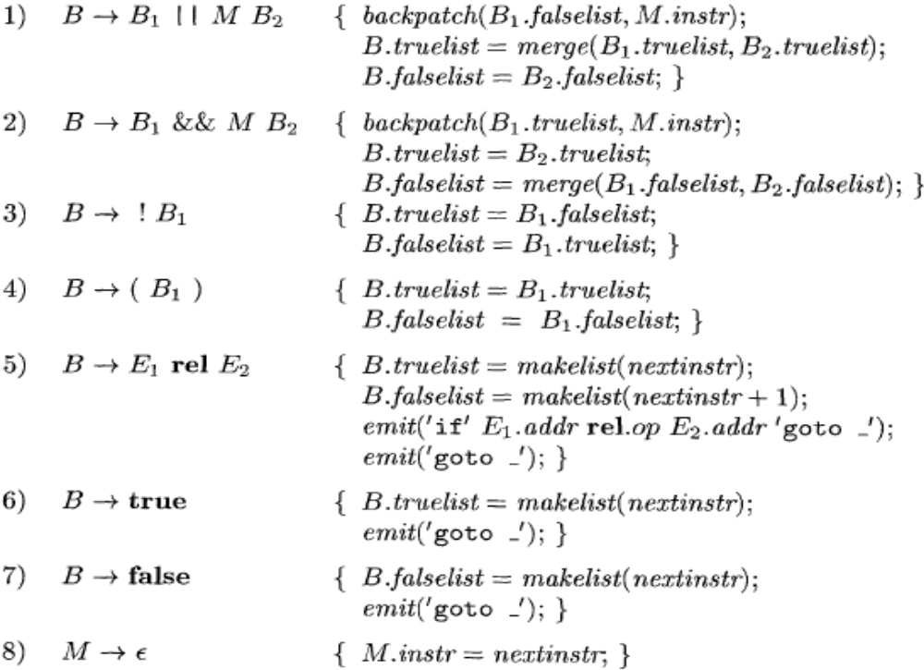
Backpatching for Boolean Expressions

Slide 66
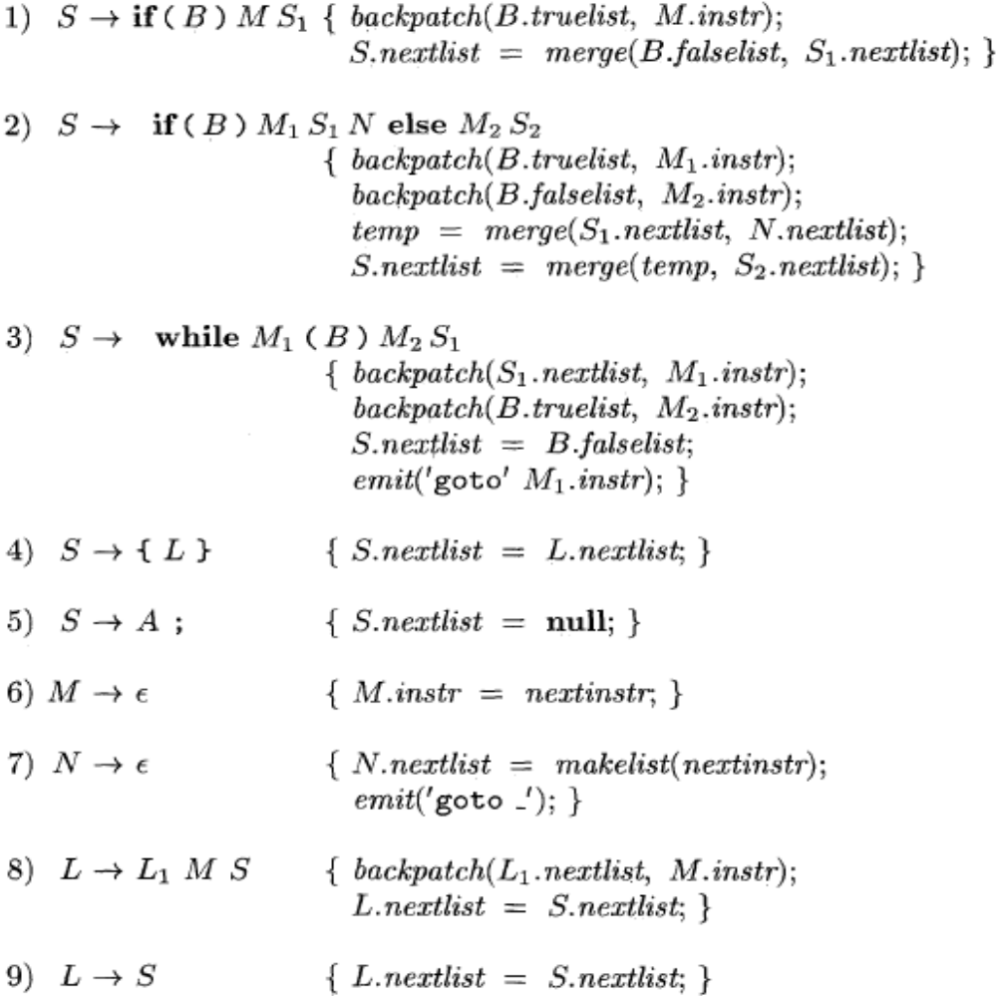
Flow-of-Control Statements

Slide 67
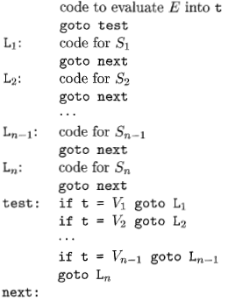
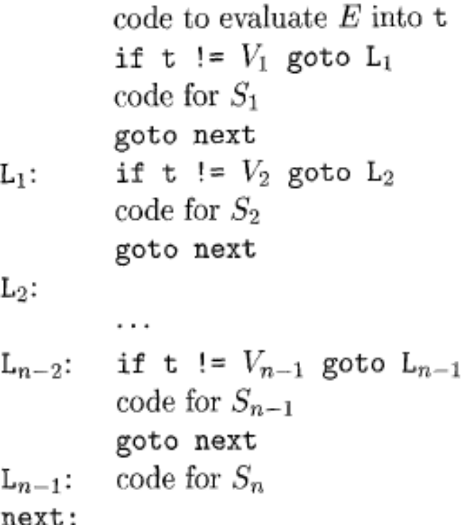
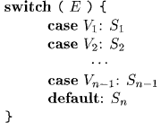
Translation of a switch-statement

Slide 68
Translation of a switch-statement
Long jumps
(efficient)
Short jumps

Slide 69
Intermediate Code for Procedures
Procedures and their implementation will be discussed at length in Chapter 7, along with the run-time management of storage for names.
Function - a procedure that returns a value.
In three-address code, a function call is divided into
evaluation of parameters in preparation for a call,
followed by the call itself.
For simplicity, we assume that parameters are passed by value;

Slide 70
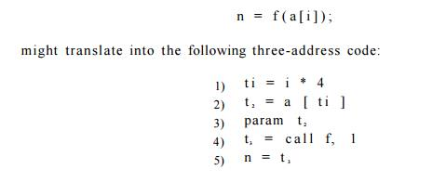
Example 6.25 : Suppose that a is an array of integers, and that
‘f’ is a function from integers to integers. Then, the assignment

Slide 71
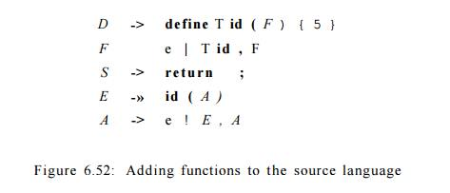
The productions in Fig allow function definitions and function calls.
Non-terminals D and T generate declarations and types
A function definition generated by D consists of
keyword define, a return type, the function name, formal parameters in parentheses and a function body consisting of a statement
Nonterminal F generates zero or more formal parameters, where a formal parameter consists of a type followed by an identifier.

Slide 72
Non-terminals S and E generate statements and expressions,
The production for S adds a statement that returns the value of an expression.
The production for E adds function calls, with actual parameters generated by A. An actual parameter is an expression.
Function definitions and function calls discussed previously
Function types. The type of a function must encode the return type and the types of the formal parameters.
void be a special type represents no parameter or no return type.
The type of a function pop() that returns an integer is therefore "function from void to integer.“
Function types can be represented by using a constructor fun applied to the return type and an ordered list of types for the parameters.

Slide 73
Symbol tables. Let s be the top symbol table when the function definition is reached. The function name is entered into s for use in the rest of the program.
The formal parameters of a function can be handled in analogy with field names in a record
In the production for D, after seeing define and the function name,
we push s and set up a new symbol table
Env.push(top); top = new Env(top);
Call the new symbol table, t. Note that top is passed as a parameter
in new Env(top), so the new symbol table t can be linked to the previous one, s.
The new table t is used to translate the function body.
We revert to the previous symbol table s after the function body is translated.

Slide 74
Type checking. Within expressions, a function is treated like
any other operator including the rules for coercions.
Ex. if f is a function with a parameter of type real, then the integer 2 is coerced to a real in the call f( 2 ) .
Function calls. When generating three-address instructions for a function call id(E, E,... , E), it is sufficient to generate the three-address instructions for evaluating or reducing the parameters E to addresses, followed by a param instruction for each parameter.
If we do not want to mix the parameter-evaluating instructions with the param instructions, the attribute E.addr for each expression E can be saved in a data structure such as a queue.
Once all the expressions are translated, the param instructions can be generated as the queue is emptied.

Slide 75
The procedure is such an important and frequently used programming construct that it is imperative for a compiler to good code for procedure calls and returns.
The run-time routines that handle procedure parameter passing, calls, and returns are part of the run-time support package.

