Slide 1
Intermediate Code Generation
Part I

Slide 2
Intermediate Code Generation
Facilitates retargeting: enables attaching a back end for the new machine to an existing front end
Enables machine-independent code optimization
Front end
Back end
Target
machine
code
Intermediate
code

Slide 3
Intermediate Representations
Abstract Syntax Trees
Directed Acyclic graph (DAG)
Postfix notation: operations on values stored on operand stack (similar to JVM bytecode)
Three-address code: (e.g. triples and quads)
x := y op z

Slide 4
Abstract Syntax Trees
A Syntax tree is a graphical representation of the source program.
It is a hierarchical structure that can be constructed by syntax rules.

Slide 5
Syntax-Directed Translation of Abstract Syntax Trees
Production
S → id := E
E → E₁ + E₂
E → E₁ * E₂
E → - E₁
E → ( E₁ )
E → id
Semantic Rule
S.nptr := mknode(‘:=’, mkleaf(id, id.entry), E.nptr)
E.nptr := mknode(‘+’, E₁.nptr, E₂.nptr)
E.nptr := mknode(‘*’, E₁.nptr, E₂.nptr)
E.nptr := mknode(‘uminus’, E₁.nptr)
E.nptr := E₁.nptr
E.nptr := mkleaf(id, id.entry)

Slide 6
Abstract Syntax Trees
E.nptr
a * (b + c)
E.nptr
*
E.nptr
a
(
E.nptr
)
E.nptr
+
E.nptr
b
c
*
Pro: easy restructuring of code
and/or expressions for
intermediate code optimization
Cons: memory intensive
a
+
b
c

Slide 7
Abstract Syntax Trees
a = b*-(c - d) + b*-(c - d)

Slide 8
DAG
Directed Acyclic Graph (DAG)
The tree that shows the same information with identical
Common sub- expression is called DAG
DAG reduces space and time requirements.

Slide 9
Abstract Syntax Trees versus DAGs
a := b * -c + b * -c
:=
:=
a
+
a
+
*
*
*
b
uminus
b
uminus
b
uminus
c
c
c
Tree
DAG

Slide 10
Postfix Notation
a := b * -c + b * -c
a b c uminus * b c uminus * + assign
Postfix notation represents
operations on a stack
Pro: easy to generate
Cons: stack operations are more
difficult to optimize

Slide 11
Three-Address Code
a := b * -c + b * -c
t1 := - c
t2 := b * t1
t3 := - c
t4 := b * t3
t5 := t2 + t4
a := t5
t1 := - c
t2 := b * t1
t5 := t2 + t2
a := t5
Linearized representation
of a syntax tree
Linearized representation
of a syntax DAG

Slide 12
Three-Address Statements
Assignment statements: x := y op z, x := op y
Indexed assignments: x := y[i], x[i] := y
Pointer assignments: x := &y, x := *y, *x := y
Copy statements: x := y
Unconditional jumps: goto lab
Conditional jumps: if x relop y goto lab
Function calls: B fun (x1,x2… xn)
param x1
param x2…
call p, n
return B

Slide 13
Syntax-Directed Translation into Three-Address Code
Productions
S → id := E
| while E do S
E → E + E
| E * E
| - E
| ( E )
| id
| num
Synthesized attributes:
S.code three-address code for S
S.begin label to start of S or nil
S.after label to end of S or nil
E.code three-address code for E
E.place a name holding the value of E
gen(E.place ‘:=’ E₁.place ‘+’ E₂.place)
Code generation
t3 := t1 + t2

Slide 14
Syntax-Directed Translation into Three-Address Code (cont’d)
Productions
S → id := E
S → while E
do S₁
E → E₁ + E₂
E → E₁ * E₂
E → - E₁
E → ( E₁ )
E → id
E → num
Semantic rules
S.code := E.code || gen(id.place ‘:=’ E.place); S.begin := S.after := nil
(see next slide)
E.place := newtemp();
E.code := E₁.code || E₂.code || gen(E.place ‘:=’ E₁.place ‘+’ E₂.place)
E.place := newtemp();
E.code := E₁.code || E₂.code || gen(E.place ‘:=’ E₁.place ‘*’ E₂.place)
E.place := newtemp();
E.code := E₁.code || gen(E.place ‘:=’ ‘uminus’ E₁.place)
E.place := E₁.place
E.code := E₁.code
E.place := id.name
E.code := ‘’
E.place := newtemp();
E.code := gen(E.place ‘:=’ num.value)

Slide 15
Syntax-Directed Translation into Three-Address Code (cont’d)
Production
S → while E do S₁
S.begin:
E.code
if E.place = 0 goto S.after
Semantic rule
S.begin := newlabel()
S.after := newlabel()
S.code := gen(S.begin ‘:’) ||
E.code ||
gen(‘if’ E.place ‘=‘ ‘0’ ‘goto’ S.after) ||
S₁.code ||
gen(‘goto’ S.begin) ||
gen(S.after ‘:’)
S.code
goto S.begin
S.after:
…

Slide 16
Example
i := 2 * n + k
while i do
i := i - k
t1 := 2
t2 := t1 * n
t3 := t2 + k
i := t3
L1: if i = 0 goto L2
t4 := i - k
i := t4
goto L1
L2:

Slide 17
Representation of Three Address Code
These are special structures to represent Three Address Code
Quadruple
Triple
Indirect Triple

Slide 18
Implementation of Three-Address Statements: Quads
a := b * -c + b * -c
# | Op | Arg1 | Arg2 | Res
(0) | uminus | c |  | t1
(1) | * | b | t1 | t2
(2) | uminus | c |  | t3
(3) | * | b | t3 | t4
(4) | + | t2 | t4 | t5
(5) | := | t5 |  | a
Quads (quadruples)
Pro: easy to rearrange code for global optimization
Cons: lots of temporaries

Slide 19
Implementation of Three-Address Statements: Triples
a := b * -c + b * -c
# | Op | Arg1 | Arg2
(0) | uminus | c
(1) | * | b | (0)
(2) | uminus | c
(3) | * | b | (2)
(4) | + | (1) | (3)
(5) | := | a | (4)
Triples
Pro: temporaries are implicit
Cons: difficult to rearrange code

Slide 20
Implementation of Three-Address Statements: Triples
a[i] := b
# | Op | Arg1 | Arg2
(0) | []= | a | i
(1) | = | (0) | b
Triples
Pro: temporaries are implicit
Cons: difficult to rearrange code

Slide 21
Implementation of Three-Address Stmts: Indirect Triples
a := b * -c + b * -c
# | Stmt
(0) | (14)
(1) | (15)
(2) | (16)
(3) | (17)
(4) | (18)
(5) | (19)
# | Op | Arg1 | Arg2
(14) | uminus | c
(15) | * | b | (14)
(16) | uminus | c
(17) | * | b | (16)
(18) | + | (15) | (17)
(19) | := | a | (18)
Program
Triple container
Pro: temporaries are implicit & easier to rearrange code

Slide 22
Represent the following code in Quadruple, Triple and Indirect Triple
a := b * -(c-d) + b * -(c-d)

Slide 23
Types and Declarations
The applications of types can be grouped under checking and translation.
Type checking : uses logical rules to reason about the behavior of a program at run time. it ensures that the types of the operands match the type expected by an operator.
Translation Applications: From the type of a name, a compiler can determine the storage that will be needed for that name at run time.

Slide 24
Types and Declarations
Semantic analyzer does mainly static checking.
Static checks can be :
Uniqueness checks –uniqueness of variables
Flow of control checks– statement that causes flow of control to leave a construct should also have a place to transfer flow of control.
Type checks –Incompatible operands
Name-related checks– Same name is used for start and end of the same block.

Slide 25
Type systems
A type system is a collection of rules for assigning types to various parts of a program.
A Type checker implements a type system.
It is a translation scheme that synthesizes the type of each expression from the types of its subexpression. It can handle arrays, pointers, statements and functions.

Slide 26
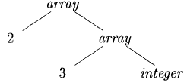
Type Expressions
The Type expressions are used to represent the type of programming language construct.
Types have structure, which we shall represent using type expressions
Example : The array type int [2][3] can be read as "array of 2 arrays of 3 integers each" and written as a type expression array (2, array (3, integer)).

Slide 27
Type Expressions
Definition : a type expression is either a basic type or is formed by applying an operator called a type constructor to a type expression.
A basic type is a type expression. Typical basic types for a language include boolean, char, integer, float, and void.
A type name is a type expression.
A type expression can be formed by applying the array type constructor to a number and a type expression.
Array: array(I,T)
Ex: Var C: array[1..20] of integers
4. A record is a data structure with named fields. A type expression can be formed by applying the record type constructor to the field names and their types.

Slide 28
Type Expressions
5.A type expression can be formed by using the type constructor → for function types. We write s → t for "function from type s to type t. “
Ex: function fun(a,b:char) *integer
char x char → pointer(integer)
6. If s and t are type expressions, then their Cartesian product s x t is a type expression.
7. Type expressions may contain variables whose values are type expressions

Slide 29
Type Equivalence
" if two type expressions are equal then return a certain type else error."
two types are structurally equivalent if and only if one of the following conditions is true:
They are the same basic type.
They are formed by applying the same constructor to structurally equivalent types.
One is a type name that denotes the other
If type names are treated as standing for themselves, then the first two conditions in the above definition lead to name equivalence of type expressions.

Slide 30
Declarations
D → T id ; D | ε
T → B C | record ‘{‘ D ‘}'
B → int | float
C → ε | [num] C

Slide 31
Storage Layout for Local Names
From the type of a name, we can determine the amount of storage that will be needed for the name at run time. At compile time, we can use these amounts to assign each name a relative address.
Address Alignment:The storage layout for data objects is strongly influenced by the addressing constraints of the target machine.

Slide 32
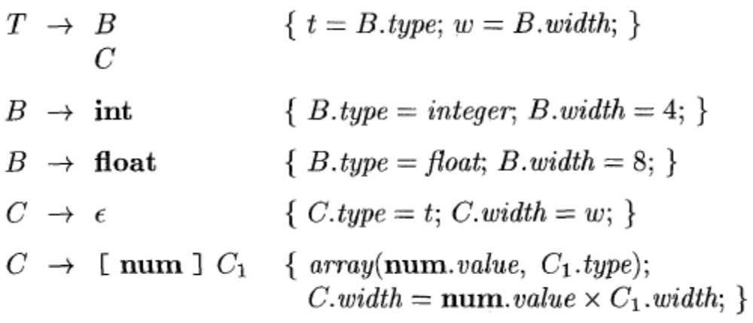
Storage Layout for Local Names
Computing types and their widths
C.type

Slide 33
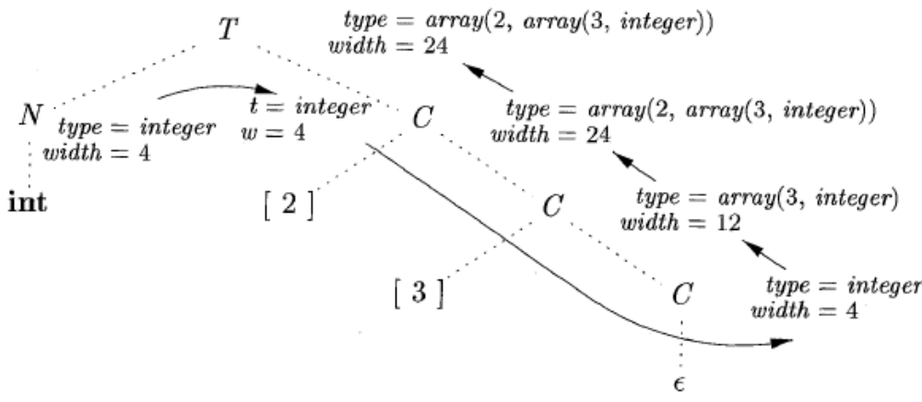
Storage Layout for Local Names
The parse tree for the type int [2][3] is shown by dotted lines The solid lines show how the type and width are passed from B,down the chain of C's through variables t and w, and then back up the chain as synthesized attributes type and width.
Syntax-directed translation of array types

Slide 34
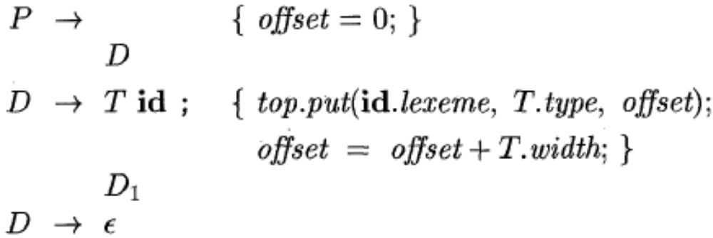


Sequences of Declarations
we can use a variable, say offset, to keep track of the next available relative address.
Using a marker nonterminal M,
can be restated as:

Slide 35
Names and Scopes
The three-address code generated by the syntax-directed definitions shown on the previous slides is somewhat simplistic, because it assumes that the names of variables can be easily resolved by the back end in global or local variables
We need local symbol tables to record global declarations as well as local declarations in procedures, blocks, and structs to resolve names

Slide 36
Fields in Records and Classes
The field names within a record must be distinct; that is, a name may appear at most once in the declarations generated by D.
The offset or relative address for a field name is relative to the data area for that record.
Example:The use of a name x for a field within a record does not conflict with other uses of the name outside the record.
float x;
record ( float x; float y; ) p;
record ( int tag; float x; float y; ) q;
A subsequent assignment x = p . x + q. x ; sets variable x to the sum of the fields named x in the records p and q.

Slide 37
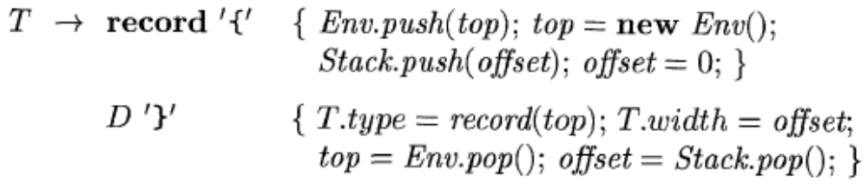
Fields in Records and Classes
Handling of field names in records

Slide 38
Symbol Tables for Scoping
struct S
{ int a;
int b;
} s;
void swap(int& a, int& b)
{ int t;
t = a;
a = b;
b = t;
}
void somefunc()
{ …
swap(s.a, s.b);
…
}
We need a symbol table
for the fields of struct S
Need symbol table
for global variables
and functions
Need symbol table for arguments
and locals for each function
Check: s is global and has fields a and b
Using symbol tables we can generate
code to access s and its fields

Slide 39
Offset and Width for Runtime Allocation
struct S
{ int a;
int b;
} s;
void swap(int& a, int& b)
{ int t;
t = a;
a = b;
b = t;
}
void somefunc()
{ …
swap(s.a, s.b);
…
}
The fields a and b of struct S
are located at offsets 0 and 4
from the start of S
(0)
a
The width of S is 8
b
(4)
Subroutine frame holds
arguments a and b and
local t at offsets 0, 4, and 8
Subroutine
frame
fp[0]=
(0)
a
fp[4]=
(4)
b
fp[8]=
(8)
t
The width of the frame is 12

Slide 40
Symbol Tables for Scoping
globals
struct S
{ int a;
int b;
} s;
void swap(int& a, int& b)
{ int t;
t = a;
a = b;
b = t;
}
void foo()
{ …
swap(s.a, s.b);
…
}
prev=nil
[8]
Trec S
s
(0)
[8]
prev=nil
swap
(0)
a
foo
(4)
b
Tfun swap
Tref
[12]
prev
Tint
(0)
a
(4)
b
(8)
t
Table nodes
type nodes
(offset)
[width]
Tfun foo
[0]
prev

Slide 41
Hierarchical Symbol Table Operations
mktable(previous) returns a pointer to a new table that is linked to a previous table in the outer scope
enter(table, name, type, offset) creates a new entry in table
addwidth(table, width) accumulates the total width of all entries in table
enterproc(table, name, newtable) creates a new entry in table for procedure with local scope newtable
lookup(table, name) returns a pointer to the entry in the table for name by following linked tables

Slide 42
Syntax-Directed Translation of Declarations in Scope
Productions
P → D ; S
D → D ; D
| id : T
| proc id ; D ; S
T → integer
| real
| array [ num ] of T
| ^ T
| record D end
S → S ; S
| id := E
| call id ( A )
Productions (cont’d)
E → E + E
| E * E
| - E
| ( E )
| id
| E ^
| & E
| E . id
A → A , E
| E
Synthesized attributes:
T.type pointer to type
T.width storage width of type (bytes)
E.place name of temp holding value of E
Global data to implement scoping:
tblptr stack of pointers to tables
offset stack of offset values

Slide 43
Syntax-Directed Translation of Declarations in Scope (cont’d)
P → { t := mktable(nil); push(t, tblptr); push(0, offset) }
D ; S
D → id : T
{ enter(top(tblptr), id.name, T.type, top(offset));
top(offset) := top(offset) + T.width }
D → proc id ;
{ t := mktable(top(tblptr)); push(t, tblptr); push(0, offset) }
D₁ ; S
{ t := top(tblptr); addwidth(t, top(offset));
pop(tblptr); pop(offset);
enterproc(top(tblptr), id.name, t) }
D → D₁ ; D₂

Slide 44
Syntax-Directed Translation of Declarations in Scope (cont’d)
T → integer { T.type := ‘integer’; T.width := 4 }
T → real { T.type := ‘real’; T.width := 8 }
T → array [ num ] of T₁
{ T.type := array(num.val, T₁.type);
T.width := num.val * T₁.width }
T → ^ T₁
{ T.type := pointer(T₁.type); T.width := 4 }
T → record
{ t := mktable(nil); push(t, tblptr); push(0, offset) }
D end
{ T.type := record(top(tblptr)); T.width := top(offset);
addwidth(top(tblptr), top(offset)); pop(tblptr); pop(offset) }

Slide 45
Example
globals
s: record
a: integer;
b: integer;
end;
proc swap;
a: ^integer;
b: ^integer;
t: integer;
t := a^;
a^ := b^;
b^ := t;
proc foo;
call swap(&s.a, &s.b);
prev=nil
[8]
Trec
s
(0)
[8]
prev=nil
swap
(0)
a
foo
(4)
b
Tfun swap
Tptr
[12]
prev
Tint
(0)
a
(4)
b
(8)
t
Table nodes
type nodes
(offset)
[width]
Tfun foo
[0]
prev

Slide 46
Syntax-Directed Translation of Statements in Scope
S → S ; S
S → id := E
{ p := lookup(top(tblptr), id.name);
if p = nil then
error()
else if p.level = 0 then // global variable
emit(id.place ‘:=’ E.place)
else // local variable in subroutine frame
emit(fp[p.offset] ‘:=’ E.place) }
Globals
(0)
s
(8)
x
(12)
y
Subroutine
frame
fp[0]=
(0)
a
fp[4]=
(4)
b
fp[8]=
(8)
t
…

Slide 47
Syntax-Directed Translation of Expressions in Scope
E → E₁ + E₂ { E.place := newtemp();
emit(E.place ‘:=’ E₁.place ‘+’ E₂.place) }
E → E₁ * E₂ { E.place := newtemp();
emit(E.place ‘:=’ E₁.place ‘*’ E₂.place) }
E → - E₁ { E.place := newtemp();
emit(E.place ‘:=’ ‘uminus’ E₁.place) }
E → ( E₁ ) { E.place := E₁.place }
E → id { p := lookup(top(tblptr), id.name);
if p = nil then error()
else if p.level = 0 then // global variable
E.place := id.place
else // local variable in frame
E.place := fp[p.offset] }

Slide 48
Syntax-Directed Translation of Expressions in Scope (cont’d)
E → E₁ ^ { E.place := newtemp();
emit(E.place ‘:=’ ‘*’ E₁.place) }
E → & E₁ { E.place := newtemp();
emit(E.place ‘:=’ ‘&’ E₁.place) }
E → id₁ . id₂ { p := lookup(top(tblptr), id₁.name);
if p = nil or p.type != Trec then error()
else
q := lookup(p.type.table, id₂.name);
if q = nil then error()
else if p.level = 0 then // global variable
E.place := id₁.place[q.offset]
else // local variable in frame
E.place := fp[p.offset+q.offset] }

