Slide 1
Entrepreneurship and Project Management
UNIT-I
Introduction to Entrepreneurship

Slide 2

UNIT-I Introduction to Entrepreneurship Contents
Introduction to Entrepreneurship and Entrepreneur
Characteristics and Skills of an Entrepreneur
Factors affecting Entrepreneurship development
Types of Entrepreneurs
Entrepreneur Vs Intrapreneur
Entrepreneur Vs Entrepreneurship
Women Entrepreneurs- Growth and Problems
Incubation Centers

Slide 3
Entrepreneur
Frenchword- Enterprendre
"between-taker" and "go-between" i.e.,' to undertake'
"the director or manager of a public musical institution, one who 'gets up' entertainment, especially musical performance"
"The professional application of knowledge, skills and competencies and/or of monetizing a new idea, by an individual or a set of people by launching an enterprise do novo or diversifying from an existing one (distinct from seeking self employment as in a profession or trade), thus, to pursue growth while generating wealth, employment and social good"

Slide 4

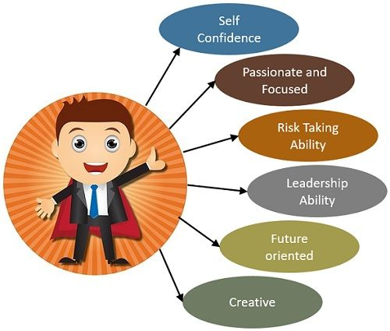
Entrepreneur
The term 'entrepreneur' has been defined in many ways and various senses. These views are broadly classified into three groups, namely, risk-bearer, organizer and innovator.
Entrepreneur as Risk-Bearer
Entrepreneur as Organizer or Coordinator
Entrepreneur as Innovator

Slide 5
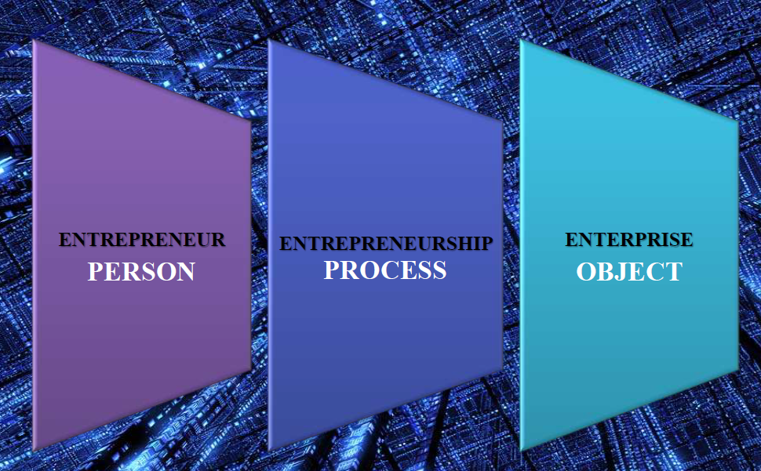
Entrepreneur-Entrepreneurship-Enterprise

Slide 6
Characteristics of Successful Entrepreneurs
Hard Work
Desire for High achievement
Highly Optimistic
Independence
Foresight
Good Organizer
Innovative
Perseverance(J.K Rowling- Harry Potter)
Team Spirit

Slide 7
Azim Premji's Ten Golden Rules for a Successful Entrepreneur
Dare to Dream
Set clear goals
Never loose your Zest and Curiosity for learning
Strive for Excellence
Build Self-confidence
Learn to work in Teams
Take care of yourself
Persevere
Have a Broader Social Vision
Never let success go to your head

Slide 8
Skills of an Entrepreneur
Business Management Skills
Communication and Active listening Skills
Risk-taking Skills
Networking Skills
Critical thinking Skills
Problem Solving Skills
Creative thinking Skills
Customer Service Skills
Leadership Skills
Financial Skills
Time Management and Organisational Skills
Technical Skills

Slide 9
Essential Qualities of a Successful Entrepreneur Dr.Kiran Mazumdar-Shaw
Sprit of challenge
Sense of Conviction
Resourcefulness
Ethos of Persistence
Ability to manage failure
Problem solving approach
Ability to spot and leverage opportunity
Building core competence and excellence
Uncompromising work ethic
Building a strong organizational DNA through differentiation

Slide 10
The Major Charms of becoming an Entrepreneur
Opportunity to create One's own destiny
Opportunity to make a difference
Opportunity to reach one's full potential
Opportunity to reap impressive profits
Opportunity to contribute to society
Opportunity to do what one enjoys

Slide 11
Entrepreneurship
Entrepreneurship is the attempt to create value through recognition of business opportunity, the management of risk-taking appropriate to the opportunity, and through the communicative and management skills to mobilise human, financial and material resources necessary to bring a project to fruition. Kao and Stevenson 1984
Entrepreneurship is the purposeful activity of an individual or a group of associated individuals, undertaken to initiate, maintain or aggrandize profit by production or distribution of economic goods and services. A.H.Cole

Slide 12
Entrepreneurship
Entrepreneurship is based on purposeful and systematic innovation. It includes not only the independent businessman but also company directors and managers who actually carry out innovative functions.
Joseph A. Schumpeter
Entrepreneurship refers to the functions performed by an entrepreneur in establishing an enterprise.
Entrepreneurship is the act of being an entrepreneur.
Entrepreneurship is a process involving various actions to be undertaken to establish an enterprise. It is, thus, process of giving birth to a new enterprise.

Slide 13
Concept of Entrepreneurship
Entrepreneurship is an innovative function. It is a leadership rather than an ownership. The process of innovation may be in the form of
Introduction of a New Product
Use of a New Method of production
Opening of a New Market
The conquest of New Source of supplying Raw Materials
Joseph A. Schumpeter.

Slide 14
ENTREPRENEUR AND ENTREPRENEURSHIP
An entrepreneur is simply the founder of a business who works towards a vision.
Entrepreneurship varies from single to multiple projects, which help generate multiple employment opportunities.
An entrepreneur is an individual or team of people who not only generate profits but also solve societal challenges through products and services. They provide value through their products, engage with clients and customers and take risks.
Entrepreneurship is the art of turning an idea into a venture. It’s not only about getting resources but also making constant efforts to build on the idea. There’s a direction and the people involved are all working toward a goal.
An entrepreneur is a critical thinker, who brings new and innovative ideas to the table in the hope of making the world a better place.

Slide 15
ENTREPRENEUR AND ENTREPRENEURSHIP
Entrepreneurship provides the platform to make changes through innovations and out-of-the-box thinking. It allows people to solve problems with creative solutions.
An entrepreneur typically initiates and operates a new business. Simultaneously, they’re accountable for any associated risks.
Entrepreneurship is the procedure of starting a new business that prepares someone for both risks and opportunities.
An entrepreneur coordinates the essential requirements of an organization. They lead, motivate and direct to coordinate multiple efforts from different directions.
Entrepreneurship is the process of coordination that allows individuals to streamline their efforts and resources. It’s the planning and organization of tasks and priorities.
If an entrepreneur is the creator, entrepreneurship is the act of creation

Slide 16
Entrepreneurship
Innovation and Risk bearing are regarded as the two basic elements involved in Entrepreneurship
Relationship between Entrepreneur and Entrepreneurship
Entrepreneur | Entrepreneurship
Person | Process
Organiser | Organization
Innovator | Innovation
Risk-bearer | Risk-bearing
Motivator | Motivation
Creator | Creation
Visualiser | Vision
Leader | Leadership
Imitator | Imitation

Slide 17

Nature of Entrepreneurship
The main features of Entrepreneurship are
Economic activity
Creative activity
Purposeful activity
Function of risk-bearing
Organizing function
Gap-filling function
Dynamic function
Innovative function

Slide 18
Factors affecting Entrepreneurship Development
Economic Factors
Capital
Availability of Raw Materials
Availability of Human Resources
Market opportunities

Slide 19
Factors affecting Entrepreneurship Development
Non-Economic Factors
Social Norms and Values
Role Models
Social Pressure
Respect and Status
Security

Slide 20
Entrepreneurial Process
The process of starting a new venture is embodied in the entrepreneurial process which involves more than just problem solving in a typical management position. It is creation, maintenance and expansion of a business enterprise. An entrepreneurial process has the following five distinct phases.
Identification and Evaluation of Opportunity
Drawing up of a Business Plan
Determination of the required Resources
Creating the venture
Managing the Enterprise

Slide 21
The Entrepreneurial decision process
The Present status
Reasons for changing the present status
Desire for change from the present status to become Entrepreneur
Possibilities to become an Entrepreneur

Slide 22
Functions of Entrepreneurs
Entrepreneurial functions
Managerial functions
Promotional functions
Commercial functions

Slide 23
Entrepreneurial Functions
Entrepreneur as Risk-Bearer
Entrepreneur as Organizer or Coordinator
Entrepreneur as Innovator/Innovation

Slide 24
Managerial Functions
Planning
Organizing
Staffing
Directing
Controlling

Slide 25
Promotional Functions
Identification and Selection of Business Idea
Preparation of Business Plan or Project Report
Requirement for Finance

Slide 26
Commercial Functions
Production/ Manufacturing
Marketing
Accounting

Slide 27
Types of Entrepreneurs
Based on the type of Business
Trading Entrepreneur
Manufacturing Entrepreneur
Agricultural Entrepreneur
Based on the use of Technology
Technical Entrepreneur
Non-Technical Entrepreneur

Slide 28
Types of Entrepreneurs
Based on Ownership Based on the size of Enterprise
Private Entrepreneur 1. Small-scale Entrepreneur
State Entrepreneur 2. Medium-scale Entrepreneur
Joint Entrepreneur 3. Large-scale Entrepreneur
Based on Gender
Men Entrepreneurs
Women Entrepreneurs

Slide 29
Types of Entrepreneurs
Clarence Danhof classifies entrepreneurs into four classes based on their readiness to adapt to new technologies, products or markets. The four types of entrepreneurs are
Innovative Entrepreneurs
Imitative Entrepreneurs
Fabian Entrepreneurs
Drone Entrepreneurs

Slide 30
Categorization of Entrepreneurs based on Nature of Economy
A slight variation from Danhof's grouping is offered by Singh.
Innovative Entrepreneur(Developed)
Imitative Entrepreneur(Developing)
Exploitative Entrepreneur(Under-developed)
Model Entrepreneur(Any kind of Market or Economy)

Slide 31
Classification of Entrepreneurs from Development Angle
Gupta in his classification, integrates sociological, psychological, and economic perspective of entrepreneurship development.
Prime mover type
Manager type
Minor innovator type
Initiator type
Satellite type
Local trading type

Slide 32
Types of Entrepreneurs
Following are some more types of Entrepreneurs listed by some other behavioural scientists:
Solo Operators
Active Partners
Inventors
Challengers
Buyers
Life-Timers

Slide 33


Slide 34
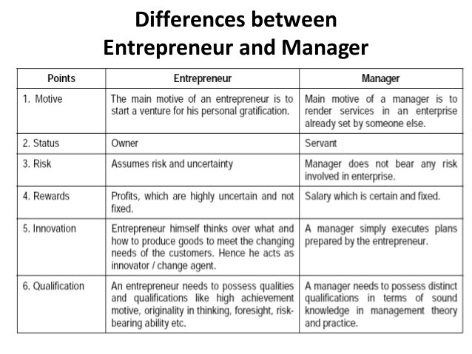
Difference between an Entrepreneur and a Manager

Slide 35
INTRAPRENEUR
"Intrapreneur is an entrepreneur within an already established organization."
Gifford Pinchot(1985)
Intrapreneurs introduced new products, services and processes which enable their companies to grow and succeed in changing environment. These persons are driven not by monetary gain but by a deep desire of personal achievement.
Pinchot suggested the creation of a system that would provide select executives a status within the corporation similar to that of an entrepreneur in society. He described such people as intra-corporate entrepreneurs or 'Intrapreneurs'.

Slide 36
Intrapreneurial Process
The process of intrapreneurship involve both analytical and creative activities. According to Pierce and Dunham, the intrapreneurial process takes place in four sequential steps.
Solo Phase
Network Phase
Boot Legging Phase
Formal Team Phase

Slide 37
Entrepreneur VS Intrapreneur
Bases of Difference | Entrepreneur | Intrapreneur
1. Dependency | An entrepreneur is independent in his operations. | An Intrapreneur is dependent on the entrepreneur, I.e., the owner
2. Raising of Funds | An entrepreneur himself raises funds required for the enterprise | Funds are not raised by the intrapreneur
3. Risk | Entrepreneur bears the risk involed in the business. | An intrapreneur does not fully bear the risk involed in the enterprise
4. Operation | An enterpreneur operates from out-side. | On the contrary, an intrapreneur operates from within the organization itself.

Slide 38
Social Entrepreneur
Social Entrepreneurs are individuals with innovative solutions to society's most pressing and daunting social problems. They are ambitious and persistent, tackling major social issues and offering new ideas for wide scale change. Throughout history, such individuals have introduced solutions to seemingly intractable social problems, fundamentally improving the lives of countless individuals by changing the way critical systems operate(Yunus 1997:9-24).
Dees(2001) gives a very detailed definition of a social entrepreneur.

Slide 39
Social Entrepreneur
According to him, the social entrepreneur plays the role of change agent in society by:
Adopting a mission to create and sustain social value;
Searching for and pursuing new opportunities to serve that mission;
Continually innovating, adapting, and learning in pursuit of the mission;
Acting boldly without consideration of resources current in hand; and
Being accountable for outcomes of activities

Slide 40
Social Entrepreneur
There are 3 key components that emerge out of this definition and are more of less common when it comes other variations of the definition of Social Entrepreneurship:
The problem
A sustainable solution
Social change

Slide 41
Social Entrepreneur
Social entrepreneur is different from a business entrepreneur in the sense that the former assesses its success in terms of its impact he/she makes on society whereas the latter measures his/her performance in terms of profit and return. While a business entrepreneur may create entirely new business enterprise, a social entrepreneur comes up with new solutions to daunting social problems and then implements them on a large-scale that benefits humanity.

Slide 42
Social Entrepreneur
Examples of Social Enterprises:
Aravind Eye Hospital & Aurolab. Social Entrepreneur Dr.Govindappa Venkataswamy
Mission: Making medical technology and health care services accessible, affordable and financially self-sustaining
SKS India. Social Entrepreneur: Vikram Akula.
Mission : Empowering the poor to become self-reliant through affordable loans
AMUL (Anand Milk Union Limited) Social Entrepreneur
The Amul Pattern has established itself as a uniquely appropriate model for rural development. Amul has spurred the White Revolution of India, which has made India the largest producer of milk and milk products in the world.

Slide 43
Social Entrepreneur
Grameen Bank. Social Entrepreneur: Muhammad Yunus
has reversed conventional banking practice by removing the need for collateral and created a banking system based on mutual trust, accountability, participation and creativity
Shri Mahila Griha Udyog Lijjat Papad.
Shri Mahila Griha Udyog Lijjat Papad is a Women’s organisation manufacturing various products from Papad, Khakhra, Appalam, Masala, Vadi, Gehu Atta, Bakery Products, Chapati, SASA Detergent Powder, SASA Detergent Cake (Tikia), SASA Nilam Detergent Powder, SASA Liquid Detergent.

Slide 44

Women Entrepreneurship
“Somebody once said, educate a woman & u will educate a family. I am saying empower a woman to become an entrepreneur, & you will create an entire family of entrepreneurs. Women entrepreneurship is the need of the nation right now, it is the surest quickest way to make INDIA a super power.

Slide 45

Women Entrepreneurship
When women move forward, the family moves, the village moves and the nation moves.......
Pandit Jawaharlal Nehru
“a confident , innovative and creative women capable of achieving self-economic independence individually or in collaboration, generates employment opportunities for others through initiating, establishing and running the enterprise by keeping pace with her personal, family and social life”
Kamal Singh

Slide 46

Women Entrepreneurship
Government of India(GOI 2006) has defined women Entrepreneur as
"an enterprise owned and controlled by a women having a minimum financial interest of 51 per cent of the capital and giving at least 51 per cent of the employment generated in the enterprise to women"

Slide 47
Why Women become Entrepreneurs?
To become economically independent
To establish their own enterprise
To establish their identity in the society
To achieve excellency in their endeavour
To build confidence to themselves
To develop risk assuming ability
To claim equal status in society
To secure greater freedom & mobility
Liking for business
An urge to do something new

Slide 48
Women Entrepreneurs in India-Traits of Women Entrepreneurs
Women are Ambitious
Women are Confident
Women is open and willing to learn
Women are cost conscious
Women Values Cooperation and Allegiance
Women can Balance Home and Work

Slide 49
Factors influencing Women Entrepreneurship
Family Culture and Traditions
Geographical factors and Social factors
Caste System
Government aids and Policies
Inherent capabilities and efficiency

Slide 50
Factors influencing Women Entrepreneurship
Push Factors
Pull Factors
a. Death of bread winner
b. Permanent inadequacy in income of the family
c. Sudden fall in family income
a. Need and perception of Women’s Liberation, Equity etc.
b. To gain recognition, importance and social status.
c. To get economic independence
d. To utilize their free time or education
e. Women’s desire to evaluate their talent

Slide 51
Woman Entrepreneurs in India – Segments of Women Entrepreneurs
Grassroots Entrepreneurs
Ex- tailors, flower sellers, STD booth owners, pan shops etc.,
Mid-Rung Entrepreneurs
Turn over-Rs.50 lakh to Rs.1 crore
Ex- garments shops, poultry farms, export businesses etc.,
Upper Crust
Turnover- more than Rs.5 crore.
Ex- export houses, travel agencies, traders in pharmaceuticals etc.,

Slide 52
Functions of Women Entrepreneurs
Frederick Harbison(1956) has enumerated the following five functions of a women entrepreneur:
Exploration of the prospects of starting a new business enterprise.
Undertaking of risk and the handling of economic uncertainties involved in business.
Introduction of innovations or imitation of innovations.
Coordination. Administration and control.
Supervision and leadership.

Slide 53
Functions of Women Entrepreneurs
All these entrepreneurial functions can be classified broadly into three categories:
Risk-bearing
Organisation
Innovations

Slide 54
Problems of Women Entrepreneurs
Women entrepreneurs encounter two sets of problems, viz., general problems of entrepreneurs and problems specific to women entrepreneurs(Birley 1989).
Problems of Finance
Scarcity of Raw Material
Stiff Competition
Limited Mobility
Family Ties
Lack of Education
Male-Dominated Society
Low Risk-Bearing Ability

Slide 55
Remedial Measures
Financial assistance
Simple legal formalities
Creating awareness & education
Co-operation from agencies
Training and development
Offering concessions
Women’s cell
Women entrepreneurs’ association

Slide 56
Woman Entrepreneurs in India – Financial Assistance
Women face difficulties in getting loans from Bank and Financial Institutions for starting their business ventures. To overcome this difficulty Financial Institutions and banks have specialized schemes where in finance is available to women entrepreneurs on concessional terms. Two of such important schemes are
Mahila Udyog Nidhi (MUN) scheme of Small Industries Development Bank of India and
Stree Shakti Package of State Bank of India.

Slide 57
Woman Entrepreneurs in India – Financial Assistance
Mahila Udyog Nidhi (MUN) scheme of Small Industries Development Bank of India
The scheme provides a soft loan up to 25 percent of cost of Project subject to a maximum of Rs. 2.5 lakh per project at zero interest but a service charge of only one percent is charged to meet expenses of the lending institutions. To avail this assistance the cost of project should not exceed Rs. 10 lakhs. The assistance is available to women entrepreneurs setting up new projects, expansion, modernization, technology upgradation and diversification of an existing unit and also for rehabilitation of viable sick units in manufacturing or service sector.

Slide 58
Woman Entrepreneurs in India – Financial Assistance
Stree Shakti Package
It is a unique scheme run by State Bank of India, aimed at supporting entrepreneurship among women. It is available to enterprises where women own more than 50 percent of the share capital.
The following concessions are offered under stree shakti package:
1. The margin is lowered by 5 percent as applicable to that type of industrial unit.
2. When the loan amount exceeds Rs. 2 lakhs the interest rate is lowered by 0.5 percent.
3. In case of tiny sector units no security is required for loan up to Rs. 5 lakhs.

Slide 59
Woman Entrepreneurs in India – Institutions Assisting Women Entrepreneurs
Association of Women Entrepreneurs of Karnataka (AWAKE)-1983
Federation of Indian Women Entrepreneurs (FIWE)
Self-Help Groups (SHGs)
Mahila Udyog Nidhi (MUN)
The Trade Related Entrepreneurship Assistance and Development (TREAD)
Bank of India’s Priyadarshini Yojana
Swarna Jayanthi Gram Swarojgar Yojana
Rashtriya Mahila Kosha

Slide 60
Woman Entrepreneurs in India – Institutions Assisting Women Entrepreneurs Other Schemes
Indian Mahila Kendra
Mahila Samiti Yojana
Mahila Vikasnidhi
Indira Mahila Yoj ana
Working Women’s Forum
Women’s Development Corporations
Marketing of Non-Farm Products of Rural Women
Assistance to Rural Women in Non-Farm Development Schemes
Prime Minister’s Rozgar Yojana (PMRY)
Self-Employment Programme for Urban Poor (SEPUP)
Integrated Rural Development Programme (IRDP)

Slide 61
Woman Entrepreneurs in India-Scope of Opportunities for Women Entrepreneurs
The modern world women has been able to overcome the hurdle of society’s perception of considering them to the confined to the four walls of the house or viewing them as weak entrepreneurs caught up in limited business area such as papad making, pickle preparation food items, paintings, handicrafts, etc.
They have been able for show a remarkable shift from these small entrepreneurs at ventures to modern technology-based business ventures such as-

Slide 62
Woman Entrepreneurs in India-Scope of Opportunities for Women Entrepreneurs
Computer services and information dissemination
Trading in computer stationary
Computer maintenance
Travel and tourism
Quality testing, quality control laboratories
Community kitchens

Slide 63
Woman Entrepreneurs in India-Scope of Opportunities for Women Entrepreneurs
Poster and indoor plant library
Recreation centers for old people
Culture centers
Screen printing, photograph and video shooting
Stuffed soft toys, wooden toys
Mini laundry, community eating centers

Slide 64
Woman Entrepreneurs in India-Scope of Opportunities for Women Entrepreneurs
Distributing and trading of house hold provision as well as saris, dress materials, etc.
Job contracts for packaging of goods
Photocopying, typing centers
Beauty parlors
Communications centers like STD booths, cyber cafes, etc.

Slide 65
Entrepreneurship barriers​
​
Entry Barriers
Survival Barriers
Exit Barriers
Achievement Motivation​
Lack of Confidence​
Risk Bearing Capacity​
Pressure to earn money​
Adapting to changing Technology​
Constraining practices in Capital Market​
Mismanagement of Resources​
Limited Dissemination of Vital Information​
Increased competition from New Players​
Improper guidance from support agencies / Government
Unable to identify red signals​
Fear of failure​
Increasing Demand for managerial and Marketing Skills ​

Slide 66
Entrepreneurship barriers​
Environmental barriers
Personal Barriers
Societal barriers
Non availability of Raw Material​
Scarcity of Skilled Manpower​
Updated Technology​
Location​
Delay in getting Finance​
Lack of confidence​
Lack of assistance from others​
Lack of achievement Motivation​
Reaching the state of Contentment​
Expecting Fast Results or Lack of Patience​
Inhibition from starting business from Society​
Peer Pressure to join Employment​
Preference to Service than Business​

Slide 67
Reasons for Entrepreneurial failure​
Lack of experienced management​
Few trained and experienced Manpower​
Poor Financial Management​
Rapid Growth​
Lack of business Linkages​
Weak Marketing efforts​
Lack of Information​
Incorrect Pricing​
Improper Inventory Control​
Short Term Outlook​

Slide 68
How to avoid failure as an Entrepreneur​
Focus your efforts.​
Know who to surround yourself with.​
Create a company culture.​
Designate your MVP.​
Only build what is needed.​
Sell before you build.​
Reasons to Pre-Sell Product​
Build better customer relationships​
Market validation​
Test pricing. ​

Slide 69
How to avoid failure as an Entrepreneur​
Create systems.​
Talent Management System​
Marketing Management System​
Sales Management System​
Financial Management System​
Legal Management System ​
Operational Management System​
Client Management System ​
Having Cash Management​
Maintaining Interest​
The crisis of a lifetime.​

Slide 70
Incubation Centres
Business incubators are organizations designed to assist and accelerate the growth of small businesses. They typically provide business assistance in the form of coaching and training, access to investors, and access to office services and space on flexible terms. Incubators are short-term assistance programs. They are designed to provide concentrated critical resources during the key development period. Most incubators have time limits ranging from six months to three years. Business incubators have become one of the most concentrated and useful methods for obtaining business assistance.

Slide 71
Incubation Centres
Is the institution that assists entrepreneurs in developing their business and solving problems associated with it, especially in the initial stages, by providing an array of business and technical services, initial seed funds, lab facilities, advisory, network and linkages.​
Purpose of Incubation Centres​
Manufacturing space is acquired at below-market rates.​
Staff supplies advice and expertise in developing business and marketing plans.​
Assist in funding fledgeling businesses.​

Slide 72
Functions of Incubation Centers​
Reduces the investment risk associated with start-ups and R&D, thereby improving the success rate of entrepreneurs and innovators.​
Assists with incubation projects and helps with the development of new technologies and products.​
Enables the commercialization of R&D results.​
Provides a venue where academics and industry leaders can cooperate.​
Offers a testing services to speed up product development.​
Assist with consulting services in talent development, fund raising, information provision, management and other operations​

Slide 73
Incubation centers- types
Types of Incubation Centers | Role
Business Incubator (BI) | promote continuous regional and national industrial and economic growth including increasing employment through general business development or stimulating specific economic objectives such as industrial restructuring and wealth generation or utilization of resources. The incubator combines a variety of small enterprises support elements in one integrated affordable package. It has a special niche, i.e. nurturing early stage, growth-oriented ventures, through focused assistance within a supportive environment.
Technology Incubator (TI) | are intended for bolstering the technology development stage. The primary goal of technology incubators is to promote the development of technology-based firms, and assist in completion of the technologies under development.

Slide 74
Incubation centers- types
Types of Incubation Centers | Role
Technology Innovation Centers (TIC) | conduct research and development (R&D) and technology innovations required by the industrial field, which aims to jointly invest resources into university campuses or research institutions and achieve commercialization with support from business enterprises or public institutions.
Technology Business Incubators (TBI) | is a venture of universities, public research institutes, local government and private institutions to promote and bolster a new technology intensive enterprise.

Slide 75
Types of Incubation Services
Since startup companies lack many resources, experience and networks, incubators provide services which helps them get through initial hurdles in starting up a business. These hurdles include space, funding, legal, accounting, computer services and other prerequisites to running the business. Most common Incubator services are
They help with business basics
They provide Networking activities
They provide Marketing assistance
Incubators help in Market Research
They provide High-speed Internet access

Slide 76
Most Common Incubator Services
Incubators Help with accounting/financial management
They help in providing Access to bank loans, loan funds and guarantee programs
Incubators help with presentation skills
They link to higher education resources
They link to strategic partners
They provide Access to angel investors or venture capital
They organize Comprehensive business training programs
They act as Advisory boards and mentors
They help in Management team identification
They help with business etiquette
They provide Technology commercialization assistance
They help with regulatory compliance
They provide Intellectual property management

Slide 77
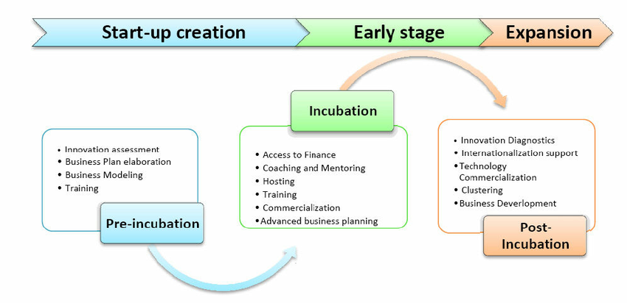
Incubation Process

Slide 78
Benefits of Incubation
Incubators are found all over the world and their approach to venture development can be summarized along the following dimensions:
Offering Space on Flexible Terms
Providing shared office services
Presenting a business consulting network
Providing opportunities to develop business relations
Facilitating access to Capital

Slide 79
Types of Incubators
Virtual Business Incubators
Medical Incubator
Kitchen Incubator
Public/Social Incubator
Seed Accelerator
Corporate Accelerator
Start up Studio
Venture Builder

Slide 80
Basis | Incubators | Accelerators
Clients | Science based Business(Bio Tech, Medical Devices, Nano Technology) | Mostly IT Based( Web Designing, Cloud Computing)
Selection Process | Competitive Selection, Mostly Same Region) | Competitive Selection of Firms from Wide Regions
Term of Assistance | 1 to 5 years | Short Term Assistance from 1-3 Months
Services | Provide Services like Consultation, Specialized advice in IPR, Skill Development | Give Ideas, Procure Resources and Investments, Find Customers
Investment | Do not have funds to invest directly, Create a network to expand the business, do not take Equity | Invest money in Companies and take Equity

