Slide 1



Hospital Emergency Response Coordinator
STATE LEVEL HACKATHON
Ranking emergency patients in real time on QNX RTOS
ATHIPATI MADHU SRI (23711A0404)
BUTTI NAVYA SAI REDDY (23711A0407)
SHAIK SHABREEN (24715A0406)
NARAYANA ENGINEERING COLLEGE, NELLORE, ANDHRA PRADESH
Notes:
EXPLAIN IT SIMPLY: Introduce the team and college, then the idea: when several patients arrive together, our system ranks them by severity and shows who should be treated next, using separate QNX processes.
ADD FROM OUR OWN WORK: A photo or screenshot of the setup you actually run (QNX target or VM with the dashboard open).
QUESTION FOR THE TEAM: What works today, and what is still planned? Say it in one sentence so the judges know what to expect.
(Delete the capitalised guide lines from these notes before you present, and keep only what you can say yourself.)

Slide 2



Why Triage Order Matters
When patients arrive together, who is treated first?
The Scenario
Why Timing Matters
What We Aim For
In a surge, several patients arrive together and staff must pick the treatment order while conditions keep changing.
Severity and bed availability change while staff are working, so the ranking has to update without delay.
The dashboard should always show each patient's priority rank, free ICU beds and the next patient to treat.
Notes:
EXPLAIN IT SIMPLY: Several patients arrive close together, beds are limited and conditions change. The ranking has to stay correct as that happens, and a real-time OS gives predictable timing.
ADD FROM OUR OWN WORK: The real inputs your system takes for one patient, and one real test case such as two patients arriving together.
QUESTION FOR THE TEAM: What describes a patient in your system (age, vitals, symptom, manually chosen severity)? What update delay are you aiming for, and have you measured it?
CITE OR VERIFY: Any hospital or emergency statistics you quote need a source. Do not quote numbers you cannot cite.
(Delete the capitalised guide lines from these notes before you present, and keep only what you can say yourself.)

Slide 3




Our Solution
OUR APPROACH
A QNX system that ranks patients by severity, tracks ICU beds and shows the next patient on a dashboard.
Triage by severity
Automatic priority ranking
Built as separate QNX processes
Live ICU and bed tracking
Real-time dashboard
Notes:
EXPLAIN IT SIMPLY: Say what the system does in one breath: it ranks patients by severity, tracks ICU beds and shows the next patient to treat.
ADD FROM OUR OWN WORK: A screenshot of your dashboard with your own test patients on it.
QUESTION FOR THE TEAM: For ranking, bed tracking and the dashboard: is each one working, partly working or planned?
(Delete the capitalised guide lines from these notes before you present, and keep only what you can say yourself.)

Slide 4


QNX Architecture
Patient
Triage
Priority
Resource
Display
Patient arrival
Condition and severity
Priority rank
ICU beds and resources
Dashboard
QNX Inter-Process Communication (IPC) | [TEAM: name the IPC mechanism used]
Separate Processes
Easier to Debug
Easy to Extend
Each function is its own QNX process
Each process can be tested on its own
A new feature can be a new process
Notes:
EXPLAIN IT SIMPLY: Go left to right: Patient (arrival), Triage (severity), Priority (rank), Resource (ICU beds), Display (dashboard). QNX gives each process its own memory space, so a bug in one is less likely to corrupt the others.
ADD FROM OUR OWN WORK: Your own architecture diagram built from your code, with the real process names and arrows showing who sends to whom.
QUESTION FOR THE TEAM: Which IPC do you use: message passing (MsgSend/MsgReceive/MsgReply), pulses, named channels, or something else? Which process is the server? How is each process started?
CITE OR VERIFY: The QNX documentation for any claim about process isolation or IPC. Keep 'easier to debug' only if you tested processes on their own.
(Delete the capitalised guide lines from these notes before you present, and keep only what you can say yourself.)

Slide 5
Processing Flow
1
Triage Process
DASHBOARD MOCK-UP
Takes the patient's condition and sets a severity level
Next patient to treat
2
Priority Process
Patient A
Critical
Sorts patients by severity into a priority queue
Patient B
Severe
Patient C
Severe
3
Resource Process
Keeps count of free ICU beds and other resources
Patient D
Moderate
Patient E
Mild
4
Display Process
ICU beds and resources
Shows the ranked list and the next patient to treat
Sample data only, not real output
Notes:
EXPLAIN IT SIMPLY: Patient data goes to Triage, which sets a severity level. Priority sorts patients into a queue. Resource keeps the free-bed count. Display shows the ranked list and the next patient.
ADD FROM OUR OWN WORK: A short code snippet of the message structure or the comparison that orders patients.
QUESTION FOR THE TEAM: How are two patients with the same severity ordered (arrival time or something else)? Is the queue a sorted array, a heap or another structure, and which process owns it?
CITE OR VERIFY: Check that every box and arrow here matches your code.
(Delete the capitalised guide lines from these notes before you present, and keep only what you can say yourself.)

Slide 6
Four Severity Levels
Simplified example for teaching. Not a clinically validated triage protocol.
1 Critical
HOW IT RANKS
Triage Process gives each patient one of these four levels
2 Severe
Priority Process orders patients, most severe first
3 Moderate
4 Mild
Display Process shows who is next
Notes:
EXPLAIN IT SIMPLY: Four levels from Critical to Mild. Triage assigns a level and Priority orders patients, most severe first. This is a simplified teaching example and not a clinically validated triage protocol.
ADD FROM OUR OWN WORK: Your actual severity rules or table, exactly as coded.
QUESTION FOR THE TEAM: How does Triage choose a level: fixed rules, thresholds on inputs, or manual entry? Is the scale your own or based on a published one?
CITE OR VERIFY: If it follows a published scale (ESI, MTS, START or another), name it and cite it. If it is your own simplification, say so.
(Delete the capitalised guide lines from these notes before you present, and keep only what you can say yourself.)

Slide 7



Why Separate Processes
The Problem
Our Design
Target Result
Patients arrive together
Severity and beds keep changing
Staff need an answer fast
Five independent QNX processes
One job per process
Processes talk through QNX IPC
Consistent priority queue
Dashboard updates quickly
Steady timing, to confirm in the profiler
Notes:
EXPLAIN IT SIMPLY: The problem is many patients and changing data. Our design answer is one job per process, linked by IPC. The last column is a target until we have measurements.
ADD FROM OUR OWN WORK: One design decision with your real reason, for example why separate processes and not threads. Use it only if that was your actual reasoning.
QUESTION FOR THE TEAM: Did you test what happens when one process stops or restarts? What did you observe?
(Delete the capitalised guide lines from these notes before you present, and keep only what you can say yourself.)

Slide 8
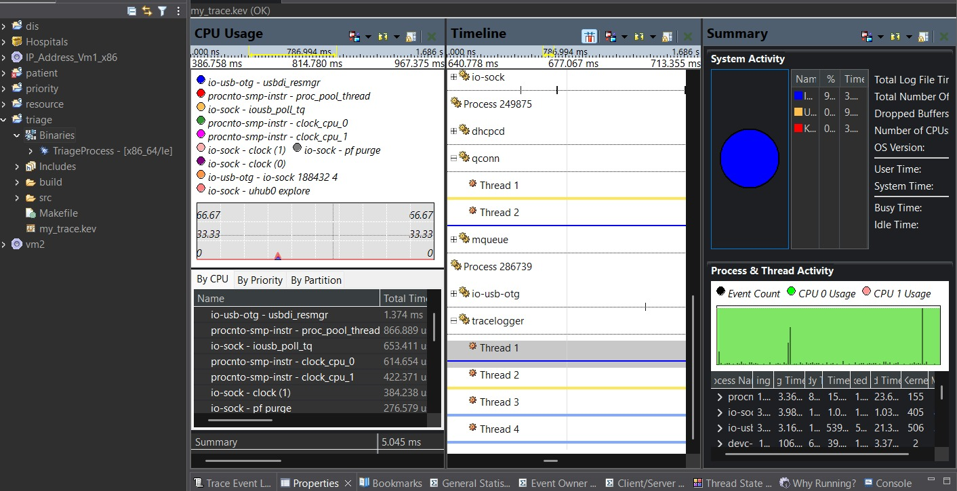
Real-Time Performance
WHAT WE MEASURE
Time from a severity change to the dashboard update
CPU usage of each of the five processes
Thread timing while patients are added
Insert QNX Momentics System Profiler screenshot here
Required: our own run, CPU usage and thread timing
Notes:
EXPLAIN IT SIMPLY: The profiler capture shows CPU use of each process and thread timing during our run. Read the numbers as they are and say what they do and do not show.
ADD FROM OUR OWN WORK: The real Momentics System Profiler screenshot from your own run, with the numbers you read from it.
QUESTION FOR THE TEAM: Which processes and threads appear in the capture? How long was the run and how many patients were in it? Did you set QNX scheduling priorities?
CITE OR VERIFY: Do not use a sample or online screenshot. Do not describe results you did not measure.
(Delete the capitalised guide lines from these notes before you present, and keep only what you can say yourself.)

Slide 9
Live Demonstration
1
2
3
4
Add several patients
Change a patient's severity
Change ICU and bed availability
Watch the dashboard and queue update
Notes:
EXPLAIN IT SIMPLY: Four steps: add several patients, change a severity, change ICU or bed availability, then watch the dashboard and queue update.
ADD FROM OUR OWN WORK: Screenshots of each step from a real run, plus a short screen recording as a backup.
QUESTION FOR THE TEAM: What exact patients and values will you use? What on the screen shows that the ranking changed?
(Delete the capitalised guide lines from these notes before you present, and keep only what you can say yourself.)

Slide 10



Growth Path
Planned extension: from one core system to a hospital network
Hospital Network
Multi-Department Hospital
Future idea: hospitals sharing bed and priority data
Core QNX System
Planned: more departments, patients and beds
Five processes in the current design
Notes:
EXPLAIN IT SIMPLY: This is the growth path and it is planned work: more departments, patients and beds, then hospitals sharing data. The current design has five processes.
ADD FROM OUR OWN WORK: A short honest list of what is not tested yet, such as larger patient counts.
QUESTION FOR THE TEAM: Have you thought about how processes on different machines would talk to each other? (QNX has a native networking layer called Qnet. Mention it only if you looked into it.)
CITE OR VERIFY: Anything you say about QNX networking or scaling needs a QNX documentation source.
(Delete the capitalised guide lines from these notes before you present, and keep only what you can say yourself.)

Slide 11
Scalability and Conclusion
Hospital Network
WHY QNX FOR THIS
QNX RTOS gives predictable scheduling and process isolation. We use both for ranking emergency patients.
Multi-Department Hospital
More Patients, Beds & Resources
A QNX-based patient ranking system
Next: test with our own timing data
Core QNX System | Five Processes
Possible growth path (planned, not yet tested)
Notes:
EXPLAIN IT SIMPLY: QNX is a real-time OS with predictable scheduling and process isolation, which suits a system where late updates matter. We use both for ranking emergency patients.
ADD FROM OUR OWN WORK: One limitation of the current version, stated honestly.
QUESTION FOR THE TEAM: Which QNX documentation did you use for these two points?
CITE OR VERIFY: Cite the QNX documentation for the scheduling and isolation claims.
(Delete the capitalised guide lines from these notes before you present, and keep only what you can say yourself.)

Slide 12
Thank You
Hospital Emergency Response Coordinator
A QNX-based system that ranks emergency patients by severity and tracks ICU beds.
Built on QNX RTOS | Happy to take questions
Notes:
EXPLAIN IT SIMPLY: Repeat the idea in one sentence and invite questions.
ADD FROM OUR OWN WORK: A link to your code repository or a demo video, if you want judges to see more.
QUESTION FOR THE TEAM: Prepare answers to: which IPC did you use, how is severity decided, what happens if a process stops, what did the profiler show?
(Delete the capitalised guide lines from these notes before you present, and keep only what you can say yourself.)

