Slide 1

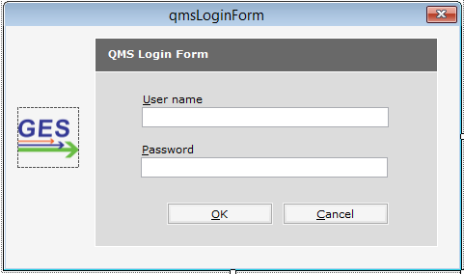
Quote Management System
Creates New Quote
QMS Application
Quote Template Folder
System List Template
(Ocean Export Type CFR & FOB Basis)
(Ocean Export General Quote)
(Air Import Quote)
(Air Export Quote)
(Ocean Import General Quote)
(Ocean Import with Custom Clearance Quote)
Converts Template to Official Quote
QMS Data Directories
SH
KK
AA
HA
AK

Slide 2
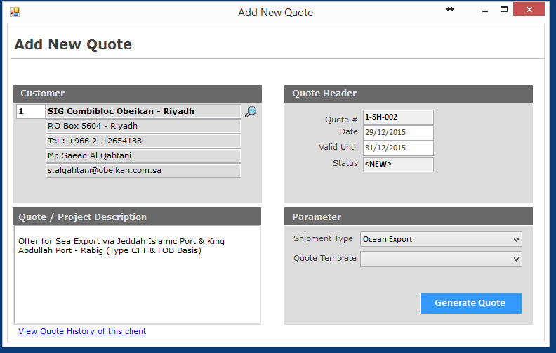

You can get the list of clients from database
Enter client code to get info
Quote# is generated upon customer selection
[company code ] – [user code] – [quote sequence#]
You need to choose Template from this List
Transform Template into Official quote in Excel Format
History Tab shows you the list of Quotes prepared for this customer

Slide 3
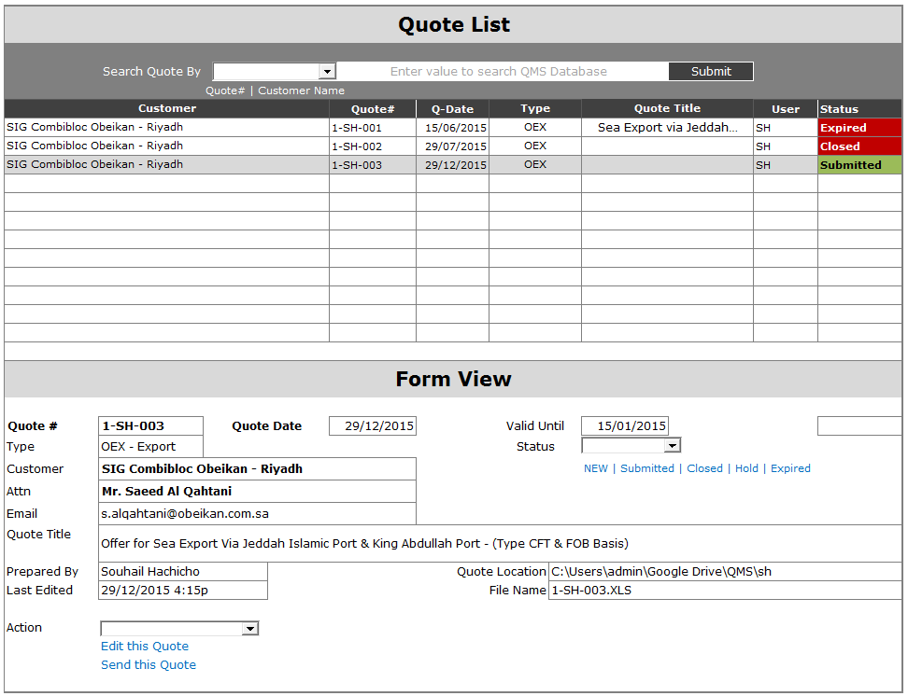

Slide 4
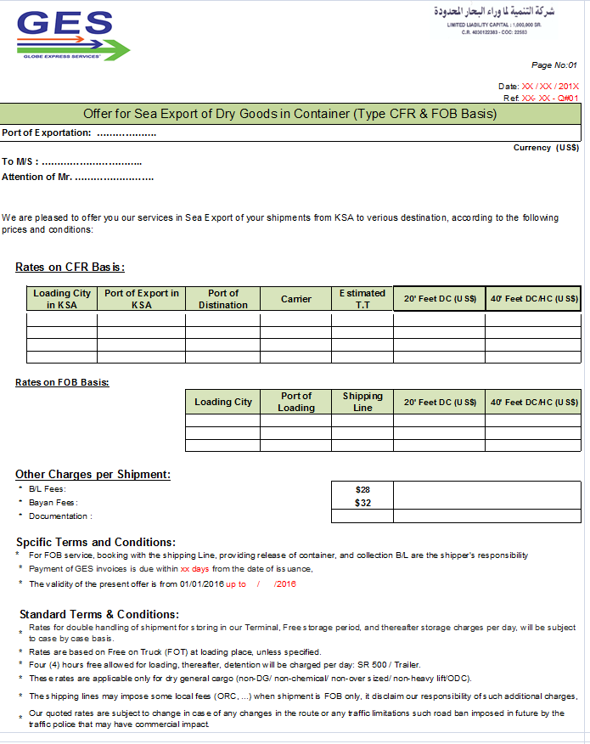
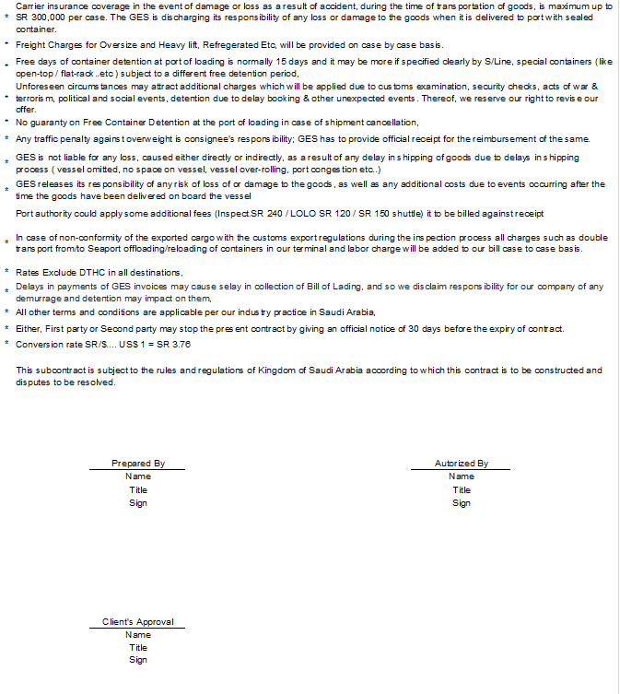



Slide 5
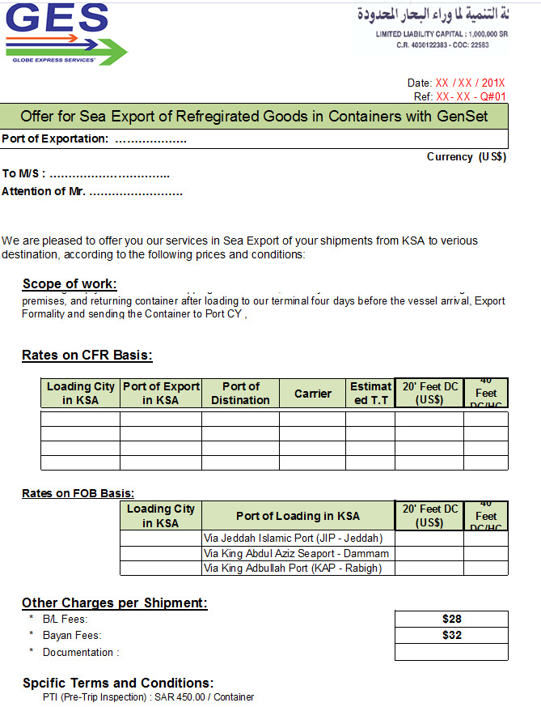
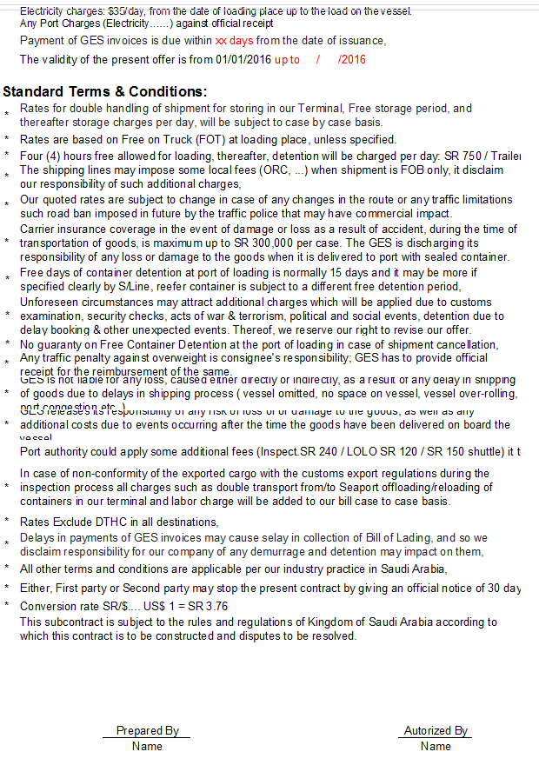

Slide 6
