Slide 1
Module 1

Slide 2
1.F=(A+B)(A+B’)

Slide 3
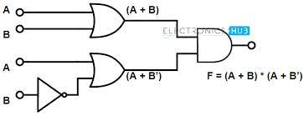

Slide 4
Y=(A+B).(C+D)

Slide 5
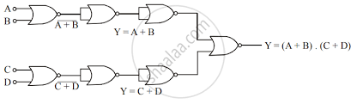

Slide 6
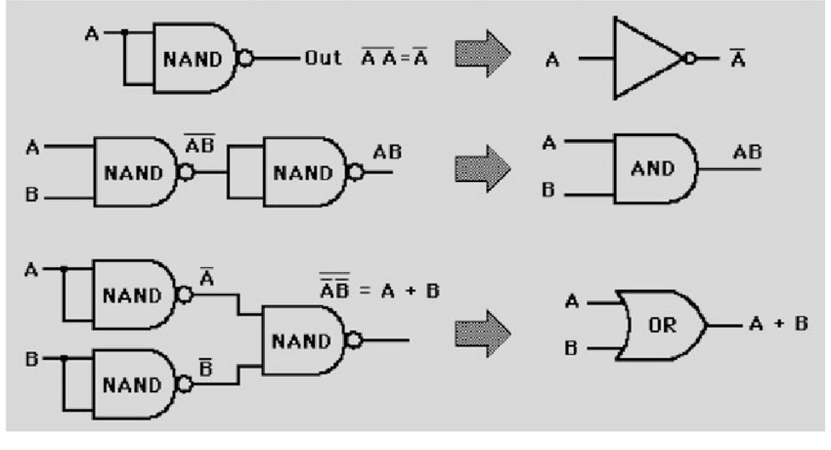
Realization of basic gates using NAND GATE
implementation-of-basic-gates-using-NAND-gate

Slide 7
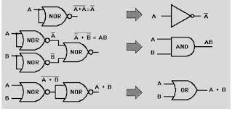
implementation-of-basic-gates-using-NOR-gate

Slide 8
XOR gate
The 2-input OR gate is also known as the Inclusive-OR gate because when both inputs A and B are set to 1, the output comes out 1(high).

Slide 9
In the Ex-OR function, the logic output "1" is obtained only when either A="1" or B="1" but not both together at the same time. Simply, the output of the XOR gate is high(1) only when both the inputs are different from each other.

Slide 10
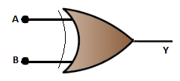
Symbol and Truth Table of XOR gate

Slide 11

The Truth Table of 2 input XOR gate
The Boolean expression representing the 2 input XOR gate is written as

Slide 12
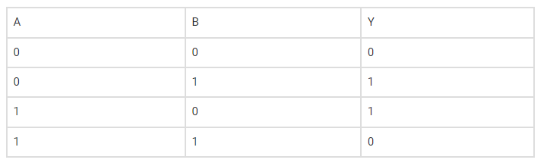

Slide 13
The Truth Table for 3 input XOR gate
The Boolean expression for the three-input logic gate is given by

Slide 14
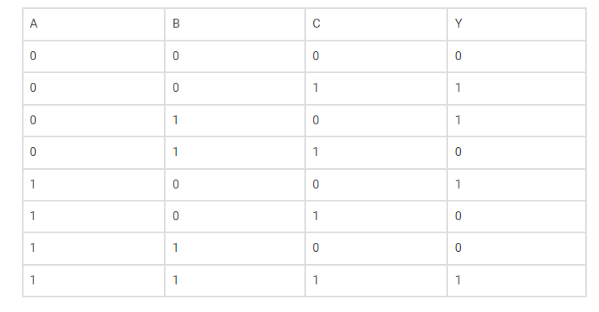

Slide 15
Exclusive-NOR Gate
Basically the “Exclusive-NOR” gate is a combination of the Exclusive-OR gate and the NOT gate but has a truth table similar to the standard NOR gate in that it has an output that is normally at logic level “1” and goes “LOW” to logic level “0” when ANY of its inputs are at logic level “1”.

Slide 16

Ex-NOR Gate Equivalent

Slide 17
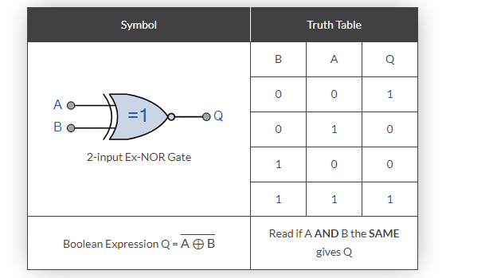

Slide 18


Slide 19
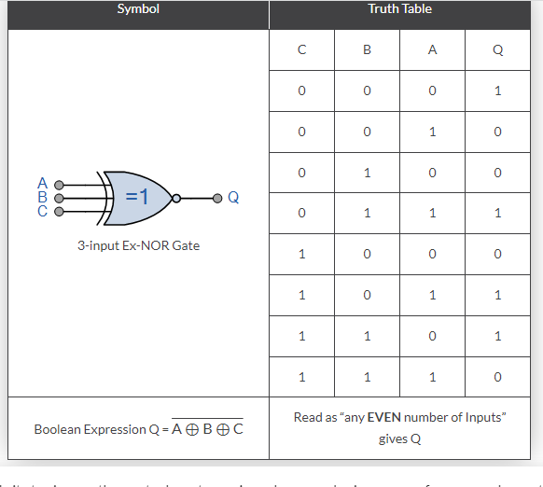
3-input Ex-NOR Gate

